Slide 1
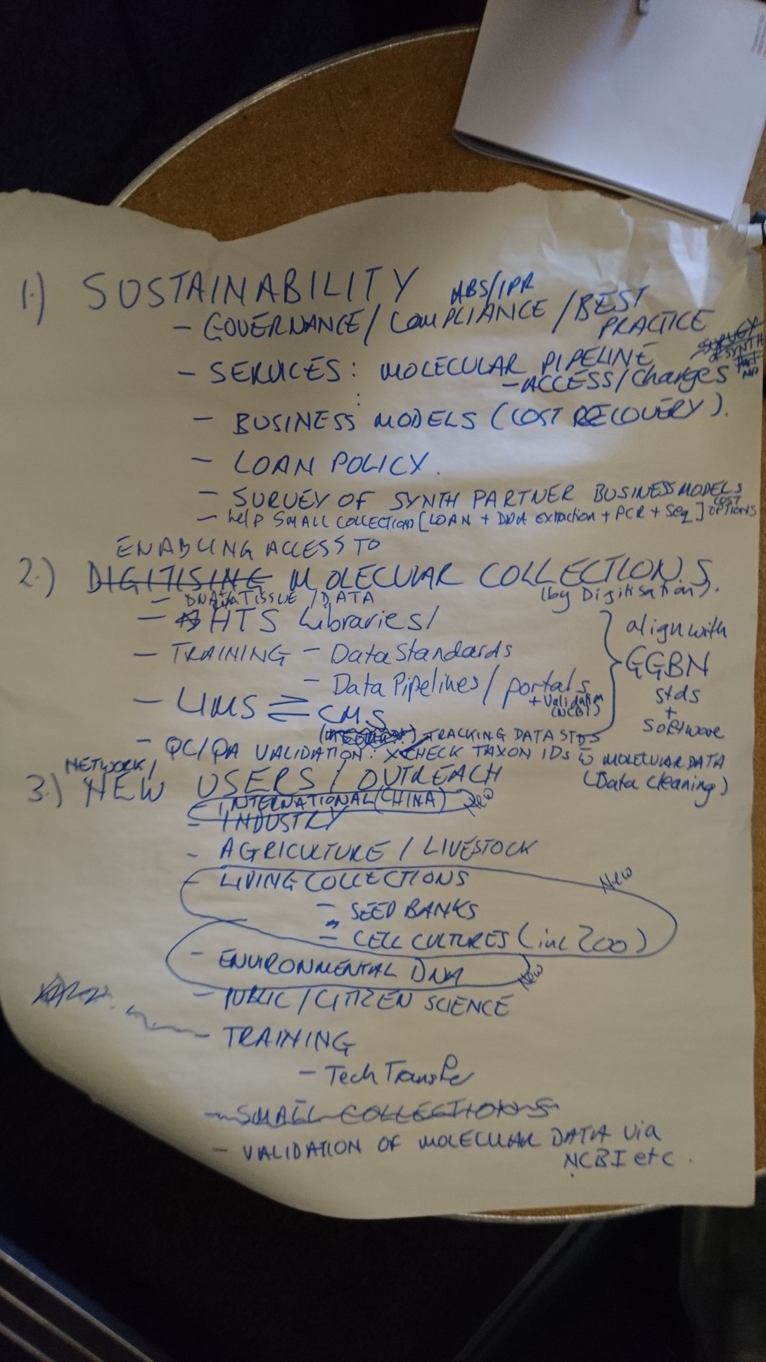

Slide 2
SYNTHESYS+ and GGBN
Everything done regarding molecular collections within SYNTHESYS+ should be done under the GGBN umbrella
Every SYNTHESYS+ partner with biorepository must be a GGBN member (e.g. observer status -> no fees ☺)
GGBN currently 60 members with ca. 12-14 million samples
6-7% available through GGBN
GGBN/GGI awards program started, 6 institutions will get financial support to mobilize their data
Until GGBN 2018 conference > 2 million samples will be made available!

Slide 3
SYNTHESYS+ Potential Tasks (Template)
Category: | Molecular Collections
Title | Enabling Access to Molecular Collections
Vision | All molecular sample data available through GGBN
The key challenge(s) | Implementing GGBN Data Standard
KPI’s | Possible measures of success e.g. #loans, #requests, #downloads, #genera, #families, #biodiversity
Possible Partners | ALL with biorepository IUCN, INSDC, CITES

Slide 4
SYNTHESYS+ Potential Tasks (Template)
Category: | Molecular Collections
Title | Enabling Access to Molecular Collections
Vision | All molecular sample data available through GGBN (gDNA, eDNA, aDNA, tissues, eSamples, cultures)
The key challenge(s) | Implementing GGBN Data Standard
KPI’s | Possible measures of success e.g. #loans, #requests, #downloads, #genera, #families, #biodiversity
Possible Partners | ALL with biorepository IUCN, INSDC, CITES

Slide 5
SYNTHESYS+ Potential Tasks (Template)
Category: | Molecular Collections
Title | Outreach to new users and other biobanks (e.g. crops, vet, culture collections)
Vision | Knowledge exchange between communities, joint projects and research, donation of research material to biobank hubs
The key challenge(s) | Identifying new users, public engagement, small collections without support, language barrier
KPI’s | Possible measures of success e.g. #attendeesGGBNconference, #longtermViability?, #depositions
Possible Partners | Zoos, livestock, crop, European Virus Archive, universities IUCN, INSDC, CITES

