Slide 1



Dimitris Koureas
Lead, Research Data and Partnerships
Coordinator, DiSSCo proposal preparation
Chair, TDWG Executive Committee
Co-chair, RDA Interest and Working Groups
Final meeting
6-7 June, 2017
London
@DimitrisKoureas

Slide 2

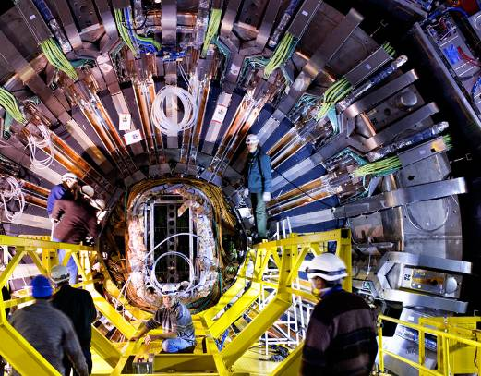
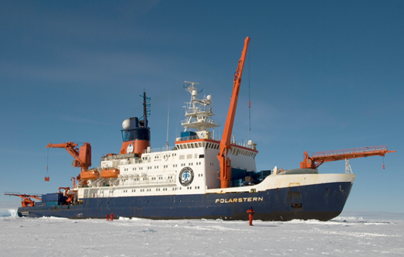
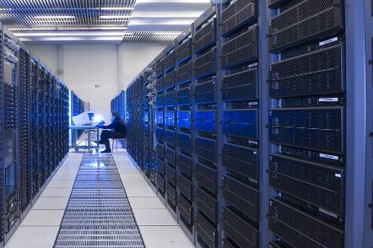
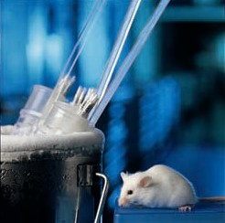
What are Research Infrastructures?
Definition
Research infrastructures (RIs) are facilities, resources and services used by the science community to conduct research and foster innovation.
By pooling effort and developing RIs, European countries can achieve excellence in highly-demanding scientific fields and simultaneously build the European Research Area (ERA) and Innovation Union.
They include: major scientific equipment, resources such as collections, archives or scientific data, such as data and computing systems, and communication networks e-infrastructures.

Slide 3
The European Research Infrastructure landscape
The following three Research Infrastructure categories reflect the need for action at all levels — national, regional, European and global, to tackle research challenges and avoid duplication of effort:
Intergovernmental RIs: Well-established RIs supported by EU Member States (e.g. EIROforum)
New Pan-European RIs: RIs listed in the ESFRI Roadmap, including those with European Research Infrastructure Consortium (ERIC) legal status.
  Single-sited
  Distributed
  Virtual
National RIs of European interest: National and regional RIs that receive EU support, in particular through Integrating Activities projects for transnational access, open to all European researchers from academia and industry

Slide 4

European Strategy Forum on Research Infrastructures
The mission of ESFRI is to support a coherent and strategy-led approach to policy-making on research infrastructures in Europe, and to facilitate multilateral initiatives leading to the better use and development of research infrastructures, at EU and international level.
Typical timeframes from inclusion to ESFRI until operational is 10 years
Governmental support (financial and political) for inclusion to the ESFRI roadmap

Slide 5
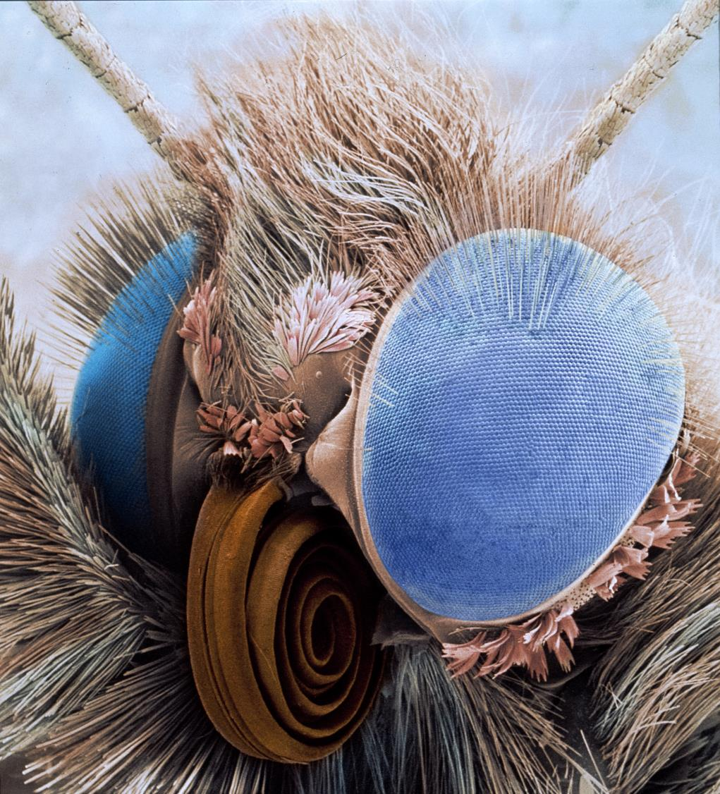

Bio- and Geo- collections
Integral part of our natural and cultural capital
Document our planet’s biological and geological history
Result of more than 400 years of accumulated scientific effort

Slide 6
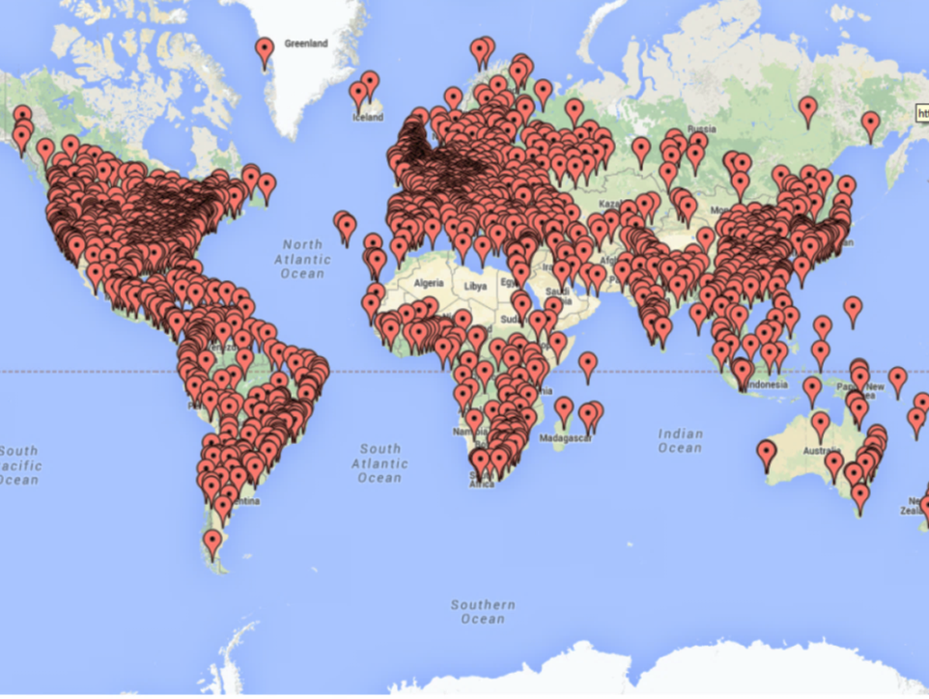
Globally
7,015
Collection holding agencies / institutions
2,102
in Europe
Source: http://grbio.org/
Potentially one of the largest distributed research infrastructures
in the world

Slide 7
European Collections
1.5 billion specimens
80% of described biodiversity
100 collaborative projects
5,000 scientists
35,000 scientific visitors pa
7,500 publications pa
300 Laboratories
10 million public visitors pa

Slide 8

SYNTHESYS vision:
“Creating an integrated European infrastructure for researchers in the natural sciences”

Slide 9
IA projects lead to ESFRI projects
Commission and national contacts report (2015)
?

Slide 10
2004
2017
To date funded c.50,000 days of researcher access to
>3,800 researchers throughout Europe leading to
>4,500 research outputs.
How do we sustain and expand scientific value of access to collections?

Slide 11
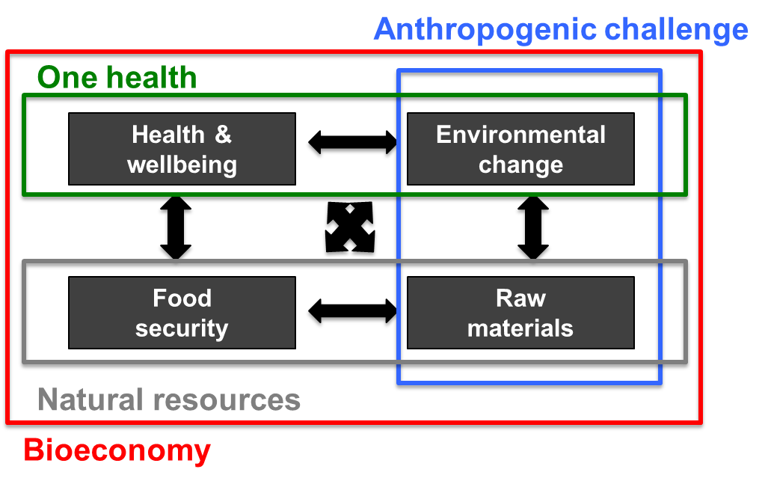
Our grand challenges require
Data-driven solutions
Collections need to deliver data at the
Scale, form and precision required
Break Silos | Deliver knowledge

Slide 12
Challenges in unlocking data from European natural science collections
01
Access to collections and data
Less than 10% widely available, fragmented services
02
Integration and interoperability
Standards, protocols, workflows
Challenges
03
Digital skills and competencies
Training, awareness

Slide 13

90
Museums
19
Countries
Aim to develop a distributed system of scientific collections under the ESFRI umbrella
Inclusion in
2018
roadmap
DimitrisKoureas
DiSSCoEU

Slide 14
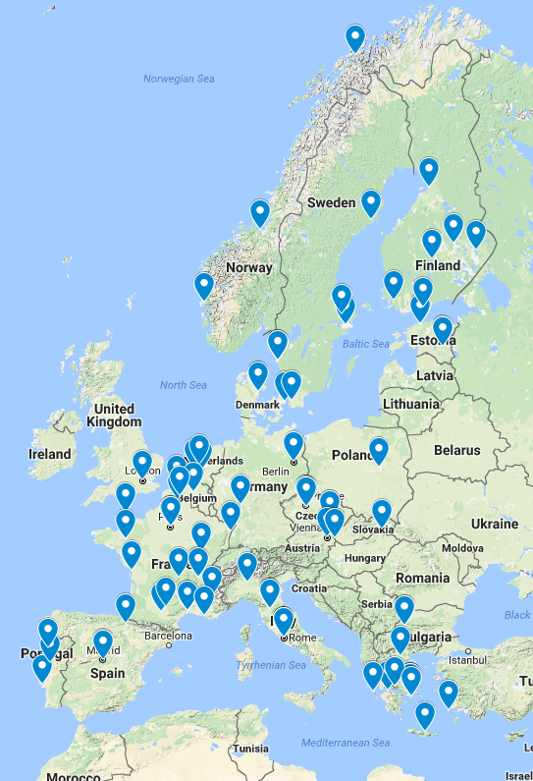
DiSSCo represents a common vision of the largest ever consortium of natural science collection organisations to
Transform a fragmented collection access model
into
integrated
European research infrastructure
2018
roadmap
http://dissco.eu/content/partners

Slide 15

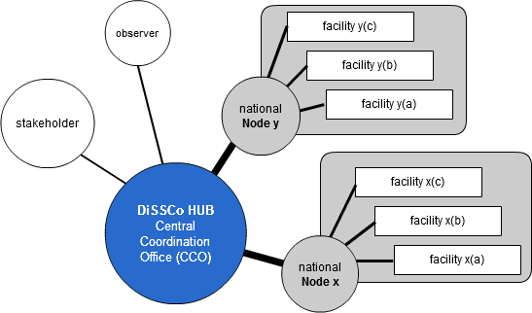
How would success look like
2025- onwards
new European legal entity:
A clear governmental mandate;
The resources to sustain itself;
The capacity to deliver services;
The power to harmonise policies/processes;
The authority to coordinate digital activities/priorities at institutional (facility) level
DimitrisKoureas
DiSSCoEU

Slide 16
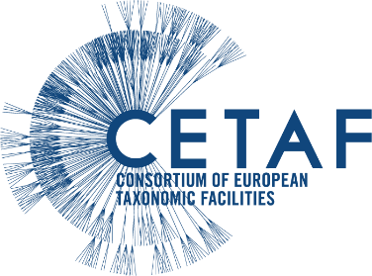

Building on a mature community
A mature / aligned network of partners
Strong and long-standing support from national budgets
Research and public engagement activities
A clear position within the existing landscape
A 13-year programme for physical and digital access
Existing feasibility studies (design study)
A focus on science, industry and policy
Global collaborations:
GBIF
CoL/Species 2000
GEO (GEOSS)
BHL
EoL
GGBN
SPNHC
EU collaborative projects:
EDIT
ViBRANT
EU BON
OpenUp

Slide 17







Policies
Taxonomic skills
Access
Data skills
Data
Analytical skills
Data
Skills
Labels
Imaging
Traits
Molecular data
Chemical data

Slide 18
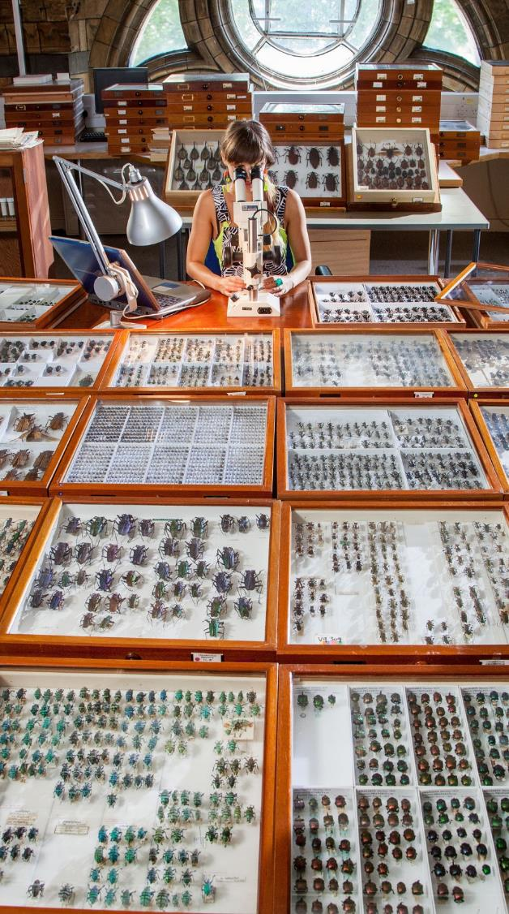

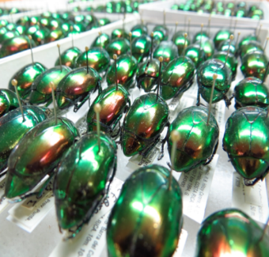
Linking the linkable
Trait data
Location registry/index
Chemical
data
Imaging (incl. 3D)
Sequence
data
Spatial/temporal
data
All data uniquely linked to the
physical object

Slide 19
Unifying the domain: The DiSSCo knowledge graph
Sequence
Occurrence
Taxon
Interaction
Publication
Taxon
Concept
Taxon Name
Gene
Specimen
Collection
Trait
Collections share instances of these classes
All instances uniquely identified
Need linked open data graph of all instances

Slide 20








European
Loans and Visits
System
DiSSCo
Data Portal
Unified
Curation & Annotation
System
DiSSCo Data Store
(non-relational db)

Slide 21
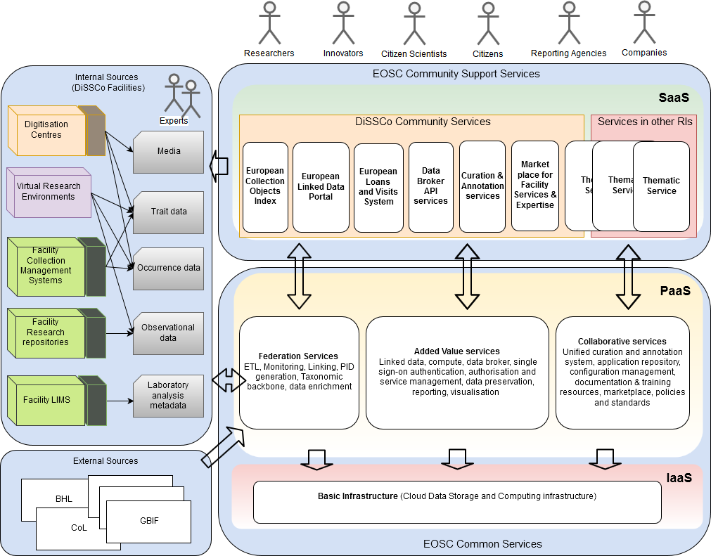

Slide 22
DiSSCo public offering
1
DiSSCo e-services (virtual access)
DiSSCo Linked Data Portal
European Loans and Visits System
Unified Curation and Annotation System
2
DiSSCo physical and remote access
Coordination and Support for physical access (visits and loans)
Coordination and Support for remote access (e.g. on demand digitisation)
3
Digital Skills and competencies
Robust formal and professional training programmes and activities

Slide 23




DiSSCo will serve biodiversity and geodiversity data
at the scale, form and precision needed by researchers and research infrastructures
RIs providing data on external factors
Integrative RIs
Species/
organisms
observatories
System
observatories
Experiments
DATA MEASUREMENTS MODELLING
Biodiversity standards / Reference data
Taxonomic backbone

Slide 24
A concrete action plan
Key actions
2025 -
Operational
Phase
Legal entity establishment
Provision of Content and Services
STEP 05
Operational
Capacity
2025
Central Facilities
Access challenges addressed
Construction
programme
STEP 04
2018-2024
Preparatory & Implementation Phase
(on the roadmap)
Organisational Agreements - Policy Harmonisation
Socio-cultural challenges addressed
Consolidation
programme
STEP 03
Next iteration of
SYNTHESYS
Research and Development Actions
Technical challenges addressed
Innovation
programme
STEP 02
Proposal
submission
Aug 2017
2016-2017
Consortium
& Proposal
Development
Stakeholder engagement
MS/AS commitment
Consortium agreement
Science Case
Design Study
STEP 01

Slide 25
Estimated costs
Preparatory, Construction and Operational Phases
Design Study (& Proposal preparation)
100% already invested
ca. €10M (€0.6M)
2018
Capital Investment
Preparatory & Construction phases
69% already invested/committed
ca. €85M
2025
Operational phase
48% already committed
ca. €9M/year
DimitrisKoureas
DiSSCoEU

Slide 26
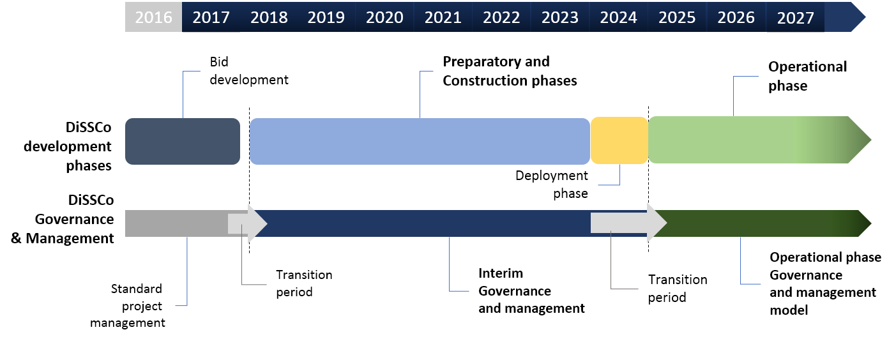
Clear Governance and management for
preparation, construction and operation

Slide 27

Contact DiSSCo Coordination Team
Dimitris Koureas (NHM)
Ana Casino (CETAF)
Wouter Addink (Naturalis)
Contact your
DiSSCo National Task Force
(currently in 19 countries)
http://dissco.eu/content/partners
Contact us online
http://dissco.eu
@DiSSCoEU
and our printed material

Slide 28
Level of commitment (partner/government)
Financial commitment (secured & likely)
Political support (secured & likely)
Support at facility (partner) level

Slide 29



European Loans and Visits System
Fully streamlines process of specimen discovery and
automates requesting and managing loans and visits
Single sign-on (e.g. ORCID, EduGAIN)
Researchers’ profiles to ensure credibility
Faceted discovery of collections material across participating facilities
Online applications of physical access
Online applications for loans and loans monitoring tools
Reporting mechanisms for specimens demand over time

Slide 30


DiSSCo Linked Data Portal
Ecological/ morphological traits
People (skills) registry
Chemical
Data/metadata
Images / media
Simple, yet robust, data discovery and visualisation portal
Dashboards that give rich information at specimen level
Provide a holistic view that includes:
Occurrence data
Rich metadata of any molecular analysis and locators for the data
Rich metadata of any chemical analysis and locators for the data
Media linked to specimens
Literature linked to specimens
Faceted (taxonomic, geographic and other metadata based) search
Single sign-on and user profiles
Genomic
metadata
Literature

Slide 31
Unified Curation & Annotation System
A cloud-based solution (software)
Authentication and Authorisation system (Access control)
Users use the same UI/UX in whichever collection they visit.
Capabilities for capturing specimen data (incl. images) using controlled vocabularies and ontologies (where available)
The software provides access to existing Specimen Profiles (rich metadata at specimen level) and provides annotation tools

