Slide 1

NA2 Objective 2
Developing strategic priorities for molecular related NH collections
Objective leader: Thomas von Rintelen

Slide 2

NA2 Objective 2
Obj 2 | Developing strategic priorities for molecular related NH collections | Oct 16 | T. von Rintelen
Task 2.1 | Develop strategic priorities for barcoding of NH collections | Dec 15 | P. Hollingsworth
Task 2.2 | Develop strategic priorities for DNA library creation of NH collections | Aug 15 | T. von Rintelen
Task 2.3 | Develop protocols for data collection from DNA extraction | Oct 16 | I. Rey
Task 2.4 | Establish network of DNA and tissue banks | Feb 15 | O. Seberg
Partners:
MfN, NHM; RBGK, RBGE, MNHN, UCPH, CSIC, NRM, NCB, BGBM, NHMW, RMCA, RBINS, NMP

Slide 3
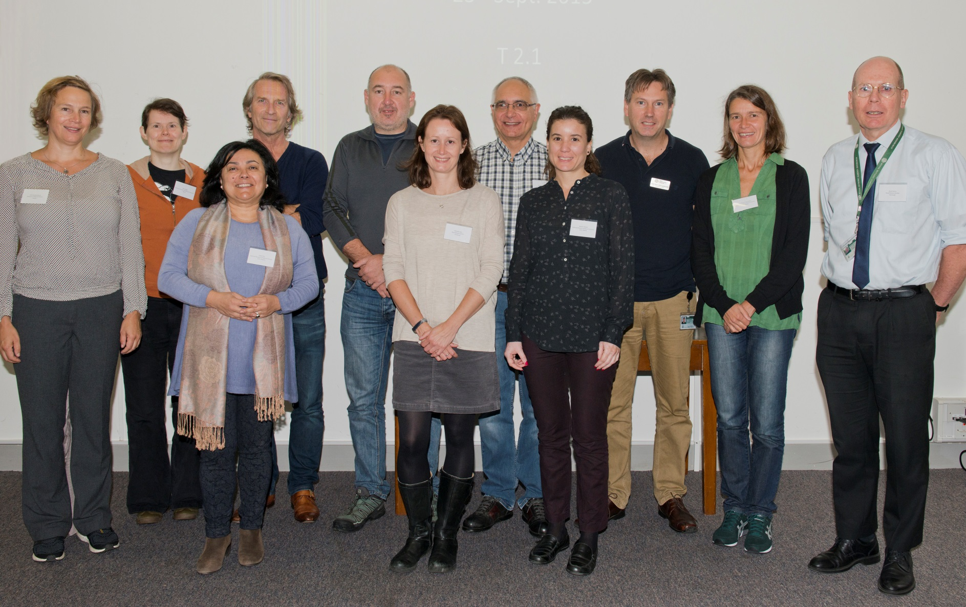
Task 2.1 Develop strategic priorities for barcoding of NH collections
Peter Hollingsworth, RBGE
Work done
Survey of existing DNA barcoding projects/priorities in NH collections conducted (SYNTHESYS member institutions)
None of the surveyed institutions has any coordinated program for DNA barcoding its collections, while many participate in national or international DNA barcoding initiatives
Workshop in Edinburgh
(September 23/24 2015)
  12 participants
  Discussing prioritisation &
  technical issues

Slide 4
Edinburgh Workshop:
Suggested prioritisation criteria
Task 2.1 Develop strategic priorities for barcoding of NH collections
  Type specimens
  Phylogenetic coverage
  Species-rich groups
  All Taxon Biodiversity Inventories (inc plot based)
Scientific benefits
  Endangered species
  Bio-indicator species
  Pollinators
  Invasive non-native species / pests / pathogens
  Species impacting human health
Societal benefits

Slide 5
Task 2.1 Develop strategic priorities for barcoding of NH collections
Prioritisation – practical issues
Research vs Application based barcoding
Cost effectiveness and tractability
Minimizing duplication of effort
Focusing on samples with rich meta-data
Barcoding of otherwise actively used specimens
Need to provide decision support advice to curators as to when to sacrifice tissue
Inevitable tension between institutional priorities and general priorities

Slide 6
Task 2.1 Develop strategic priorities for barcoding of NH collections
Conclusions
The global DNA barcode database is growing rapidly, but naming specimens is difficult
NH collections are important for this
Some generalisations are emerging as to what works and what doesn’t, and with NGS recovery of barcode loci is getting easier
Adding more loci to barcoding is possible, although expensive and with logistical challenges
There are a relatively straightforward set of issues where barcoding collections is strategically important, but these interplay with institutional priorities and practical constraints
Guidance to curators on when to sacrifice tissue

Slide 7
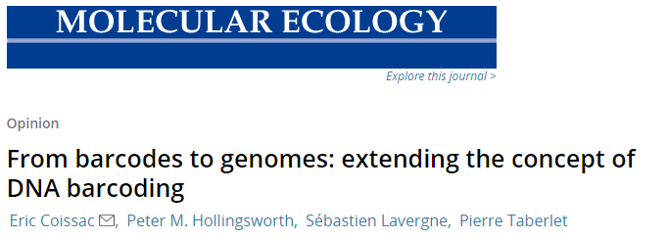
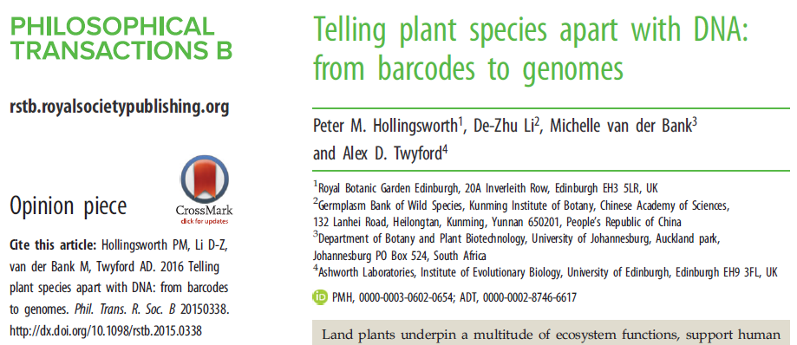
Task 2.1 Develop strategic priorities for barcoding of NH collections
NGS barcoding workshop in Edinburgh – July 12 & 13, 2017
(P. Hollingsworth, RBGE)
DNA Sequencing Natural History Specimens Using New Sequencing Platforms and Protocols
What can be done and what works best?

Slide 8
Task 2.2 Develop strategic priorities for DNA library creation of NH collections
Thomas von Rintelen, MfN
Background
DNA libraries were suggested as a means of perpetuating DNA from rare specimens in NH collections (outcome of JRAs in S2)
Workshop at MfN in February 2016 (D 2.7)
Agenda:
To obtain an overview of DNA library technology including costs and challenges from JRA leaders from S2 and other experts invited for this purpose &
to discuss priorities for DNA library creation of NH collections

Slide 9
Task 2.2 Develop strategic priorities for DNA library creation of NH collections
Background:
DNA libraries were suggested as a means of perpetuating DNA from rare specimens in NH collections (outcome of JRAs in S2)
Synthesis of NGS resources with Natural History Collections
(T. Fulcher, RBGK)
DNA libraries are an essential tool for NGS approaches, and are regularly created and used by several SYNTHESYS institutions
Evaluate the best standards and practices for storage and access to metadata of NGS libraries by adapting the GGBN Data Standard
Workshop at MfN in February 2016 (D 2.7)
Outcome:
DNA libraries are essential part of the NGS workflow, various alternative protocols exist
Technological change rapid, costs significant (c. 100 US$/library)
Discussion with experts revealed that DNA library creation from NH collections is not a worthwhile endeavour due to costs and technological issues
BUT: DNA libraries created in the course of research projects should be databased and stored in DNA banks

Slide 10
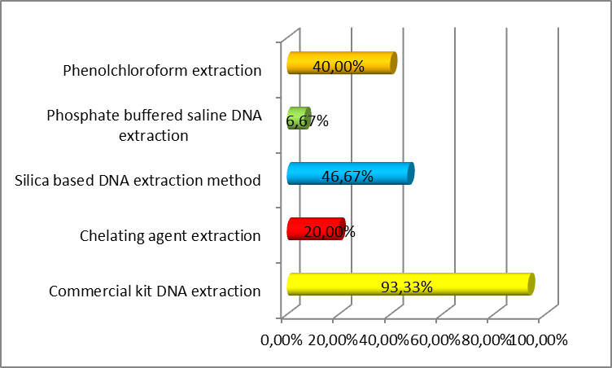
Task 2.3 Develop protocols for data collection from DNA extraction
Isabel Rey, CSIC
Develop protocols for collecting data from sequencing activities on NH collections and feedback on the success of different methodologies. Working alongside the CPB, NA2 aims to produce a Memorandum of Understanding for a European protocol
Work done
Survey of current practices in data collection within existing tissues and DNA collections or biorepositories
Protocols for collecting data on molecular collections agreed among subtask participants

Slide 11
Task 2.3 Develop protocols for data collection from DNA extraction
Results
>90% SYNTHESYS institutions with biobanks currently provide free of charge access to their collections for non-commercial research worldwide
Only 50% of collections are actually ‘discoverable’ via full digitization and accessibility via external data portals, and/or links with other important databases (GGBN/GenBank/GBIF/BOLD etc). Major digitization programmers underway at many institutions
Data content is currently mostly satisfactory to good for taxonomic, georeferenced and basic institutional identifier information (although UUIDs will be necessary soon), but lacks provenance, compliance, regulatory and management (material utilization and tracking) information, as well as links to molecular analysis results and publications.
Link to ISBER, GGBN

Slide 12
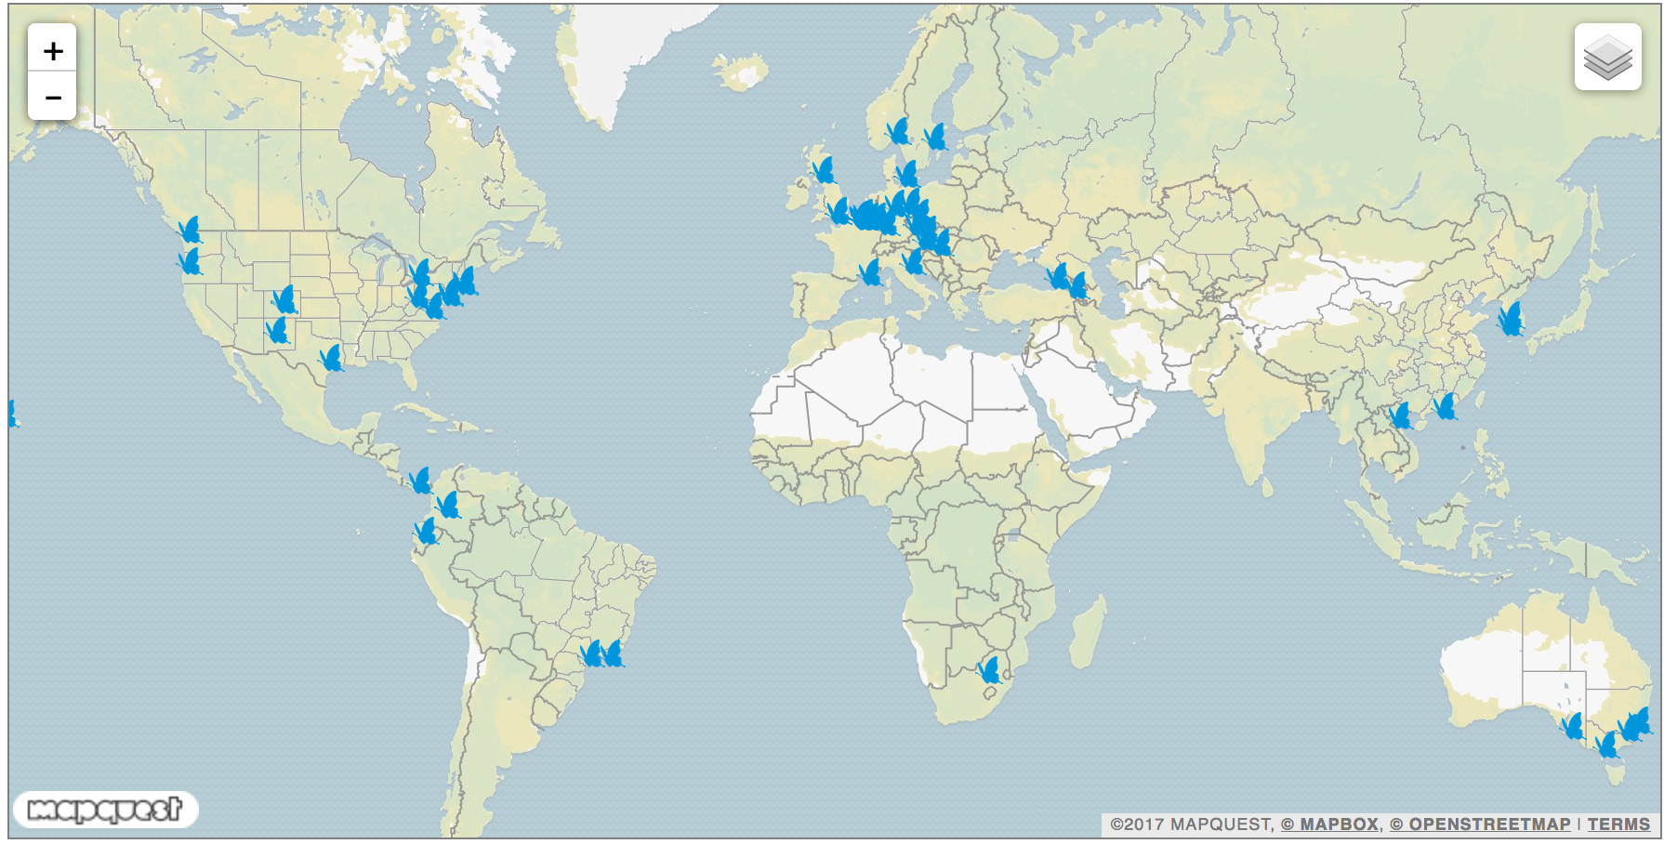
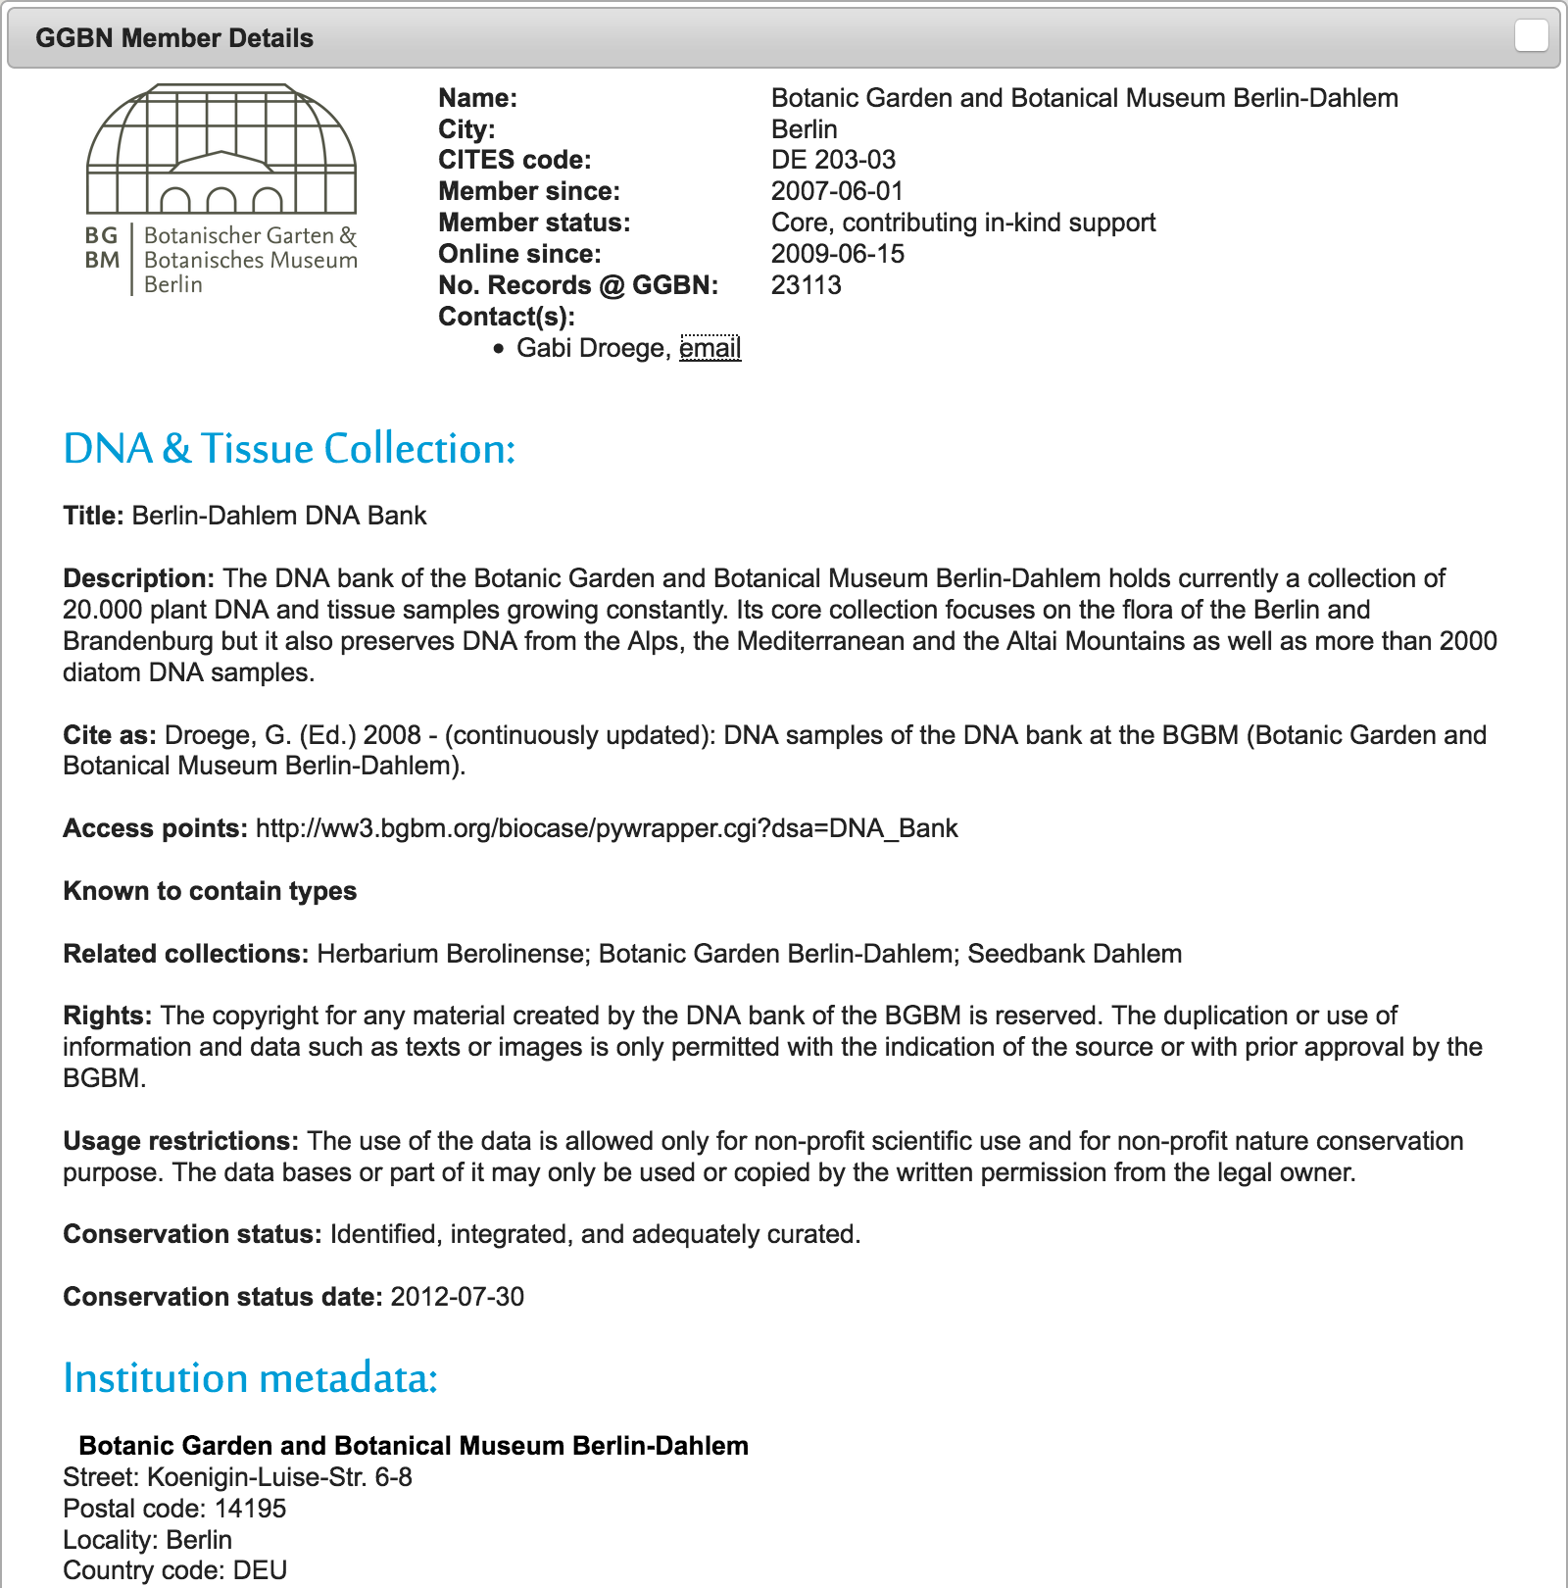
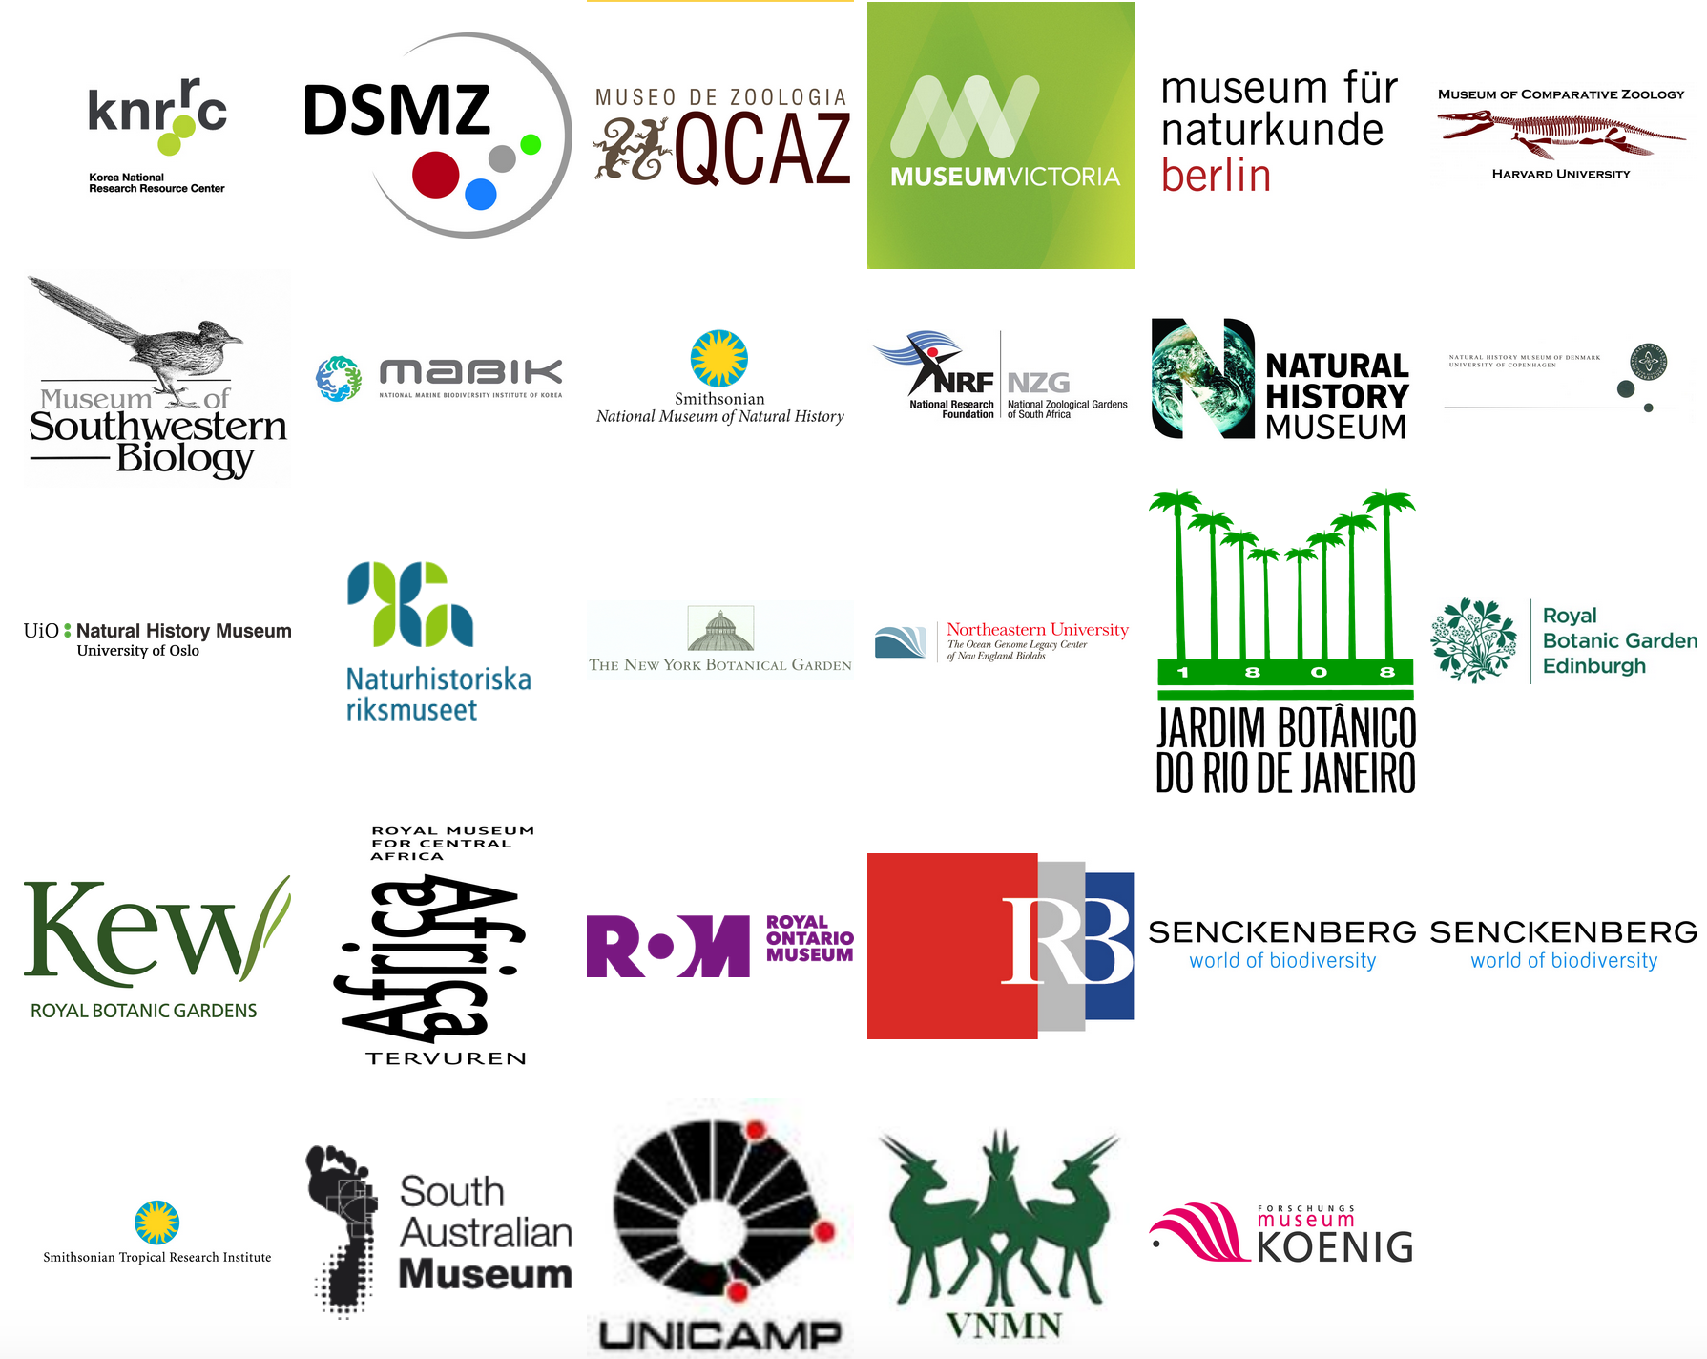
Task 2.4 Establish network of DNA and tissue banks
Ole Seberg, UCPH
Work done
Meeting in November 2014 at NHMW, Vienna (Meeting to present and discuss GGBN’s Policy document on DNA and Tissue Banks), Deliverable 2.3

Slide 13
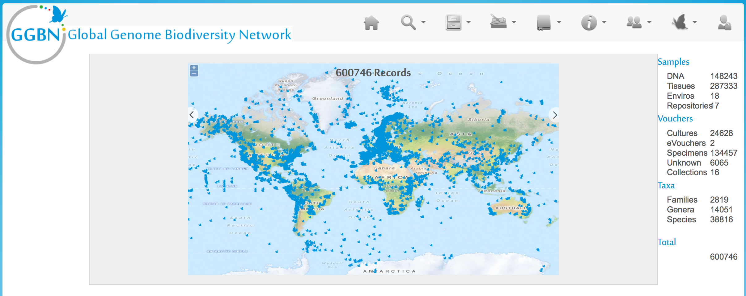
Task 2.4 Establish network of DNA and tissue banks
Work done
Network of DNA and tissue banks established (GGBN, Global Genome Biodiversity Network):
All SYNTHESYS partners with molecular collections were asked to join GGBN. 10 of 18 NA2 Objective 2 Task 2.4 participants have joined GGBN as members, 5 are now providing data to the Data Portal launched in December 2015.

Slide 14
Task 2.4 Establish network of DNA and tissue banks
Work done
SYNTHESYS session at GGBN Meeting for dissemination and workshop on “Policies for new physical collections” with 100+ participants

