Slide 1
NA2 Objective 3:
Collections Self-Assessment Tool (CSAT)
Suzanne Ryder, NHM London, NA2 Deputy
SYNTHESYS3, NHM, London
6th -7th June 2017

Slide 2
SYNTHESYS
The SYNTHESYS Access programme funds short research visits to selected natural history collections and herbaria within Europe.
Aims to improve access to data stored digitally within natural history collections by developing mechanisms that enable institutions to enrich digital media.
An integrated package that support and develop the natural history infrastructure.
Notes:
2

Slide 3
Collections Self-Assessment Tool
SYNTHESYS3 has developed a free online self-assessment tool to enable institutions to assess their collections management against the SYNTHESYS benchmark.
It provides valuable information that institutions can use in planning, management and in seeking funding.
It also provides SYNTHESYS with valuable data on collection management needs across Europe.
Notes:
3

Slide 4
BACKGROUND
SYNTHESYS1 2004-2009:
Identified the need for improved consistency in collections management standards
Developed assessment tool + benchmarks
4 surveyors x 4 days x 15 institutions – labour-intensive
SYNTHESYS2 2009-2103:
Web-based self-assessment developed – fewer resources needed
Institutions scored against 63 benchmarks
Automatically generated report
30 institutions from 14 countries registered (17 completed + 14 audited).

Slide 5
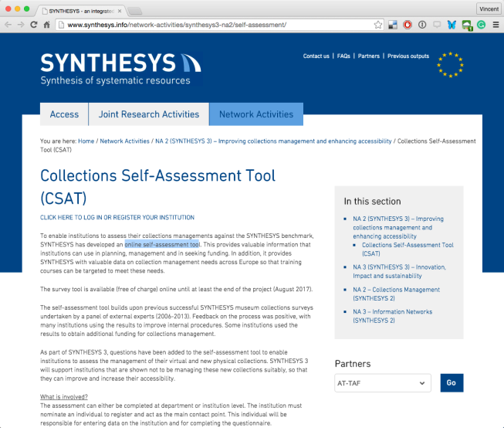
SYNTHESYS3 2013-2017: Collections Self-Assessment Tool (CSAT)
Online tool to assess collections practices against the SYNTHESYS benchmarks
Available via the SYNTHESYS website at http://www.synthesys.info/network-activities/synthesys3-na2/self-assessment/
CSAT Instructions
Notes:
5

Slide 6
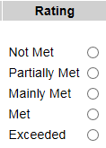
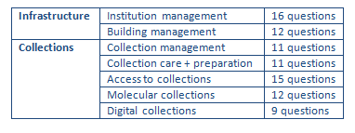
ANSWERS:
QUESTIONNAIRE BENCHMARKS:
REPORT:
Criticality rating
+
Advice
Questions cover infrastructure + collections.
Collections questions can be answered for whole institution or per department.

Slide 7
ANSWERS:
QUESTIONNAIRE BENCHMARKS:
REPORT:
Criticality rating
+
Advice
New for SYNTHESYS3
Now 86 benchmarks in total.

Slide 8
Examples of benchmarks (“Collections Access” category):
All collections are accessible to internal and external users via loan or visit.
Access to collection storage areas is restricted to authorised persons
Response to a request for access occurs within a specified time
Information on visitors to collection is recorded
SYNTHESYS3: all benchmarks examined and revised where applicable.
Answers are a simple tick-box:

Slide 9
Criticality factor added to each benchmark that will give a warning if a critical benchmark such as security of the building is not met.
Risk rating | Not met | Partially met | Mainly Met | Met | Exceeded
1 | Amber | Amber | Green | Green | Blue
2 | Red | Amber | Amber | Green | Blue
3 | Red | Red | Amber | Green | Blue
Scoring system
Notes:
9

Slide 10
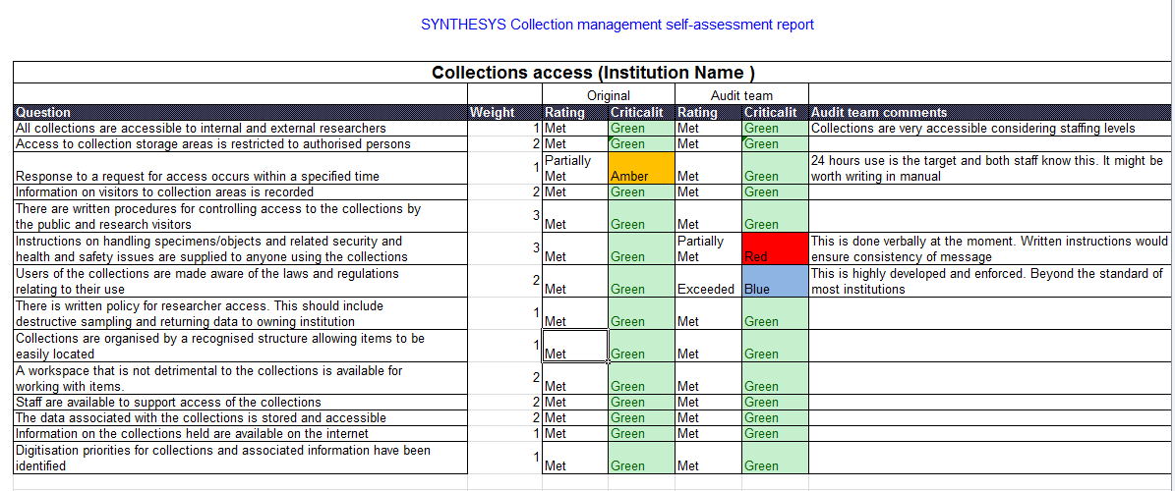
Sample page from the self-assessment output report.
All institutions receive an automatic feedback report highlighting weakness and giving advice on how to address them.
Notes:
10

Slide 11
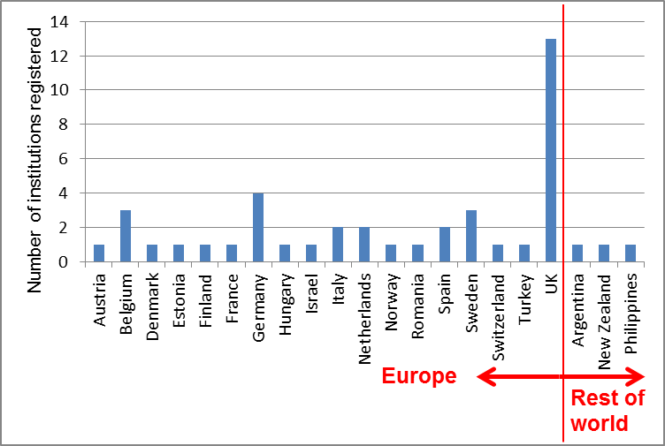
Current participants:
43 institutions registered, from 22 countries
Notes:
11

Slide 12
Benefits:
Use results to decide priorities + plan collections management
Results provide evidence to support case for improvement
Build results into major improvement projects
Use to build Key Performance Indicators for staff + departments
Use as a checklist for new laboratories, offices, collections areas or other facilities
Use as a tool for efficiency + planning
Use results to support funding bids + applications
Notes:
12

Slide 13
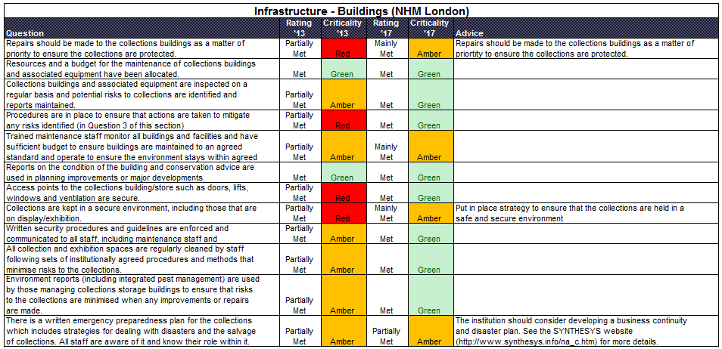
NHM 2017 results:
Notes:
13

Slide 14
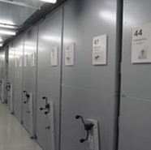
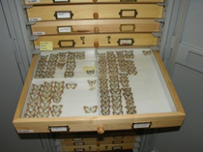
The CSAT has proved to be a valuable resource for the NHM Collections
Staff are better informed as a result of it.
It has been used to develop major projects within the NHM e.g. the NHM collections standards, NE Tower refurbishment and CSIP (Collections Storage Infrastructure Programme)
Notes:
14

Slide 15
There are several contrasting approaches to collection assessment available. Four are currently in use by many institutions, sometimes all within the same institution.
CETAF Passports*
Collections Dashboard
CSAT (SYNTHESYS3)
Move/Join-the-dots
Complexity
Participation
*Not restricted to collections
Notes:
15

Slide 16
CETAF Passports
Three stated goals:
Providing data for the CETAF website
Standardising information on CETAF members
Centralising data via the Secretariat
“Simple and self explanatory” MS Word form
Eight sections
Identification Collections
Expertise Personnel
Facilities Research
Communication Training
Notes:
16

Slide 17
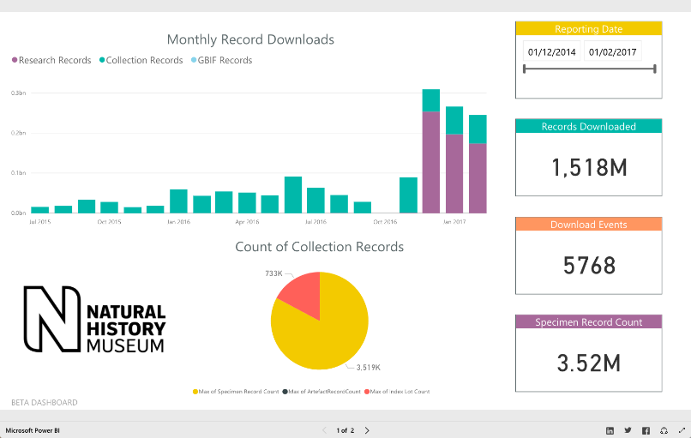
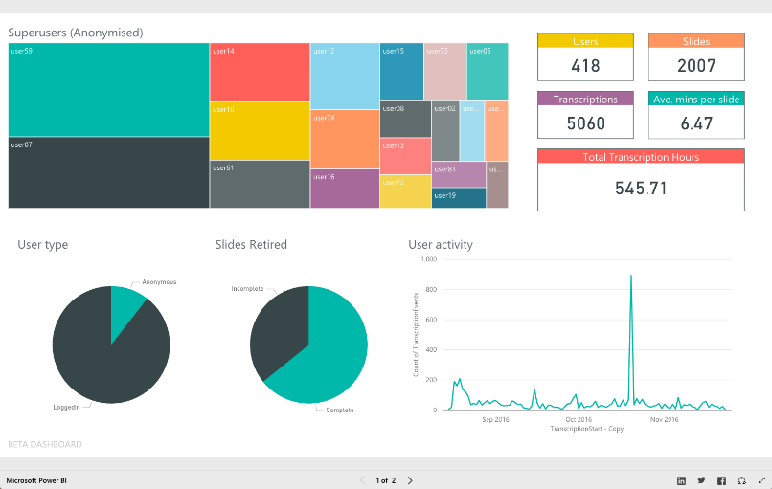
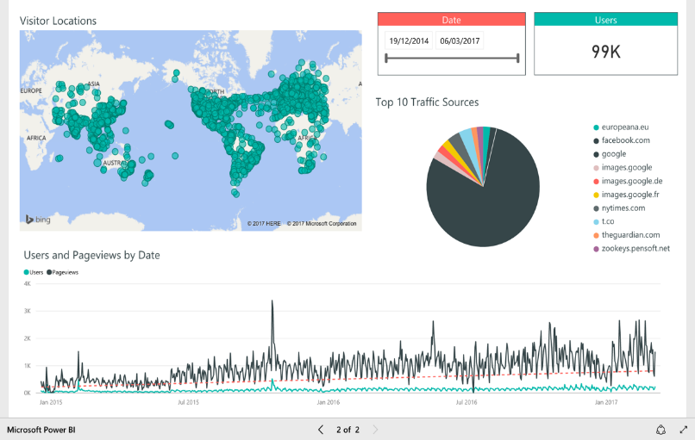
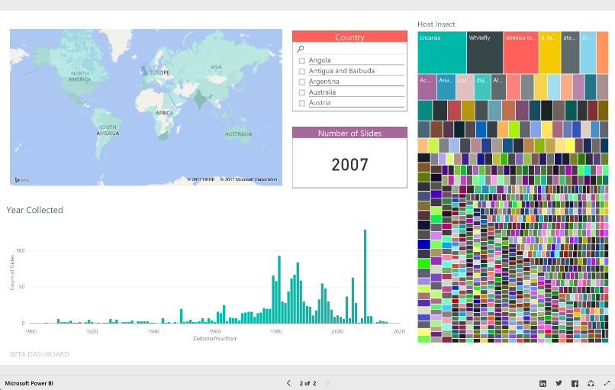
Dynamic reports from CETAF Passports
Notes:
17

Slide 18
Collections Dashboard
Objectives
To inform advocacy for natural history museums and potential collaborations by bringing together data on the global collection of natural history specimens;
To provide Directors with information on the particular strengths of their institution’s collection.
Outputs
Types of collection: 17 categories (e.g., botany, vertebrate palaeontology)
Geography: 9 terrestrial and 7 marine geographic regions (e.g., Africa, Pacific)
Resolution of data: log-10 scale to estimate the number of specimens
Staffing: number of research and collections staff and volunteers
Notes:
18

Slide 19
Pilot data – Botany data
BOTANY | TERRESTRIAL REGIONS |  |  |  |  |  |  |  |  | MARINE REGIONS |  |  |  |  |  |  | STAFF
INSTITUTION | Europe | Africa | Asia Temperate | Asia Tropical | Australasia | Pacific | North America | South America | Antarctic | North Pacific | South Pacific | North Atlantic | South Atlantic | Indian | Southern | Arctic Marine | Research | Collections | Volunteers |  | FOCUS / SPECIALTY
AMNH (New York) |  |  |  |  |  |  |  |  |  |  |  |  |  |  |  |  |  |  |  |  | N/A
DMNS (Denver) |  |  |  |  |  |  | 4 |  |  |  |  |  |  |  |  |  |  | 1 | 1 |  | N. America Rocky Mountain
FMNH (Field Museum) | 6 | 5 | 5 | 5 | 5 | 5 | 6 | 7 |  |  |  |  |  |  |  |  | 2 | 4 | 10 |  | South America
LACM (LA County) |  |  |  |  |  |  |  |  |  |  |  |  |  |  |  |  |  |  |  |  | N/A
MFN (Berlin) |  |  |  |  |  |  |  |  |  |  |  |  |  |  |  |  |  |  |  |  | DNR
MNHN (Paris) | 7 | 7 | 6 | 6 | 6 | 6 | 6 | 6 | 6 |  |  |  |  |  |  |  | 28 | 18 | 30 |  | World
NHMA (Denmark) | 6 | 6 | 5 | 6 | 5 | 5 | 6 | 6 | 2 | 3 | 3 | 6 | 5 | 3 | 4 | 5 | 3 | 4 | 11 |  | Worldwide, Greenland++
NHMUK (London) | 7 | 7 | 6 | 6 | 6 | 6 | 5 | 6 | 5 |  |  |  |  |  |  |  | 9 | 11 |  |  | see below
NMNH (Washington) | 6 | 5 | 5 | 6 | 5 | 6 | 7 | 7 | 4 |  |  | 6 |  | 4 |  |  | 11 | 24 | 50 |  | N. America, S. America
RBINS (Brussels) |  |  |  |  |  |  |  |  |  |  |  |  |  |  |  |  |  |  |  |  | DNR
RMNHD (Naturalis) | 7 | 6 | 6 | 7 | 6 | 5 | 5 | 6 | 4 | 4 | 4 | 4 | 6 | 5 | 2 | 1 | 28.9 | 13.6 | 95 |  | Worldwide
ROM (Royal Ontario) | 5 | 5 | 4 | 4 | 4 |  | 6 | 5 |  |  |  |  |  |  |  |  | 1 | 1 |  |  | North America
SCALE | 0 |  | 1 |  | 2 |  | 3 |  | 4 |  | 5 |  | 6 |  | 7
(# Specimens) | 0 |  | 1-10 |  | 11-100 |  | 101-1,000 |  | 1,001-10,000 |  | 10,000-100,000 |  | 100,001- 1,000,000 |  | >1,000,000
NHMUK: Global lichens, algae and bryophytes; seed plants from Europe, North Africa, North America, Caribbean and polar regions.
Notes:
19

Slide 20
Join the Dots
A transparent method for assessing the Museum’s collections for project planning, prioritisation and resource allocation.
A tool to measure the progress and impact of those projects.
An understanding of the use, importance and accessibility of the collections and the steps required to make inaccessible areas of the collections ready for use.
An oversight of how the collections link to the strategic vision of the Museum, and National and EU science focus.
Provide data for long-term collections development, going beyond current trends and addressing cycles in scientific research, ensuring the collections remain relevant and accessible for the future.
A clear insight into the collections for non-science, non-museology communications e.g. Trustees, other policy makers and external bodies.
A tool to help support the highest professional standards of collections care (storage, conservation, access) in association with our competencies framework and the Collections Infrastructure Programme (CSIP).
Provide data to inform the DCP, and provide a basic inventory to meet accreditation requirements by prioritising and improving collections information content.
Notes:
20

Slide 21
14 assessment criteria grouped into 4 categories
Each collections unit assessed against all 14 criteria
Category | Criterion
Condition | Physical accessibility and use
 | Conservation / physical condition
 | Storage equipment
 | Housing materials
Importance & Significance | Strategy / mission
 | Scope
 | Uniqueness
 | Usage
Information | Digital records
 | Identification
 | Documentation
 | Acquisition – collections development
Outreach | Education
 | Exhibition
Definition:
The extent to which items in a collection can be easily and promptly located and retrieved for use.
Standards:
NHM Collections Care Policy, 2014; Local Collections Manuals and McGinley, 1993.
Notes:
21

Slide 22
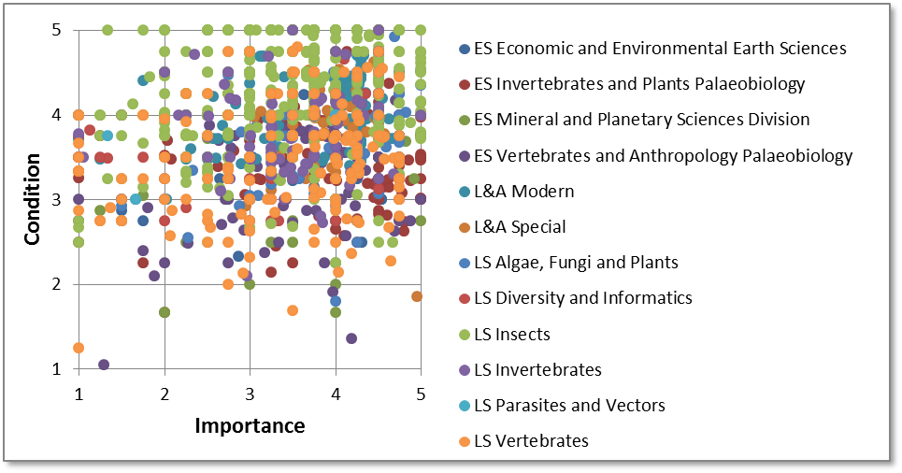
The dots
Notes:
22

Slide 23
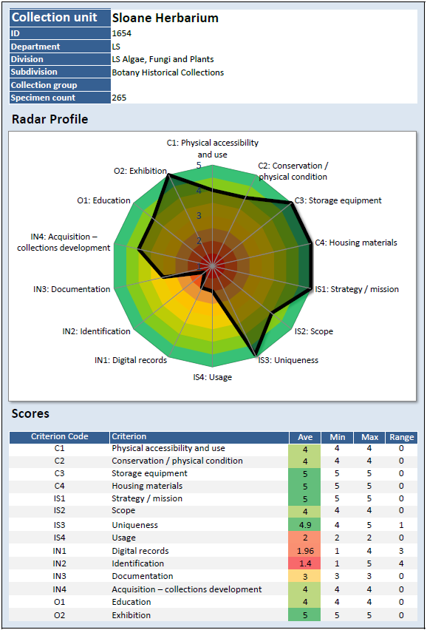
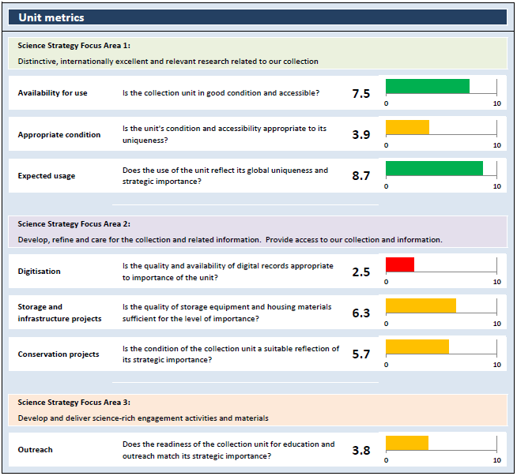
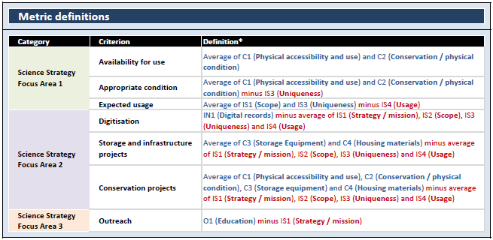
Notes:
23

Slide 24
Relevance and value of CSAT
The questions are set at a level that provides useful data to the institute and the staff working directly on the collections. The questions provide a benchmark for best practice for all to aspire.
It is as useful to a large national institute as it is a small provincial Museum
It is free and simple to use and does not need a huge input of resources to complete.
It is well established and has more than 15 years worth of useful collection data from many institutions.
Notes:
24

Slide 25
Future/Improvements:
Upgrade the website.
CSAT to be more prominent and easy to find on the website
Provide spreadsheets with the questions for different departments for easy distribution within an institute
Clarity and advise on how to use the new modules (digital & molecular)
Fully automated reporting
Provide responses to additional comments
As the report is just following a standard format, provide more in depth and individual advice possibly a panel of experts from the list of partners could be requested to visit the institute to provide further advice.
Possibly set up a set of SYNTHESYS exchange projects for collections care and conservation like the access projects for taxonomy.
Provide comparison reports from the same institute if it completes the CSAT more than once to show progress in areas and of course highlight problems.
Notes:
25

