Slide 1
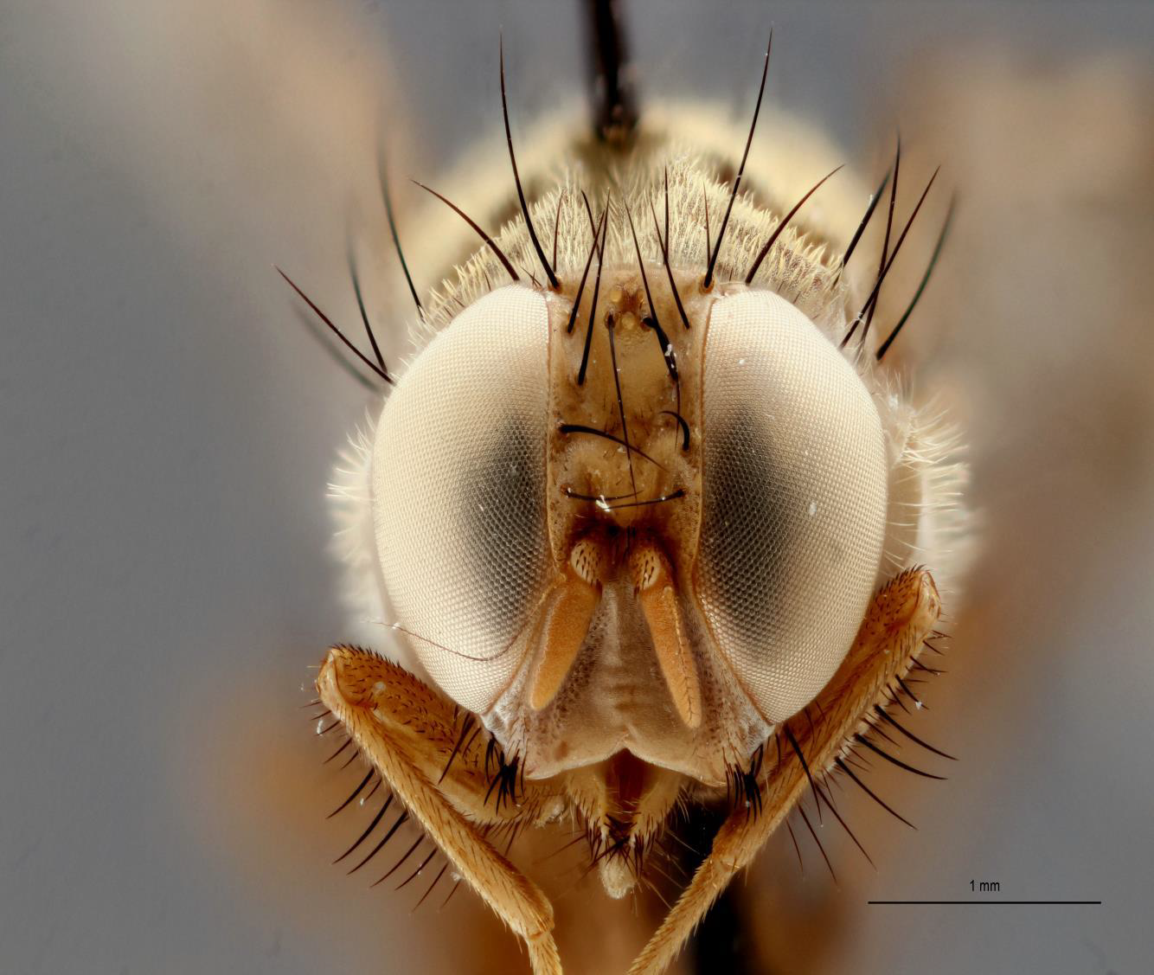
3D Digitisation

Slide 2
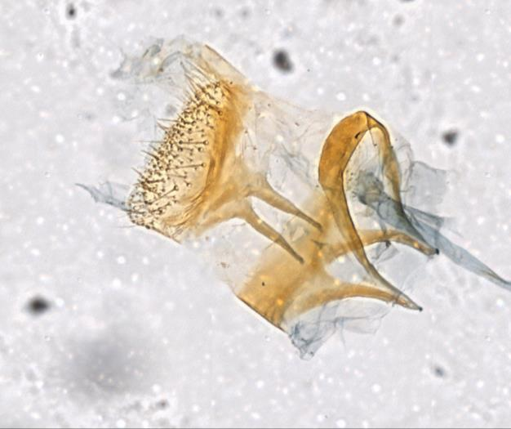
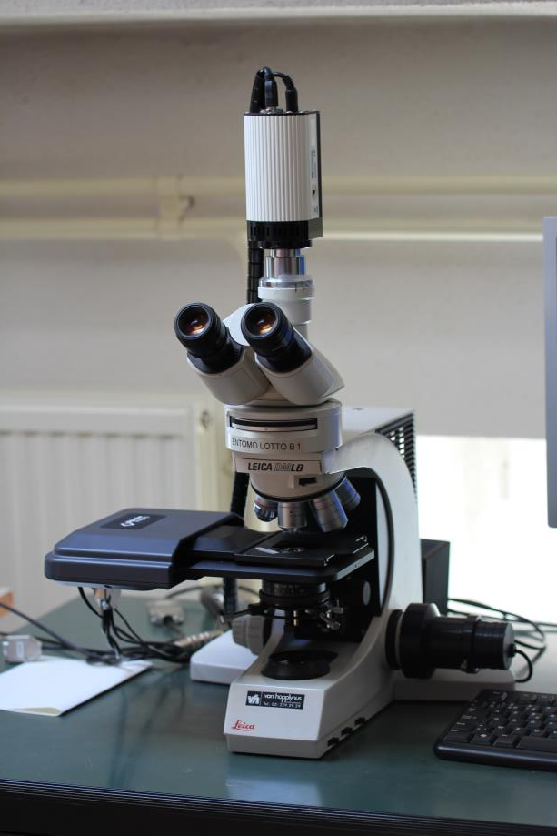
2D: Gigapan - Focus Stacking Microscope
Caloptitia galacotra (Pt) RBINS 2017
Microscope Focus Stacking 2D+
Final Meeting 06/06/2017-07/06/2017

Slide 3
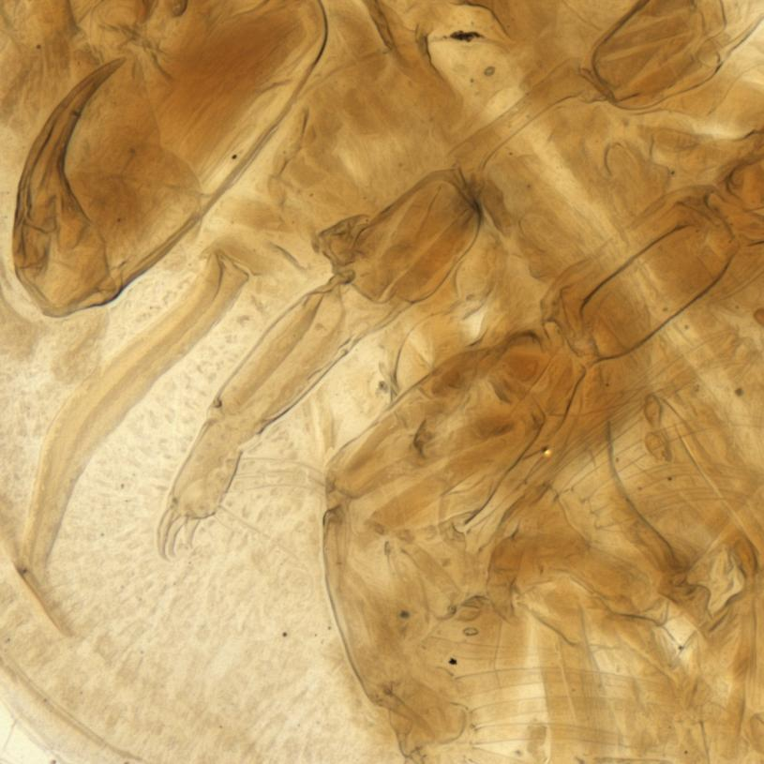
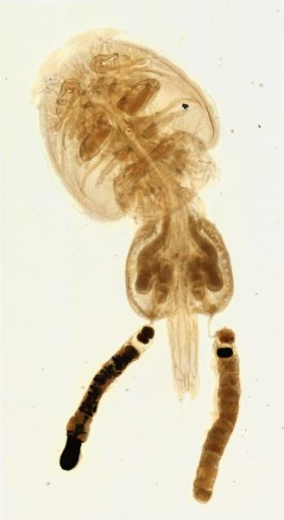
2D: Gigapan - Focus Stacking Microscope
Final Meeting 06/06/2017-07/06/2017

Slide 4
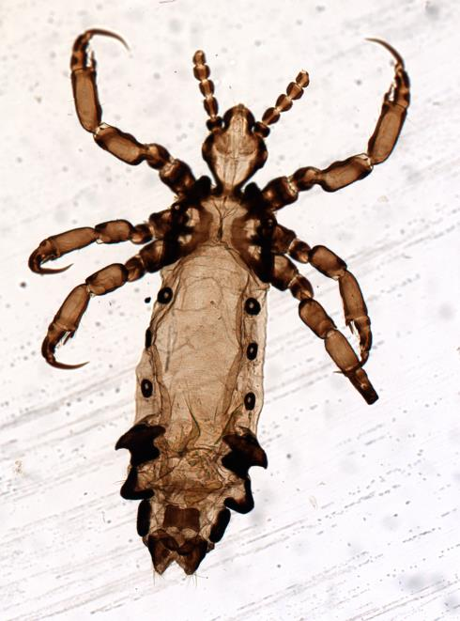
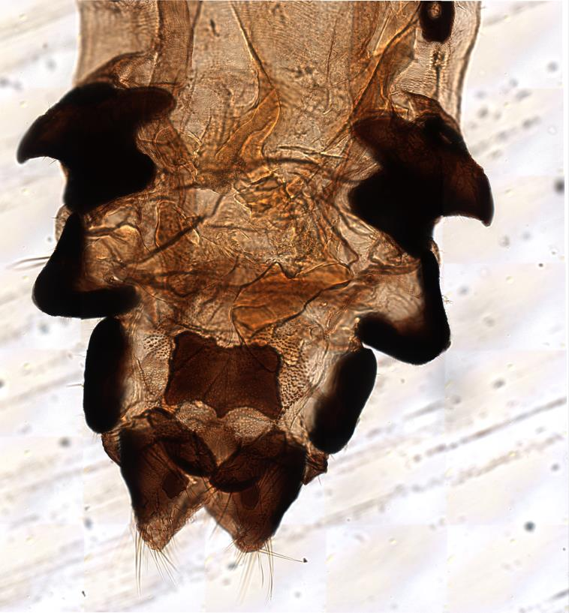
2D: Gigapan - Focus Stacking Microscope
Anoplura sp., RMCA 2015
Final Meeting 06/06/2017-07/06/2017

Slide 5
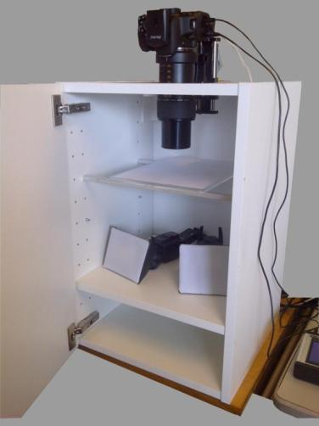
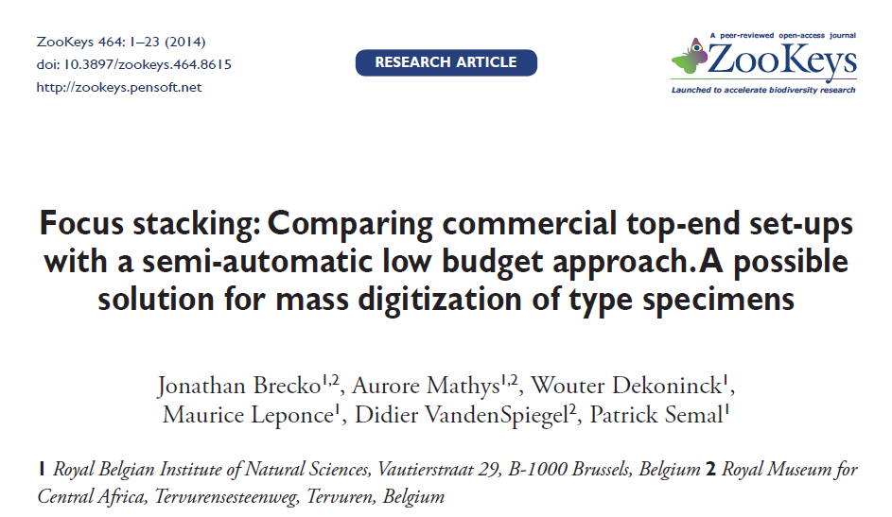
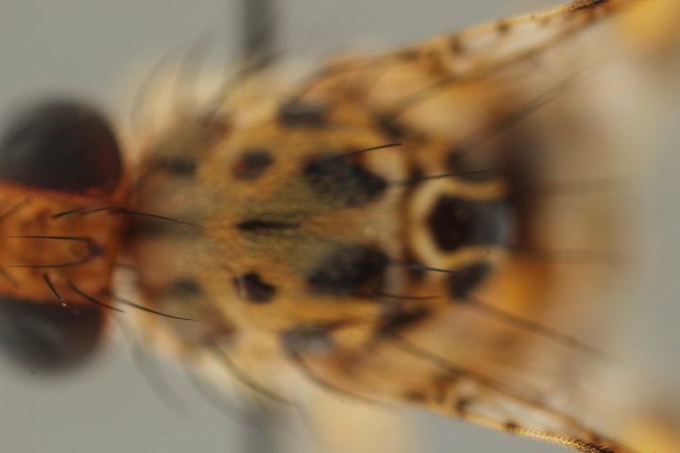
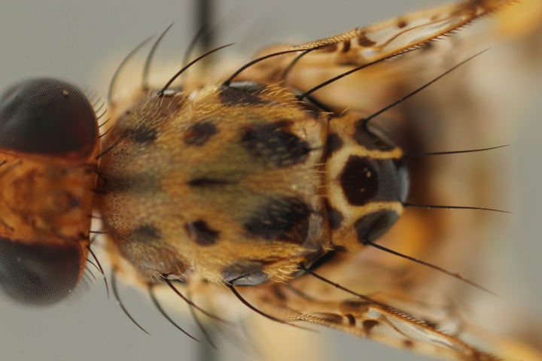
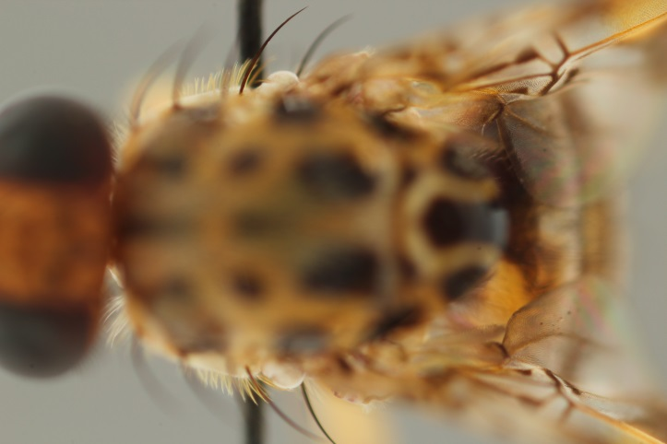
2D+ (Focus Stacking)
http://zookeys.pensoft.net/articles.php?id=4346
Focus Stacking 2D+

Slide 6
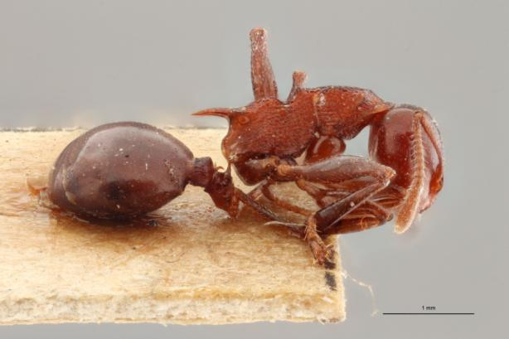
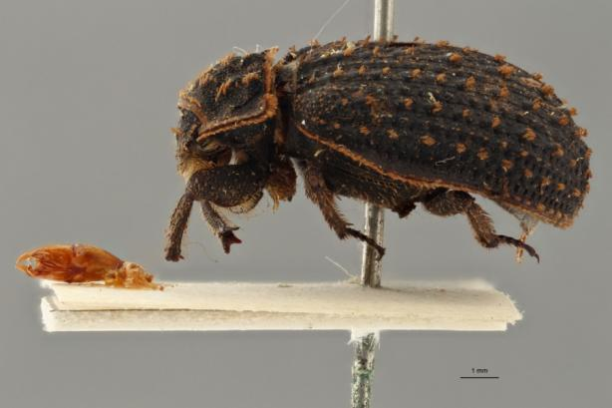
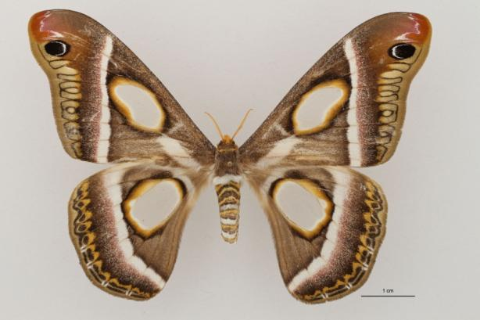
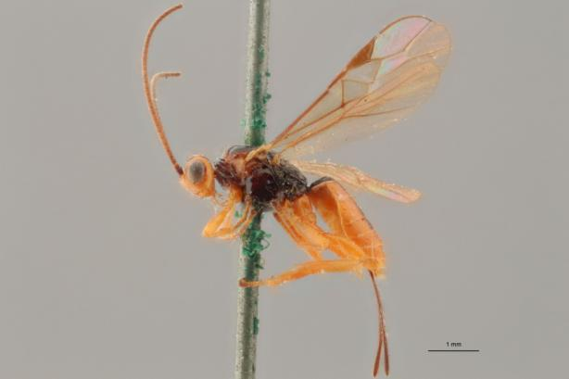
2D+ (Focus Stacking)
Final Meeting 06/06/2017-07/06/2017

Slide 7
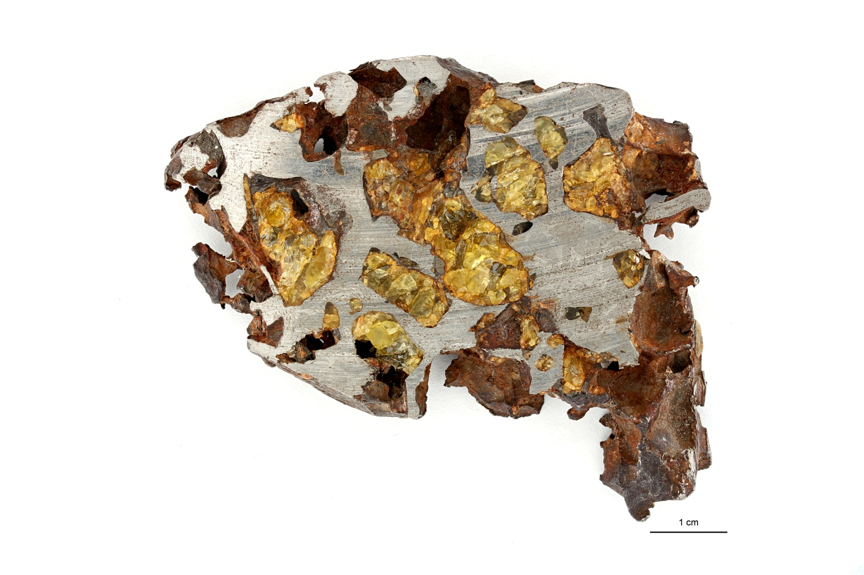
2D+ (Focus Stacking)
Final Meeting 06/06/2017-07/06/2017

Slide 8
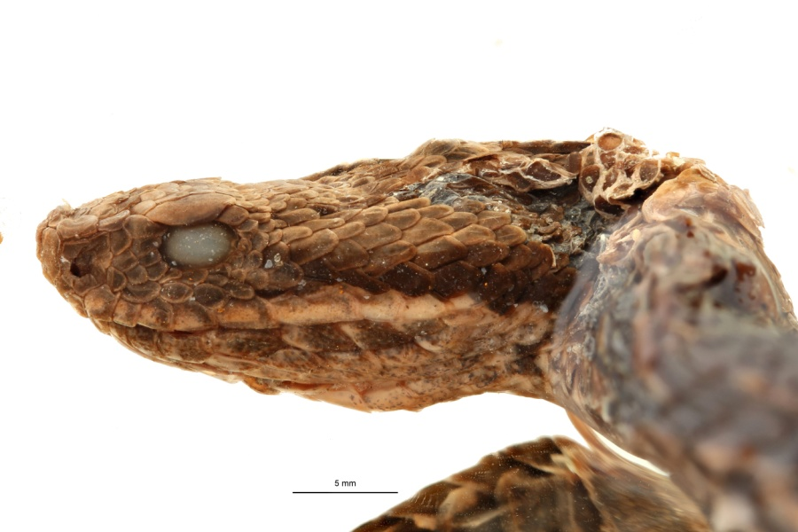
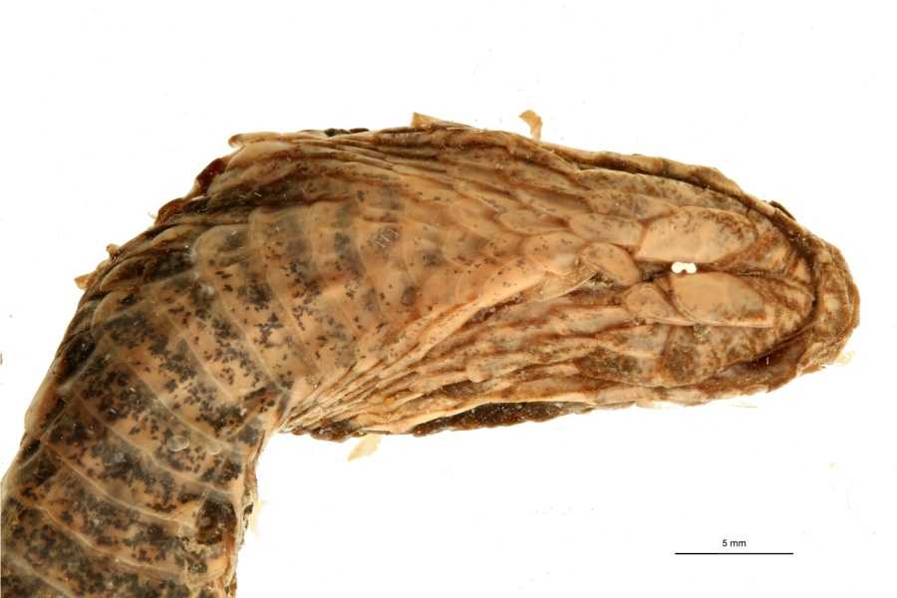
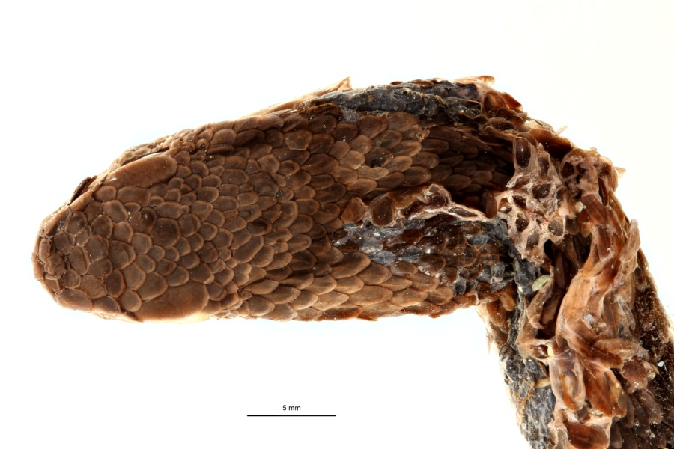
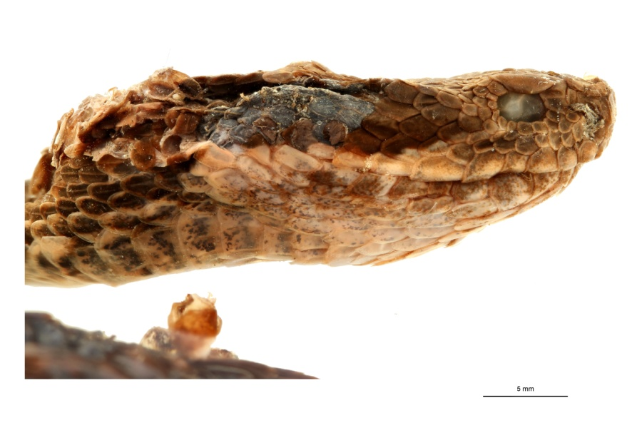
2D+ (Focus Stacking)
Final Meeting 06/06/2017-07/06/2017

Slide 9
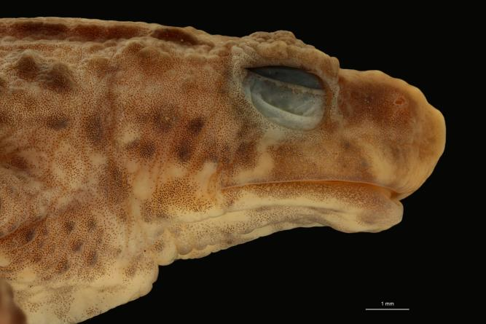
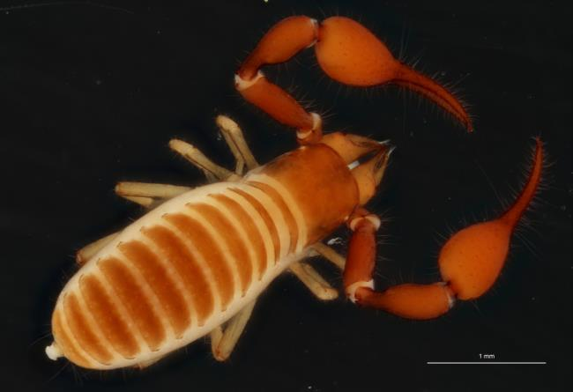
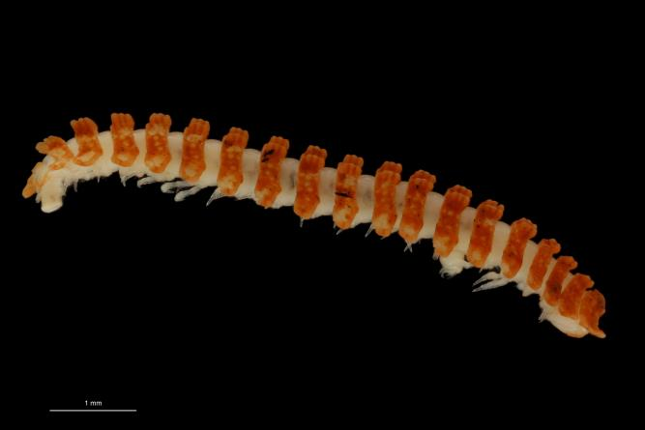
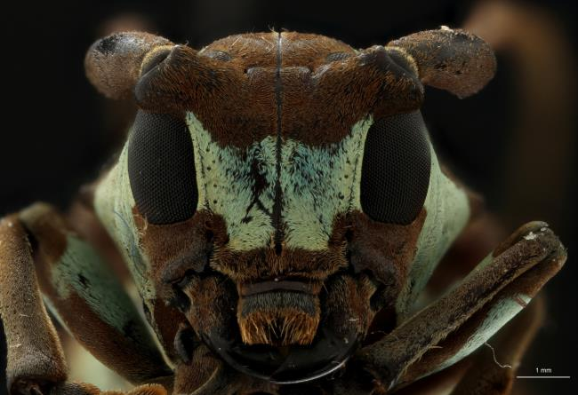
2D+ (Focus Stacking)
Final Meeting 06/06/2017-07/06/2017

Slide 10
3D scanning
Photogrammetry
Structured Light
Laser Scanning
Infrared
X-Ray
Final Meeting 06/06/2017-07/06/2017

Slide 11
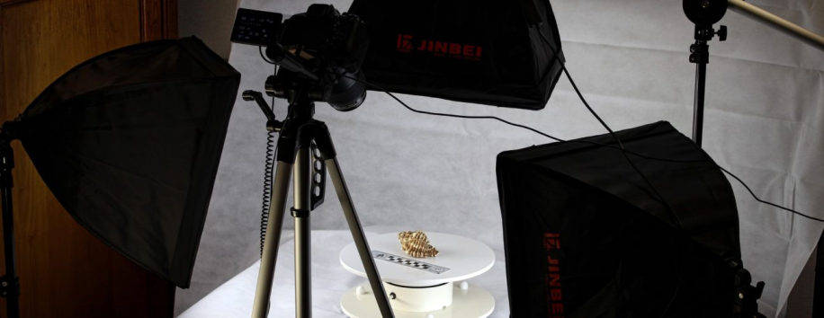
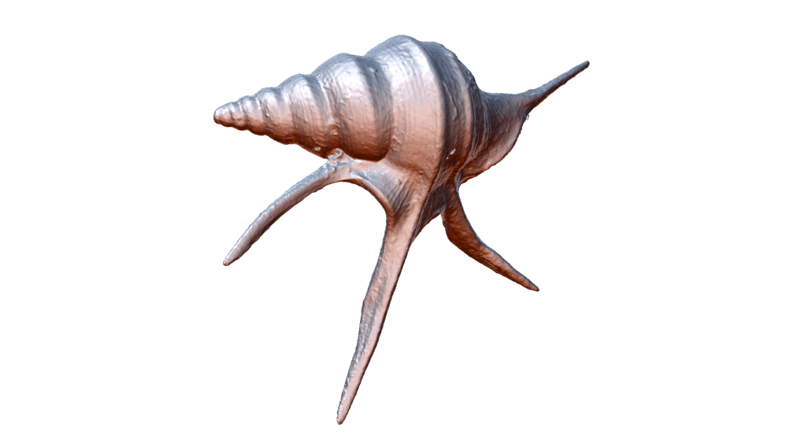
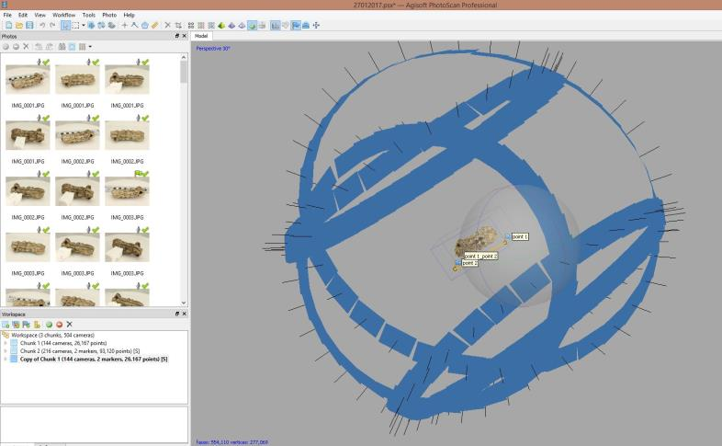
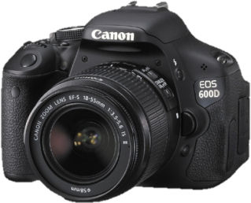
3D Scanning: Photogrammetry
Agisoft Photoscan
Photogrammetry

Slide 12
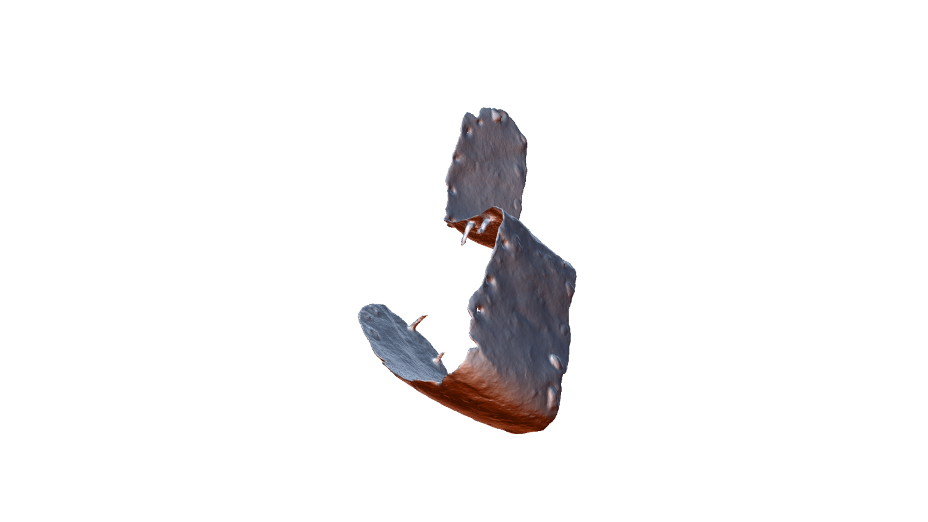
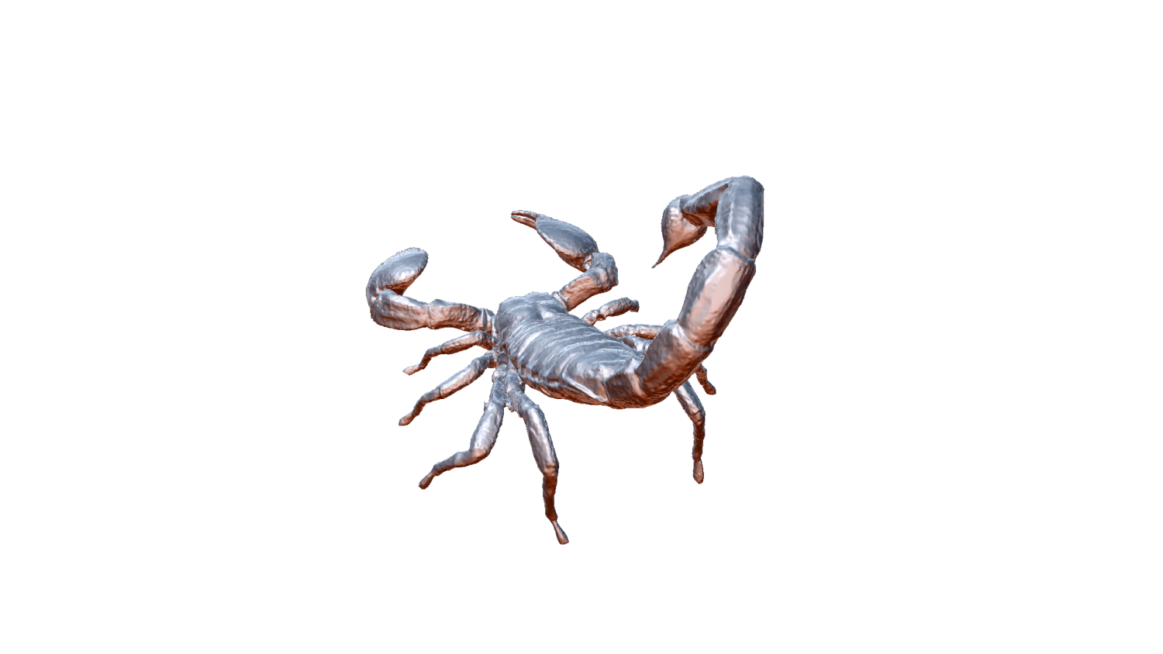
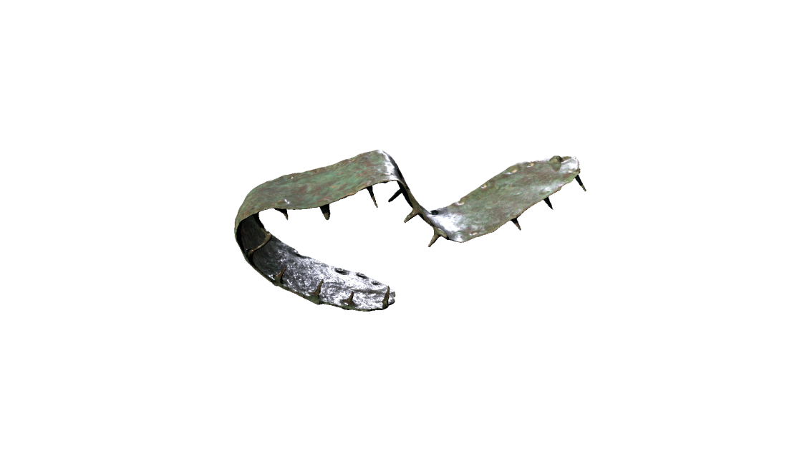
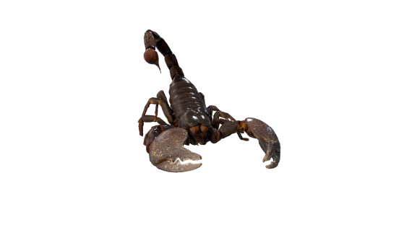
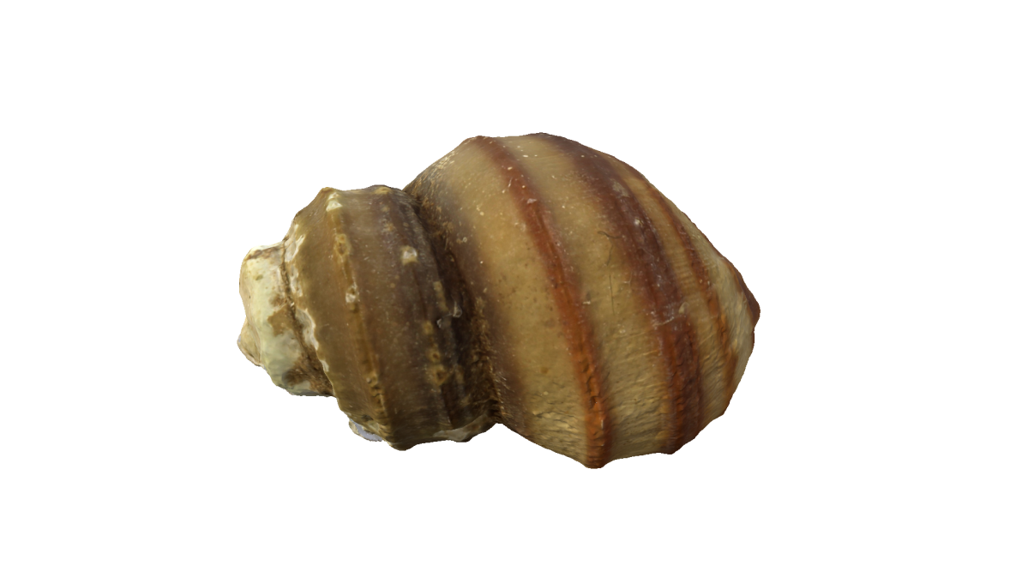
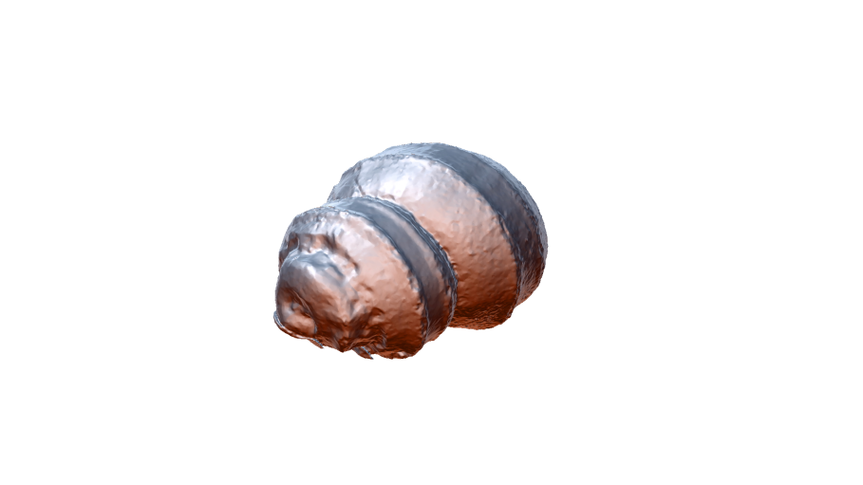
3D scanning: Photogrammetry
Final Meeting 06/06/2017-07/06/2017
Photogrammetry

Slide 13
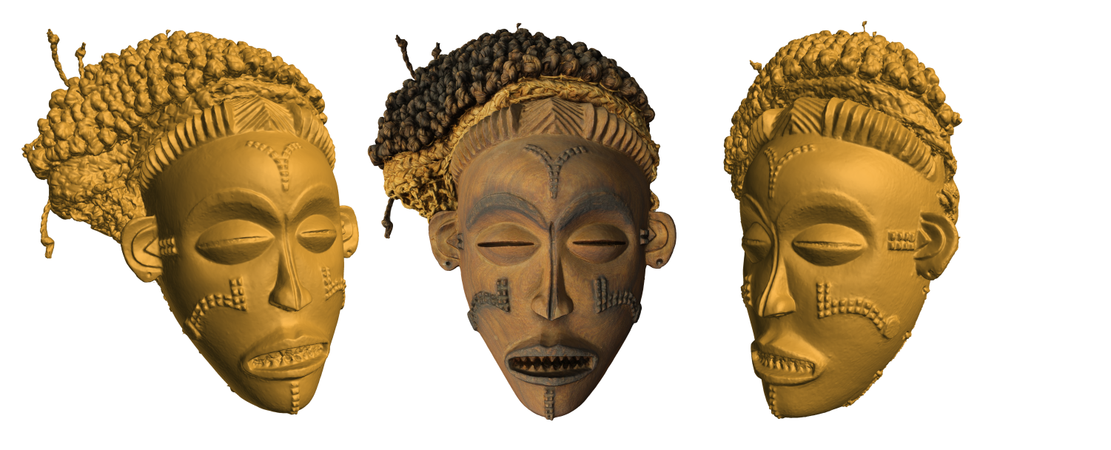
3D scanning: Photogrammetry
Final Meeting 06/06/2017-07/06/2017
Photogrammetry

Slide 14
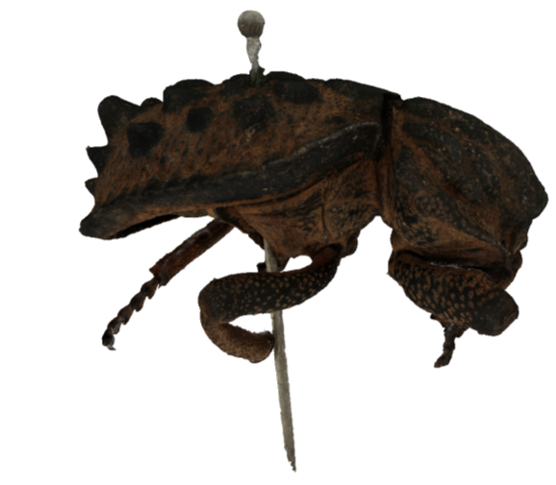
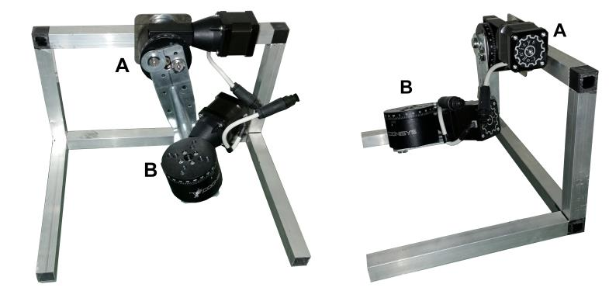
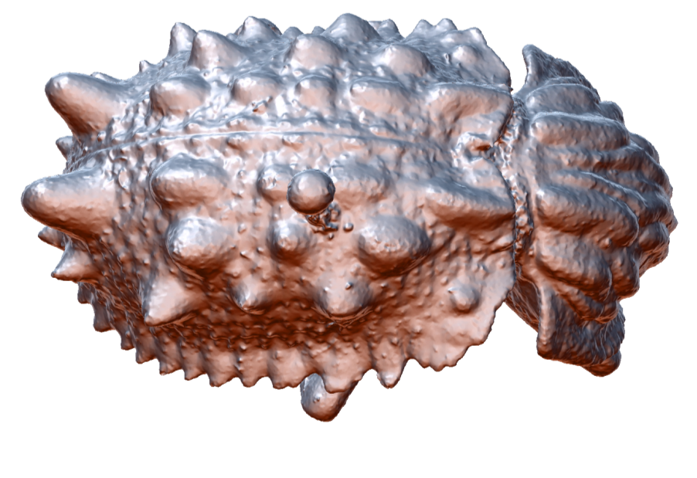
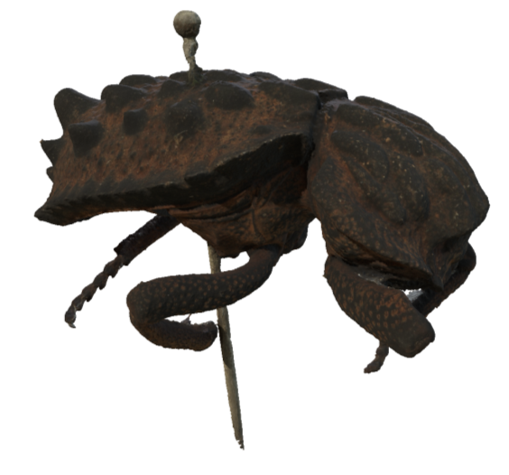
3D scanning: Focus Stacking +Photogrammetry
Final Meeting 06/06/2017-07/06/2017

Slide 15
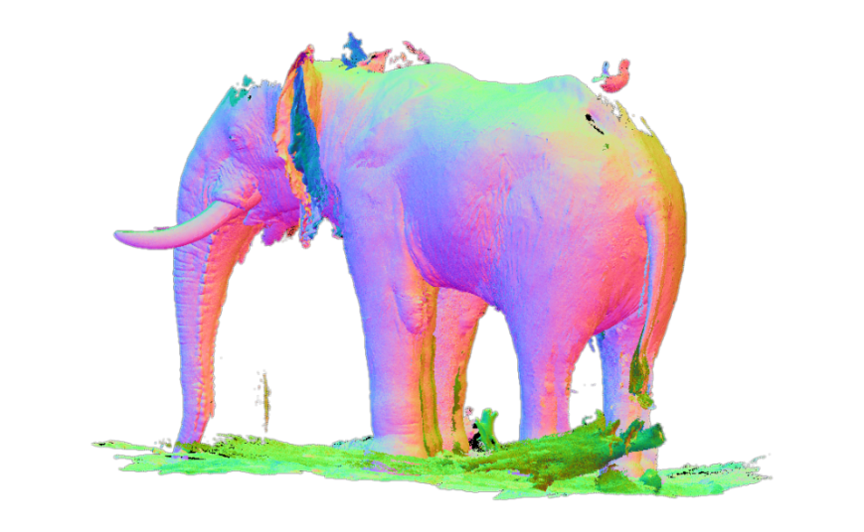
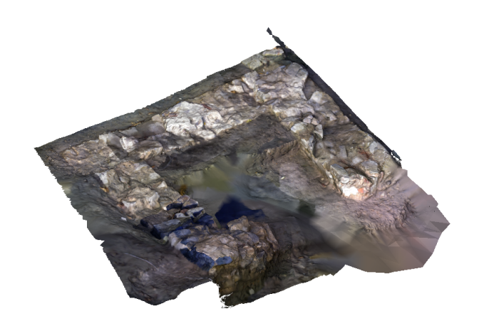
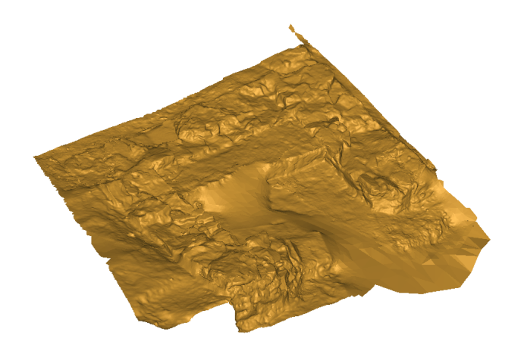
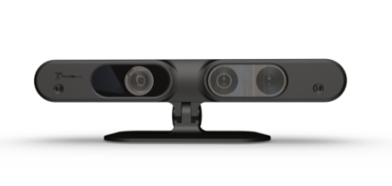
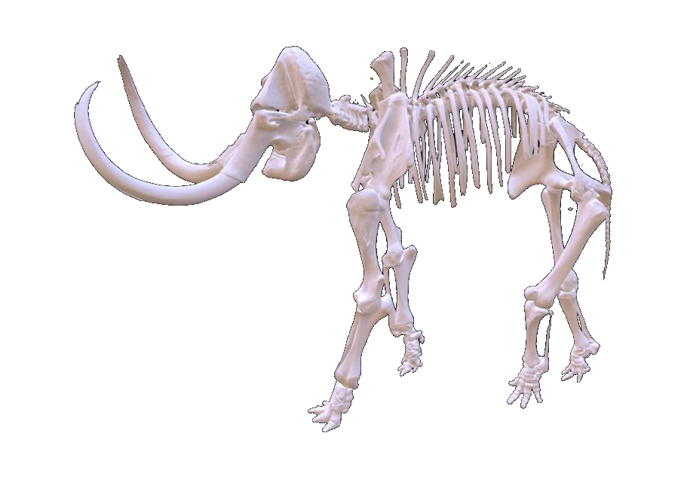
3D scanning: Infrared
Final Meeting 06/06/2017-07/06/2017
Infrared technology

Slide 16
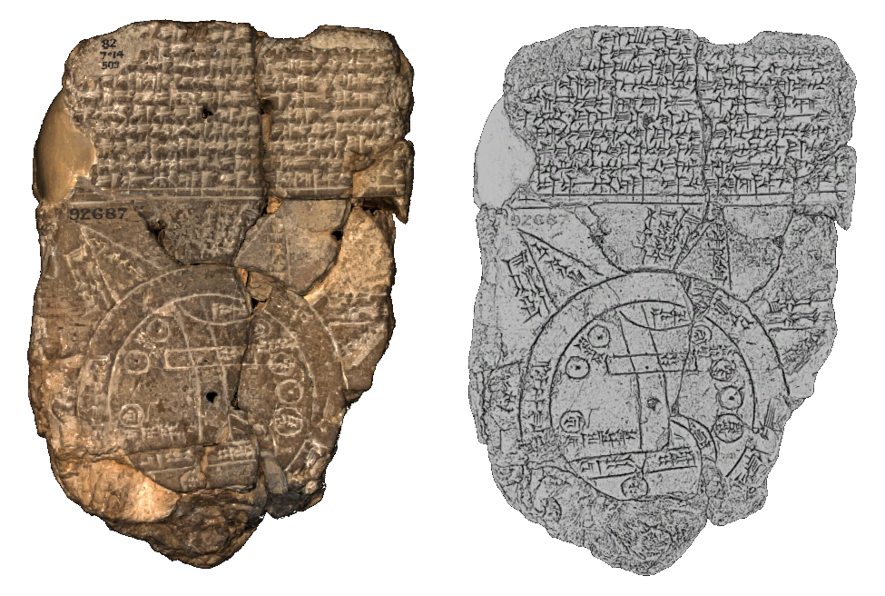
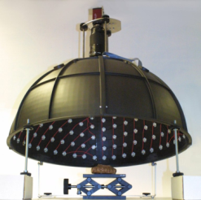
3D scanning: RTI/Minidome
Final Meeting 06/06/2017-07/06/2017
Mini Dome KULeuven

Slide 17
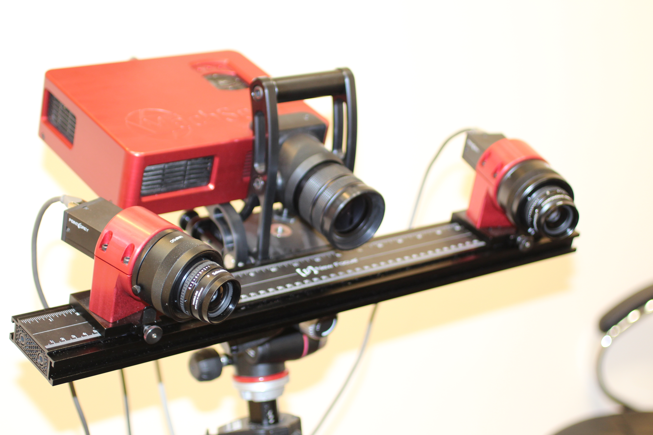
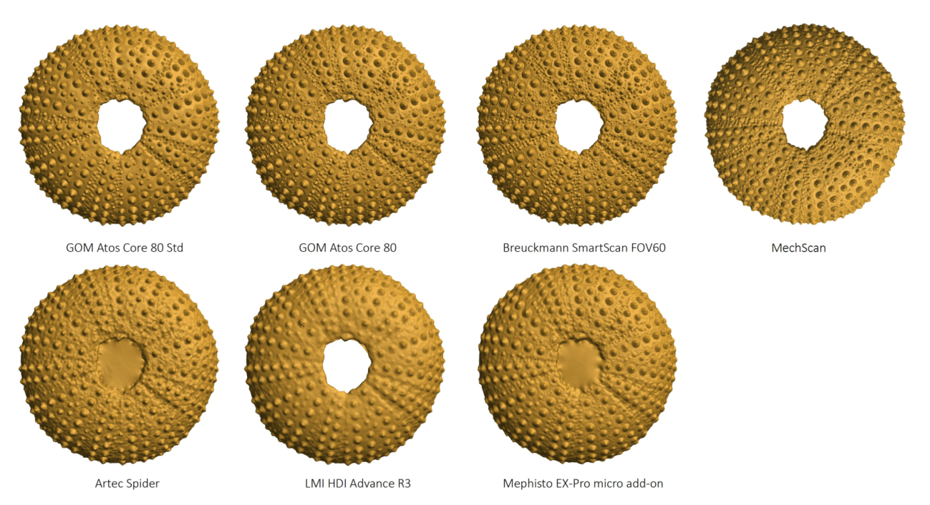
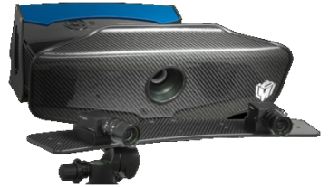
3D scanning:
Structured Light
Final Meeting 06/06/2017-07/06/2017

Slide 18
3D scanning:
Structured Light
Final Meeting 06/06/2017-07/06/2017

Slide 19
3D scanning: µCT
Final Meeting 06/06/2017-07/06/2017

Slide 20
3D scanning: µCT
Final Meeting 06/06/2017-07/06/2017

Slide 21
3D scanning: µCT
Final Meeting 06/06/2017-07/06/2017

Slide 22
Valorisation

Slide 23
3D scanning - Vergelijken

Slide 26
Virtual collections

Slide 28
Final Meeting 06/06/2017-07/06/2017

Slide 29
Research Institutes on SketchFab
Sketchfab
RBINS https://sketchfab.com/naturalsciences
RMCA https://sketchfab.com/africamuseum
MNCN https://sketchfab.com/mncn
MfN https://sketchfab.com/VisLab
NHM https://sketchfab.com/NHM_Imaging
Other
RBINS http://new-virtualcollections.naturalsciences.be/
RMCA http://digit03.africamuseum.be/allspecimens
MfN http://www.zoosphere.net/
Naturalis http://3d.naturalis.nl/

Slide 30
Spin-offs

Slide 31
Future: Multispectral 3D
3DSpectral pionneer project
Multispectral 3D applied to the collections

Slide 32
3D printing
Final Meeting 06/06/2017-07/06/2017

Slide 33
3D printing
Final Meeting 06/06/2017-07/06/2017

Slide 34
Connection with NA2

Slide 35
WIKI page 3D imaging handbook
http://biowikifarm.net/v-mfn/3d-handbook/3d_Imaging_Handbook:Main_Page
Final Meeting 06/06/2017-07/06/2017

Slide 36
Final Meeting 06/06/2017-07/06/2017

Slide 37
Thank you for your attention

Slide 38
Objective 2 Task 2.2
Micro-Computed Tomography (Micro-CT) for NH collections
Handbook
Web based framework

Slide 39
Objective 2 Task 2.2

Slide 40
https://microct.portal.lifewatchgreece.eu/

