Slide 1
Setting Collections Data Free
…with the power of the crowd

Slide 2
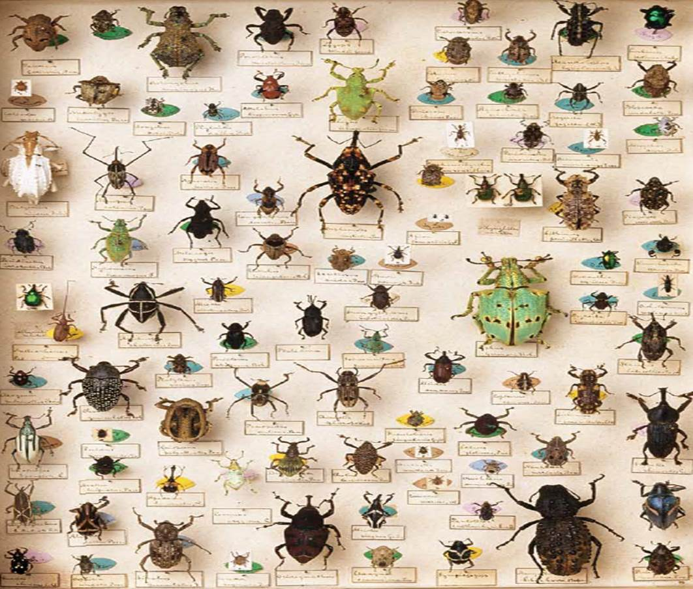


WP4 - Moving from physical to digital collections
Obj. 3 - Crowdsourcing metadata enrichment of digital images
Task 3.2 – Development of website to allow crowdsourcing data capture

Slide 3
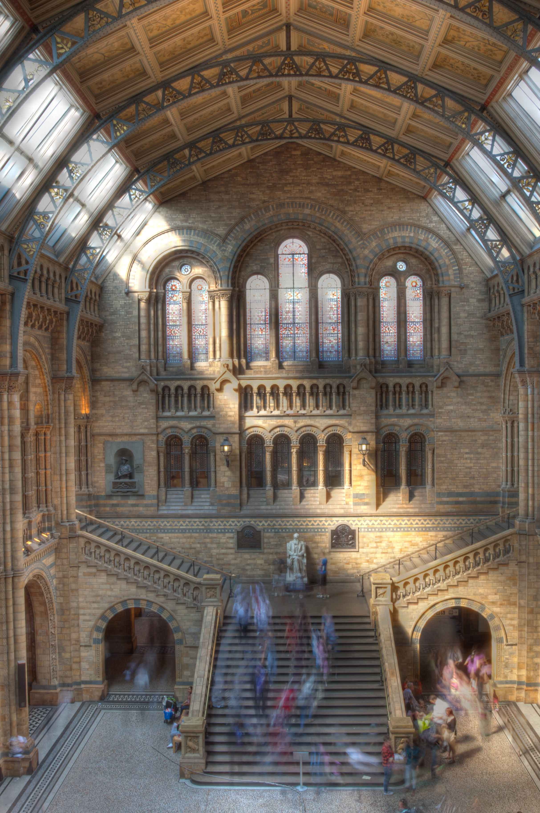

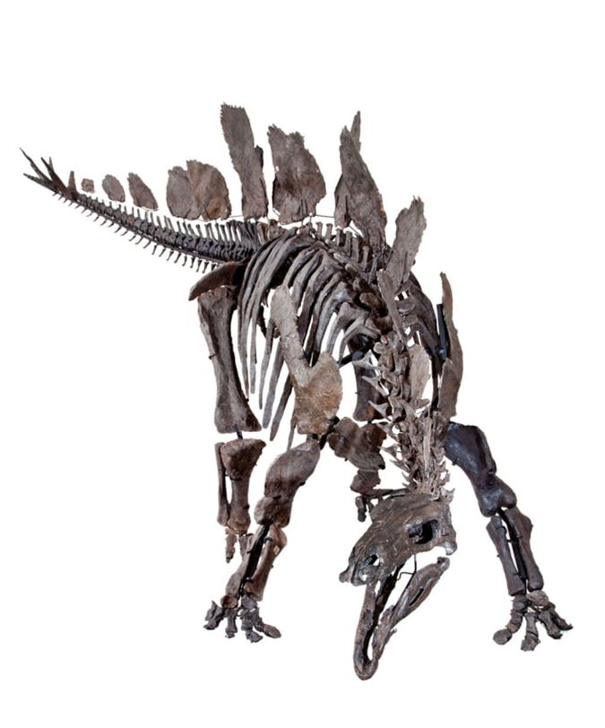
80m specimens
30m insects
7m fossils
5,000 meteorites
250 yrs of collecting
50b yrs of life on earth represented

Slide 4
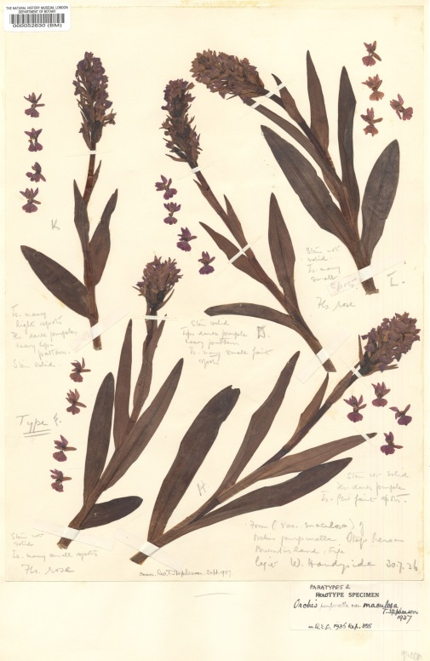
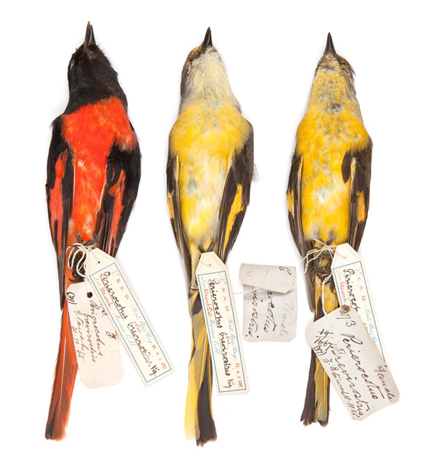
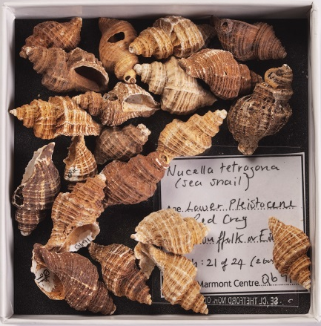
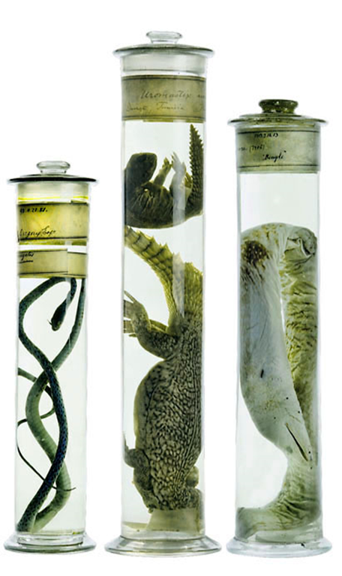
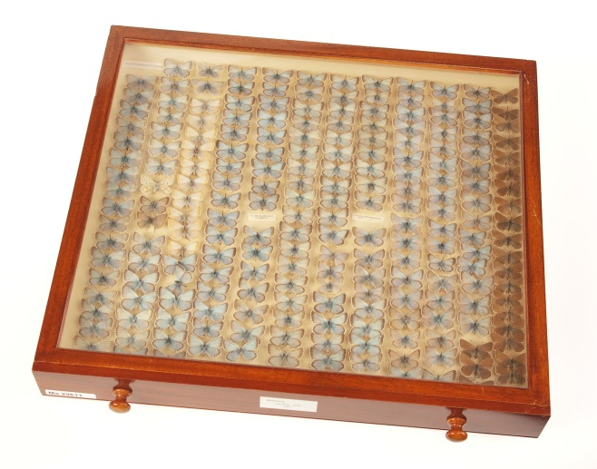
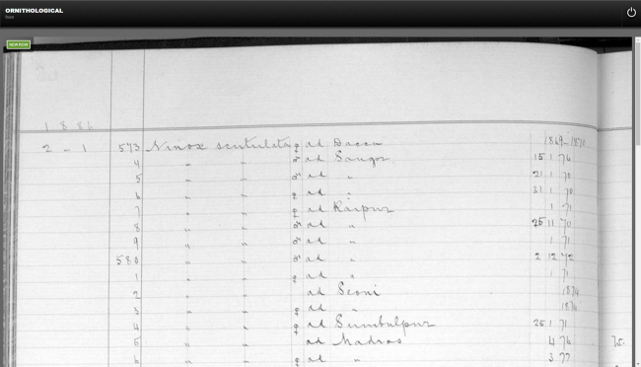

Slide 5
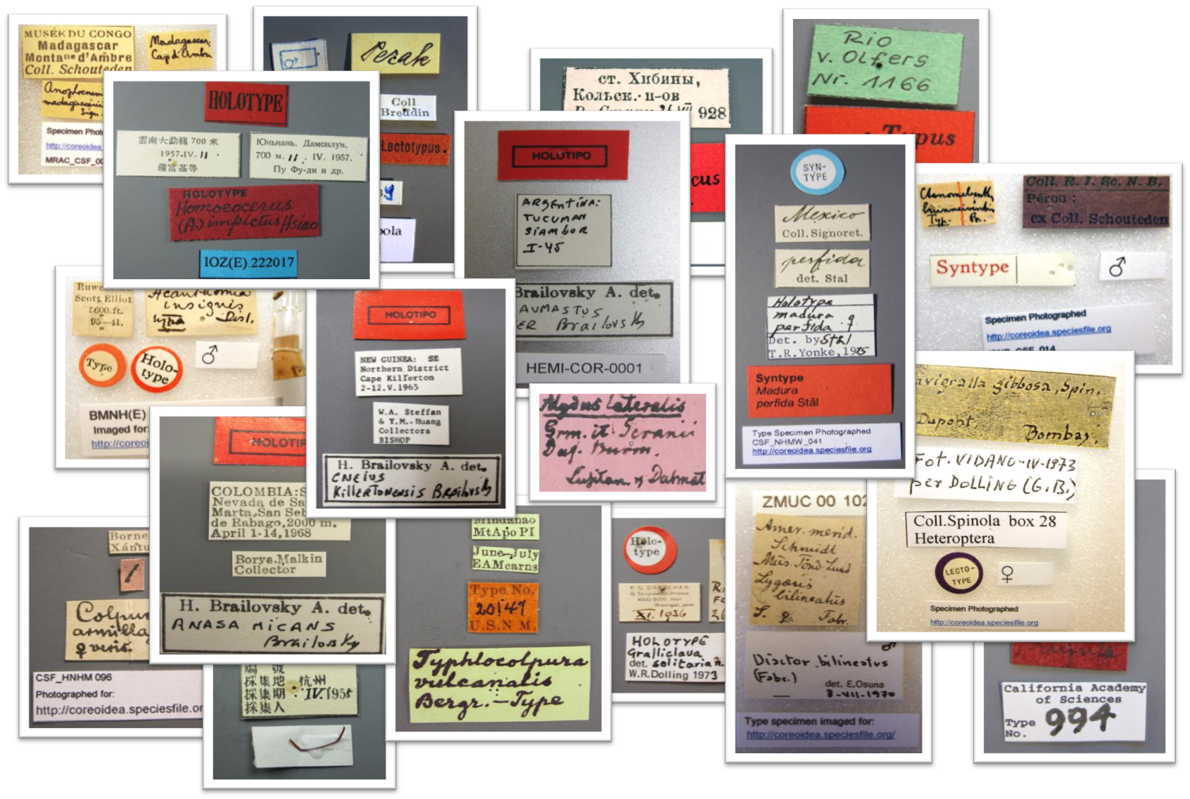

Slide 6
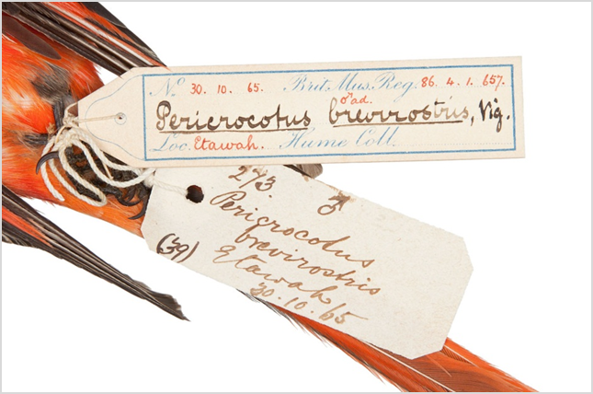
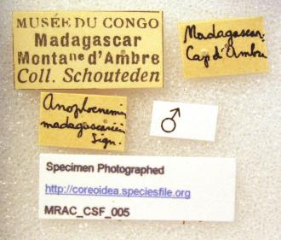
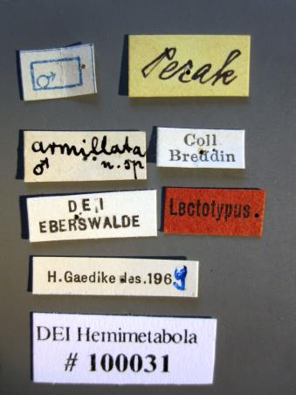
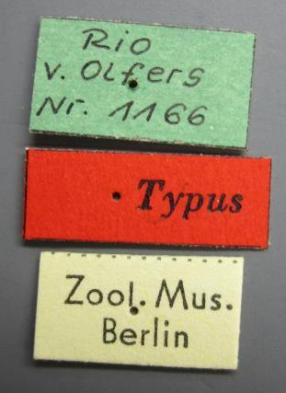
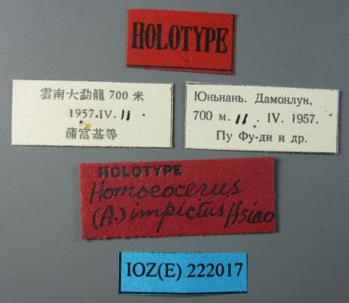
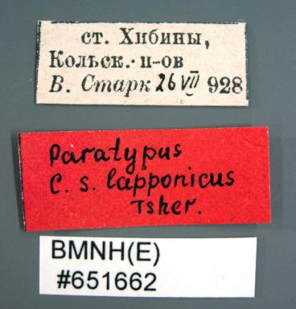
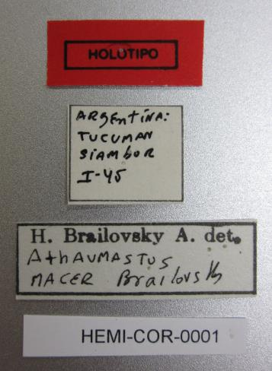
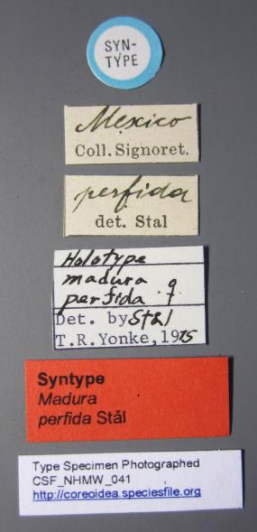
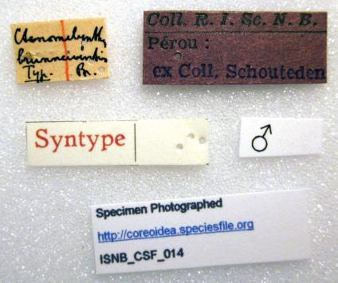
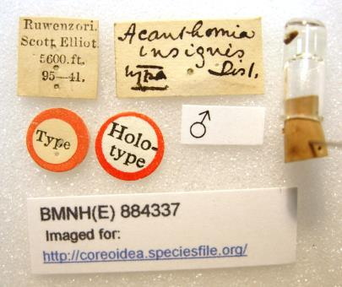
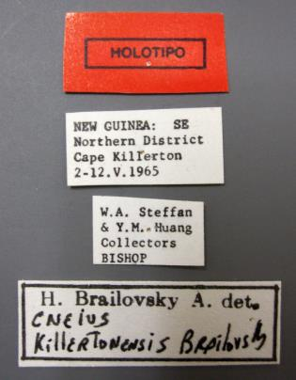
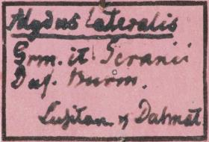
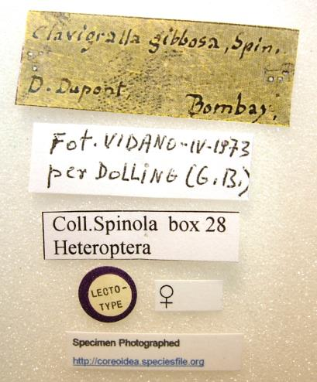
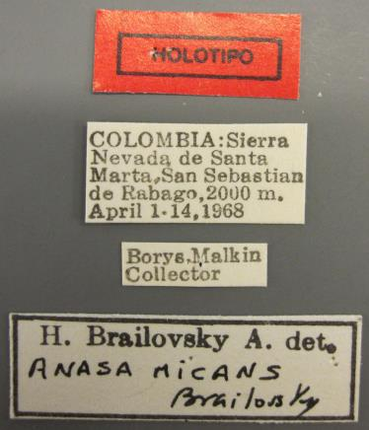
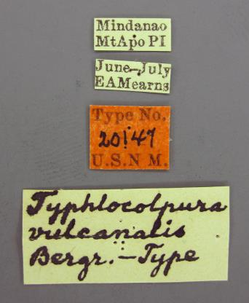
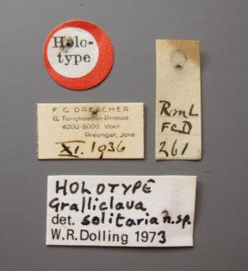
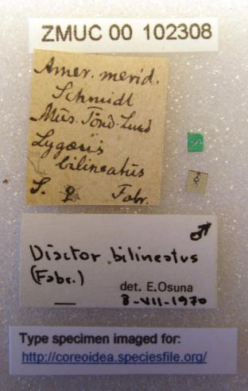
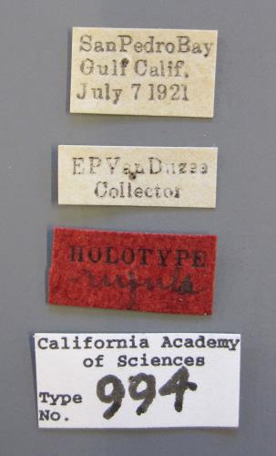
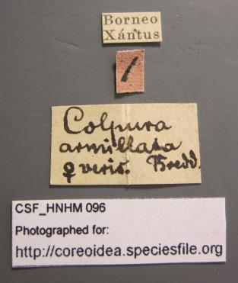
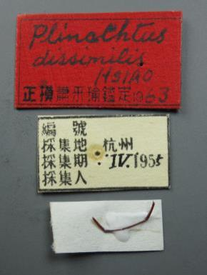


Slide 7
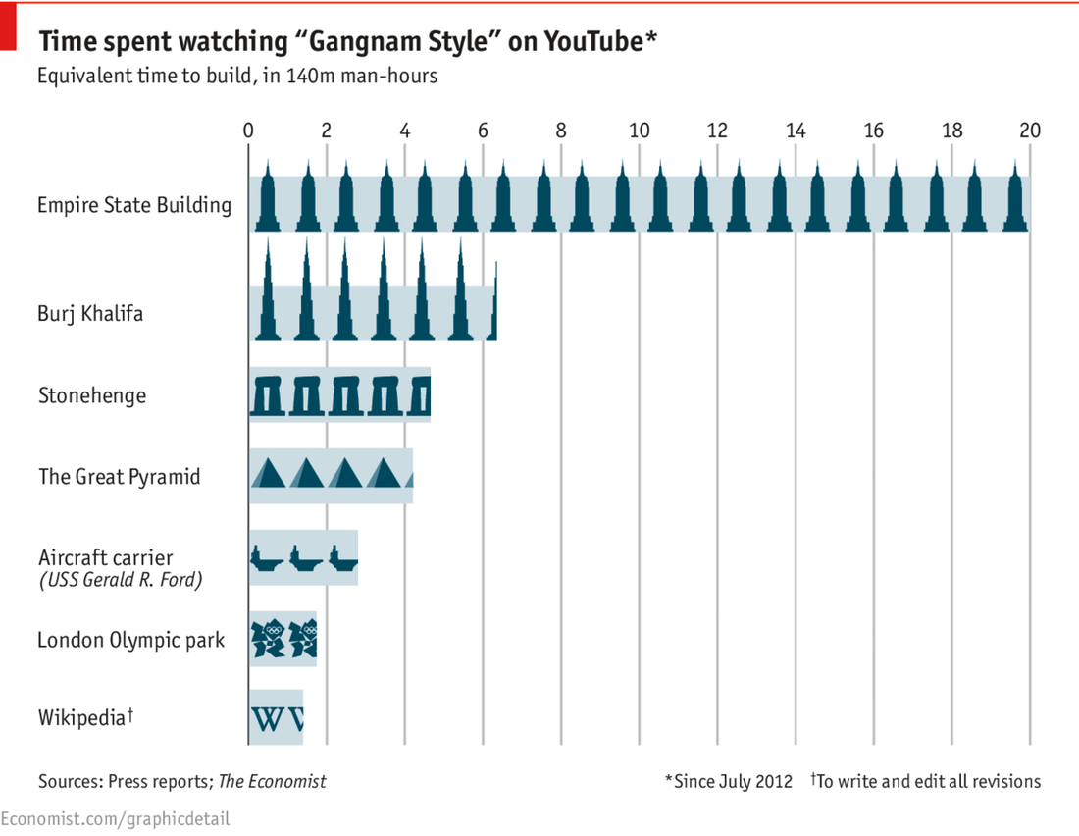


Slide 8


Slide 9
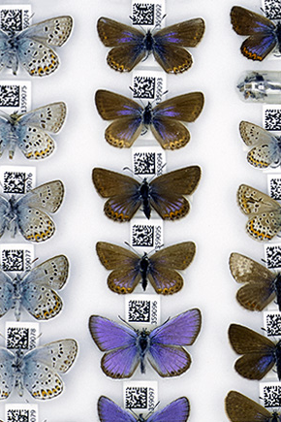
The NHM Digital Collections Programme
Small & Flat
500,000+ Lepidoptera of the British Isles
150,000 microscope slides
  6,000+ Chalcidoidea
  2,000+ Foraminifera

Slide 10
Notes:
CKAN from the OKFN
Open Source on GitHub
MapQuest & Open Street Map
Built on APIs

Slide 11
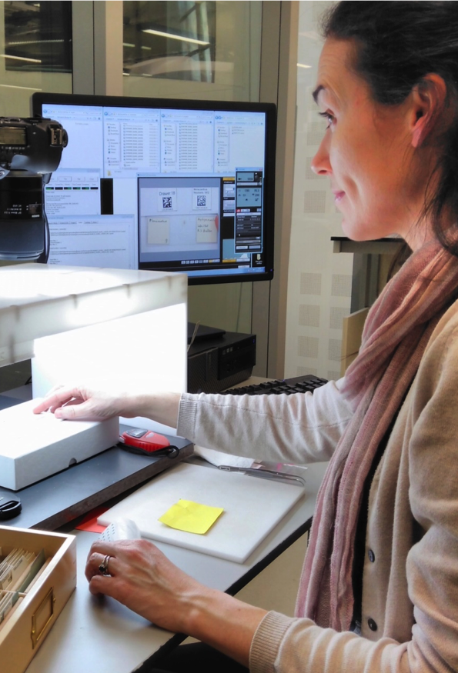
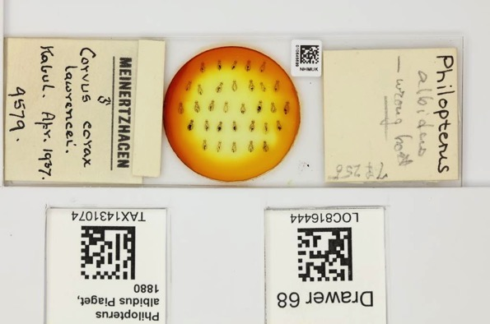
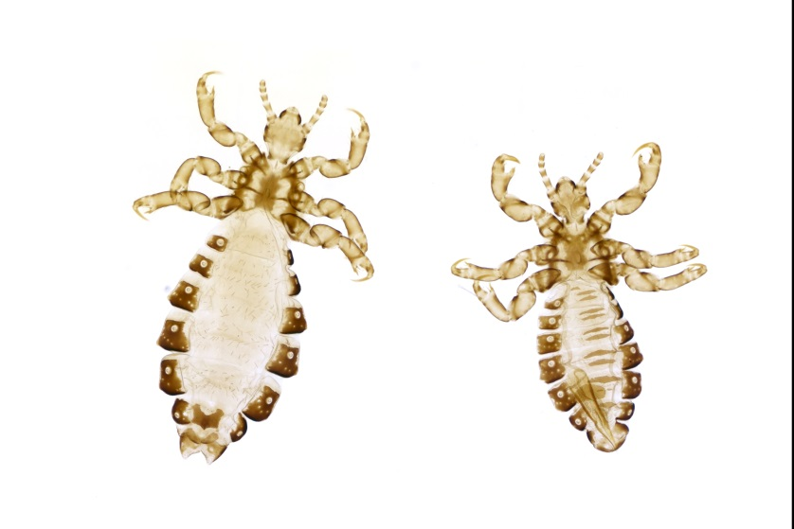
Slide digitisation 650~ 1,000 /day

Slide 12

15,000+ transcriptions for 5,000+ specimens with 1,000+ volunteers

Slide 13
98% complete
9.5% complete

Slide 14
Miniature Lives Magnified, on the Notes from Nature Platform
The Notes from Nature platform has been developed by a team from the University of Florida and SERNEC, supported by funding from the NSF, using the Panoptes open project-building tool on the Zooniverse platform.

Slide 15
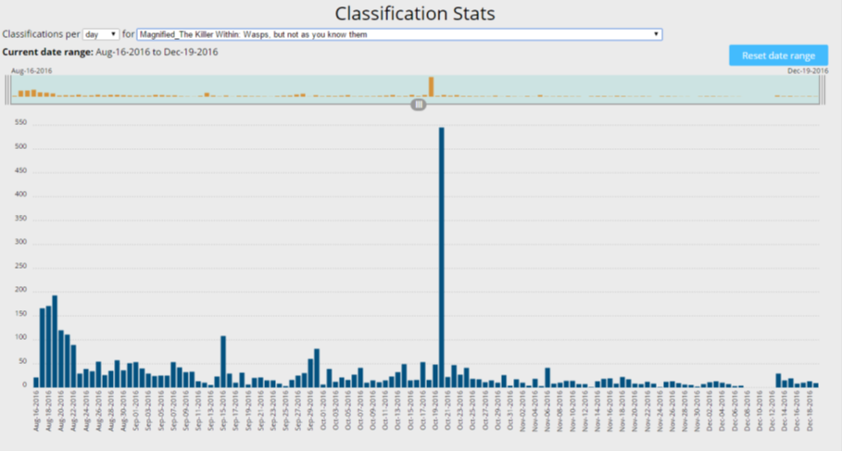

Batch #1
Aug 17th~ Jan 13th
2,097 slides
150 days
600+ participants
Batch #2
Jan 23rd ~ Mar 29th
2,097 slides
61 days
900+ participants
Batch #3
Mar 29th ~ June 5th
68 days
90%

Slide 16
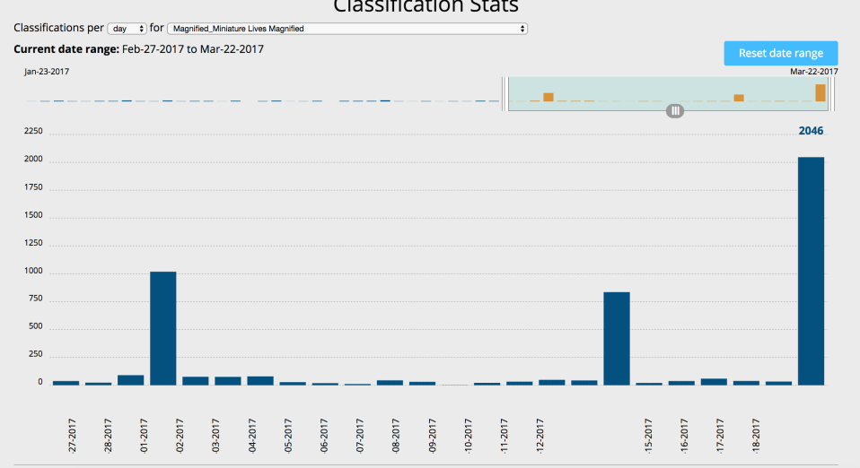
In-house ‘Visiteering’ Events
2,046

Slide 17

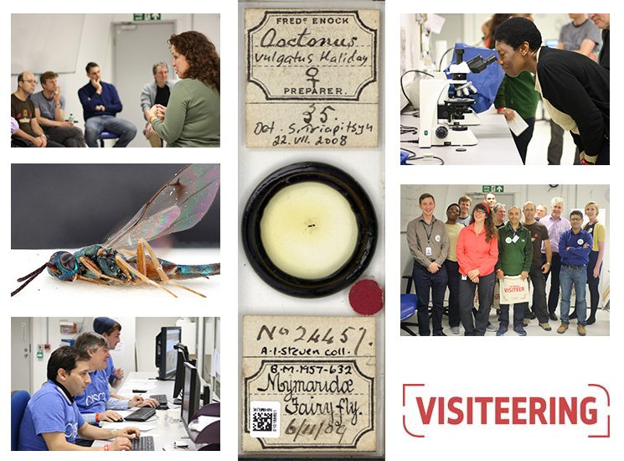
61 Visiteers / 7,000+ Classifications

Slide 18
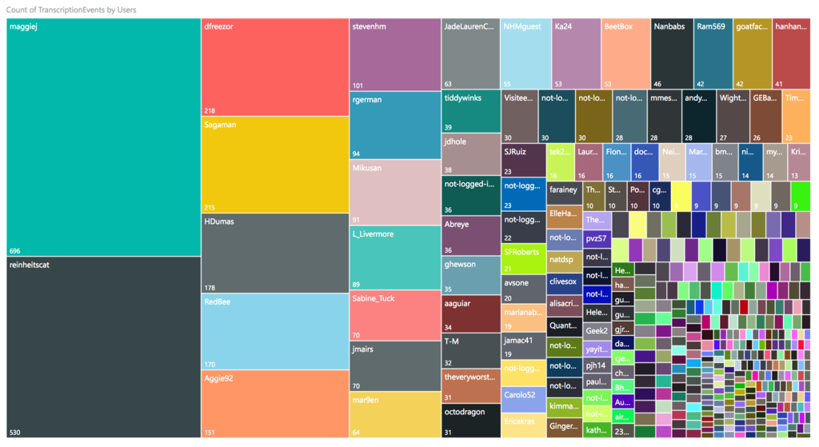
Super-Transcribers

Slide 19
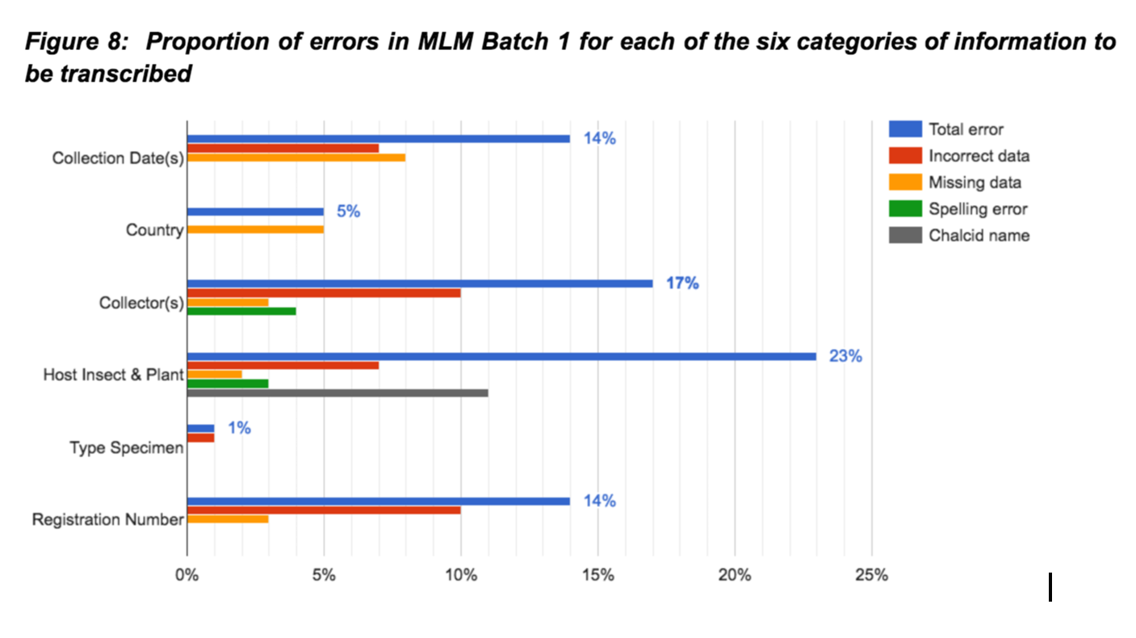
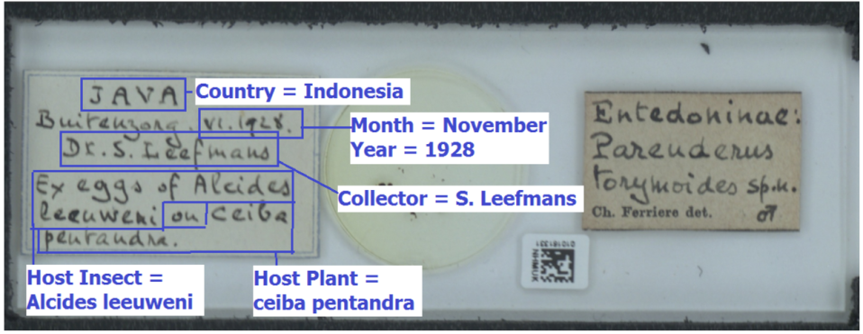

Slide 20
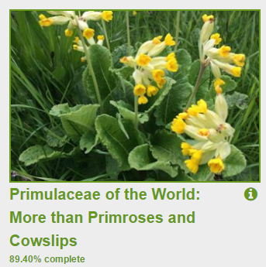
88% complete
89% complete

Slide 21
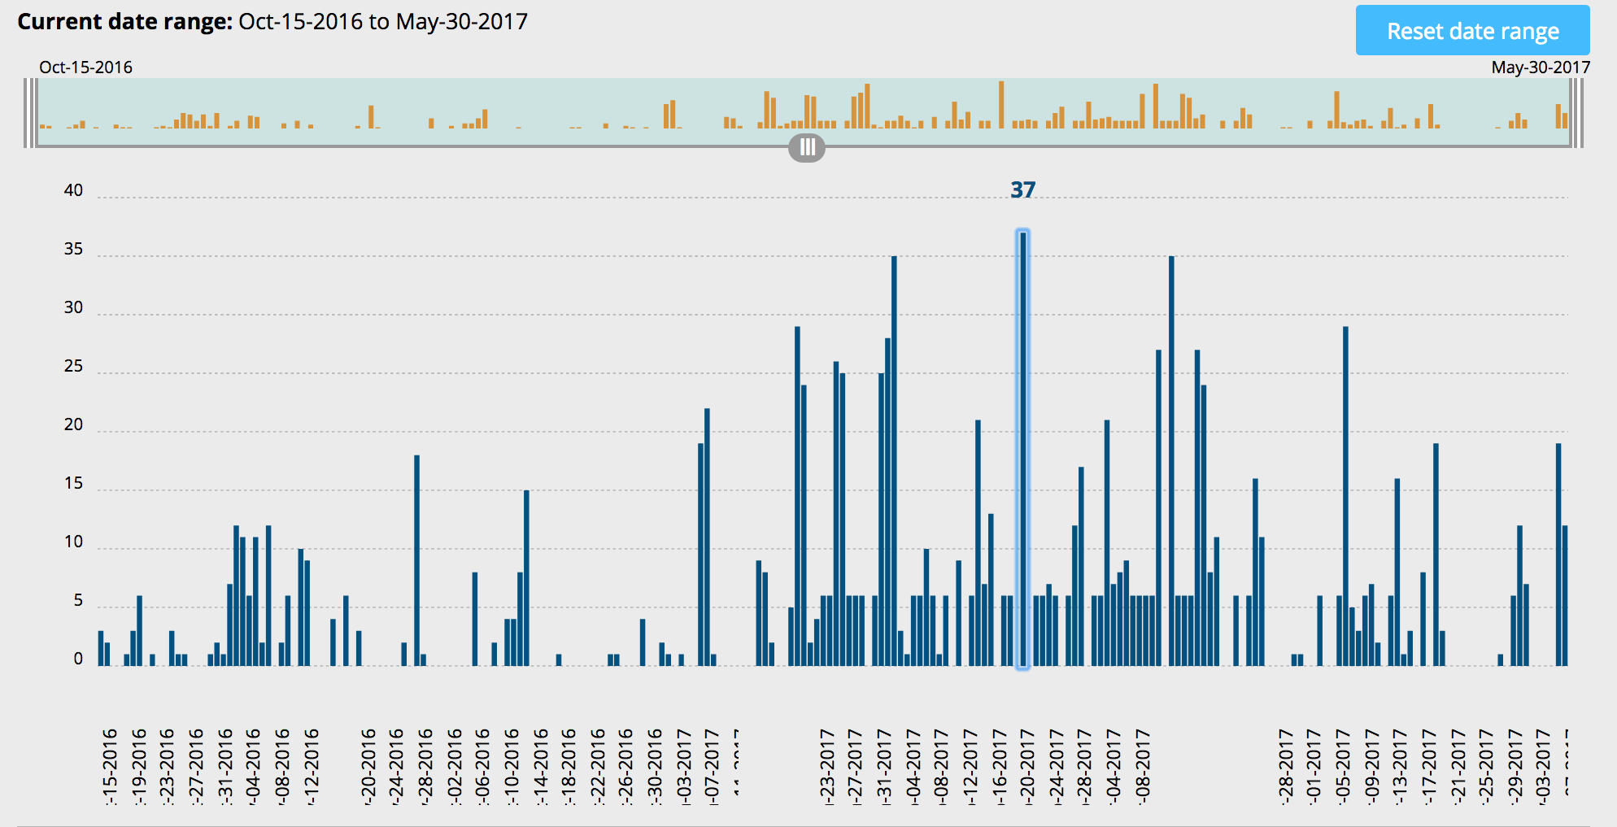
Amaranthaceae: Cosmopolitan Allrounder
37
88% complete

Slide 22
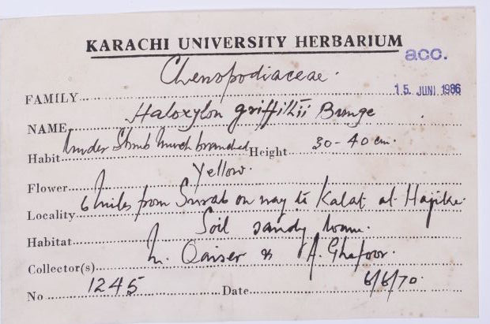

Slide 23
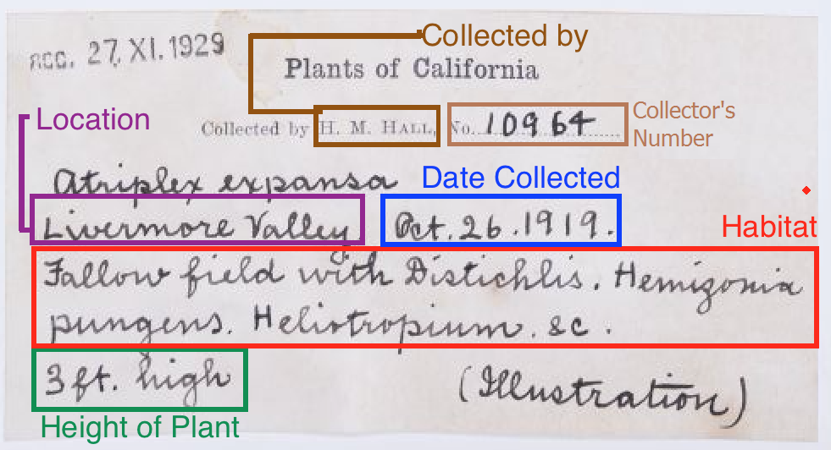

Slide 24
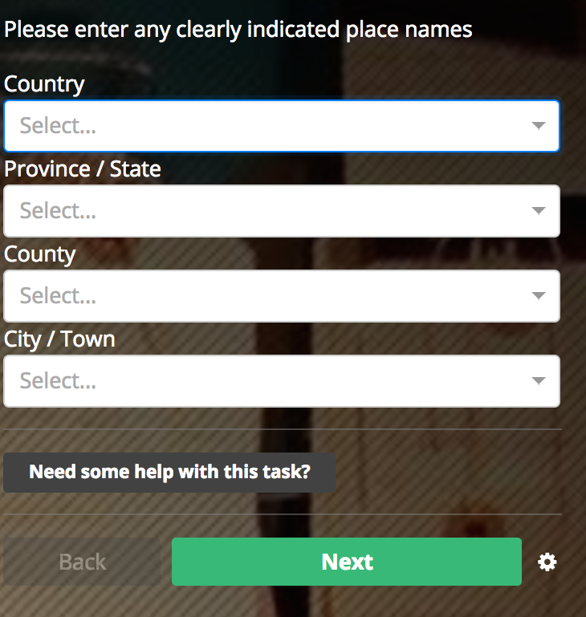
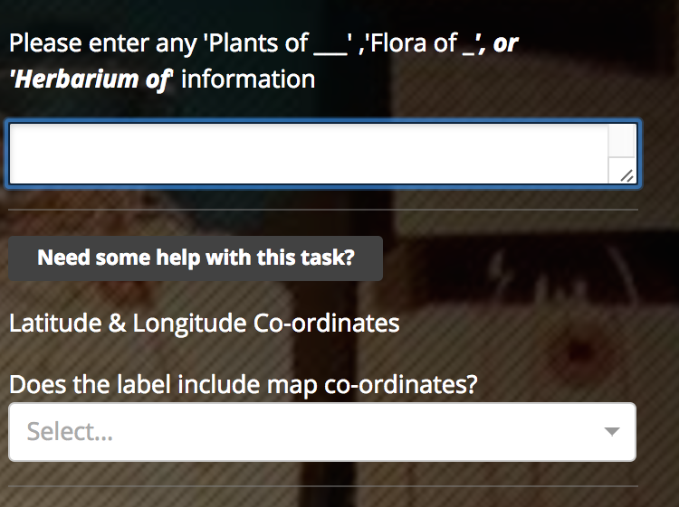
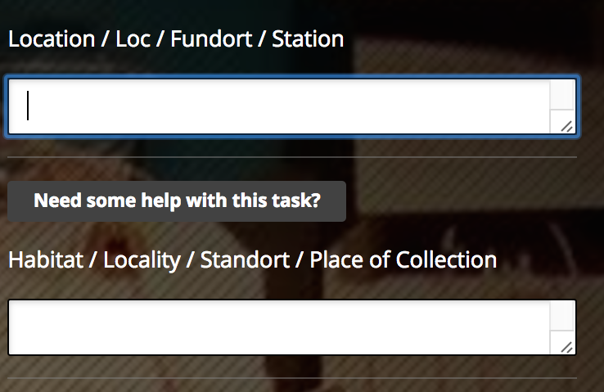
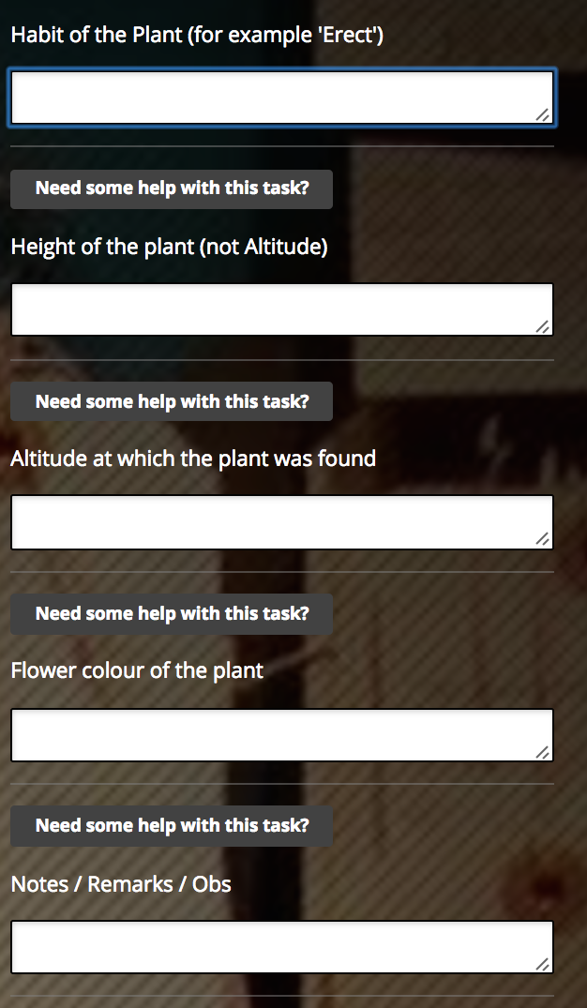
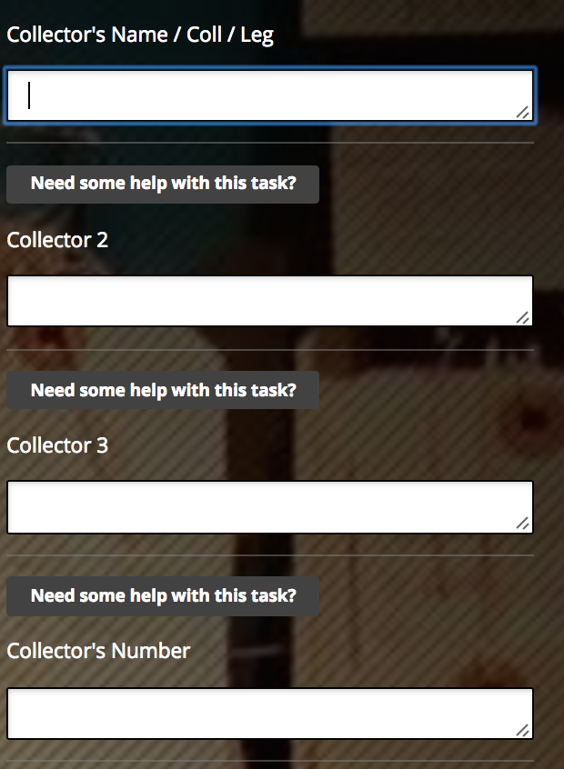


Slide 25
88% complete
89% complete

Slide 26

Primulaceae of the World: More than Primroses and Cowslips
111
90% complete

Slide 27



Slide 28





Slide 29
98% complete
9.5% complete

Slide 30

Miniature Fossils Magnified

Slide 31
Batch #1 Apr 29th~ May10th
204
157 slides
12 days
38 participants
Batch #2 May 14th~ Jun 5th
59
1,000 slides
22 days / 9%

Slide 32

Reduce Error with Drop-downs

Slide 33



Exploring Tropical Sweden
91% complete

Slide 34
Exploring Tropical Sweden
1364
903 images / 91% complete / 125 Volunteers

Slide 35


Slide 36
Exploring Tropical Sweden - Talk
44
31

Slide 37

So how did we fare?
The aim of the JRA is to improve the quality of and increase access to digital collections and data within NH institutions’ virtual collections

Slide 38

“Eventually I found an article dated around 1930 mentioning entomologist G. Carpenter doing research on Tse Tse flies on several islands in north Victoria Lake belonging to Uganda.
It specifically lists Wema Island as one of these islands he was visiting and catching specimens on.
If you Google "wema island lake Victoria carpenter” you'll come across the article.
Since the name & era matched the image listing Wema Island and I didn't think there were that many entomologists named "G Garpenter" setting foot on an island called Wema in the early 20th century I was pretty convinced the country should be Uganda.”

Slide 39

“Am I the only one here who's been inspired by the specimens we see here to try to learn more about the plants around me and how they work?
Take some photos and post them here to show us what's growing in your part of the world, and join me in trying to learn a little botany from what we see.
…To kick off summer, here's a gallery of Iris photos (same common name and scientific name) I took yesterday and today in my neighborhood.
….I found this short article from the US Forest Service about Irises native to the US, with photos of a few”

Slide 40

“Can I do more of these at home?”
“Wow, that really blew my mind!”

Slide 41


Gustav VI Adolf
King of Sweden

Slide 42



Slide 43

Access Behind the Scenes

Slide 44
Notes:
CKAN from the OKFN
Open Source on GitHub
MapQuest & Open Street Map
Built on APIs

Slide 45


Slide 46


Slide 48


Slide 49


Slide 50


Slide 51


