Slide 1
Zoosphere
Insects in „3D“
Bernhard Schurian
Notes:
Option 1

Slide 2
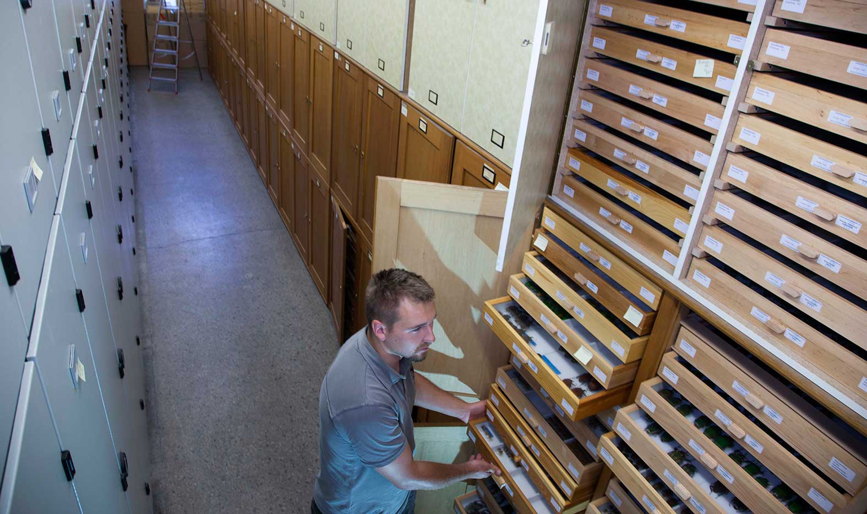
Entomology Collection
2.000 cabinets
~ 35.000 insect drawers
~ 15 Mio. single objects
~ 50.000 primary types

Slide 3
Entomology Collection
Lepidoptera 4 Mio
Diptera 1,3 Mio
Hemiptera,….
Hymenoptera
2,3 Mio
Coleoptera 6 Mio

Slide 4
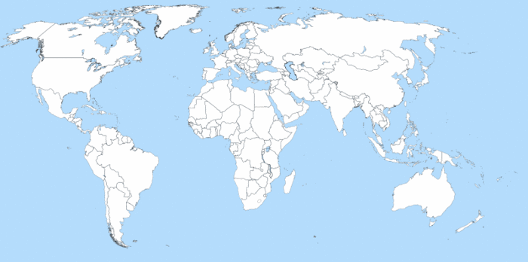
Taxonomic research
Type material
time consuming
expensiv
bureaucratic obstacles
original object

Slide 5
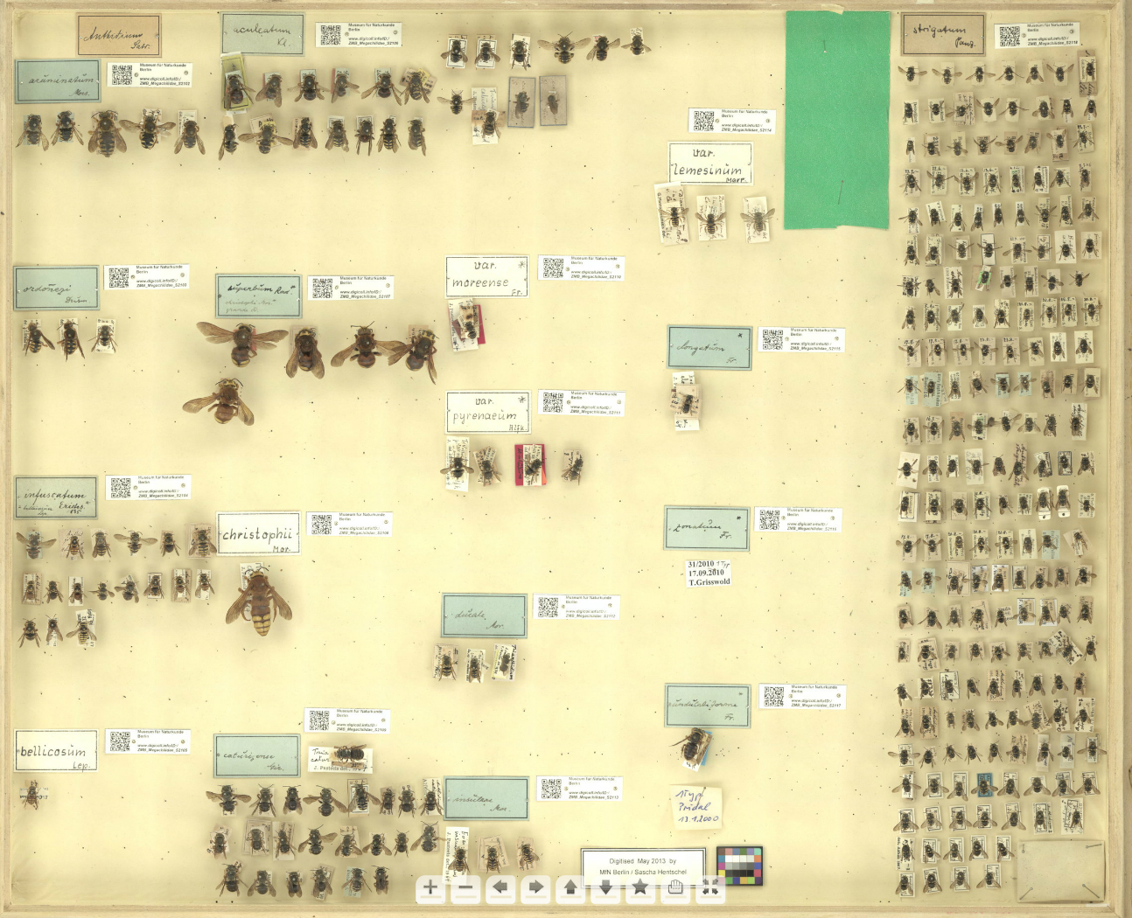
Entomology Collection Insect drawer

Slide 6
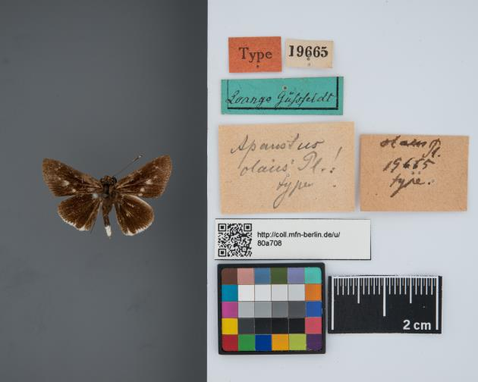
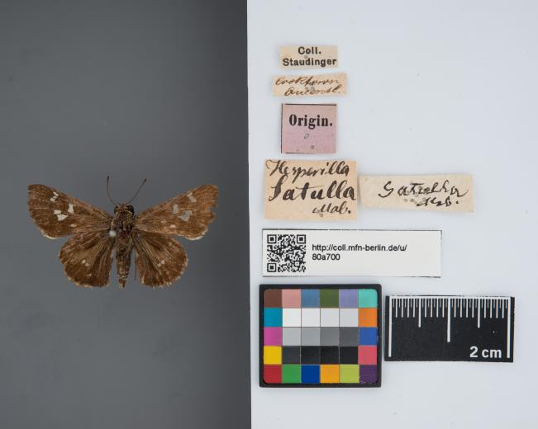
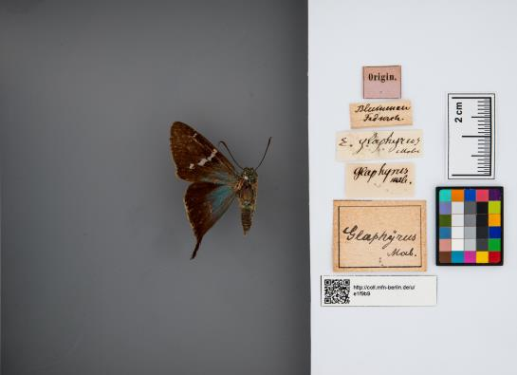
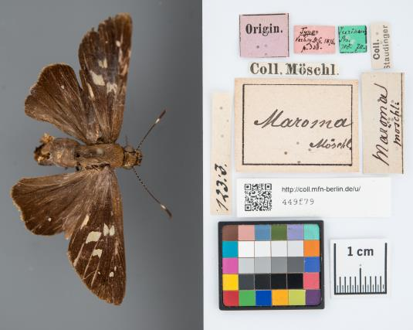
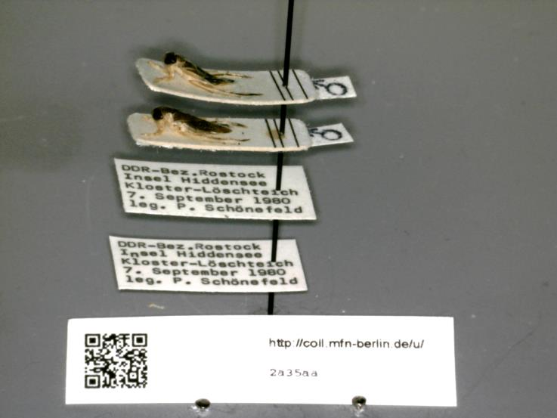
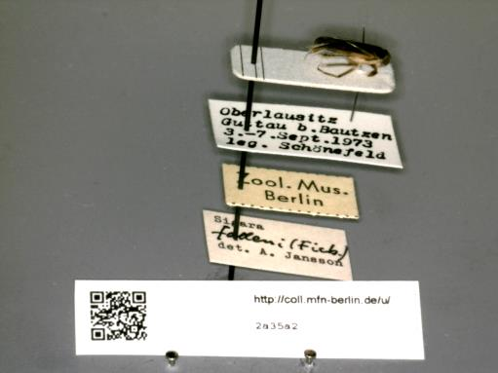
Entomology Collection Label information

Slide 7
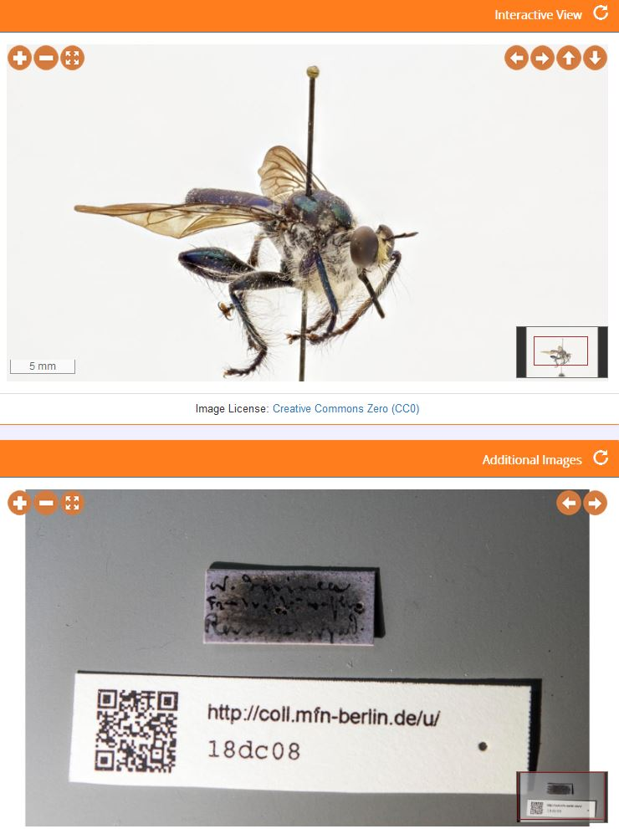
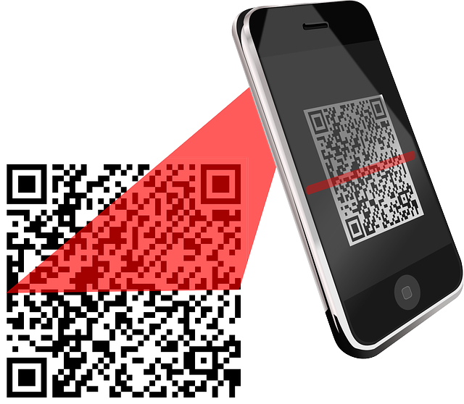
Support of collection management
Link between real object and digital data should not be lost
QR-Code („Quick Response“) as connection
http://coll.mfn-berlin.de/u/18dc08

Slide 8
URI‘s
A generally recommended URI pattern:
http://subdomain.yourdomain.org/path/variable-identifier
The MfN will use:
http://coll.mfn-berlin.de/u/ZMB_123

Slide 9
Developing a system for automated spherical image capturing and interactive 3D visualization of biological collection objects
Authors:
Martin Pluta
Alexander Kroupa
Falko Glöckler
Felix Maier
Bernhard Schurian
Notes:
Option 1

Slide 10
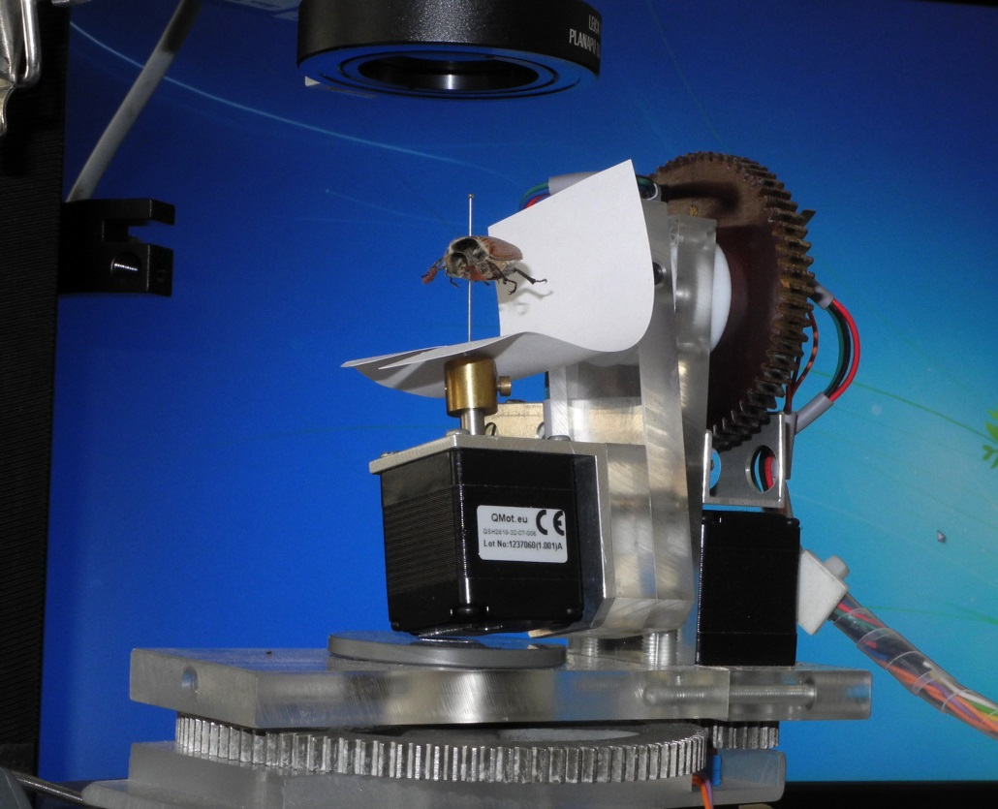
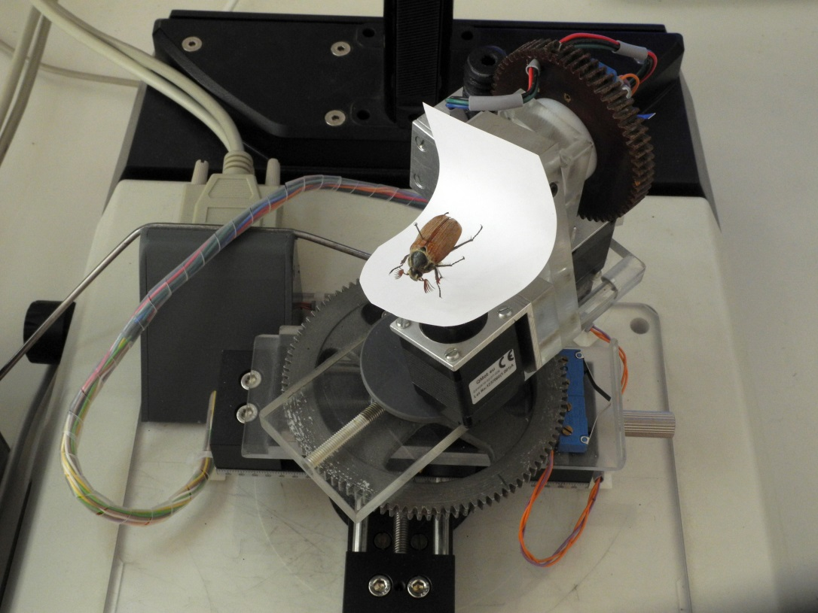
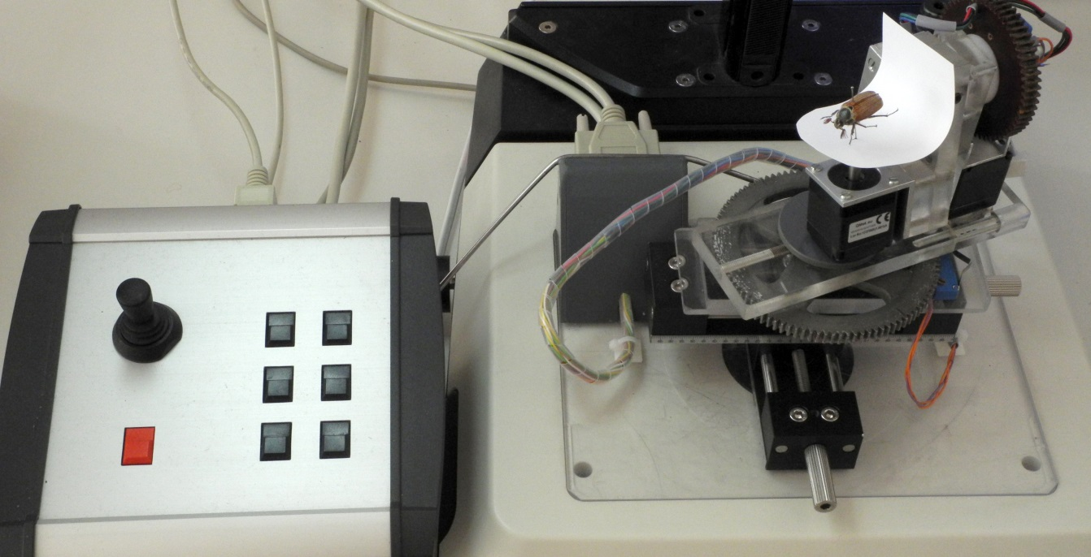
Zoosphere 1.0
Each perspective in with 3 linear motors
Stacking-Technology
SLR customer Camera and professional Flash unit
Algorithm for control

Slide 11
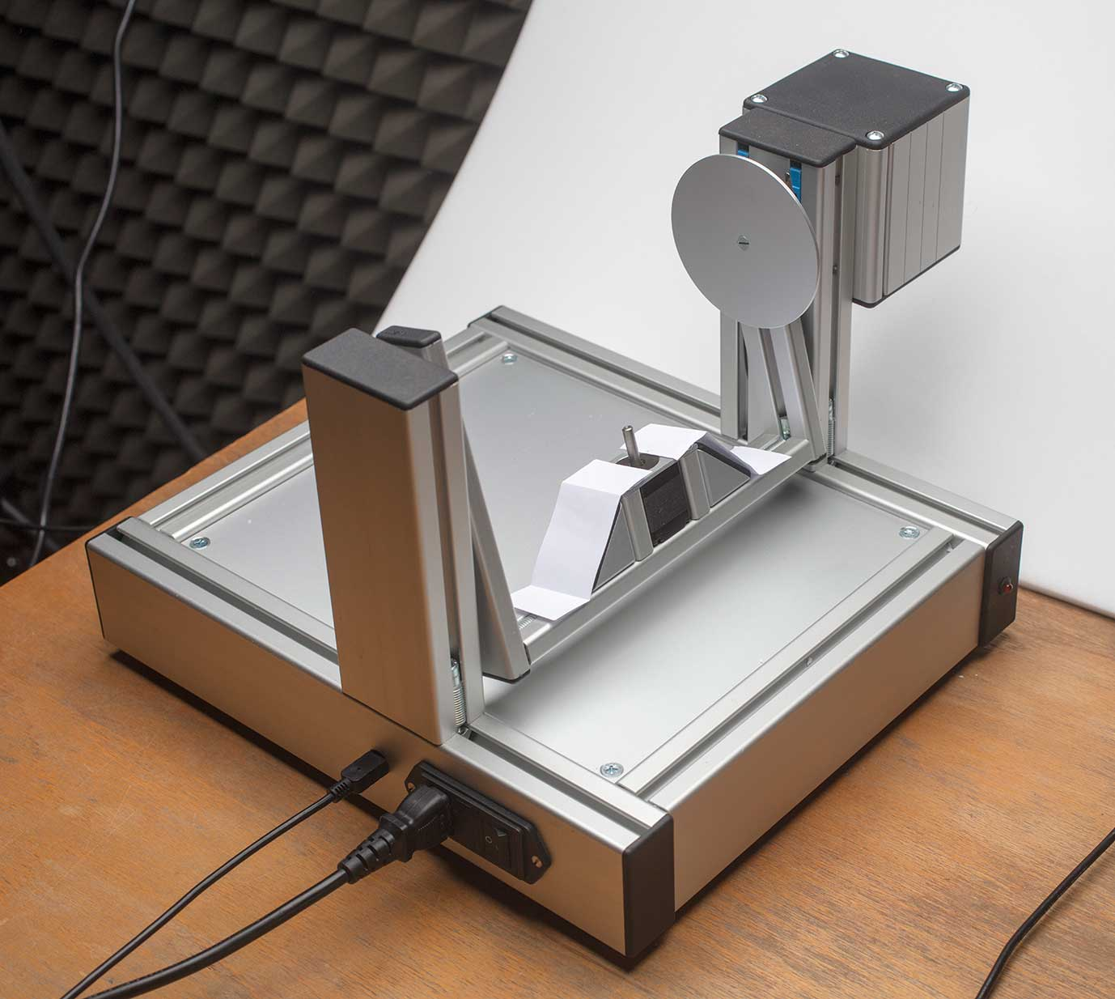
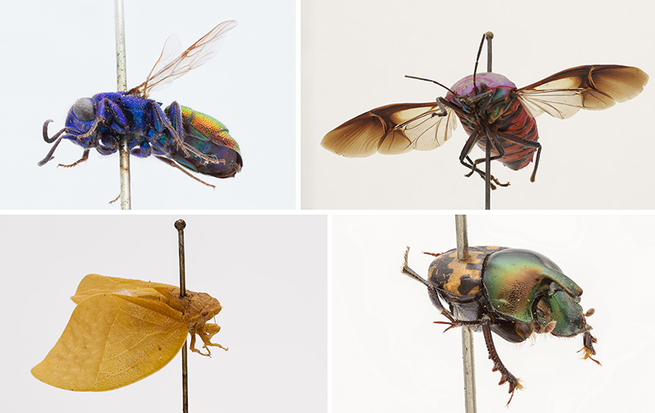
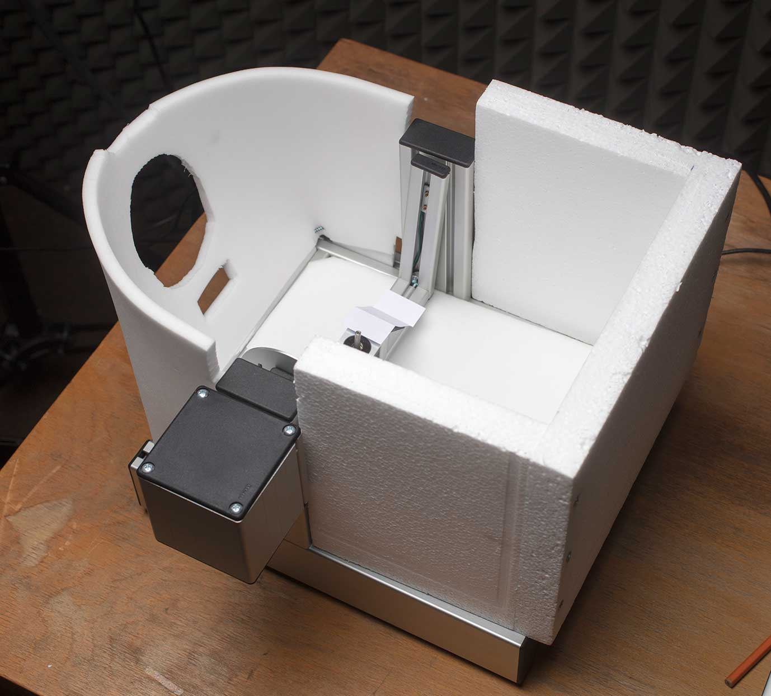
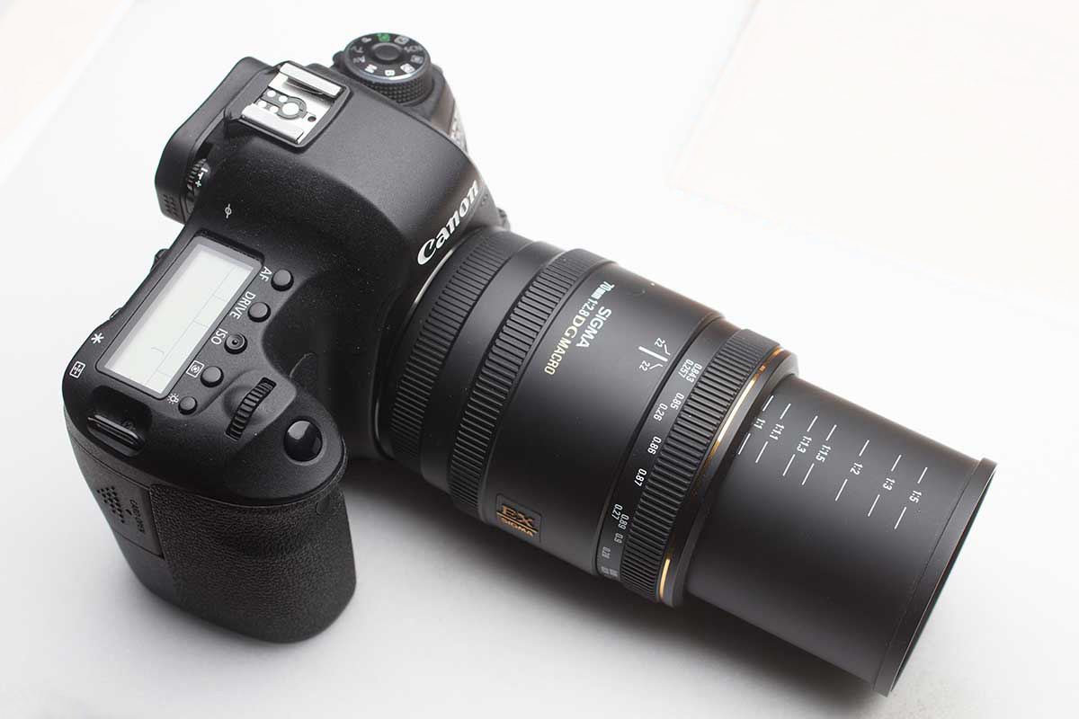
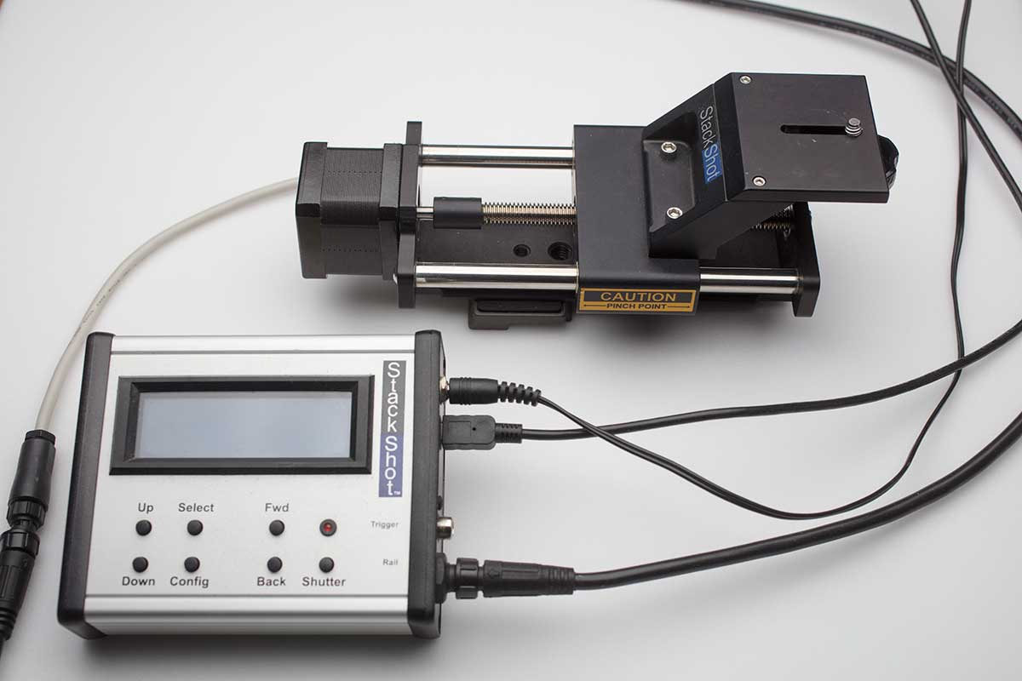
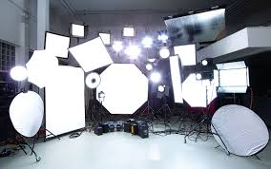
Zoosphere 2.0
Hardware

Slide 12
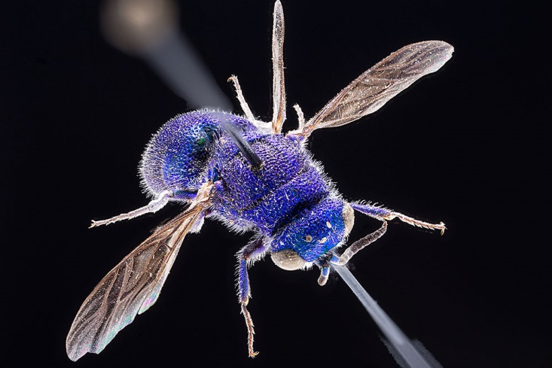
Stacking

Slide 13
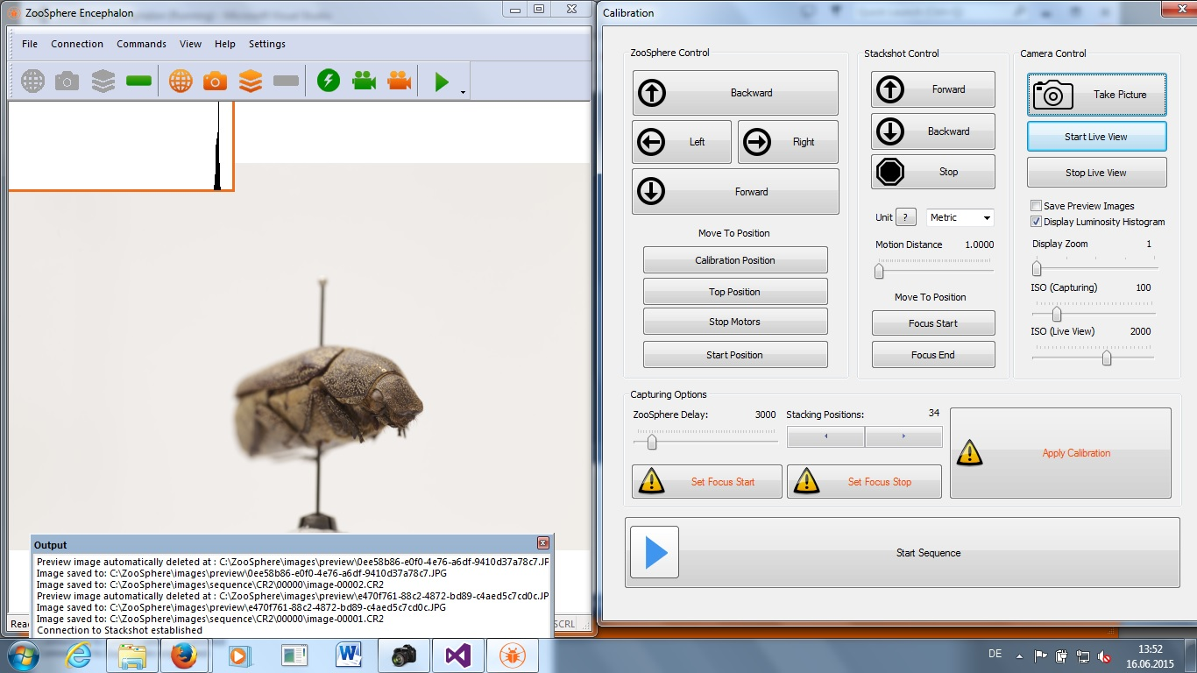
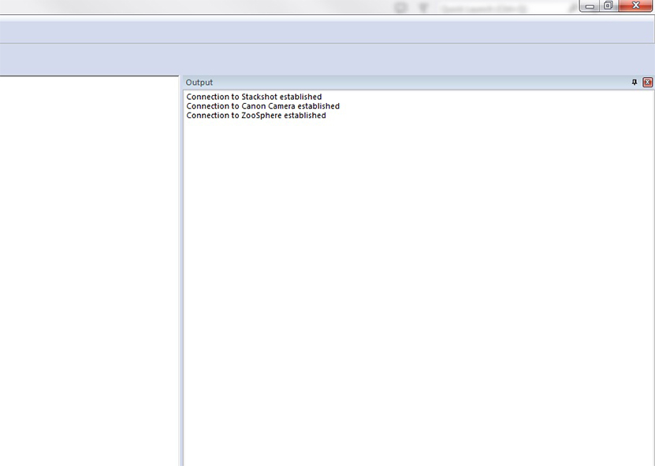
Software Zoosphere Encephalon
Step 1: connection of devices

Slide 14
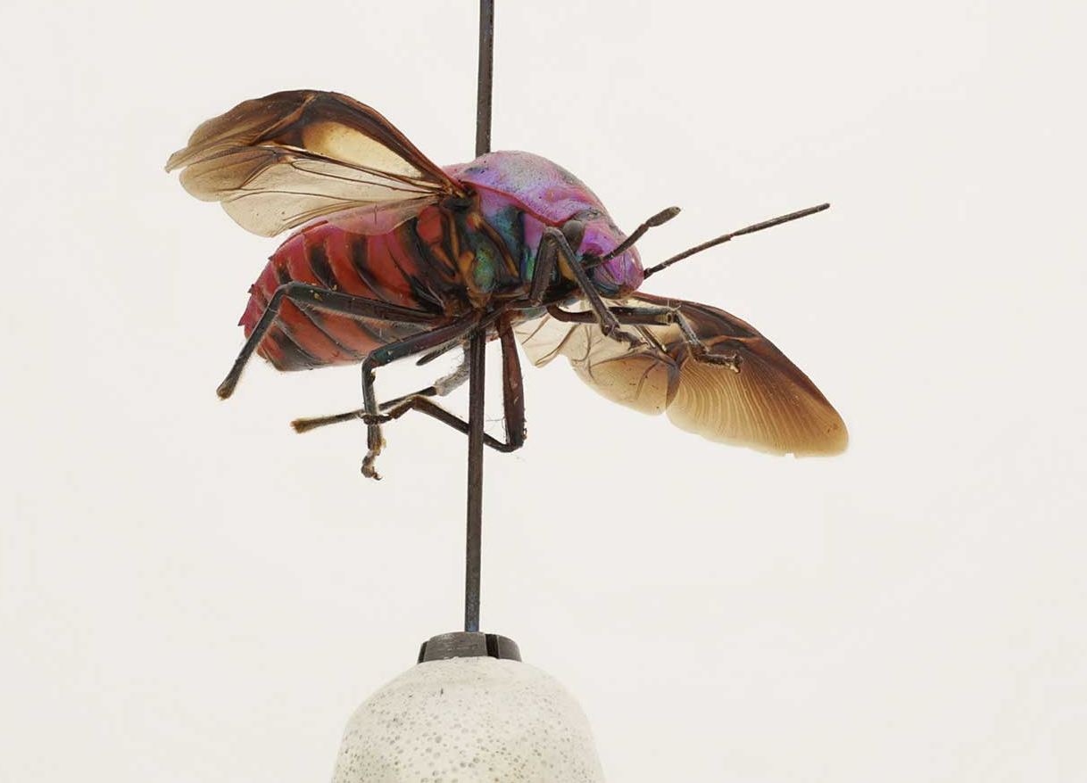
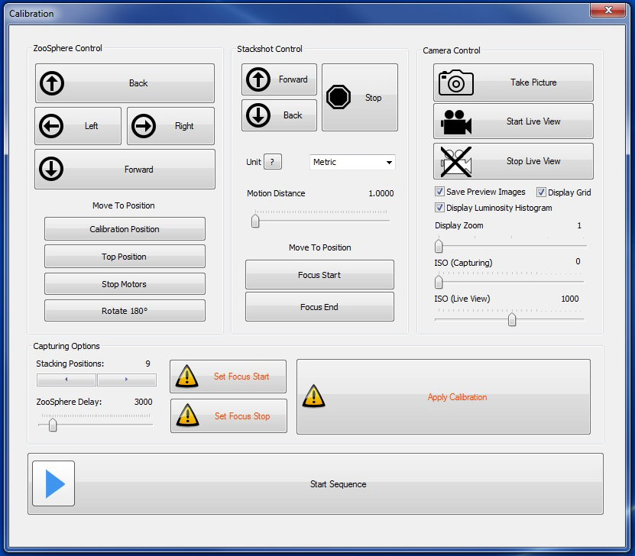
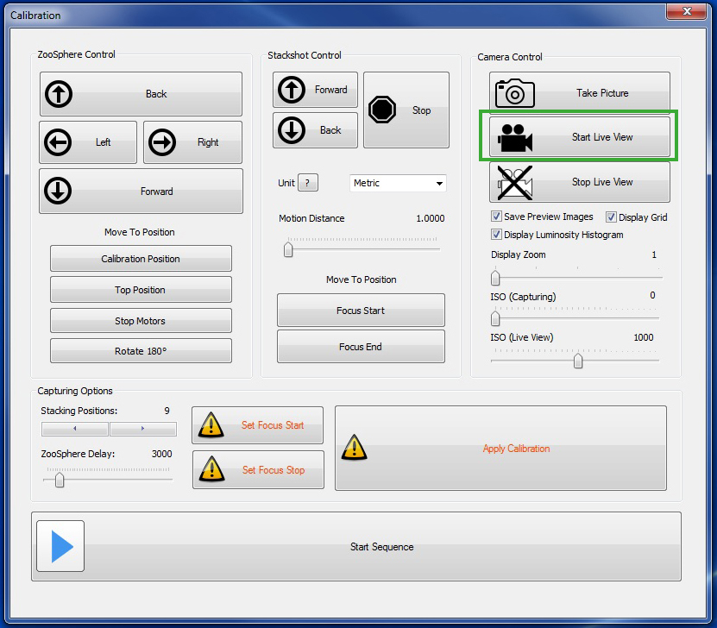
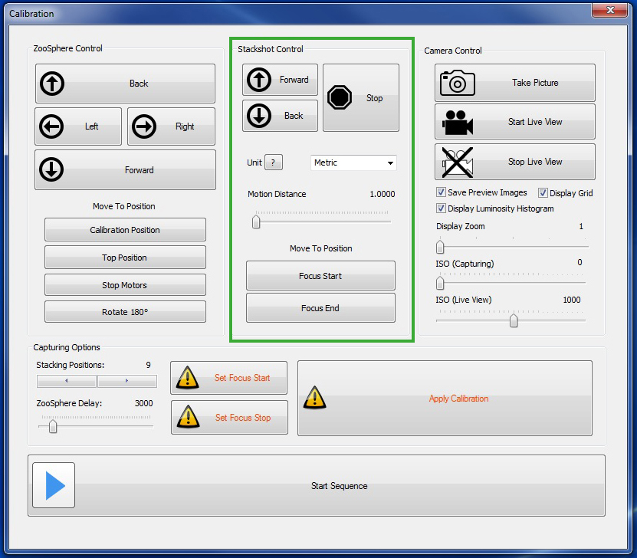
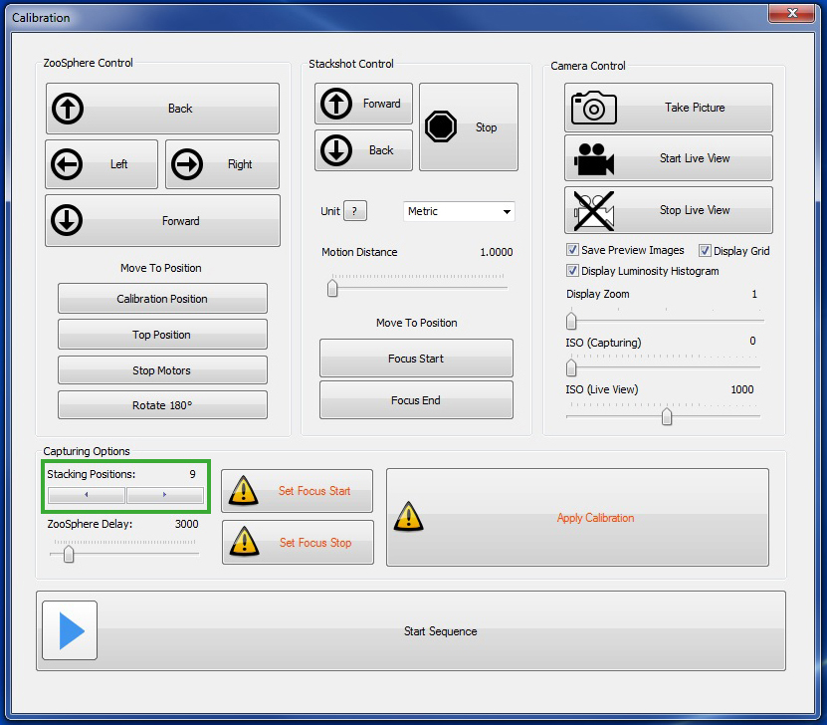
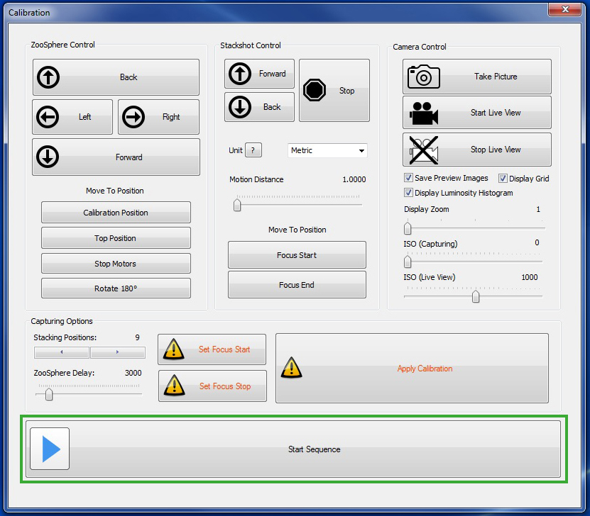
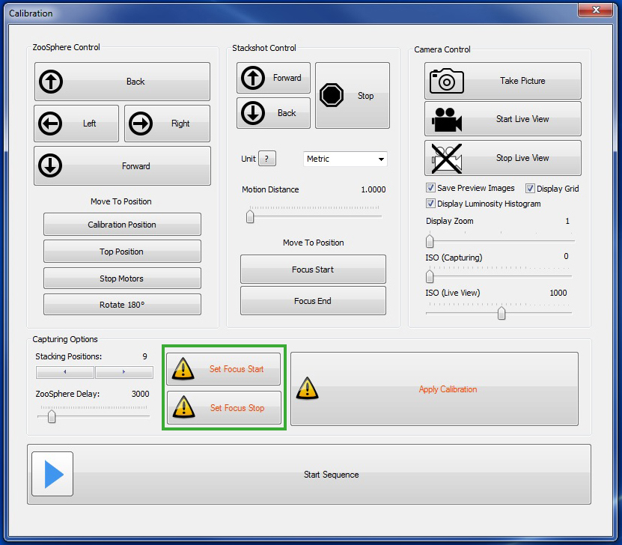
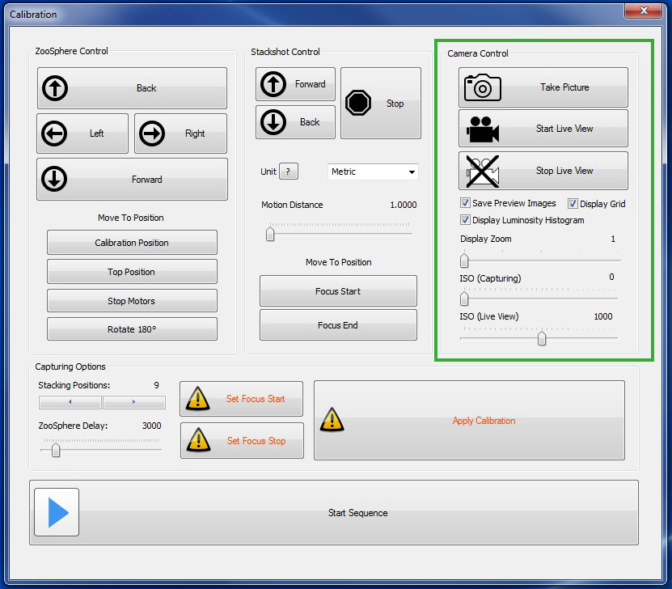
Zoosphere Encephalon
Step 2: calibration

Slide 15
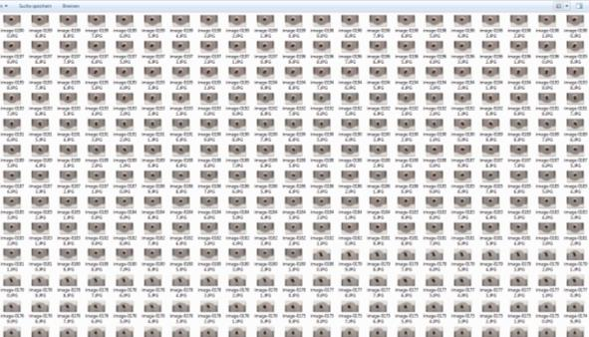
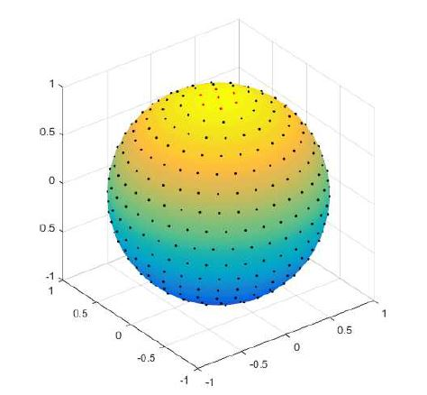
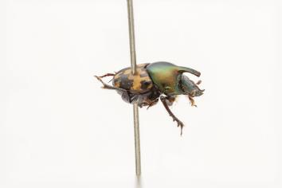
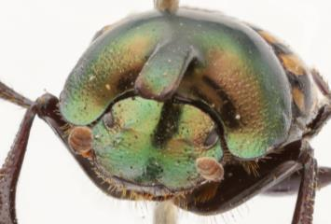
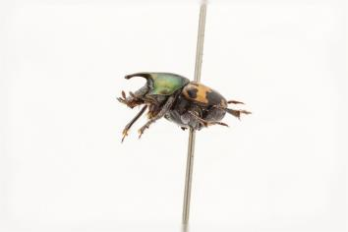
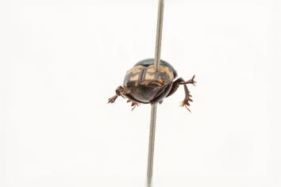
Zoosphere imaging process
2.000-6.000 Images
→ 100-144 stacked Positions

Slide 16
Data Size
2D Digitization SatScan
Original Images 1 GB
Tiff file 400 MB ________ 1.5 GB
ZooSphere
Original Images 50 GB
Stacked Images 100 MB
Webversion 50 MB
________
~ 50,15 GB
* 10.000 Objects
= 14.6 TB
* 100 Objects
= 4.8 TB

Slide 17
Zoosphere
Step 4: zoosphere tools

Slide 18
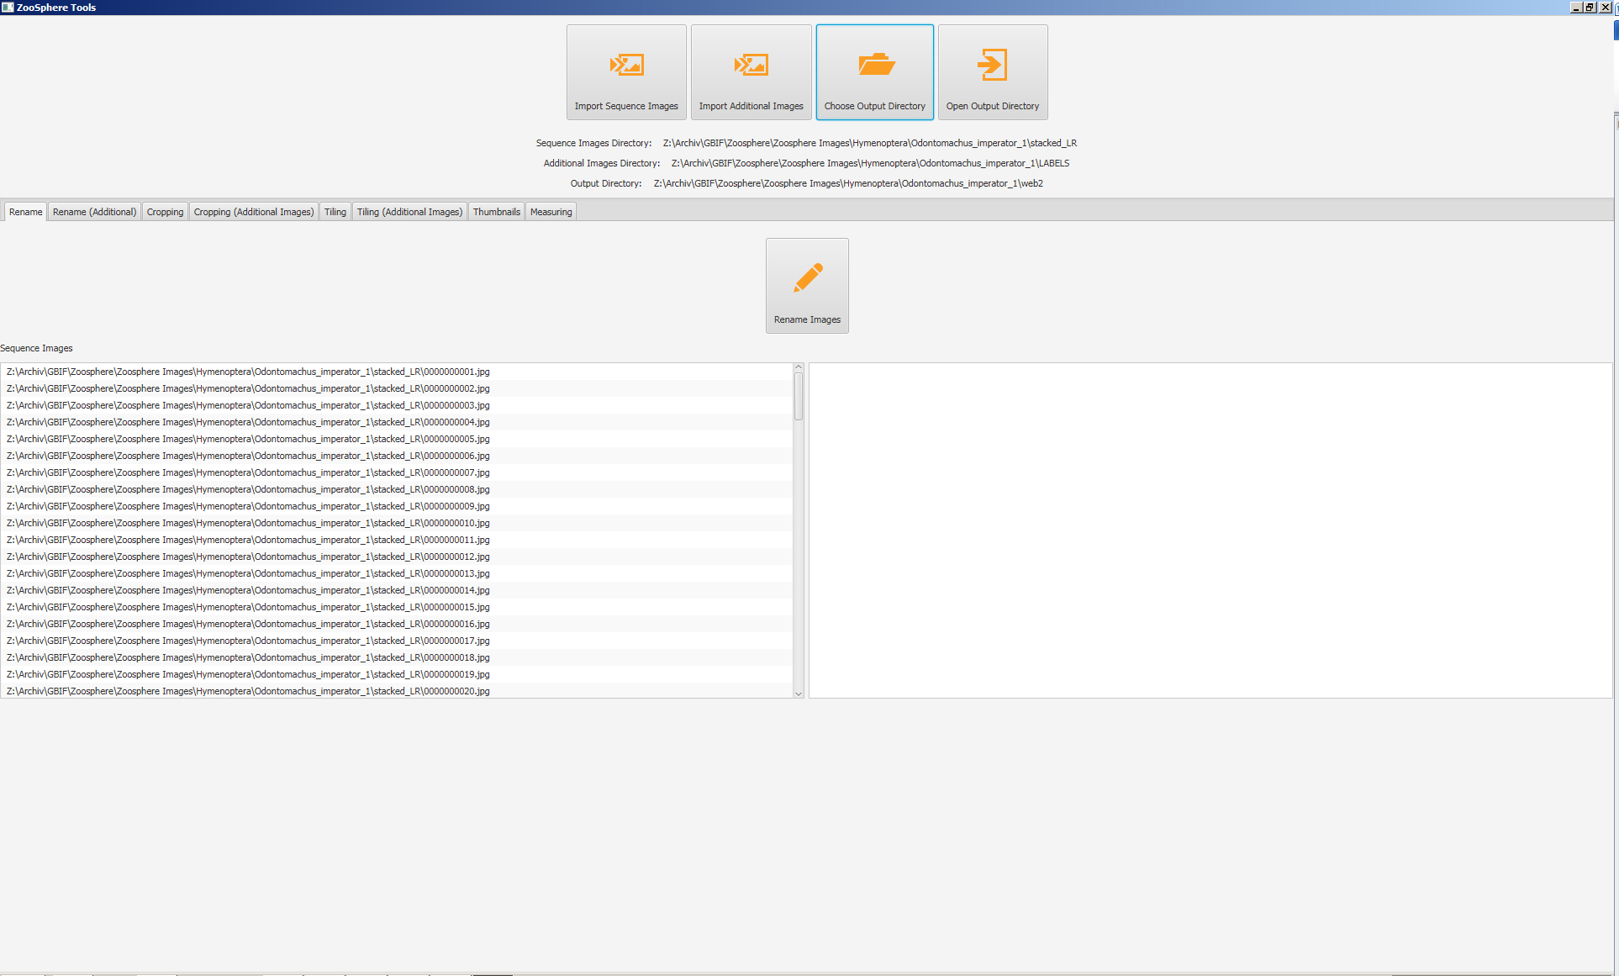
Zoosphere Tools
Data import
Renaming
Tiling

Slide 19
Zoosphere Tools
Front image
Scale bar

Slide 20
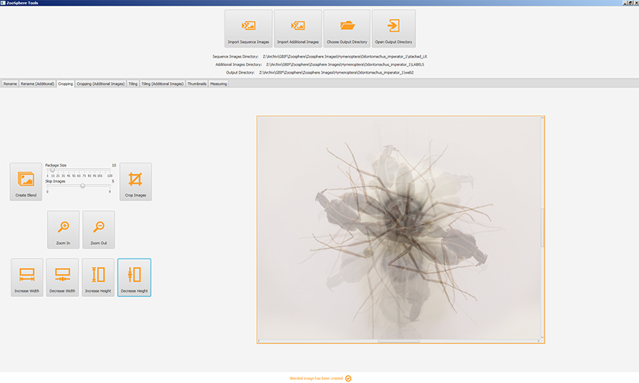
Zoosphere Tools
Image centering
Cropping
Taxonomic Data
Upload to Website

Slide 21
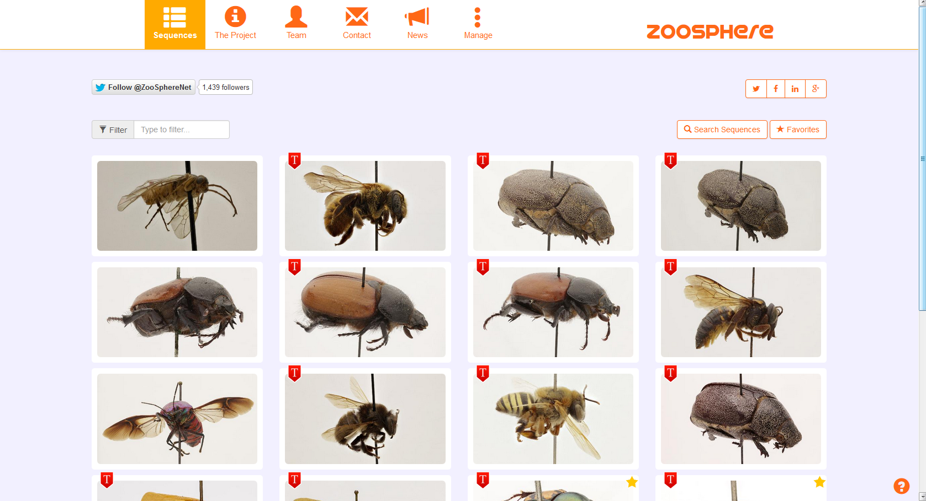
Free Access
www.zoosphere.net

Slide 22
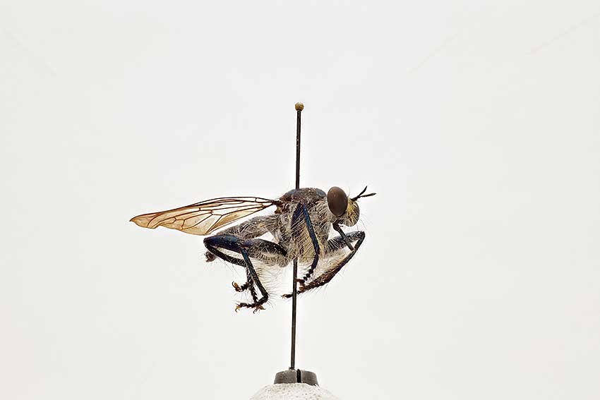
Zoosphere

Slide 23
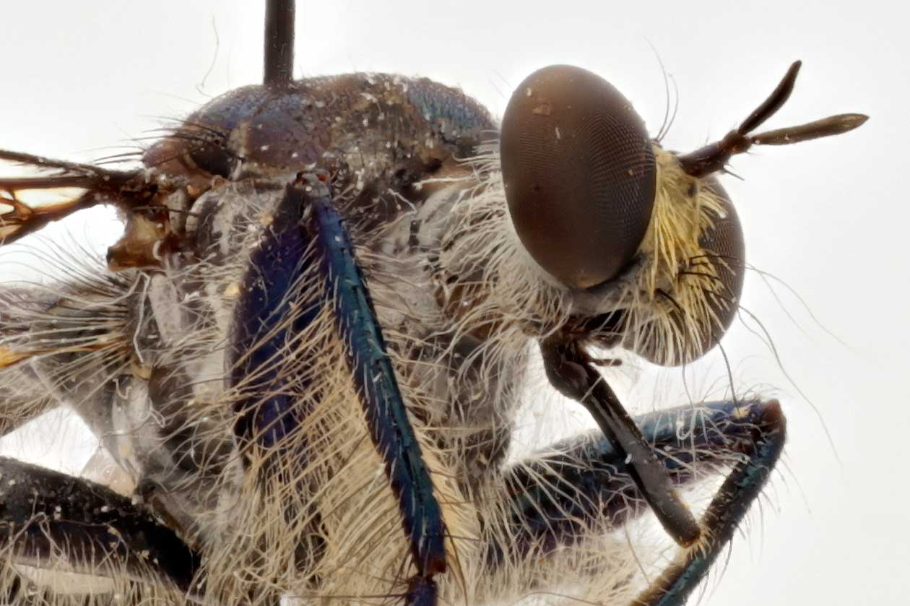
Zoosphere

Slide 24
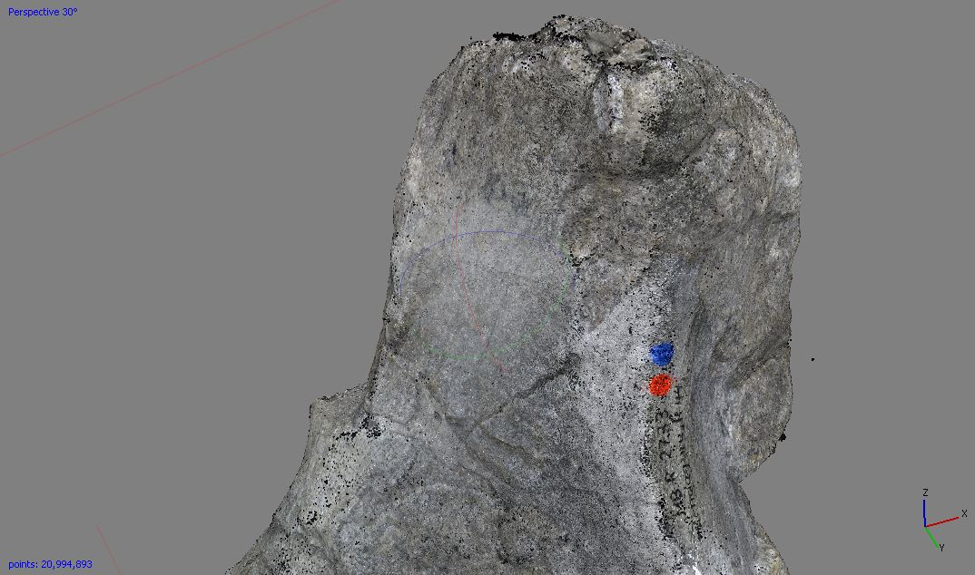
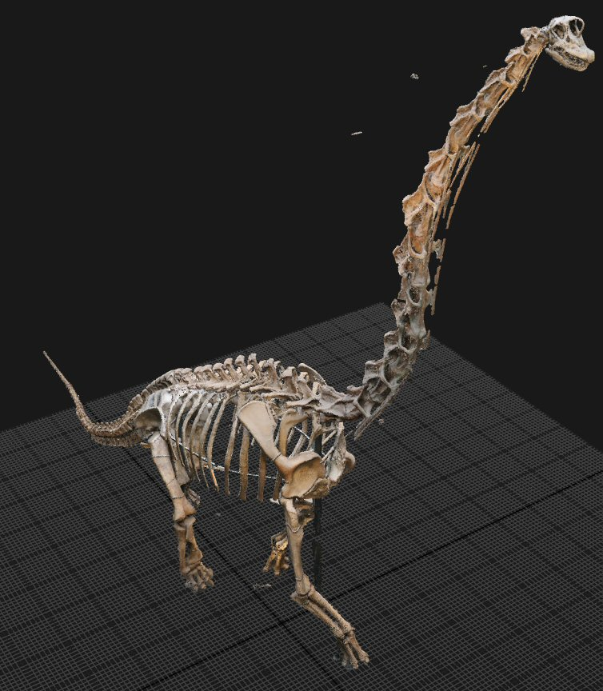
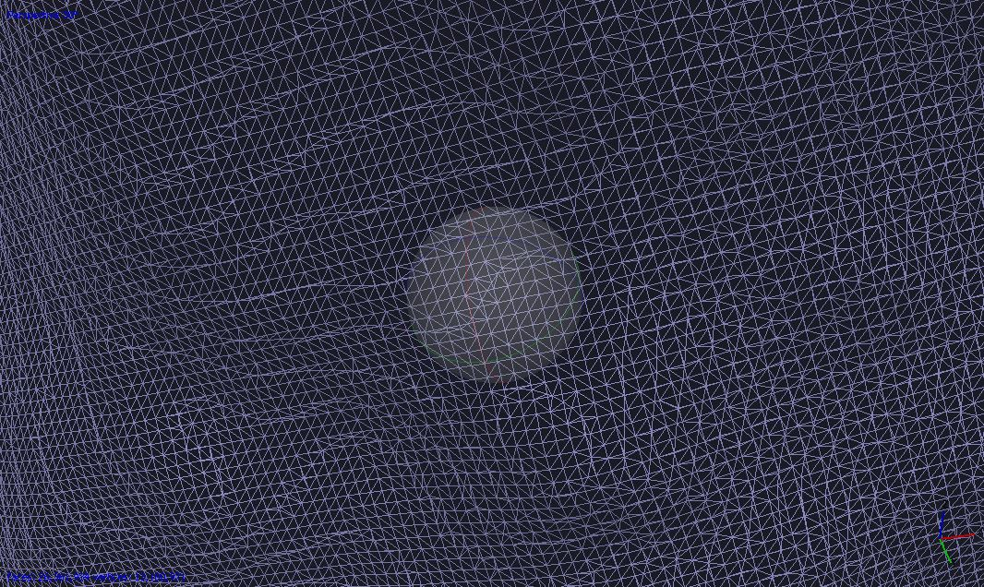
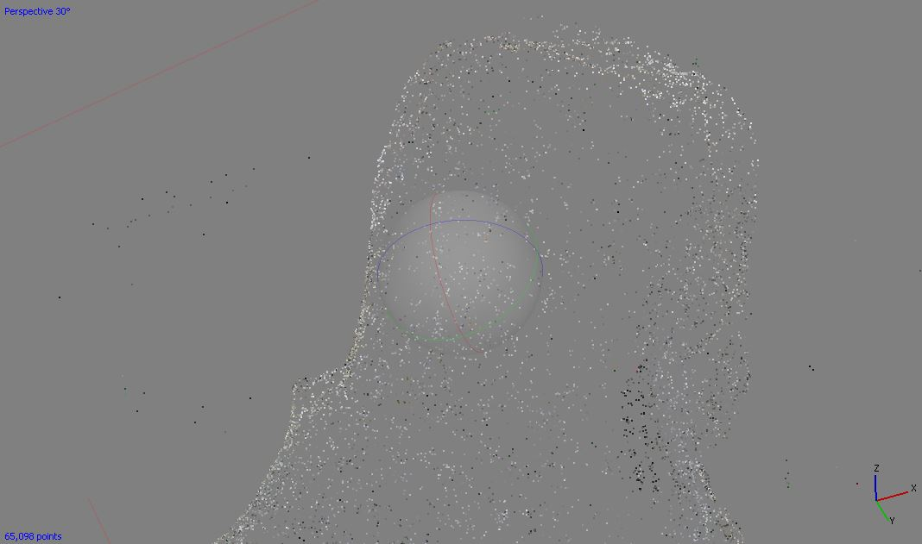
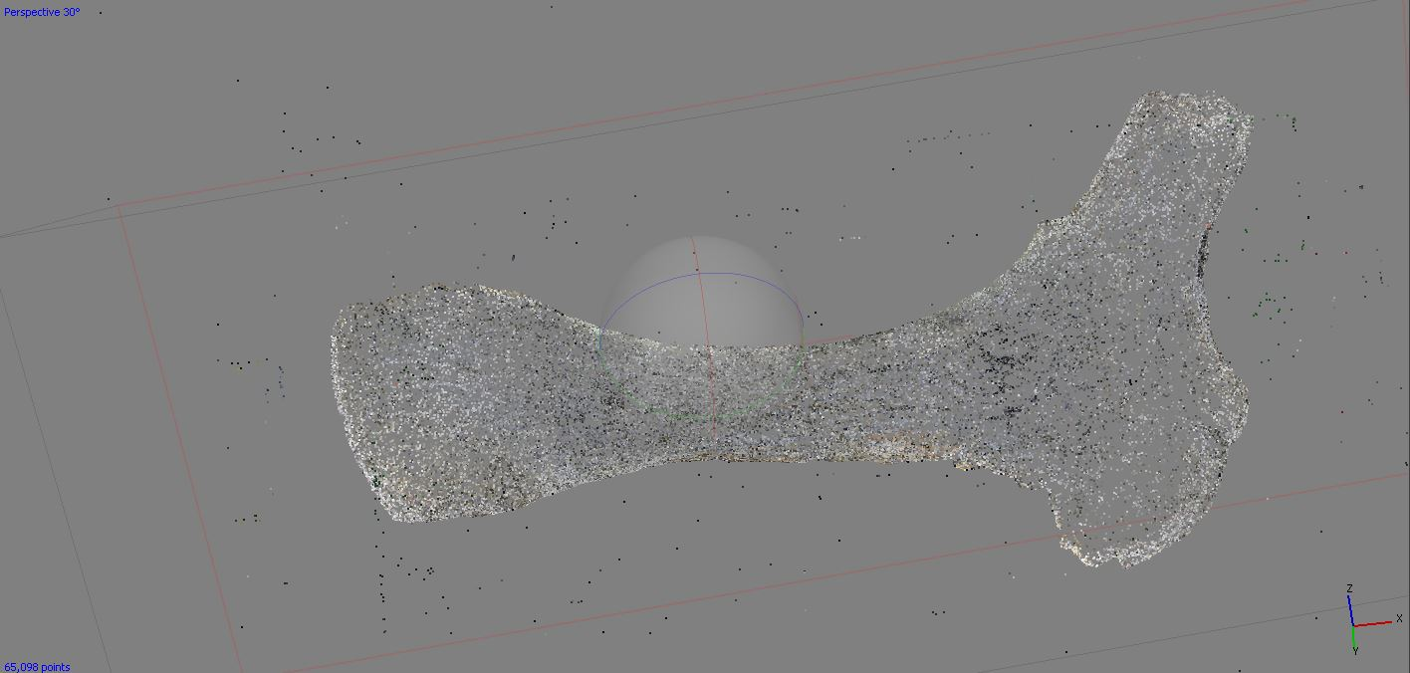
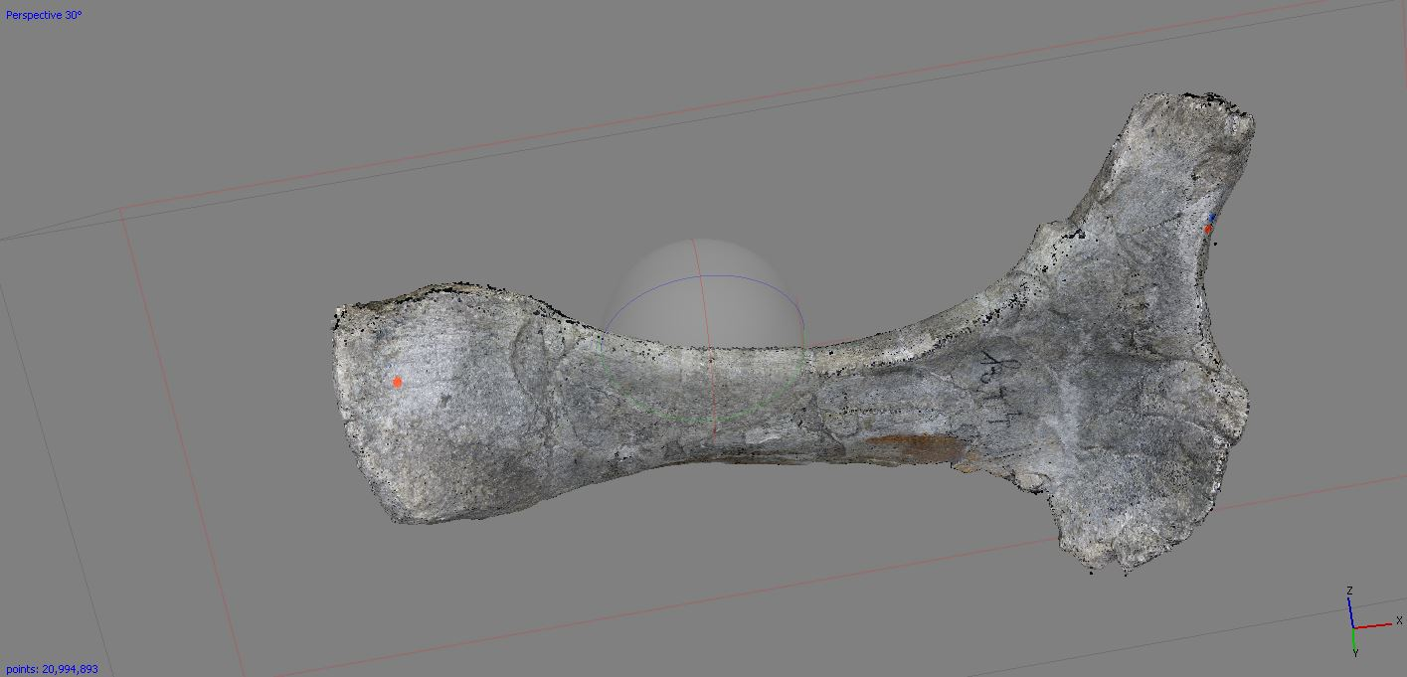
Photogrammetry:
What is a 3D Object?
Dense cloud
Wire frames / Polygones
Mesh

Slide 25
Zoosphere:
Competing System
Darmstädter Insektenscanner
Insect Scanner from Darmstadt
By Ströbel & Justice
from
Darmstadt University of Applied Science

Slide 26
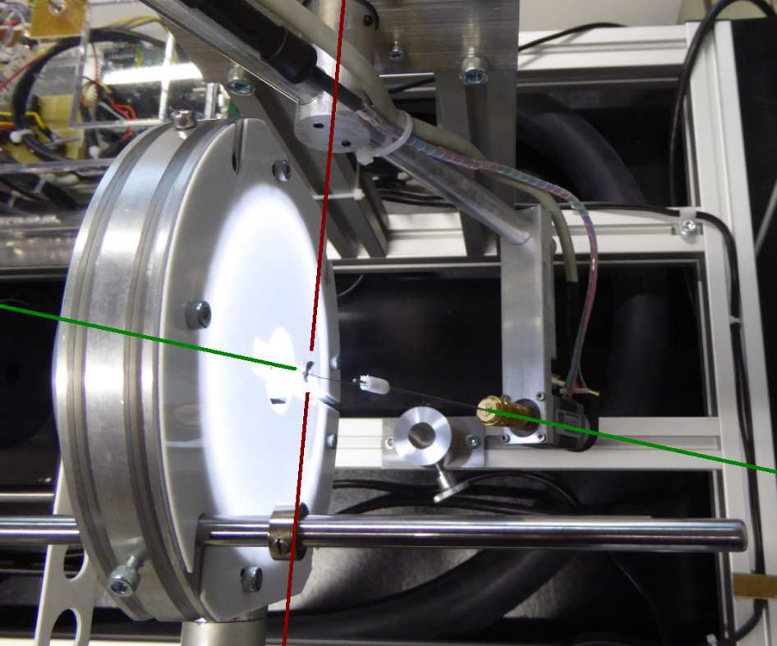
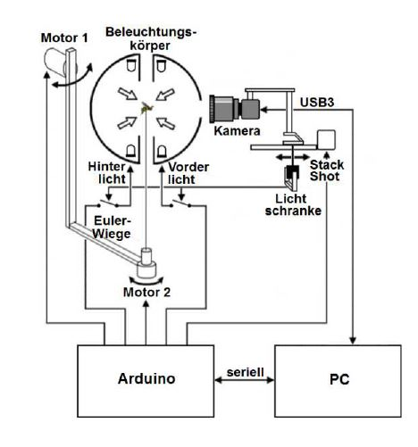
Darmstaedter Insektenscanner
"Shape from Silhouette"
398 positions
"Structure from Motion"

Slide 27
Insect Scanner from Darmstadt

Slide 28
Vision
Comparison of type specimens, independent on museum hosting the specimens
Less loans and shippings of types
Global access of digital type specimens
Facilitate global scientific research
Improve, accelerate access to collections
Support of Collection Management

Slide 29
Image sources: Zooshpere, Schurian, Mallison, marks.hn, Ströbel & Justice, Wikipedia
Questions ?

