Slide 1
Inselect:
liberating specimen images from multi-specimen scans with flexible metadata collection
Steen Dupont & Ben Price

Slide 2
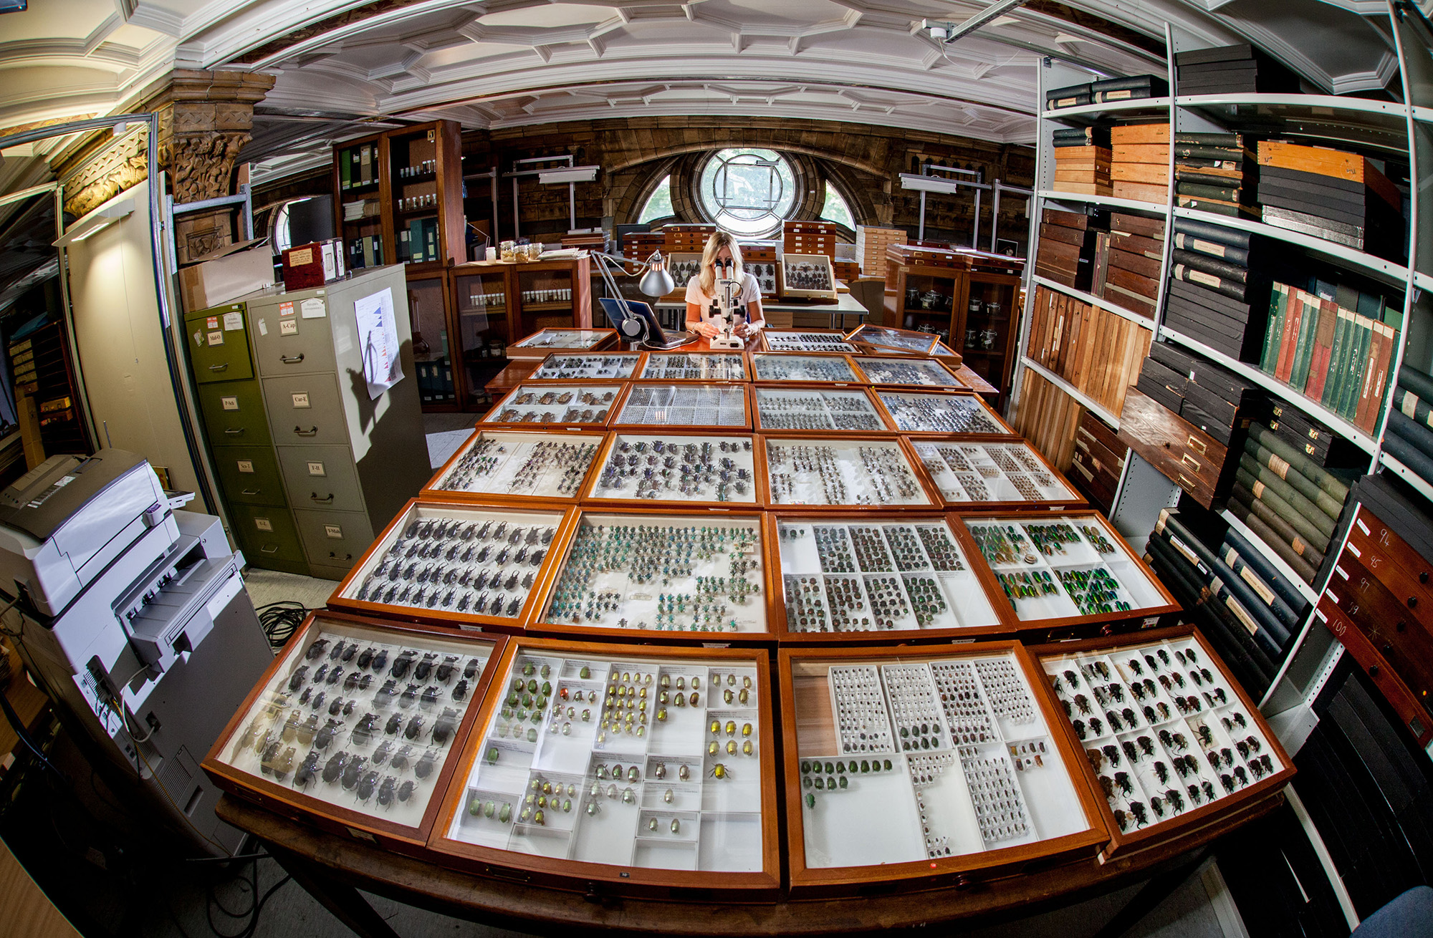
Pinned Insect Collection

Slide 3
Digitisation
Diagnostic Images
Georeferencing
Transcription
Information content
Label Images
Basic Image
Stub
Specimens per unit effort

Slide 4
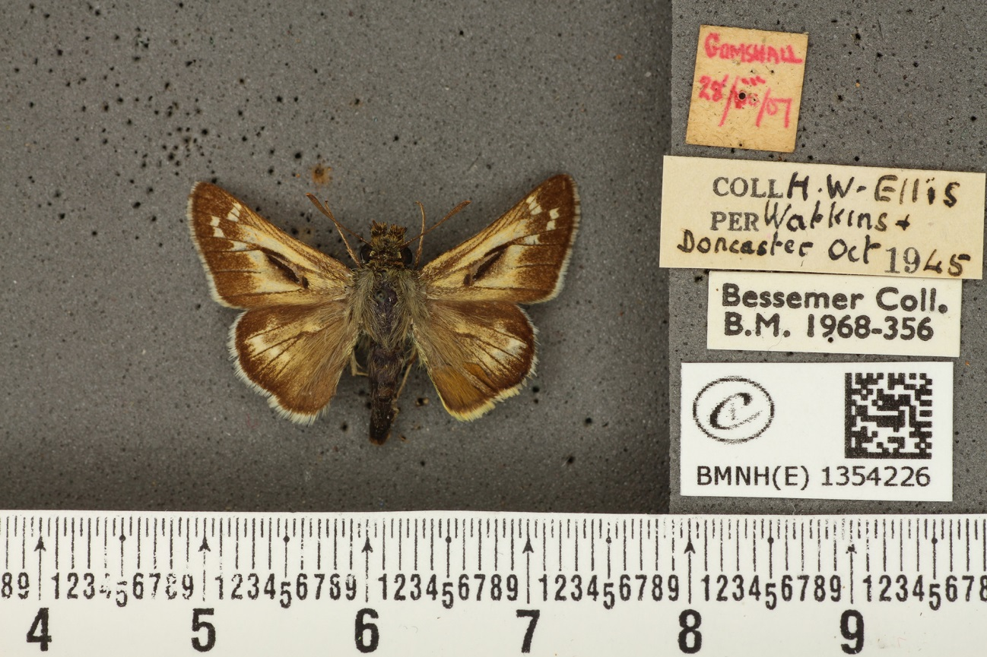
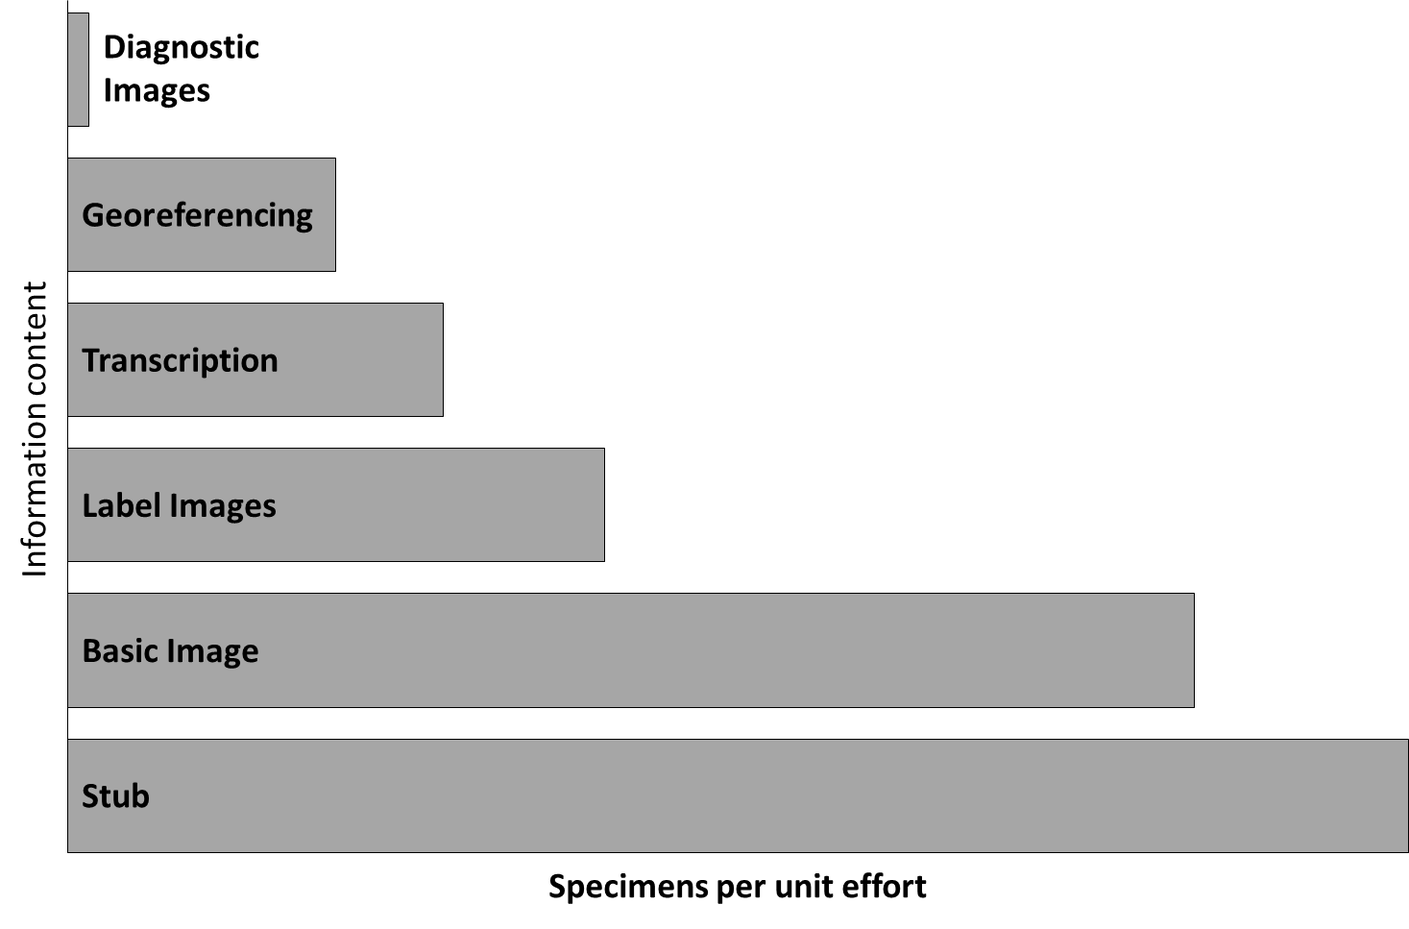
iCollections

Slide 5
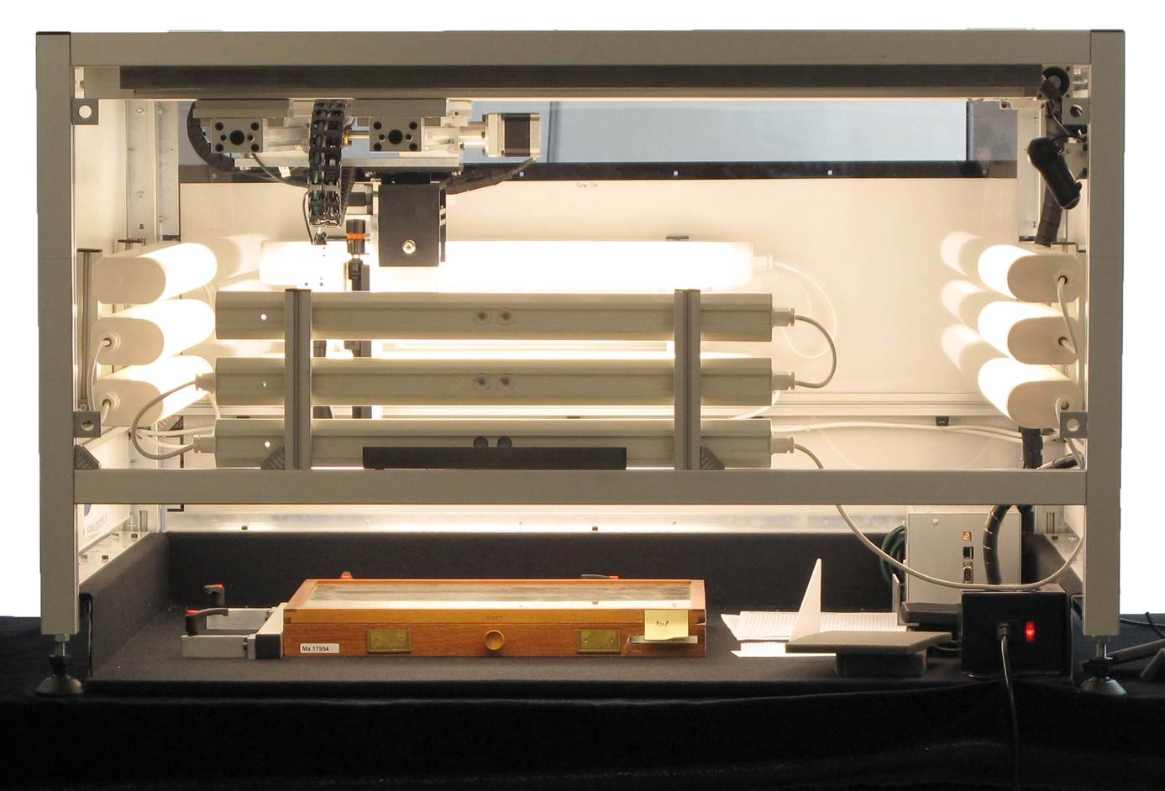
Whole Drawer Imaging

Slide 6
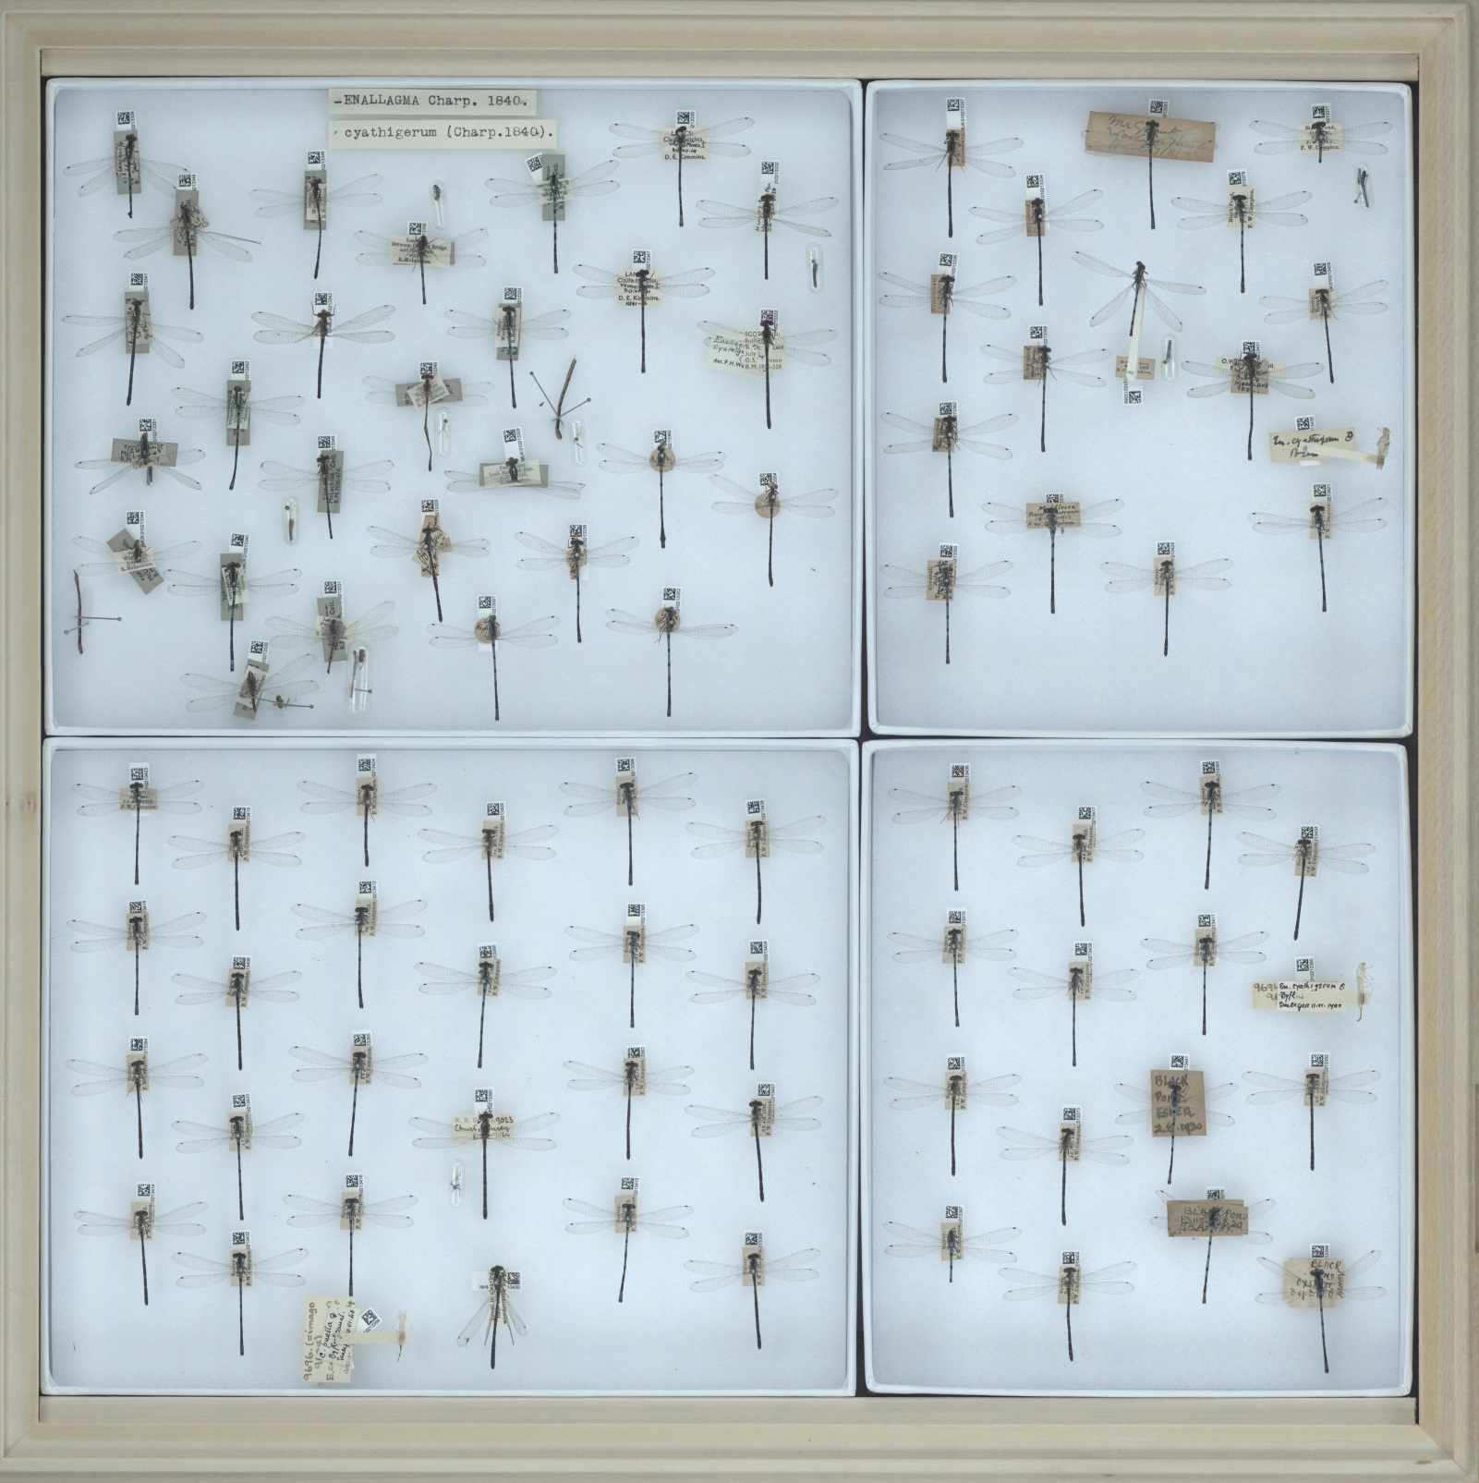
Static Drawer Image

Slide 7
Inselect Workflow Overview
Ingest
Create .inselect file & thumbnail
Optionally apply cookie cutter
Segment
Inselect application
Refine boxes
Transcribe label information
Export metadata
CSV
Read barcodes
Save crops

Slide 8
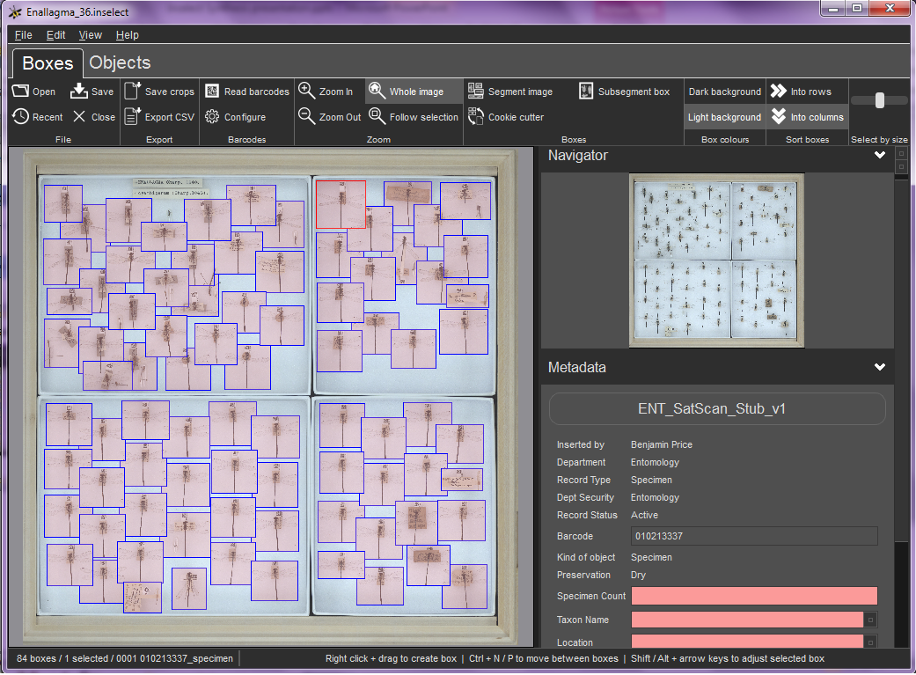
Inselect – Boxes view

Slide 9
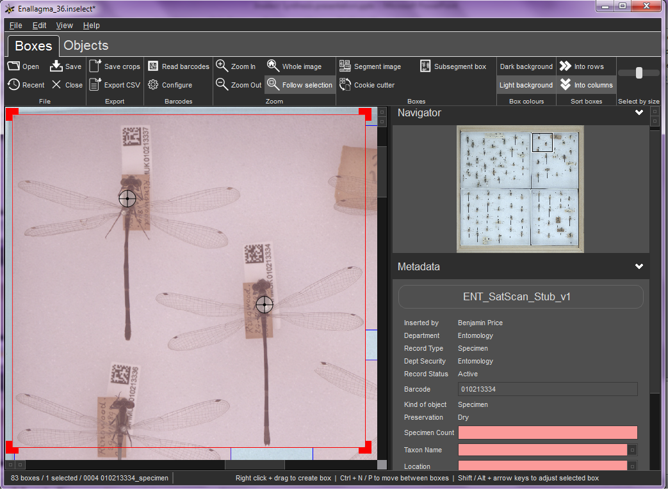
Inselect – Boxes view

Slide 10
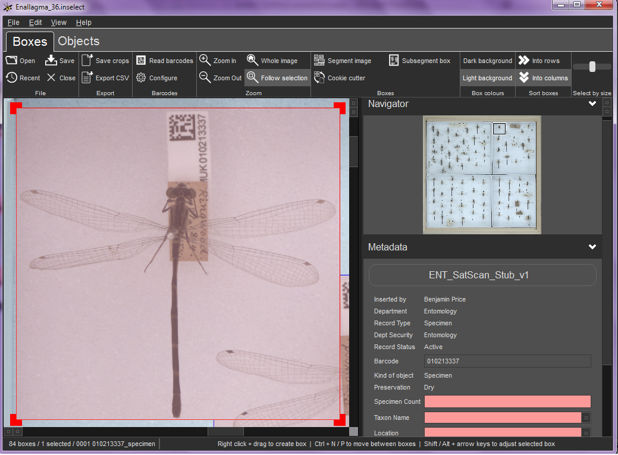
Inselect – Boxes view

Slide 11
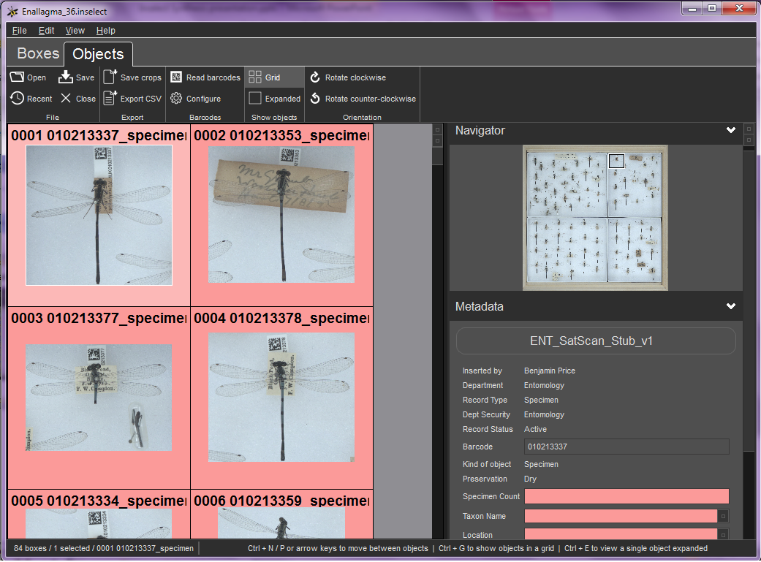
Inselect – Objects view

Slide 12
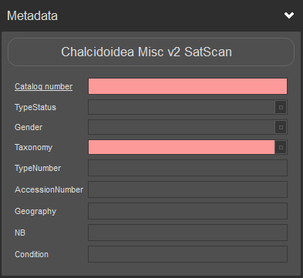
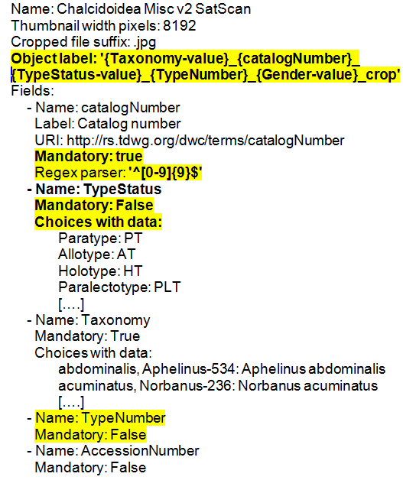
Data capture templates
Crop name
Validation
Pull down menu: data and hidden data
Free text
Mandatory data

Slide 13
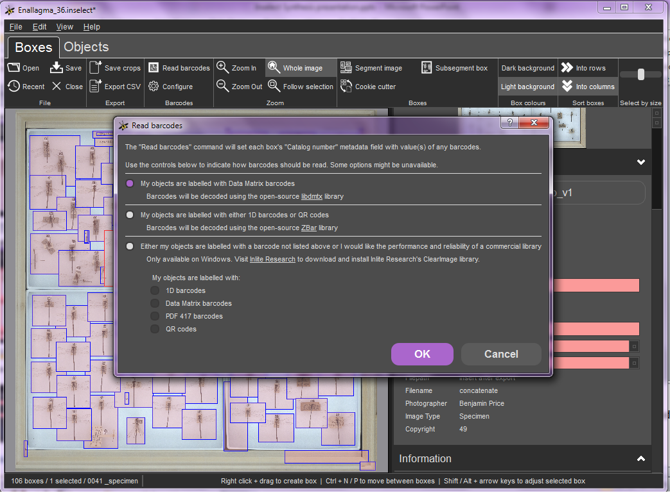
Inselect – barcodes

Slide 14
Inselect – batch processing
Ingest
Create .inselect file & thumbnail
Optionally apply cookie cutter
Segment
Inselect application
Refine boxes
Transcribe label information
Export metadata
CSV
Read barcodes
Save crops

Slide 15
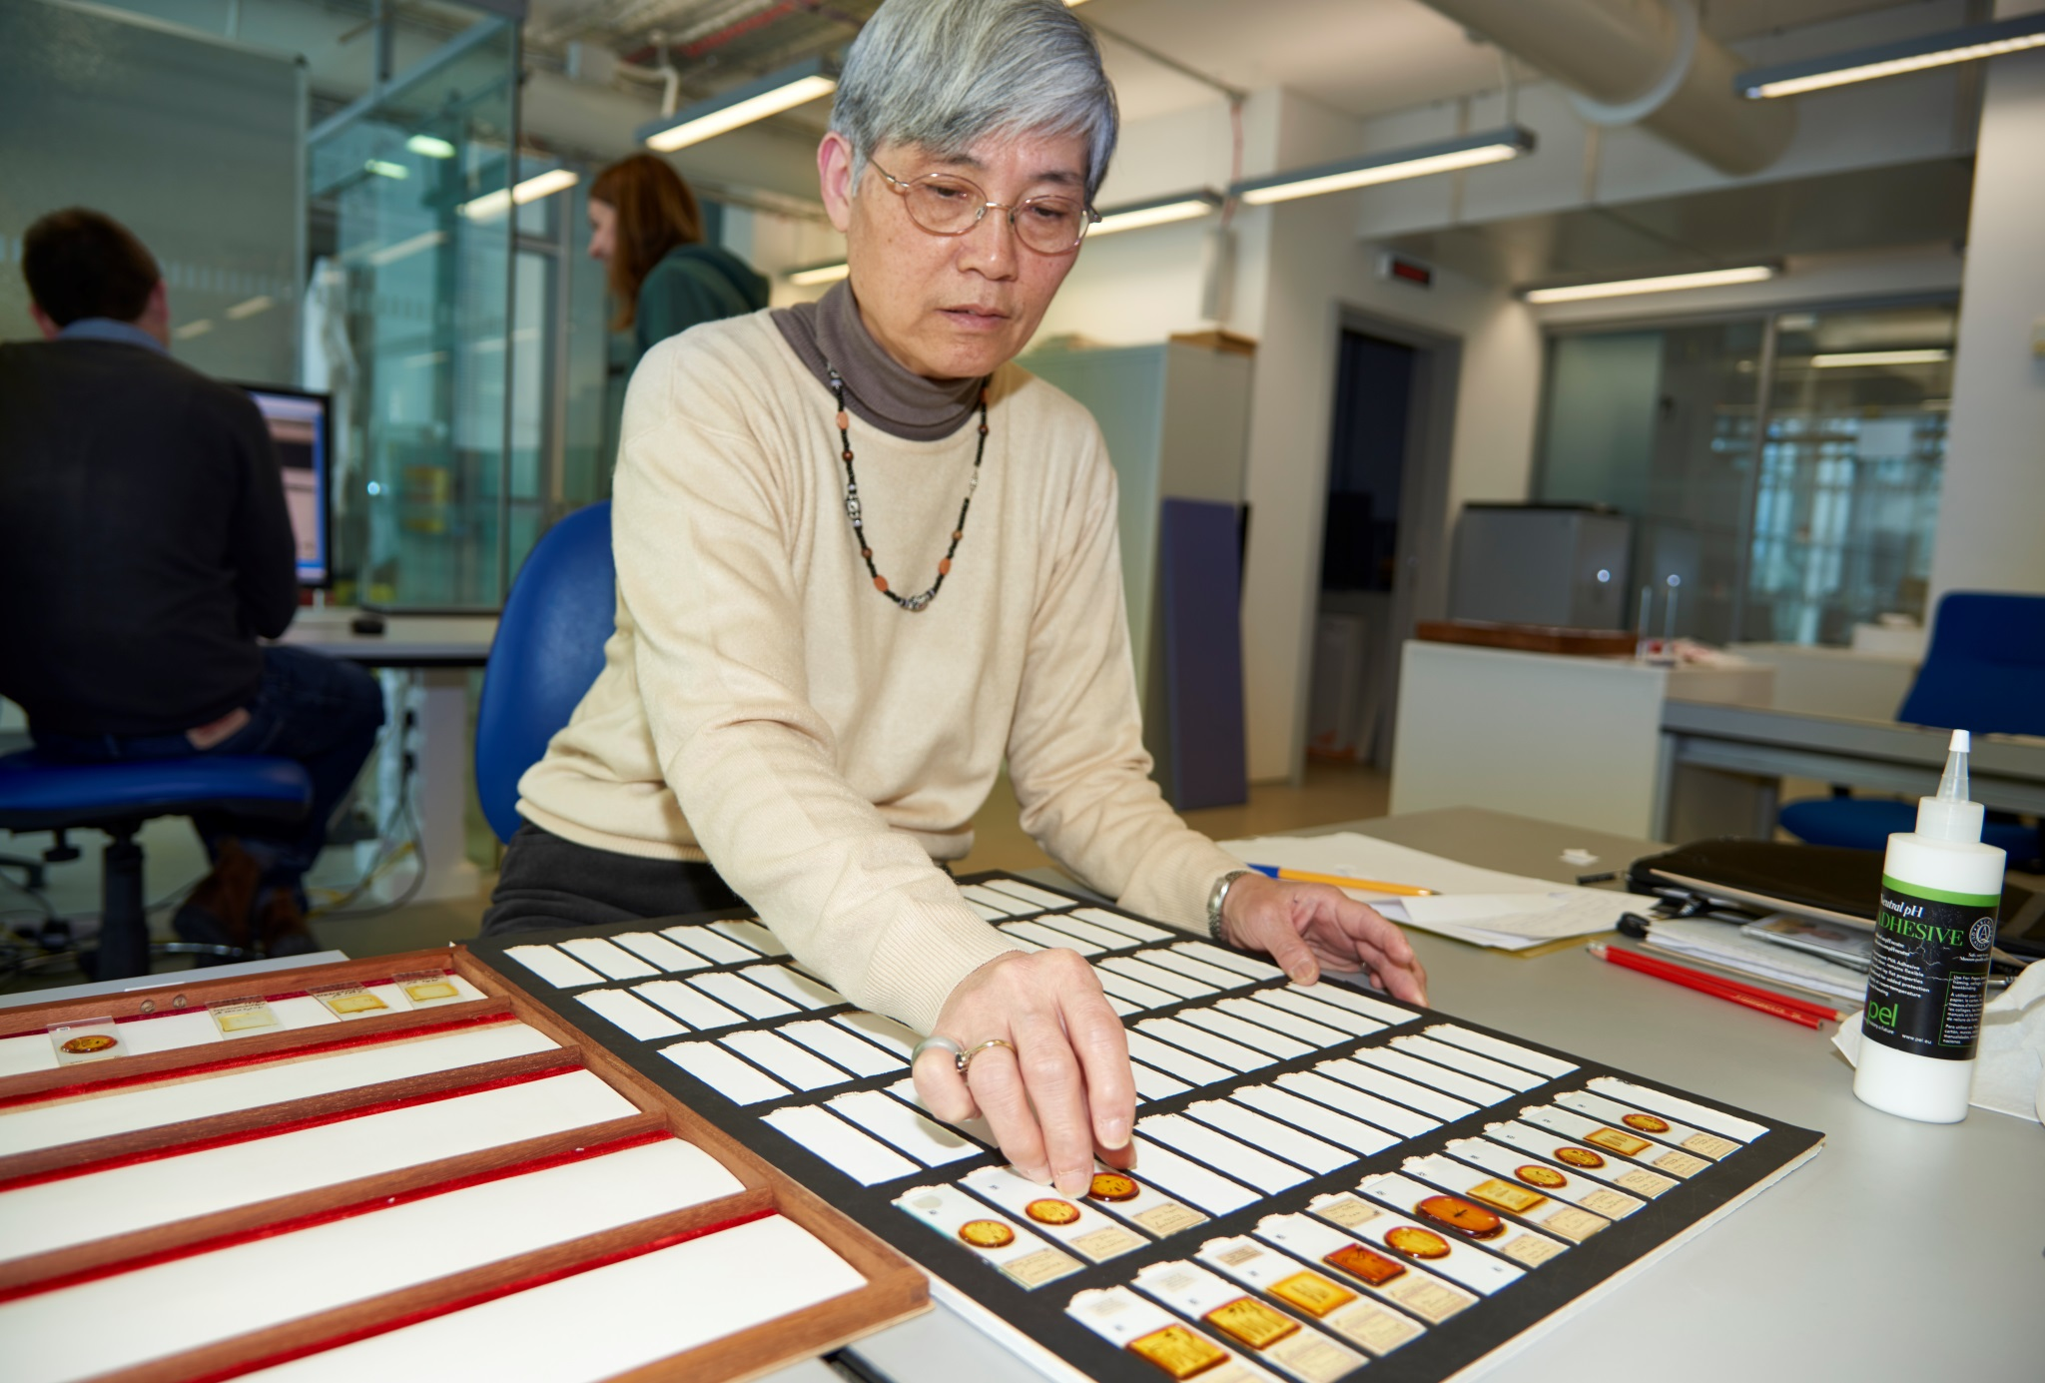
NHM Microscope Slides

Slide 16
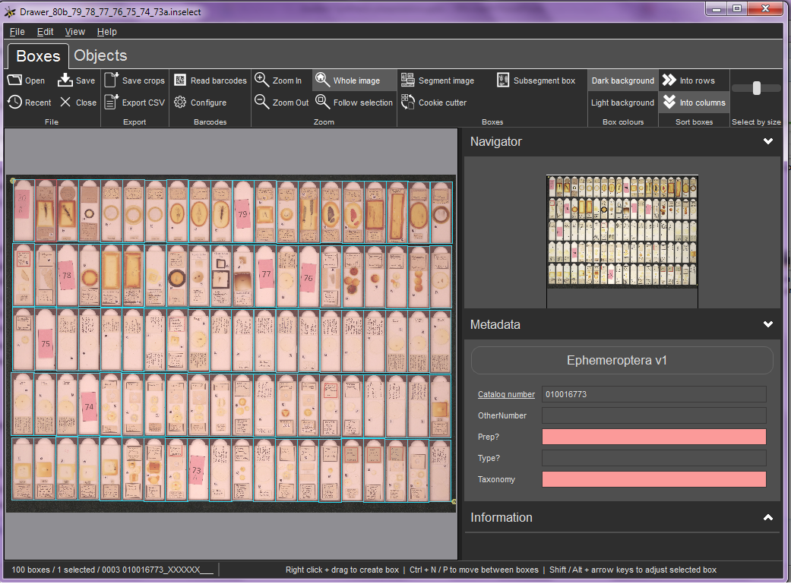
NHM Microscope Slides

Slide 17
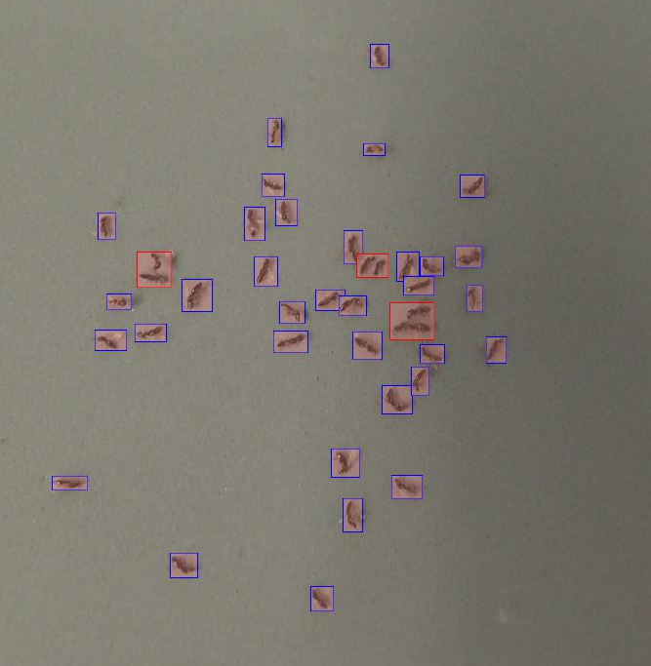
Specimen records and beyond
Counting specimens in gel caps
Notes:
]

Slide 18
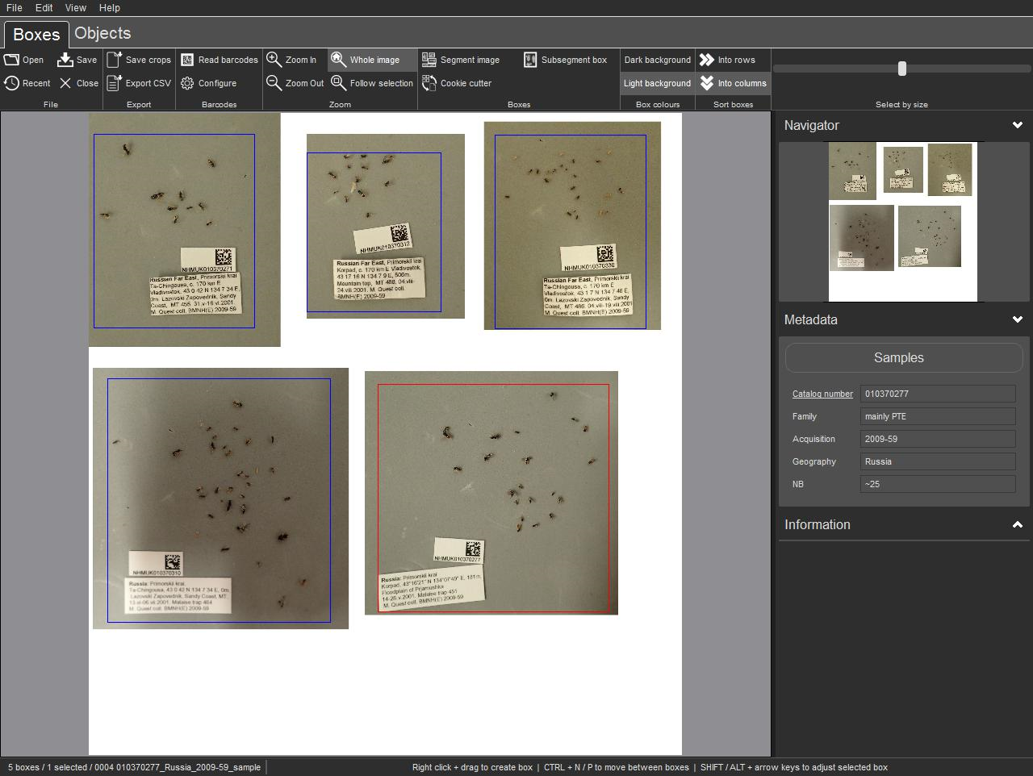
Specimen records and beyond
Summaries of material in papered and wet samples

Slide 19
Crowdsourcing insect soups
insectsoup.australianmuseum.net.au

Slide 20
Crowdsourcing insect soups
insectsoup.australianmuseum.net.au

Slide 21
Inselect for transcription
Purdue Entomological Research Collection
Collaboration with Logansport Indiana Youth Correctional Facility
Dedicated desktop stations 5–6 days per week
Cookie cutters
No internet

Slide 22
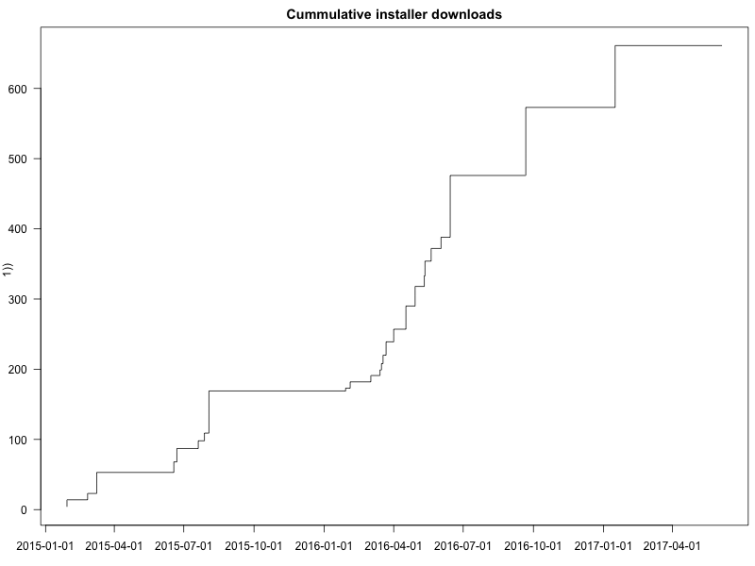
Inselect usage estimate

Slide 23
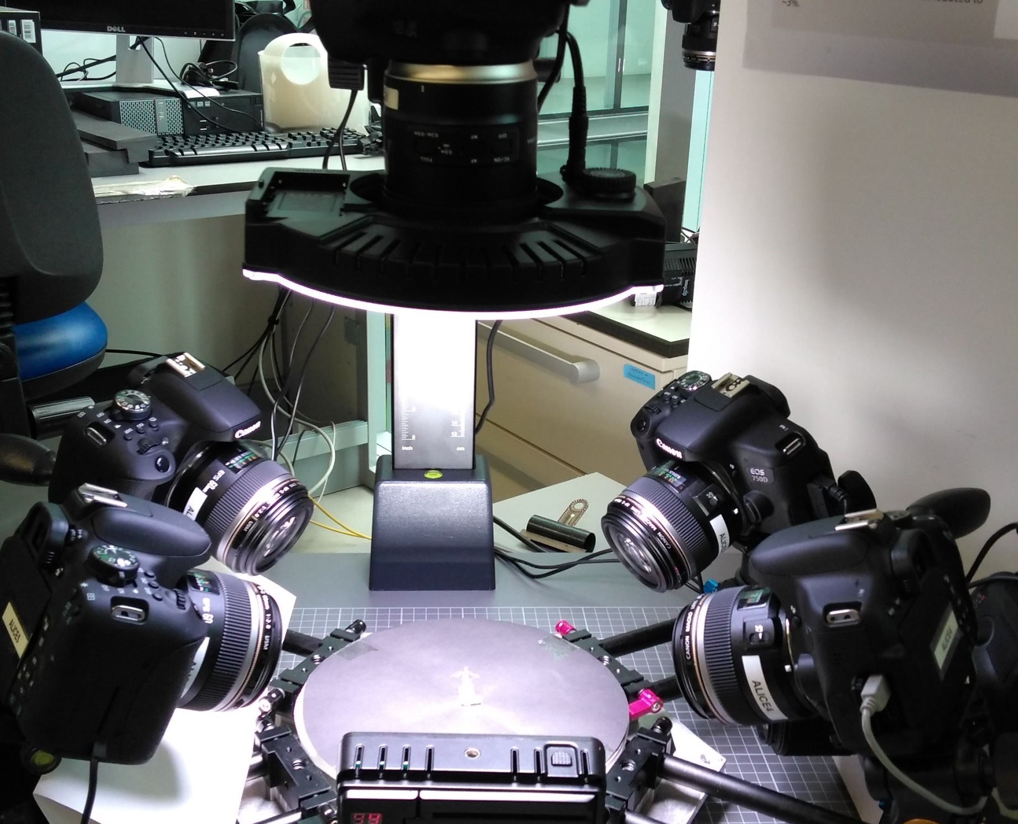
What’s next?

Slide 24
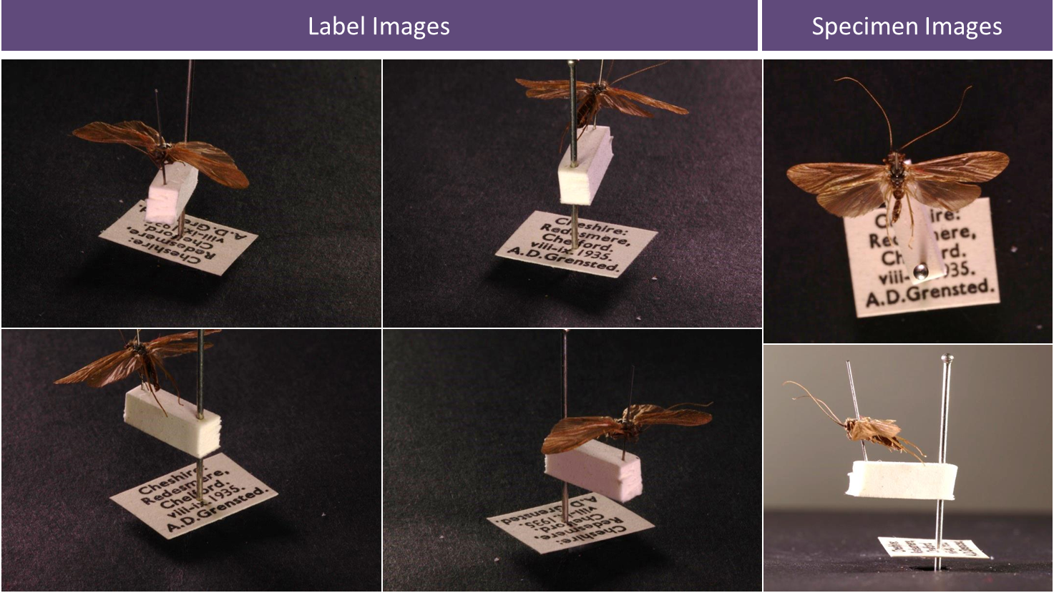
ALICE images

Slide 25
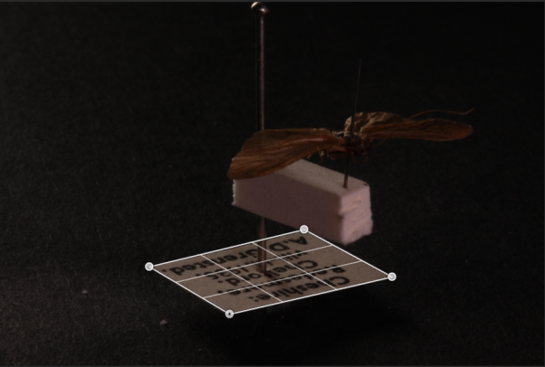
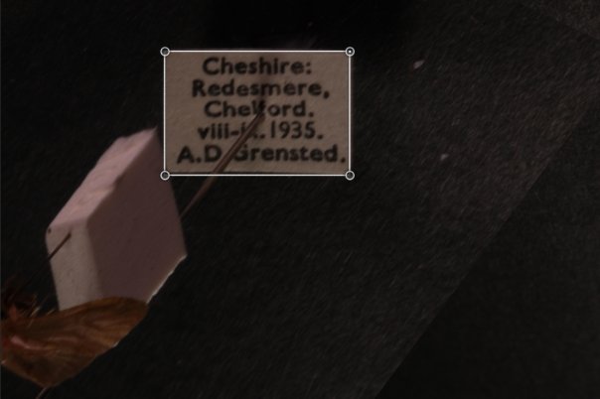
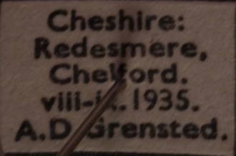
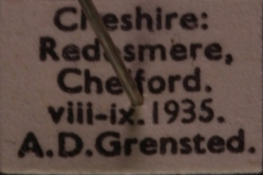
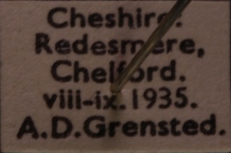
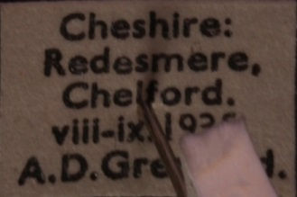
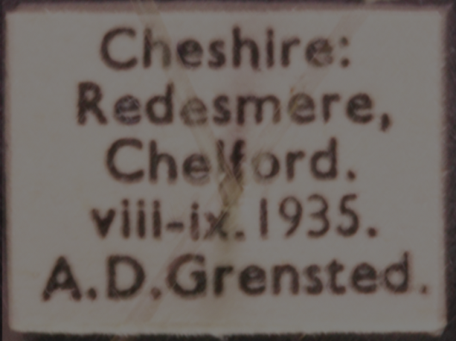
ALICE image transformation
Label identification & perspective warp
Label crop
Label merge

Slide 26
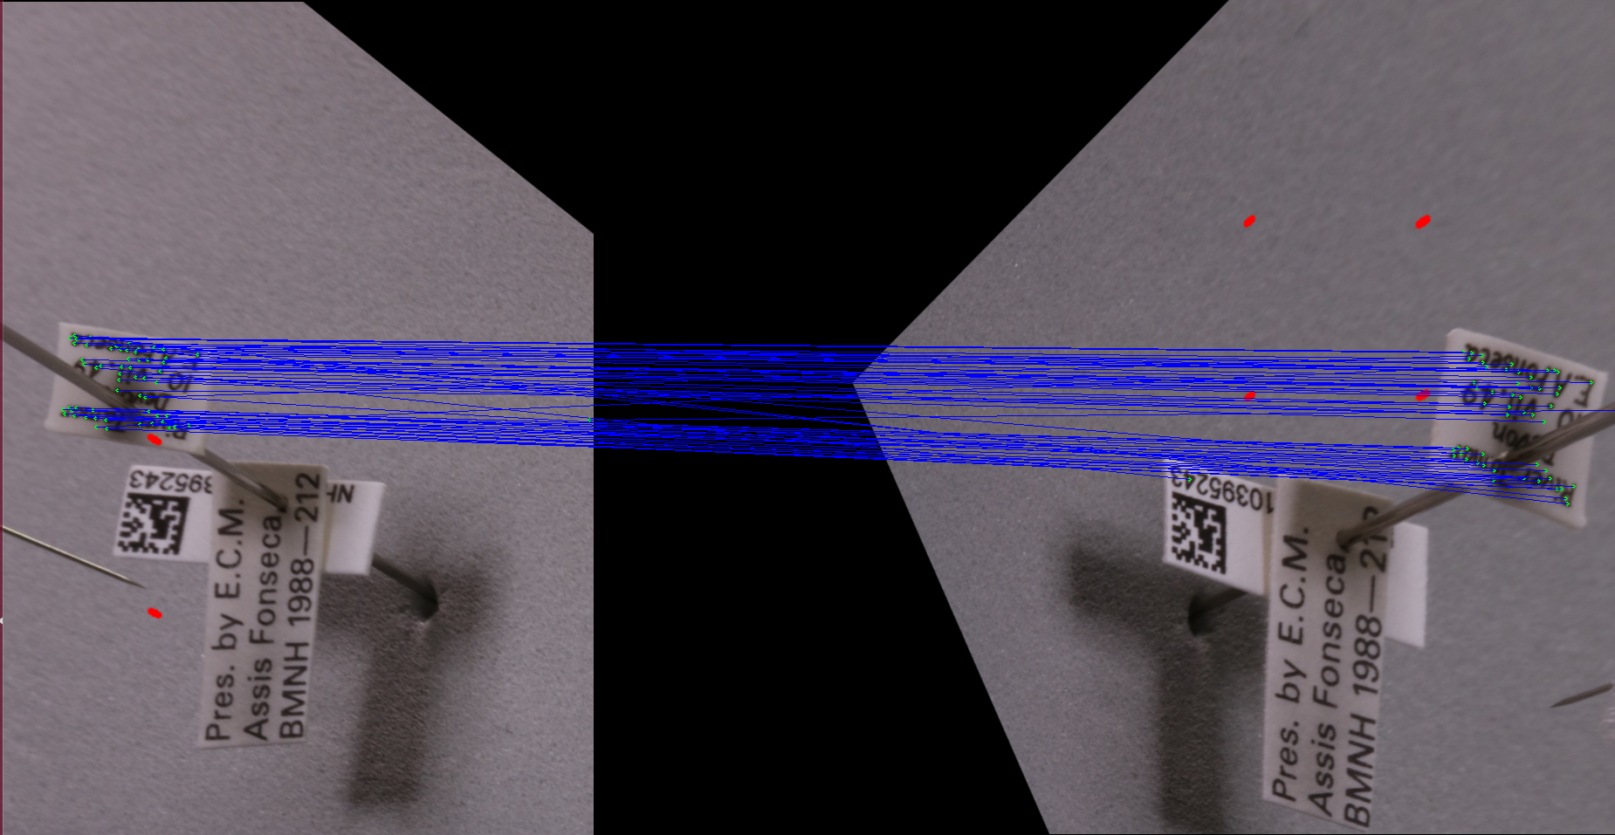
ALICE label matching

Slide 27
Acknowledgements
Inselect
Prototype: Pieter Holtzhausen (Stellenbosch), Stéfan van der Walt (Stellenbosch & University of California, Berkeley)
Application development: Lawrence Hudson and Alice Heaton
User testing: Louise Allan, Natalie Dale-Skey, Emma Sherlock and NHM volunteers
Direction: Vladimir Blagoderov, Laurence Livermore, Vincent S. Smith

Slide 28
Thank you!
Home page, including documentation and links to releases
naturalhistorymuseum.github.io/inselect
Source code and issues
github.com/NaturalHistoryMuseum/inselect/
Paper in PLOS ONE
10.1371/journal.pone.0143402
Webinar
10.6084/m9.figshare.3208021
SYNTHESYS
www.synthesys.info
#Inselect

