Slide 1

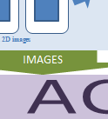
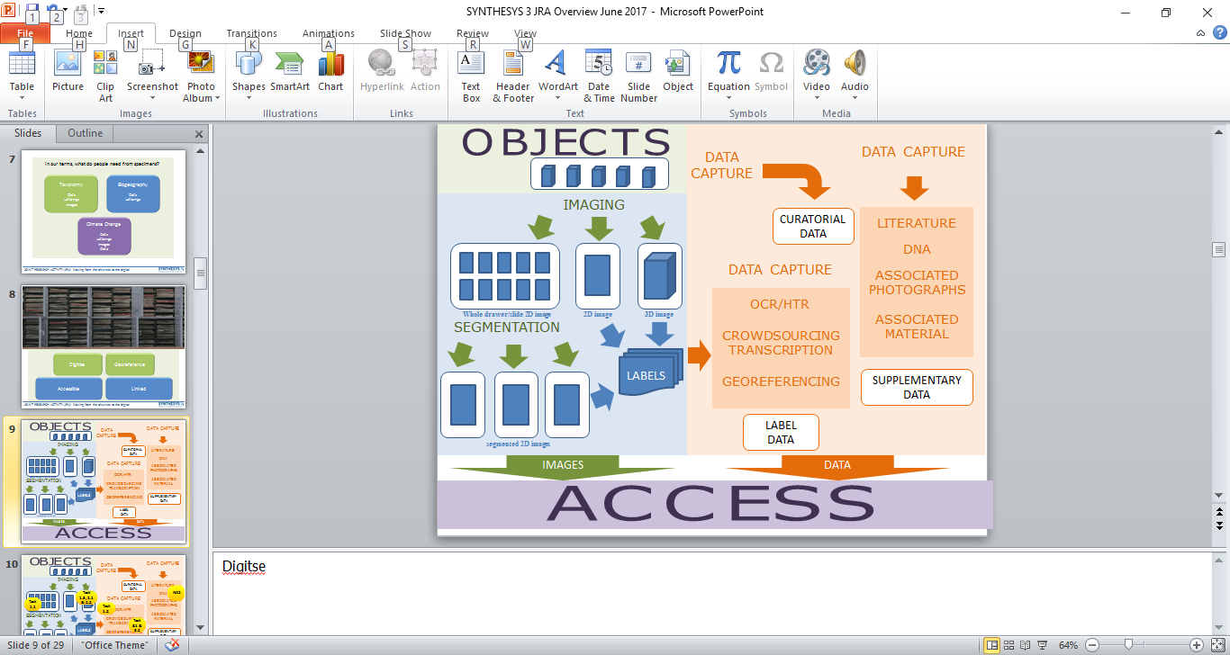
3
JOINT RESEARCH ACTIVITY (JRA):
Moving from physical to digital collections

Slide 2

What are our collections being used for?
What are the priorities for information?
How are we going to provide these requirements?
JOINT RESEARCH ACTIVITY (JRA): Moving from the physical to the digital

Slide 3
What do researchers need from specimens?
Taxonomy
Names
Distribution
Characters
Types
JOINT RESEARCH ACTIVITY (JRA): Moving from the physical to the digital

Slide 4
What do researchers need from specimens?
Taxonomy
Names
Distribution
Characters
Types
Biogeography
Names
Distribution
JOINT RESEARCH ACTIVITY (JRA): Moving from the physical to the digital

Slide 5
What do researchers need from specimens?
Taxonomy
Names
Distribution
Characters
Types
Biogeography
Names
Distribution
Climate Change
Names
Distribution
Characters
Dates
JOINT RESEARCH ACTIVITY (JRA): Moving from the physical to the digital

Slide 6
In our terms, what do people need from specimens?
Taxonomy
Dets
Latlongs
Images
Biogeography
Dets
Latlongs
Climate Change
Dets
Latlongs
Images
Data
JOINT RESEARCH ACTIVITY (JRA): Moving from the physical to the digital

Slide 7
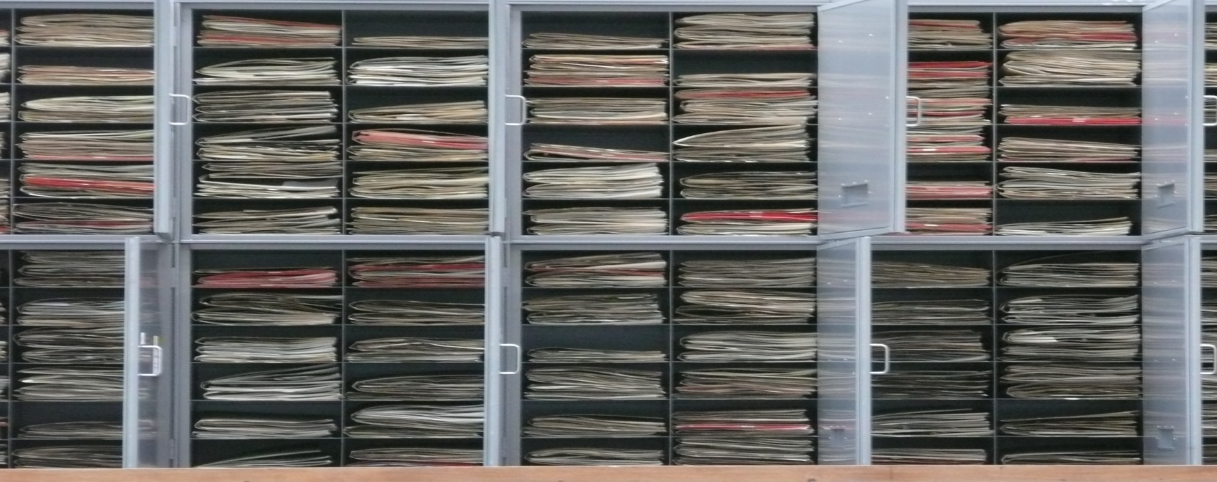
Digitise
Georeference
Accessible
Linked
JOINT RESEARCH ACTIVITY (JRA): Moving from the physical to the digital

Slide 8
OBJECTS
DATA CAPTURE
DATA CAPTURE
IMAGING
CURATORIAL
DATA
LITERATURE
DNA
DATA CAPTURE
ASSOCIATED
PHOTOGRAPHS
OCR/HTR
Whole drawer/slide 2D image
2D image
3D image
ASSOCIATED
MATERIAL
SEGMENTATION
CROWDSOURCING
TRANSCRIPTION
LABELS
GEOREFERENCING
SUPPLEMENTARY
DATA
LABEL
DATA
segmented 2D images
IMAGES
DATA
ACCESS

Slide 9
OBJECTS
DATA CAPTURE
DATA CAPTURE
IMAGING
CURATORIAL
DATA
LITERATURE
NA2
Task 1.3, 2.1 & 2.2
DNA
Task 1.1
DATA CAPTURE
ASSOCIATED
PHOTOGRAPHS
Task 1.2
OCR/HTR
Whole drawer/slide 2D image
2D image
3D image
ASSOCIATED
MATERIAL
SEGMENTATION
CROWDSOURCING
TRANSCRIPTION
Task 3.1 & 3.2
LABELS
GEOREFERENCING
SUPPLEMENTARY
DATA
LABEL
DATA
segmented 2D images
Task 4.1 & 4.2
IMAGES
DATA
ACCESS

Slide 10
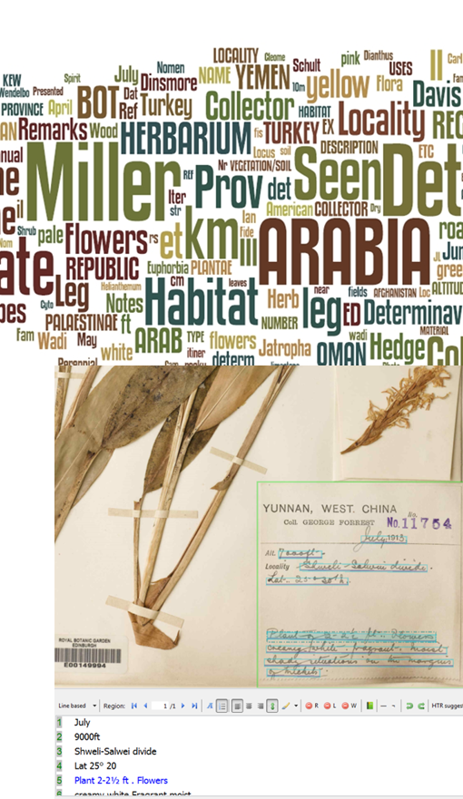
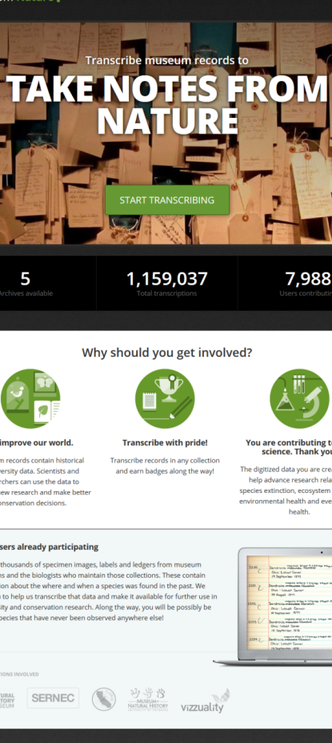
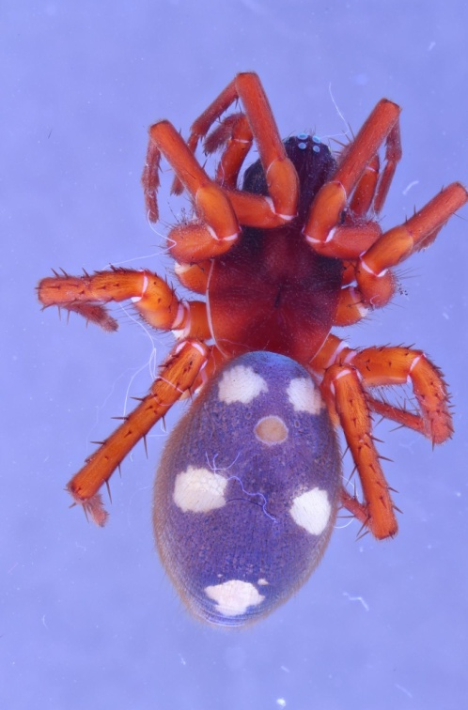
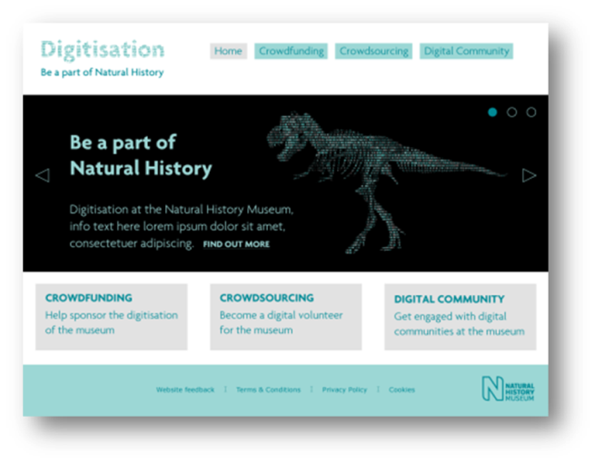
Objective 1:
Automated data collection from digital images
Objective 2:
New methods for 3D digitisation of NH collections
Objective 3:
Crowdsourcing metadata enrichment of digital images
Objective 4:
Access and management of an integrated European digital collection
JOINT RESEARCH ACTIVITY (JRA): Moving from the physical to the digital

Slide 11
OBJECTS
DATA CAPTURE
DATA CAPTURE
IMAGING
CURATORIAL
DATA
LITERATURE
DNA
Task 1.1
DATA CAPTURE
ASSOCIATED
PHOTOGRAPHS
Task 1.2
OCR/HTR
Whole drawer/slide 2D image
2D image
3D image
ASSOCIATED
MATERIAL
SEGMENTATION
CROWDSOURCING
TRANSCRIPTION
LABELS
GEOREFERENCING
SUPPLEMENTARY
DATA
LABEL
DATA
segmented 2D images
IMAGES
DATA
ACCESS

Slide 12
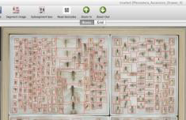
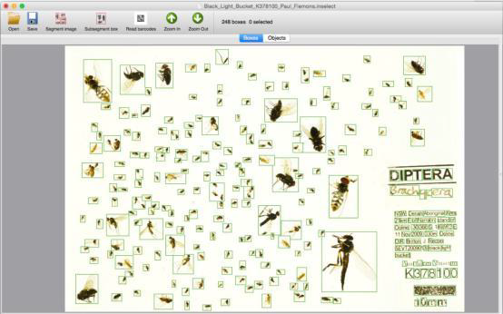
Task 1.1 Automatic processing (segmentation) of digital images
Inselect
automates cropping of whole-drawer scans and similar images
combines image processing, barcode reading, validation of user-defined metadata and batch processing
Windows and Mac OS X and open-source
developed by the Natural History Museum, London (NHM) and Stellenbosch University
publicly released in September 2014.
Automating capture of metadata for natural history specimens

Slide 13
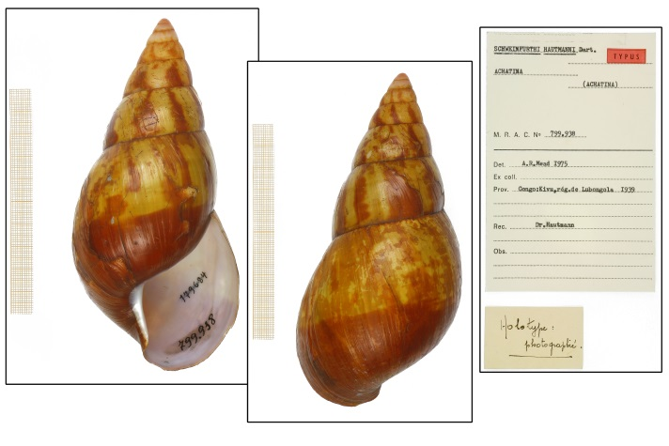
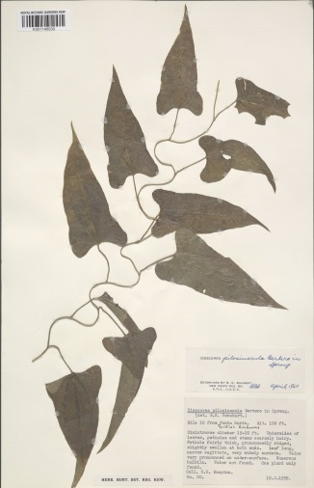
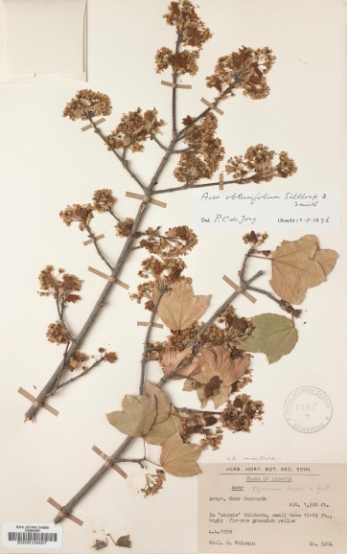
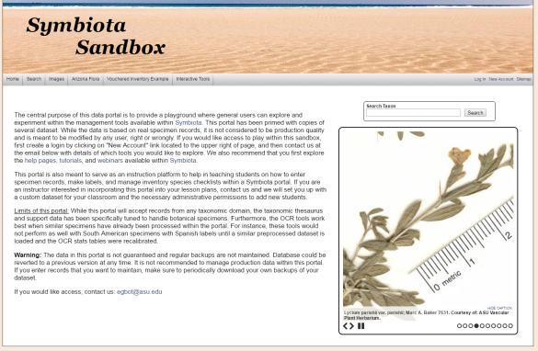
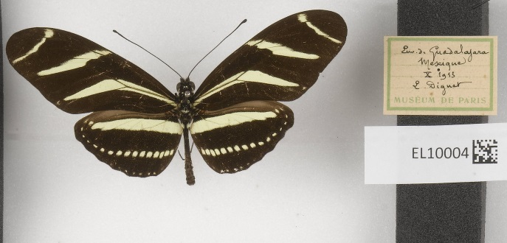
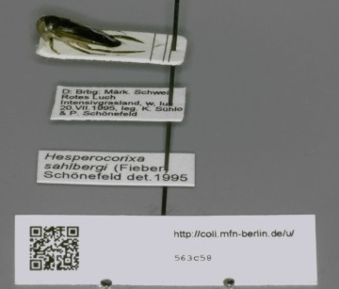
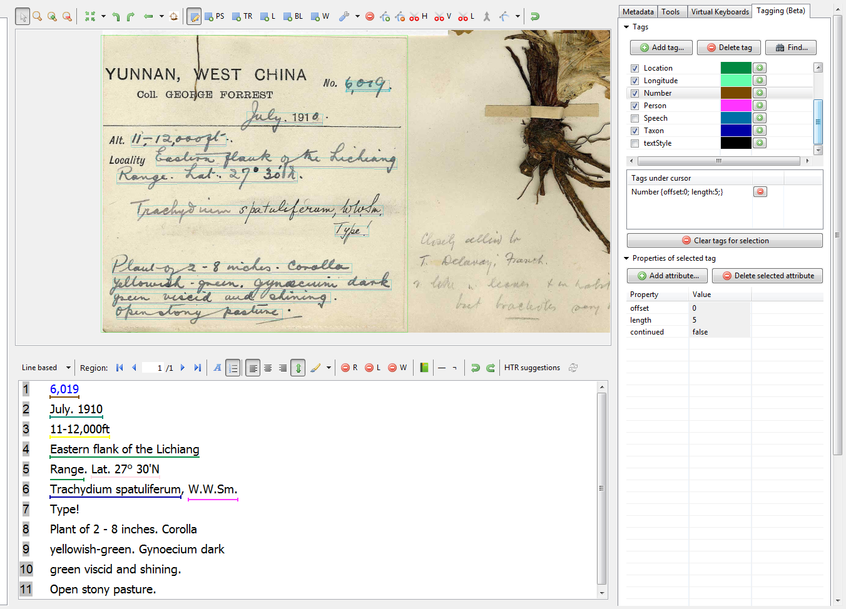
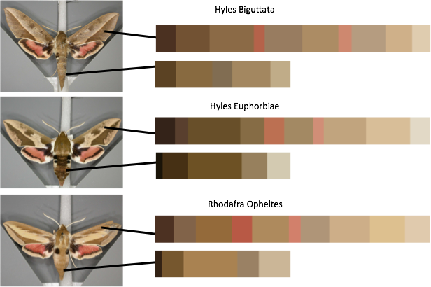
Task 1.2 Automated data collection from digital images
Section 1: Review of Optical Character Recognition (OCR) tools and workflows for metadata capture
Section 2: Review of Natural Language Processing (NLP) tools for parsing OCR text into Darwin core fields
Section 3: Review of Handwritten Text Recognition (HTR) and (semi) automatic specimen image classification
Section 4: Review of automatic capture of character including colour, shape as well as exif data
Automating capture of metadata for natural history specimens

Slide 14
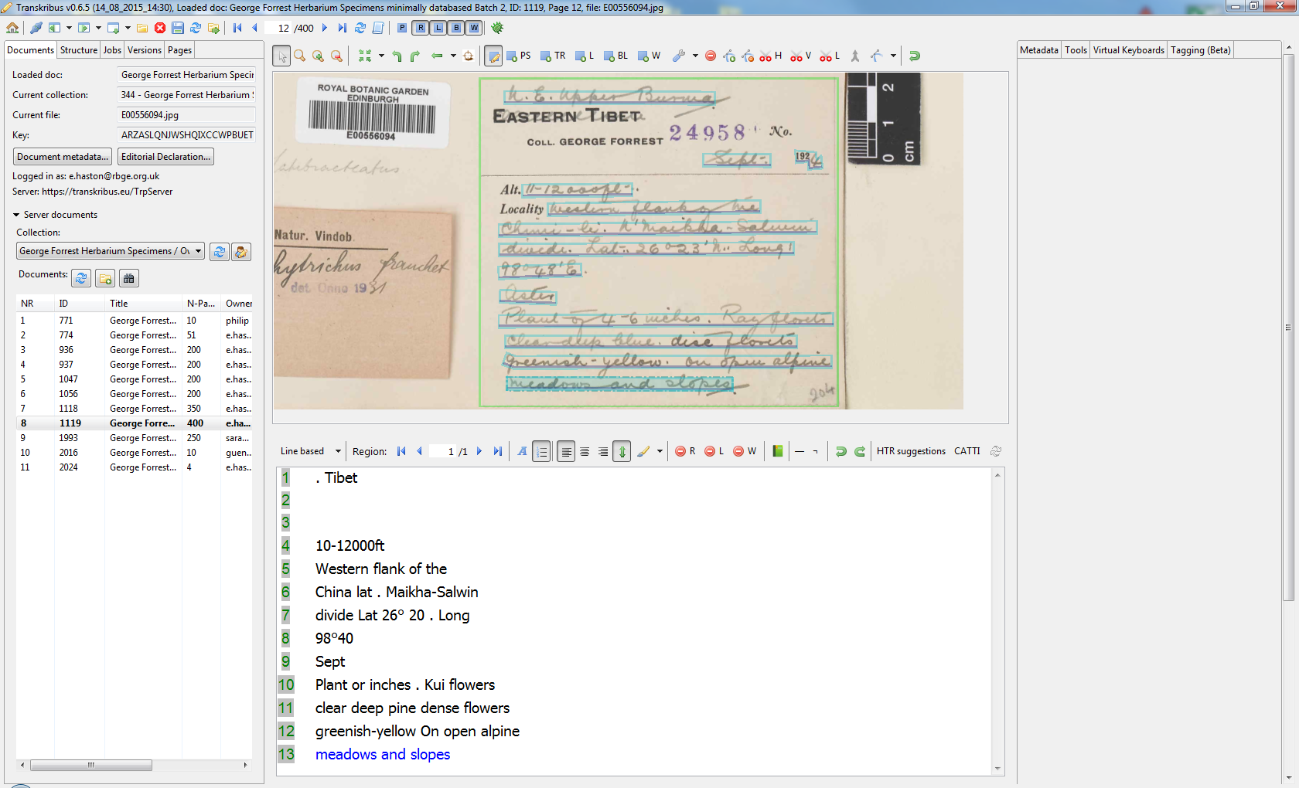
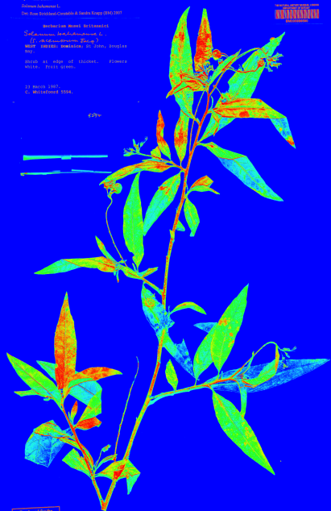
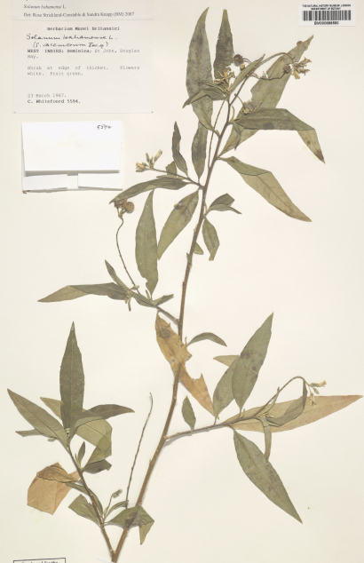
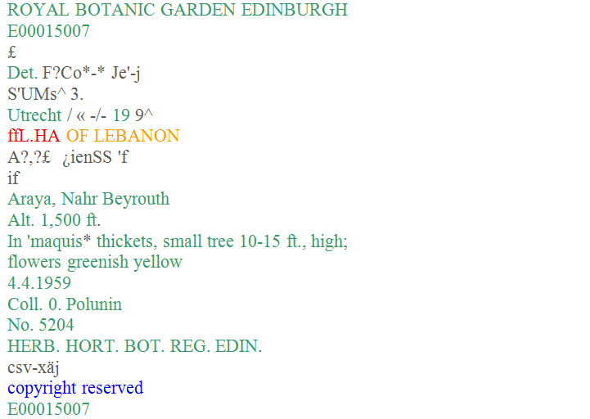
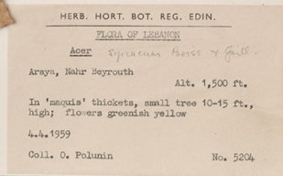
Automating capture of metadata for natural history specimens

Slide 15
OBJECTS
DATA CAPTURE
DATA CAPTURE
IMAGING
CURATORIAL
DATA
LITERATURE
Task 1.3, 2.1 & 2.2
DNA
DATA CAPTURE
ASSOCIATED
PHOTOGRAPHS
OCR/HTR
Whole drawer/slide 2D image
2D image
3D image
ASSOCIATED
MATERIAL
SEGMENTATION
CROWDSOURCING
TRANSCRIPTION
LABELS
GEOREFERENCING
SUPPLEMENTARY
DATA
LABEL
DATA
segmented 2D images
IMAGES
DATA
ACCESS

Slide 16
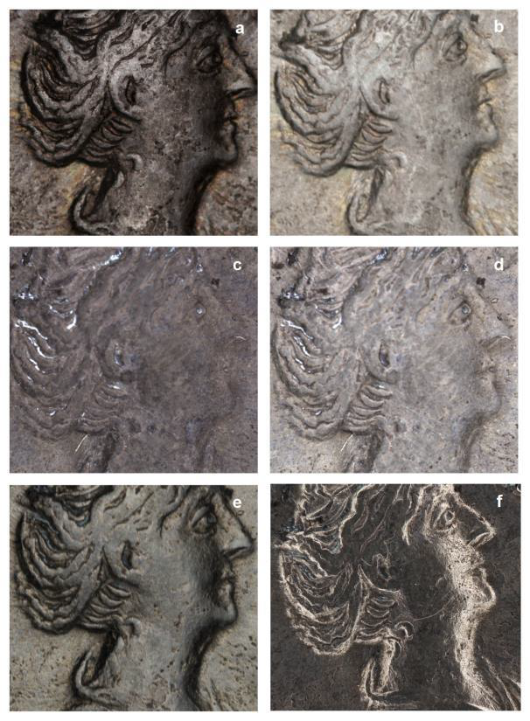
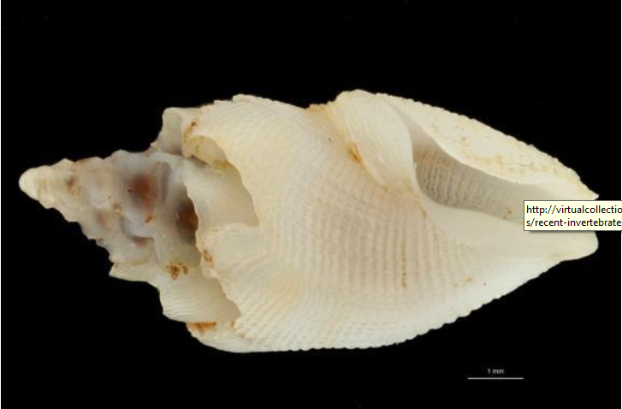
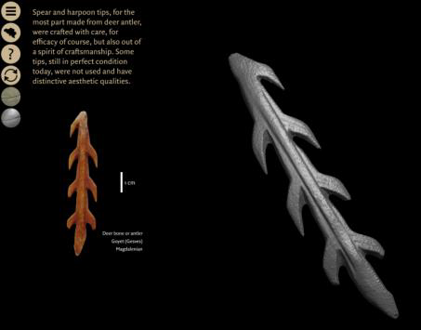
Task 1.3
2D+ and some 3D techniques including Focus Stacking, Photogrammetry and the use of Structured Light

Slide 17
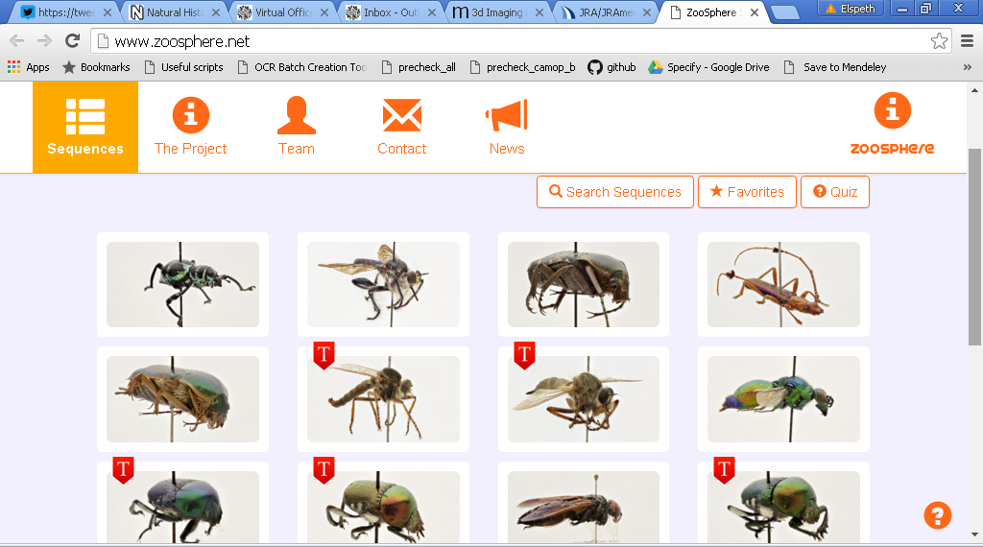
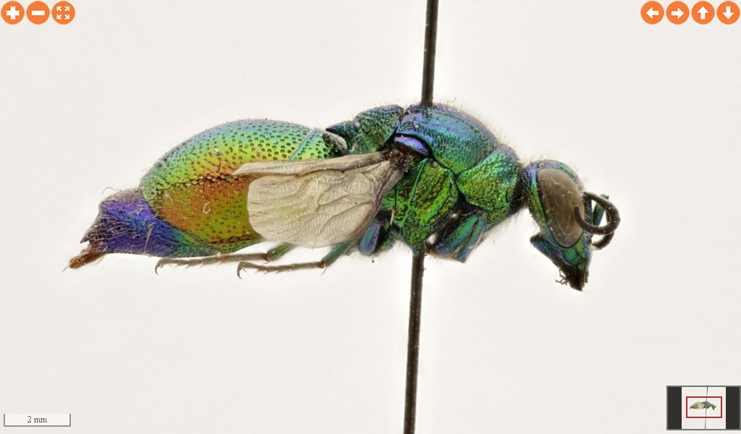
Automating capture of metadata for natural history specimens

Slide 18
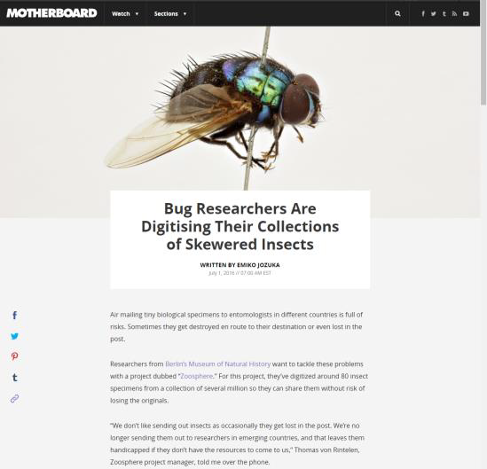
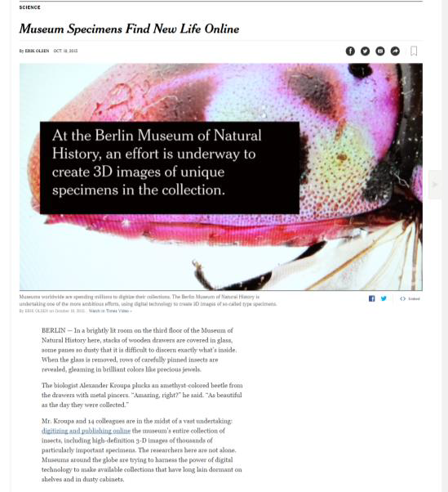
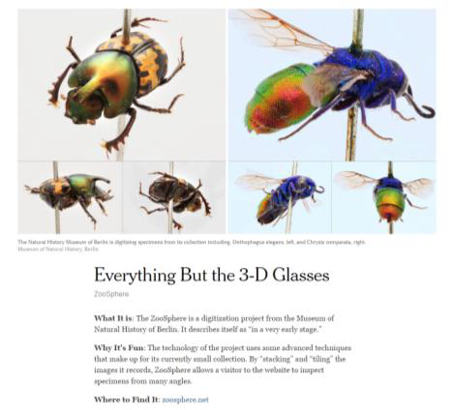
Task 2.1
Collaborating with NA2 on Zoosphere

Slide 19
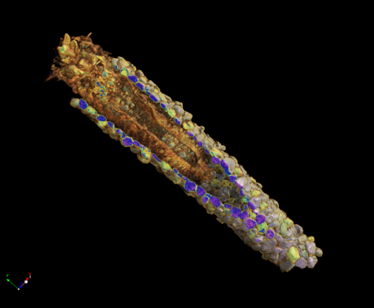
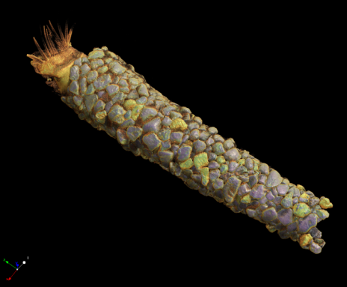
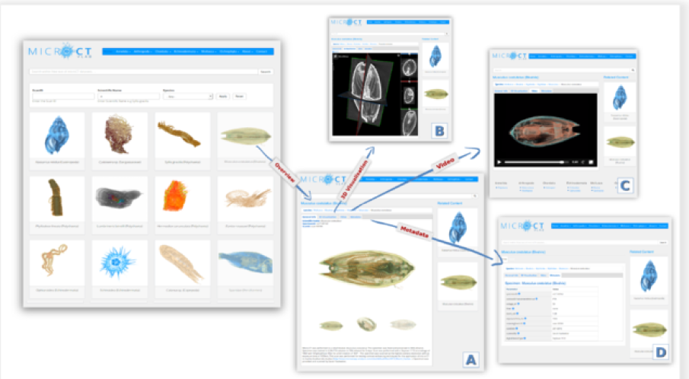
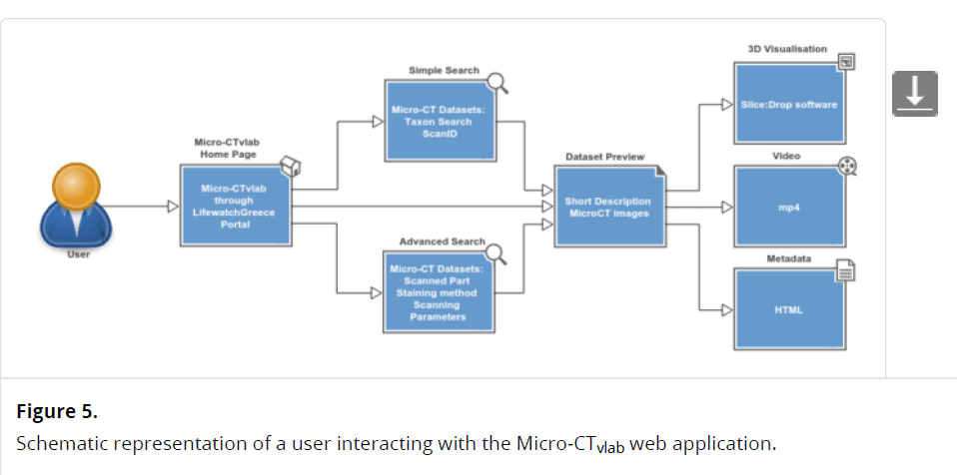
Task 2.2: Investigating the use of micro-CT techniques for natural history specimens
Several methods have been evaluated on different organisms
Best practices of curating the virtual specimens were explored and developed and are included in the handbook of best practice
Several software packages which display and manipulate micro-CT data over the internet have been reviewed and tested
Ongoing communication with scientists from different museum departments to identify their needs related to 3D imaging.
Automating capture of metadata for natural history specimens

Slide 20
OBJECTS
DATA CAPTURE
DATA CAPTURE
IMAGING
CURATORIAL
DATA
LITERATURE
DNA
DATA CAPTURE
ASSOCIATED
PHOTOGRAPHS
OCR/HTR
Whole drawer/slide 2D image
2D image
3D image
ASSOCIATED
MATERIAL
SEGMENTATION
CROWDSOURCING
TRANSCRIPTION
Task 3.1 & 3.2
LABELS
GEOREFERENCING
SUPPLEMENTARY
DATA
LABEL
DATA
segmented 2D images
IMAGES
DATA
ACCESS

Slide 21
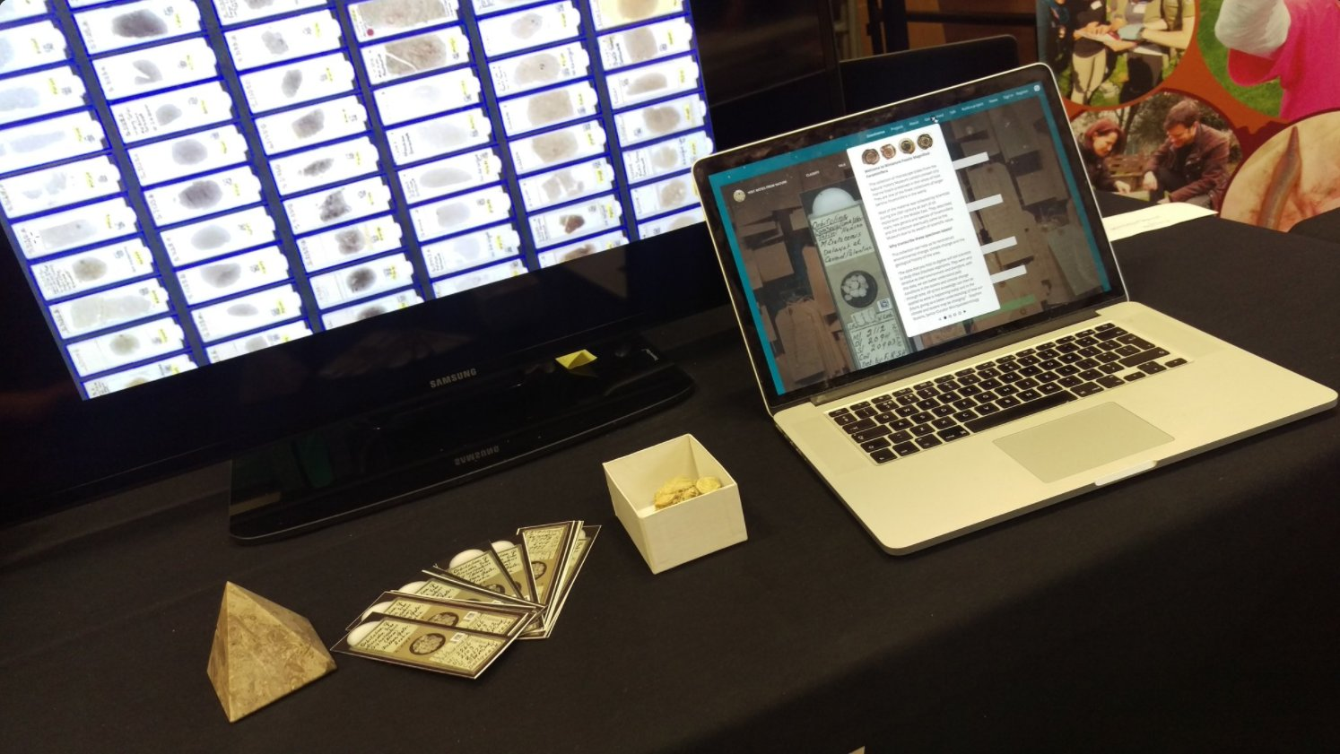
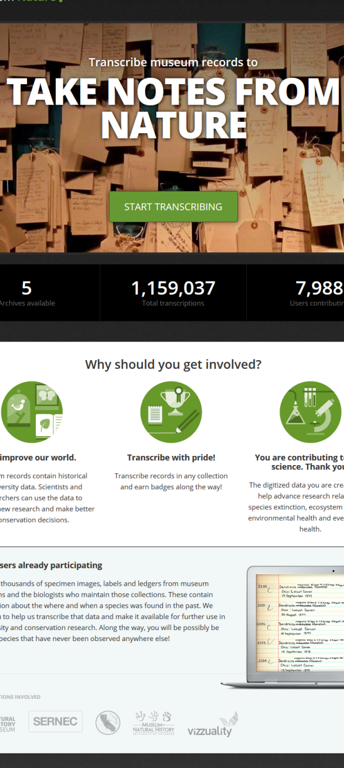
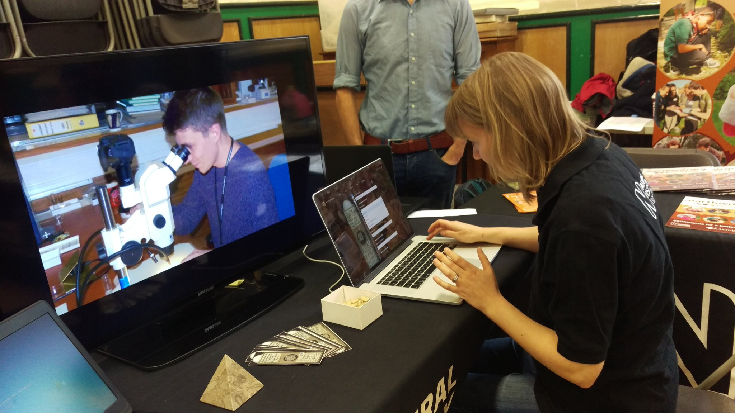

Slide 22
OBJECTS
DATA CAPTURE
DATA CAPTURE
IMAGING
CURATORIAL
DATA
LITERATURE
DNA
DATA CAPTURE
ASSOCIATED
PHOTOGRAPHS
OCR/HTR
Whole drawer/slide 2D image
2D image
3D image
ASSOCIATED
MATERIAL
SEGMENTATION
CROWDSOURCING
TRANSCRIPTION
LABELS
GEOREFERENCING
SUPPLEMENTARY
DATA
LABEL
DATA
segmented 2D images
Task 4.1 & 4.2
IMAGES
DATA
ACCESS

Slide 23
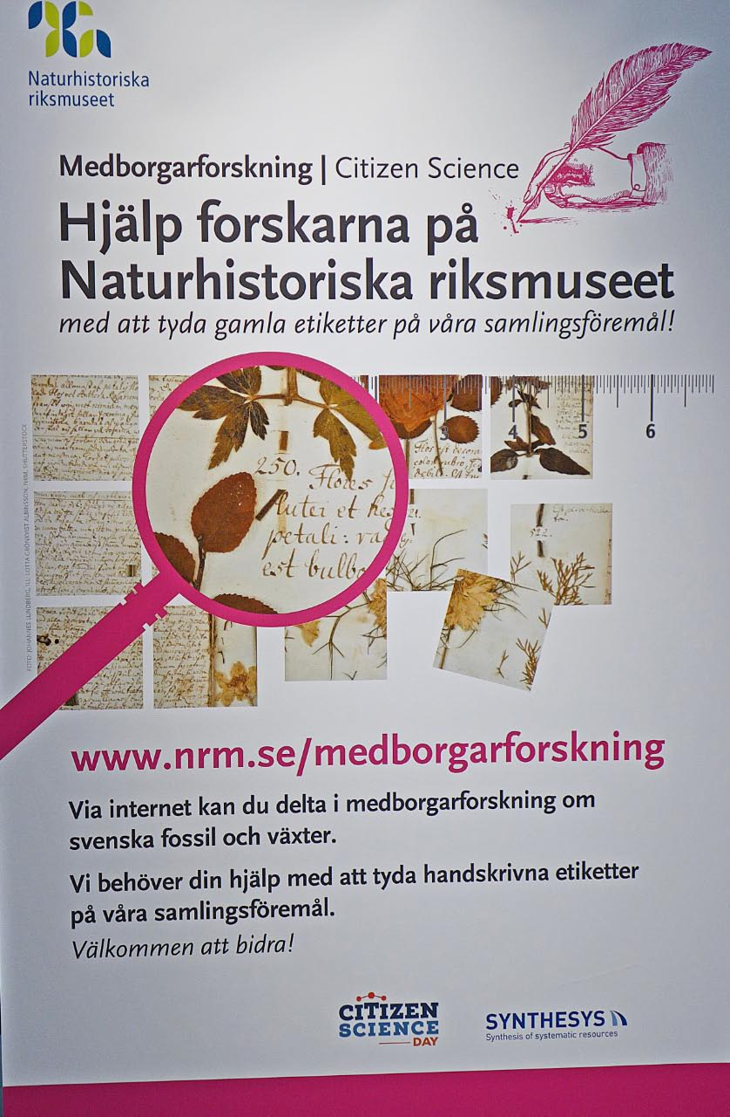
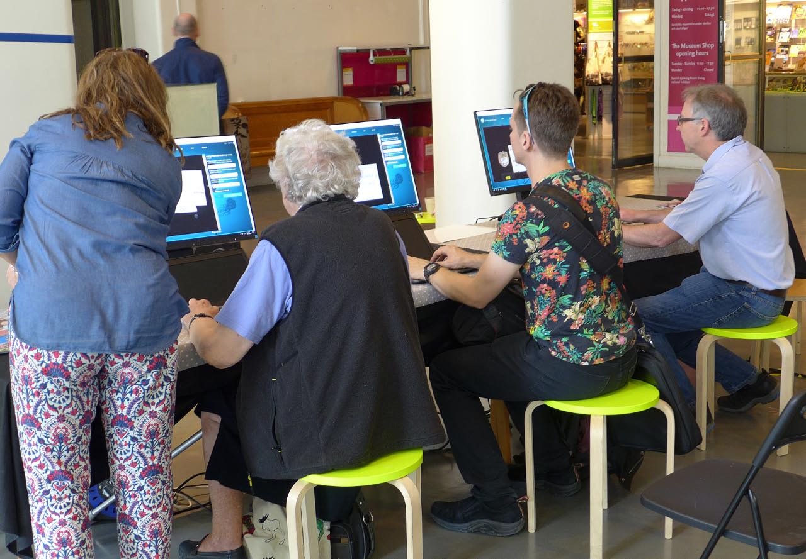

Slide 24
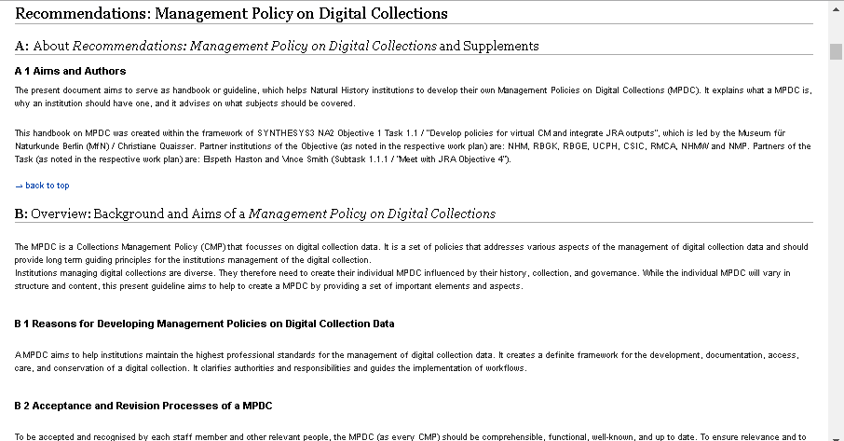
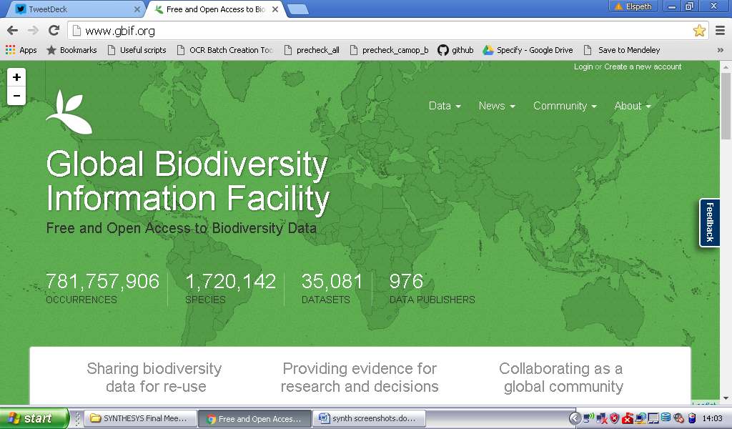

Slide 25
OBJECTS
DATA CAPTURE
DATA CAPTURE
IMAGING
CURATORIAL
DATA
LITERATURE
DNA
DATA CAPTURE
ASSOCIATED
PHOTOGRAPHS
OCR/HTR
Whole drawer/slide 2D image
2D image
3D image
ASSOCIATED
MATERIAL
SEGMENTATION
CROWDSOURCING
TRANSCRIPTION
LABELS
GEOREFERENCING
SUPPLEMENTARY
DATA
LABEL
DATA
segmented 2D images
IMAGES
DATA
ACCESS

Slide 26
IMAGES
DATA
ACCESS
?
JOINT RESEARCH ACTIVITY (JRA): Moving from the physical to the digital

Slide 27
IMAGES
DATA
ACCESS
+
JOINT RESEARCH ACTIVITY (JRA): Moving from the physical to the digital

