Slide 1
NA3
Inovation, Impact & Sustainibility
Review
WP Leader: Jiří Kvaček
WP Deputy: Christiane Quaisser
SYNTHESYS3 Final Meeting
NMH, London, 6-7 June 2017

Slide 2
Summary of WP objectives and tasks
Objective 1 INNOVATION
Task 1.1 Engagement of Scientific Advisory Board
Task 1.2 Foster relationships with industry and support technological development
Task 1.3 Pilot study into optimal digitisation technologies and equipment
Task 1.4 Pilot study into optimal crowdsourcing processes for NH institutions
Objective 2 IMPACT
Task 2.1 Promotion and dissemination
Task 2.2 Improved access to collections and contribution to ERA
Objective 3 SUSTAINABILITY
Task 3.1 Meeting the future needs of Users of Natural History institutions
Task 3.2 Facilitating Access beyond SYNTHESYS3
Task 3.3 Collaboration with iDigBio on training for the future
Task 3.4 Sustainable use of SYNTHESYS3 outputs
SYNTHESYS3 Final Meeting
NMH, London, 6-7 June 2017

Slide 3
Objective 1 INNOVATION
Task 1.1 Engagement of Scientific Advisory Board, task leader Vince Smith (NHM)
Work progress will be regularly overviewed and discussed by SAB to ensure that the work undertaken remains relevant and is utilizing the most up-to-date technology available.
Work done:
Debbie Paul (iDigBio, USA), Pieter Holtzhausen (Stellenbosch University, South Africa), Roderic D.M. Page (University of Glasgow, UK)
targeted engagement on specific tasks and events (e.g., development of Inselect software; SPNHC, „Pit Stop“ events)
SYNTHESYS3 Final Meeting
NMH, London, 6-7 June 2017

Slide 4
Objective 1 INNOVATION
Task 1.2 Foster relationships with industry and support technological development, task leader Vince Smith (NHM)
NA3 will be responsible for identifying new industrial collaborators to take this forward.
Working alongside the JRA, NA3 will support the technological developments of SYNTHESYS3 by gathering User feedback on the application of software, allowing the technology to be further developed to better meet User needs.
Work done:
NHM analysed the best practice in relationship between the NH collection institutions and industry in the field of digitisation reflecting current status.
digitisation pilot activities with the SME Picturae based in the Netherlands;
the “Pit Stop” event co-organised by NHM, Cisco Systems Inc. and facilitated by the Digital Catapult Centre; Google and Canon;
promotional opportunities with digitisation SME's at conferences and meetings
SYNTHESYS3 Final Meeting
NMH, London, 6-7 June 2017

Slide 5
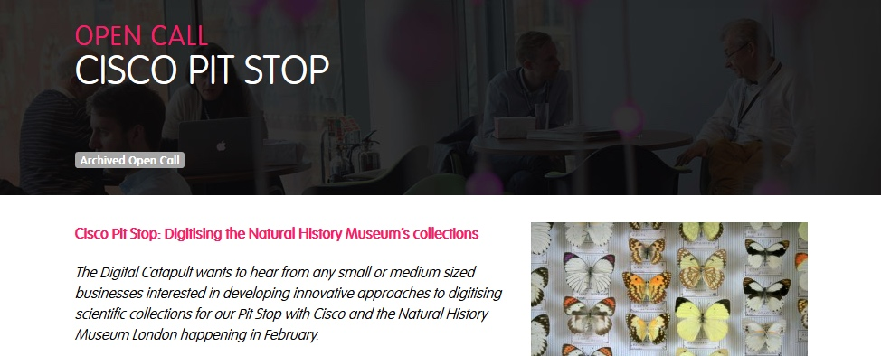
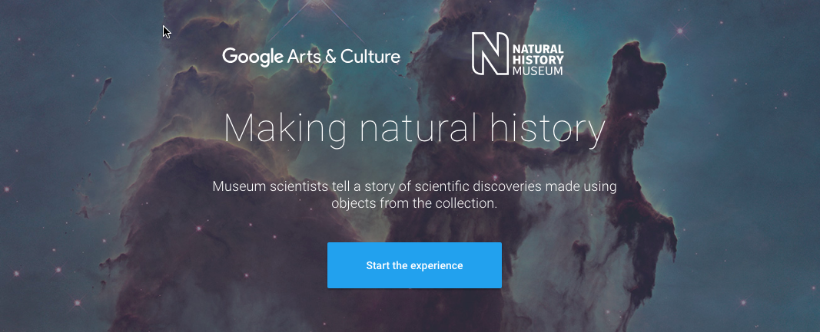
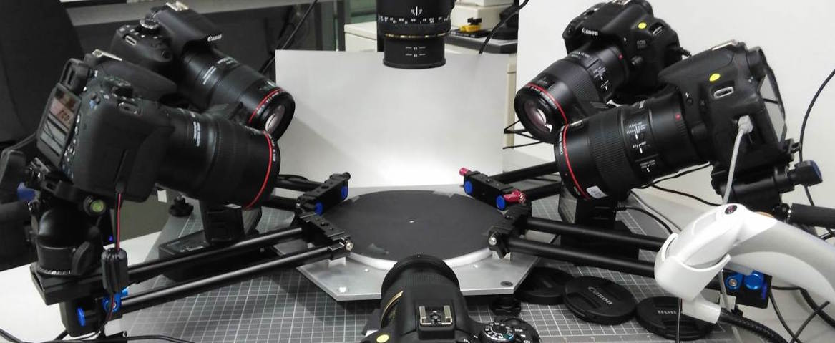
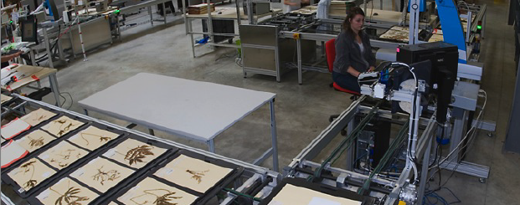
Foster relationships with industry and support technological development
Cisco / Digital Catapult
Google
Canon
Picturae

Slide 6
Objective 1 INNOVATION
Task 1.3 Pilot study into optimal digitisation technologies and equipment, task leader Sarah Phillips (RBGK)
The aim of this task was to closely collaborate with JRA to review relevant operational aspects of access to new forms of digitised collections and identify digitisation techniques suitable for particular specimens in the natural history collections.
Work done:
Report compiled by Sarah Phillips, Laura Green and Marie-Helene Weech (RGBK). It summarises some of the main components and underlying issues with respect to digitisation workflows from partner institutions as evidenced from the questionnaire responses, as well as providing some key recommendations based on these findings such as:
need for a central repository of funding bodies to ensure sufficient funding for digitisation
need for an European Digitisation Resources Repository such as iDigBio
need for a bench-mark for quality assurance of digitisation procedures
implement alternative digitisation approaches such as outsourcing or crowdsourcing
Full report can be found at
http://www.synthesys.info/network-activities/synthesys3-na3/
A digitisation work flow template that can support Users/collection managers when requesting/accessing surrogate collections for their research needs has been developed.
SYNTHESYS3 Final Meeting
NMH, London, 6-7 June 2017

Slide 7
Objective 1 INNOVATION
Task 1.4 Pilot study into optimal crowdsourcing processes for NH institutions, task leader Peter van den Besselaar (VU)
Work in this task was focused on the identification of the most appropriate target groups for crowdsourcing by mapping the current Users of the collection facilities and data mining project websites and social media. In the subsequent phase the most appropriate projects will be approached and engaged in the crowdsourcing efforts. The results will fed into the development of the crowdsourcing websites which is of the JRA tasks.
Work done:
review of crowdsourcing and citizen science projects in biodiversity research
recommendations for developing a crowdsourcing strategy for NH collections
review of literature and series of interviews with volunteers to investigate their motivations
successful completion of Deliverable D3.4
Full reports can be found at
http://www.synthesys.info/network-activities/synthesys3-na3/
SYNTHESYS3 Final Meeting
NMH, London, 6-7 June 2017

Slide 8
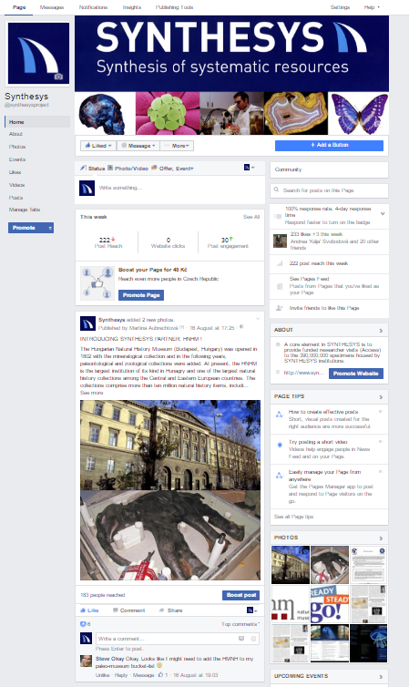
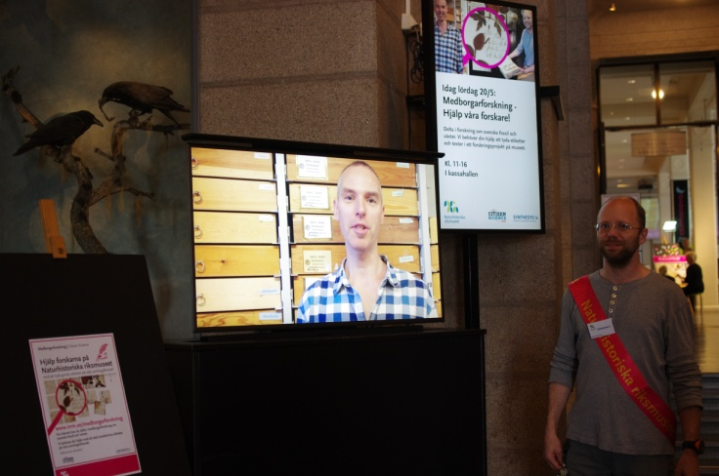
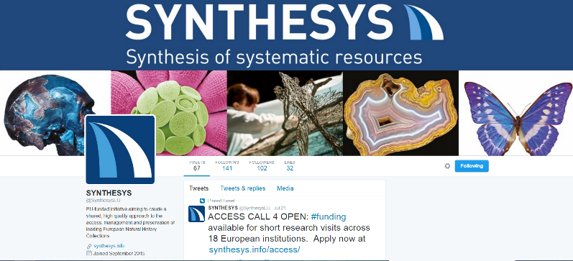
Objective 2 IMPACT
Task 2.1 Promotion and dissemination, task leader Jiří Kvaček (NMP)
Outputs of the NAs and JRA will be promoted in various ways both within and outside European Research Area.
Work done:
project Facebook and Twitter profiles
promotion of project outputs during various events
new project flyer and poster
SYNTHESYS3 Final Meeting
NMH, London, 6-7 June 2017

Slide 9
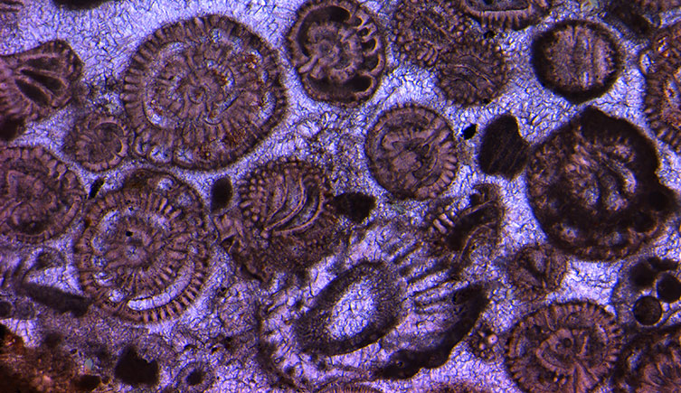
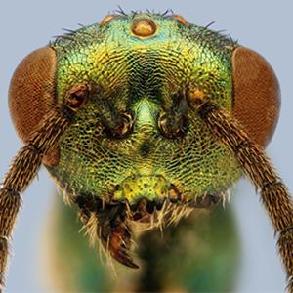
NHM - London
Symposium at the Citizen Science Conference in Minnesota (May 17-20)
Projects:
· Miniature Lives Magnified: nhm.ac.uk.mlm
· Miniature Fossils Magnified: nhm.ac.uk/mfm
· Exploring Tropical Sweden: bit.ly/2qxeJYl
For more information about the projects see:
http://www.nhm.ac.uk/…/cit…/miniature-fossils-magnified.html
https://blog.nhm.ac.uk/…/take-part-in-ocean-science-on-the the-beach-or-from-your-computer-citizen-science

Slide 10
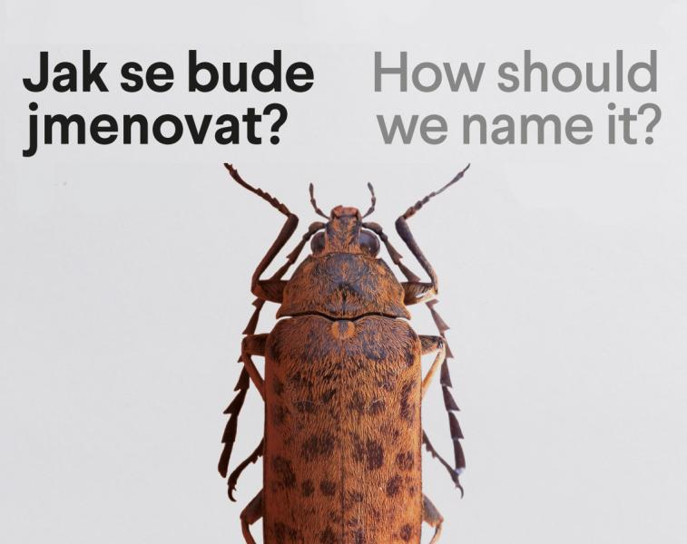
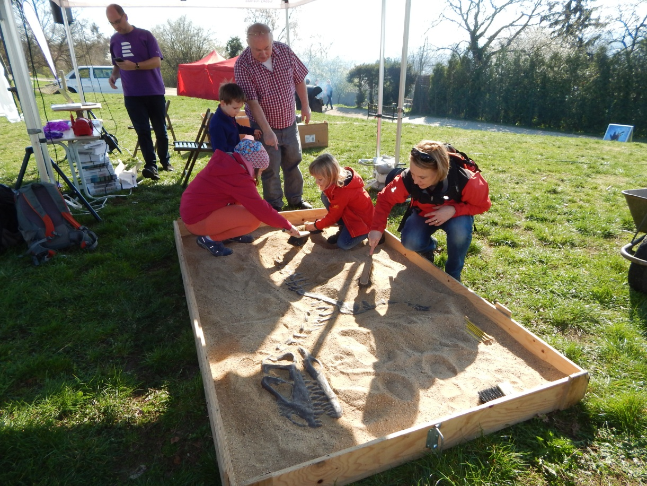
NMP - Prague
Public event
How should we name it? July 15
Tracking a dinosaur (April 1)
Promotion of Access: Facebook
For more information about the projects see:
http://www.nm.cz/Prirodovedecke-muzeum/Pripravujeme-PM/Jak-se-bude-jmenovat.html
https://www.facebook.com/synthesysproject/?ref=aymt_homepage_panel

Slide 11
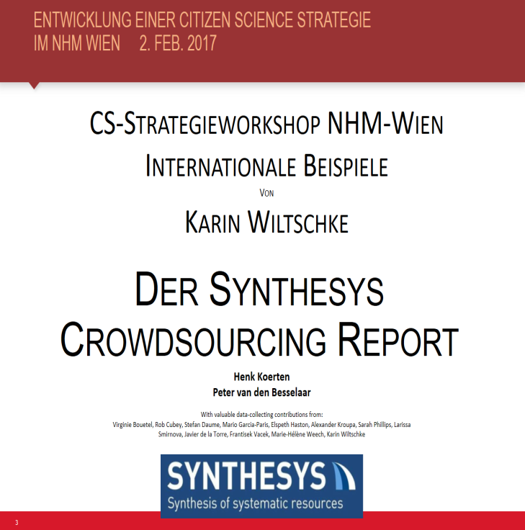
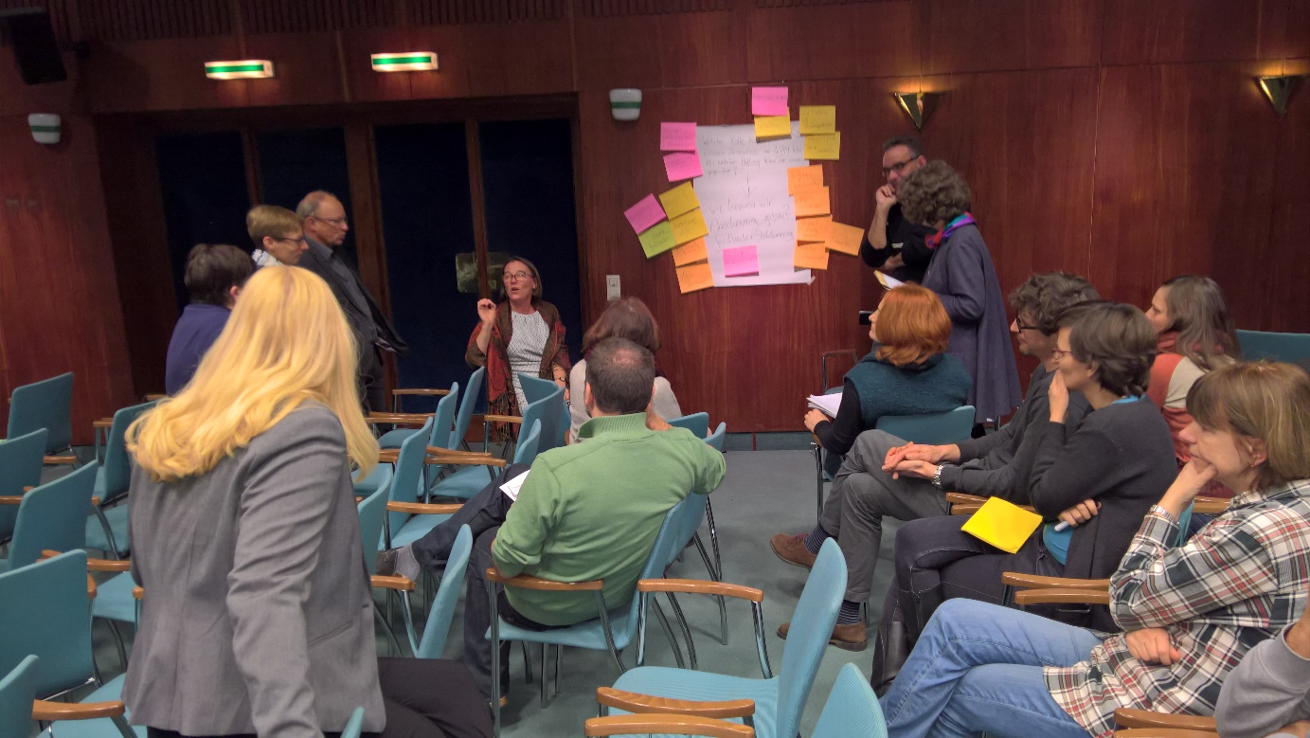
NHM-Vienna
http://www.nhm-wien.ac.at/forschung/mitmachen
http://herbarium.univie.ac.at/index.htm

Slide 12
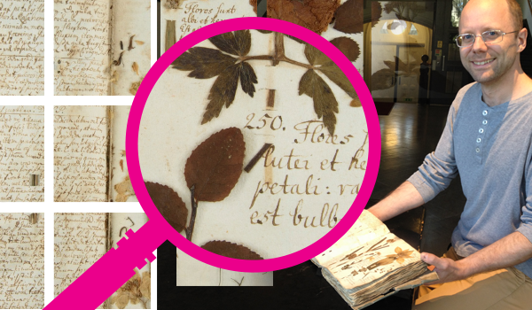
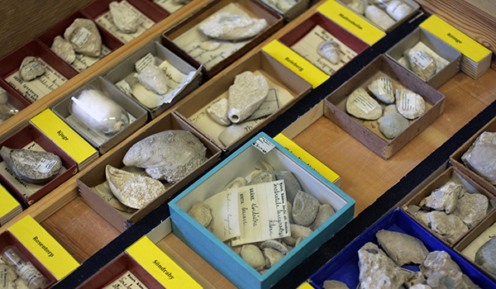
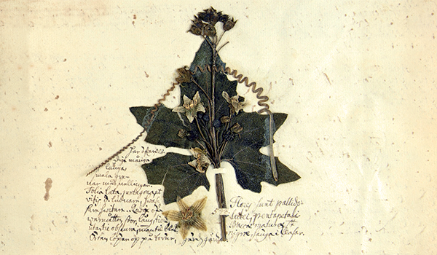
NRM - Stockholm
CITIZEN SCIENCE DAY on May 20th in the Swedish Museum of Natural History in Stockholm
For more information about the projects, see:
http://www.nrm.se/forskning…/medborgarforskning.9004490.html
http://www.nrm.se/…/kalende…/hjalpvaraforskare.9004493.html

Slide 13
HNHM - Budapest
Promotion of Access - Researcher profiles and interviews in Hungarian and English on the museum’s website
8 profiles and 7 interviews
Promotion of CSAT among institutions in Balkan
Homepage where the CSAT forms are available in Hungarian (we uploaded the original English version, as well) - csat.nhmus.hu
In addition, General questions form, which is based on the CETAF passport, to gain more information about the institutions
Presented in 4 conferences in Hungary, Croatia, Macedonia, Serbia
1 workshop in Zagreb (Croatia)
We have contacted 31 institutions/departments, 13 have already used it (from Hungary, Slovakia, Croatia, Macedonia, Montenegro Serbia, Slovenia)

Slide 14
Objective 2 IMPACT
Task 2.2 Improved access to collections and contribution to ERA, task leader Mario García París (CSIC)
Improve access to virtual and new physical collections by making all data outputs freely available and open access.
Work done:
guidelines to sharing data via four major data aggregators (Europeana, GBIF, EMBL-EBI and ISBER).
SYNTHESYS3 Final Meeting
NMH, London, 6-7 June 2017

Slide 15
Objective 3 SUSTAINABILITY
Task 3.1 Meeting the future needs of Users of Natural History institutions, task leader Christiane Quaisser (MfN)
In 2008, the EU-funded EDIT project held a symposium on the future trends in taxonomy. This will be used as a baseline document for our work; workshop will be held on sustainability of NH collections. This will result in a roadmap for European NH institutions to progress in a unified manner to meet the changing demands of research. The roadmap will be passed to CETAF for continued implementation.
Work done:
Sustainability workshop October 2015 (Deliverable D3.5)
identification of traditional and current uses of natural history collections
as well as non-conventional potential future uses and user groups
gathering documentary evidence of NHC uses
Deliverable D3.6 European Roadmap
SYNTHESYS3 Final Meeting
NMH, London, 6-7 June 2017

Slide 17
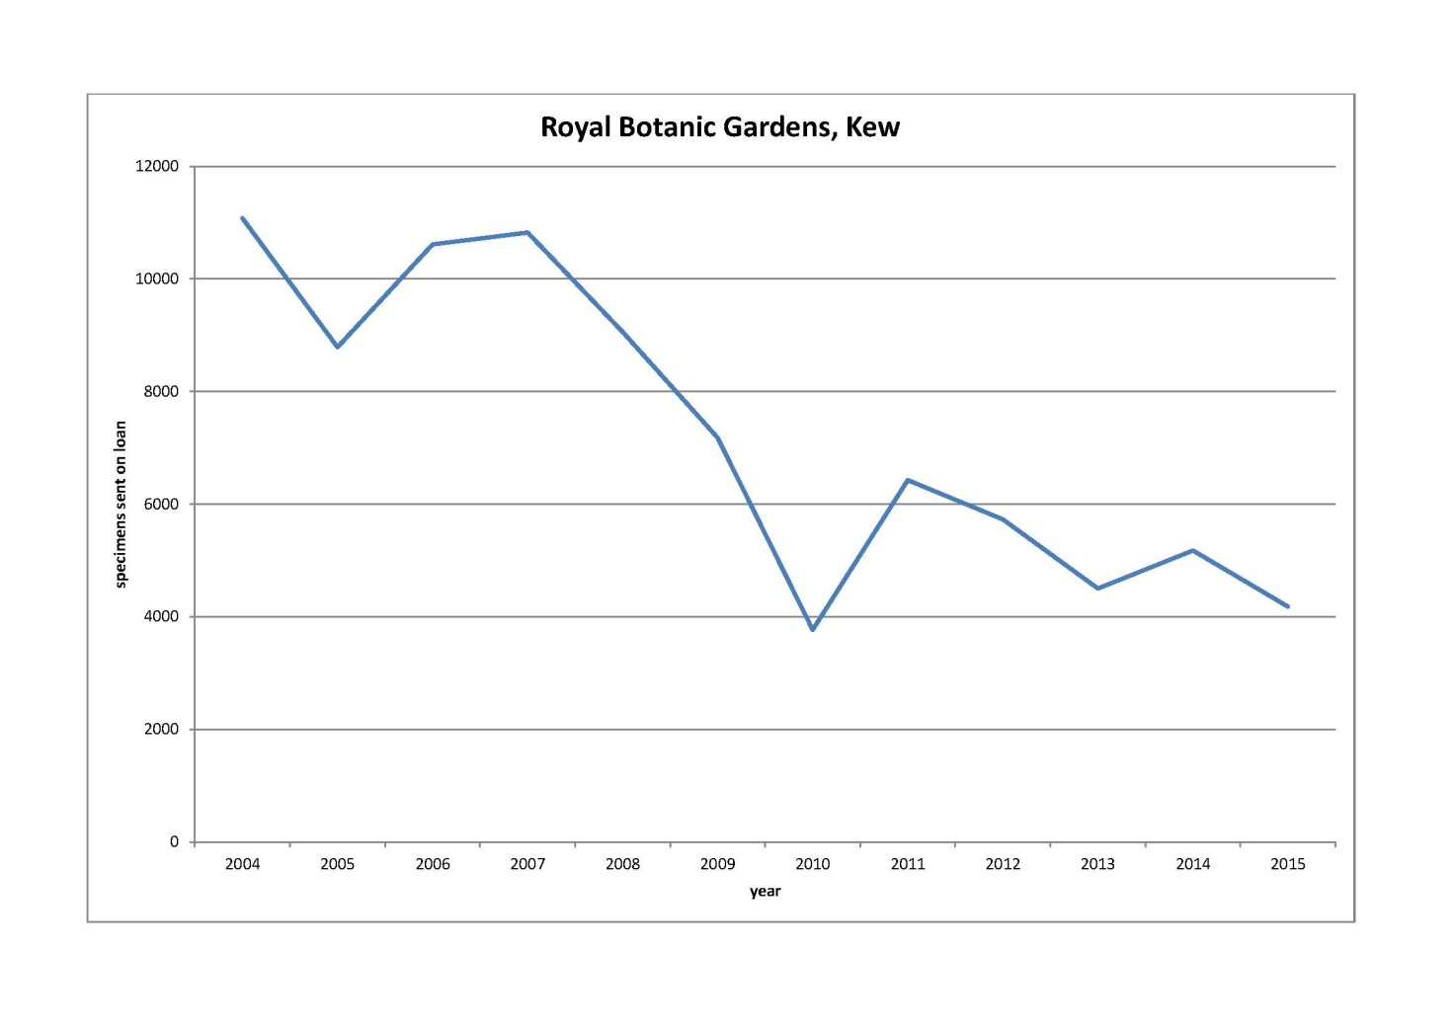
Objective 3 SUSTAINABILITY
Task 3.2 Facilitating Access beyond SYNTHESYS3, task leader Jiří Kvaček (NMP)
The improvements to NH virtual collections as a result of improved digitisation methods will, over time, change the face of Access and reduce the need for lengthy physical visits. NH institutions will increasingly be able to send digital surrogates that are of excellent research quality. This new form of access will be of benefit not only to the European research community but also to researchers in Third Countries who wish to undertake collaborative research with European scientists using collections based in Europe.
Work done:
survey to investigate how digitisation affects physical access (two on-line questionnaires by UCPH)
77 responses from custodians and 120 from users (by September 27)
SYNTHESYS3 Final Meeting
NMH, London, 6-7 June 2017

Slide 18
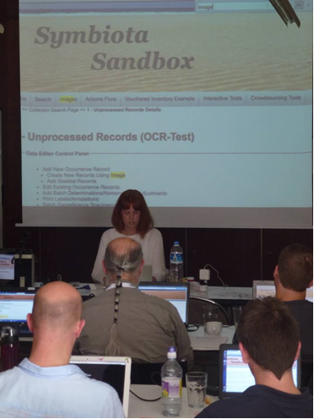
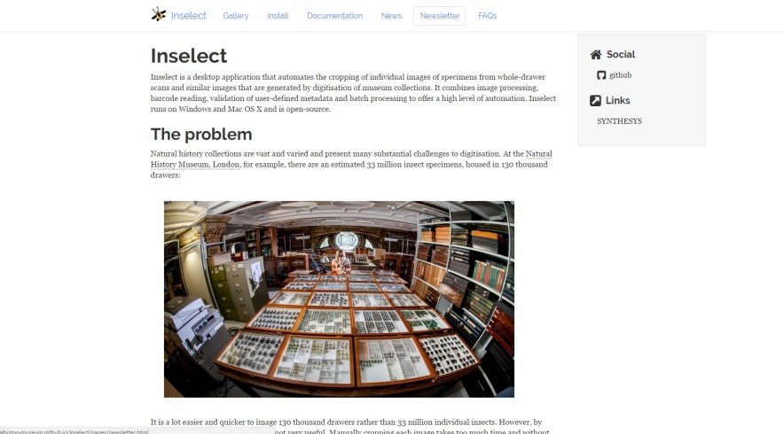
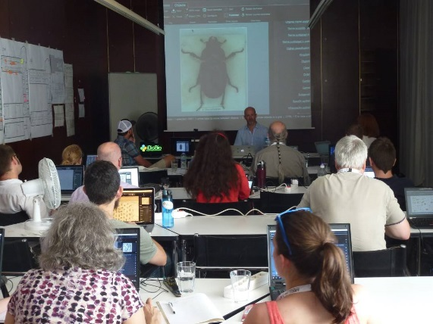
Objective 3 SUSTAINABILITY
Task 3.3 Collaboration with iDigBio on training for the future, task leader Elspeth Haston (RGBE)
It is recognised that in order to build a sustainable future for digitisation of NH collections it is critical to collaborate with other large-scale digitisation programmes on training people in new technological advances in digitisation. This task aims to link with the iDigBio programme funded by the National Science Foundation in the USA to prioritise and provide training in these new technologies. A joint workshop with iDigBio will be organised to provide training for digitisation software including that developed in the JRA Task 1.1.
Work done:
training workshop at SPNHC (June 2016)
Inselect , ABBY FineReader, Symbiota - automating the digitization
of natural history collections.
Dissemination of JRA outputs
SYNTHESYS3 Final Meeting
NMH, London, 6-7 June 2017

Slide 19
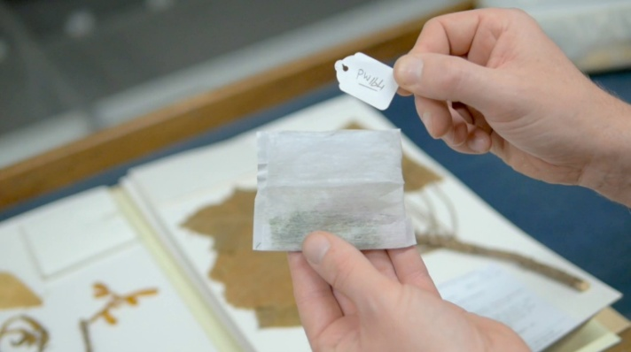
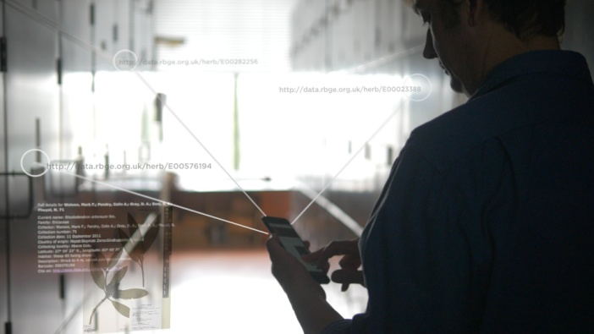
Objective 3 SUSTAINABILITY
Task 3.4 Sustainable use of SYNTHESYS3 outputs, task leader David Harris (RGBE)
Work done:
Three videos to help disseminate new techniques developed over the period of the SYNTHESYS:
1. Permanent actionable identifiers
2. New method of collecting leaf material for DNA extraction Teabag method, field demonstration
3. Inselect software
videos already on-line: https://vimeo.com/195812974
SYNTHESYS3 Final Meeting
NMH, London, 6-7 June 2017

Slide 20
4 Instruction Videos 3D scanning and printing
Megatherium americanum “digitalis”. 3D printing. 6 min 49 sec
Digitisation of fossils. 1 min
Post-proccessing of digitization of fossils. 1 min
3D Printing of fossils. 1 min

Slide 21
Progress towards milestones and deliverables
D3.1 Promotion NA2 in progress (due in August 2017)
D3.3 Promotion JRA in progress (due in August 2017)
D3.3 Optimal digitisation pilot study completed
D3.4 Crowdsourcing report completed
D3.5 Sustainability workshop completed
D3.6 European Roadmap completed
D3.7 SPNHC Symposium completed
D3.8 JRA training workshop completed
D3.9 Instruction videos in progress (to be completed soon)
SYNTHESYS3 Final Meeting
NMH, London, 6-7 June 2017

