Slide 1

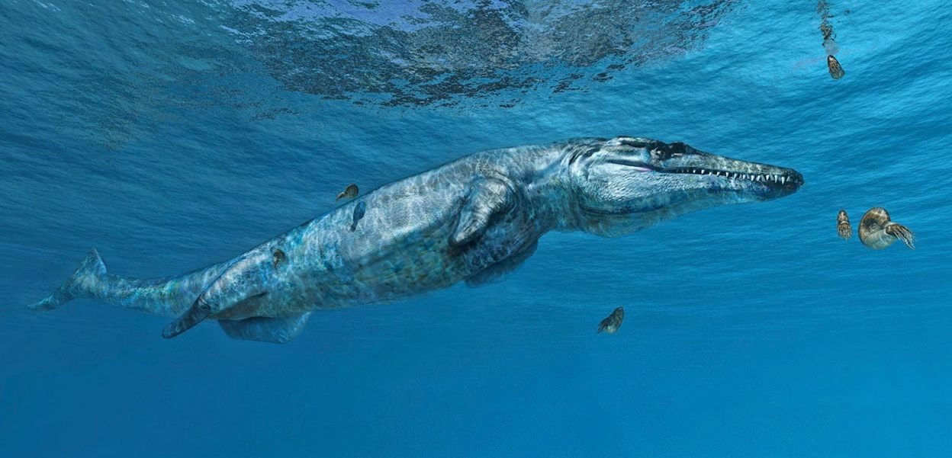

Untangling the evolution of dolphin-like marine crocodiles during the Age of Dinosaurs
Dr Mark Young
Life reconstruction of Plesiosuchus manselii by Fabio Manucci

Slide 2
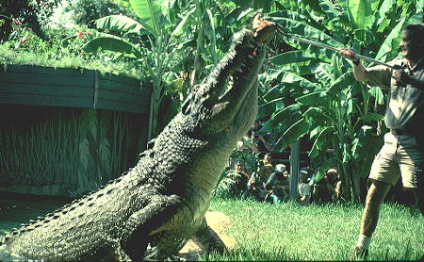
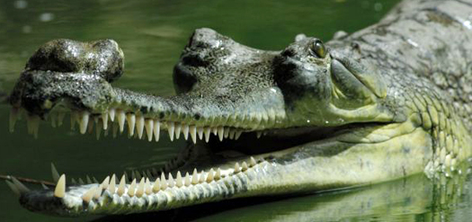
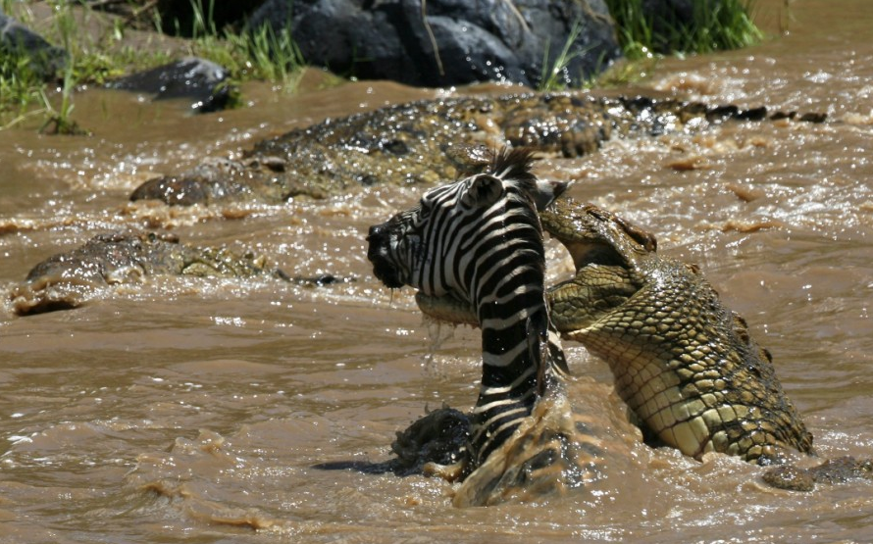
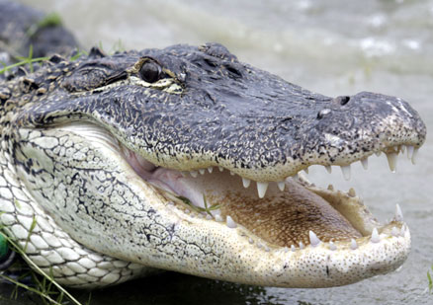
Gavialis gangeticus
Crocodylus porosus
Alligator mississippiensis
Crocodylus niloticus

Slide 3
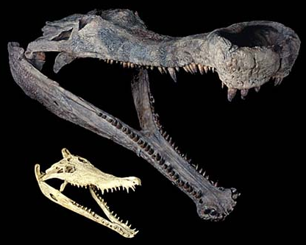
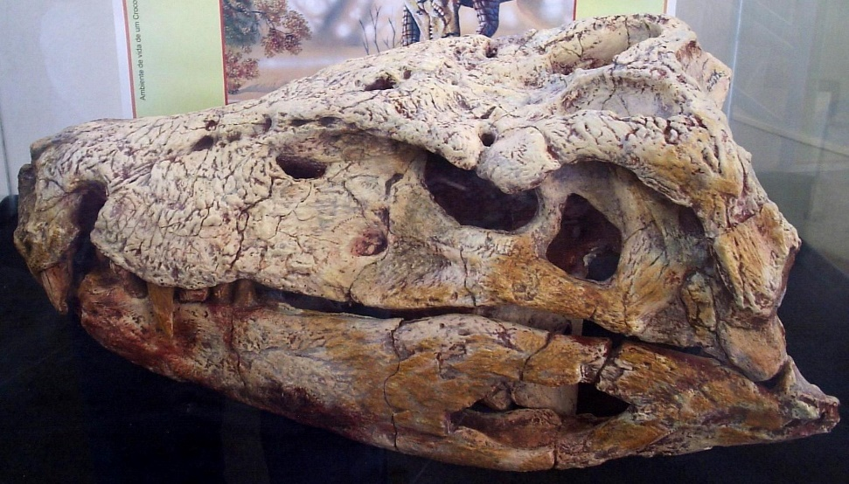
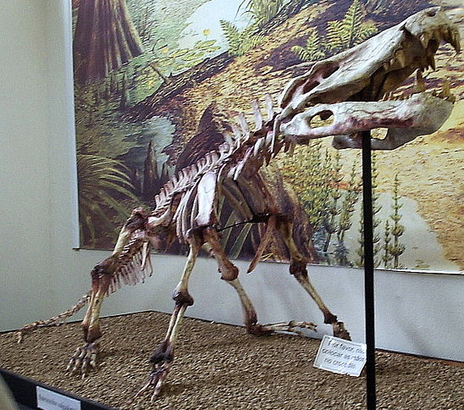
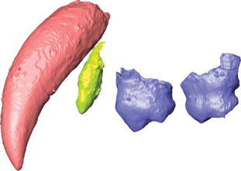
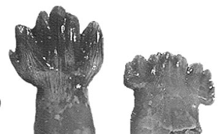
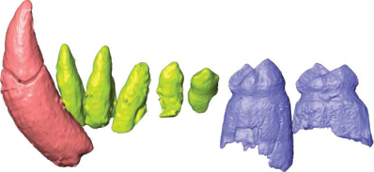
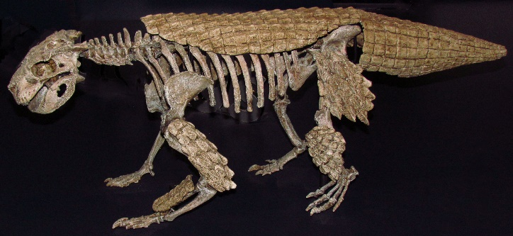
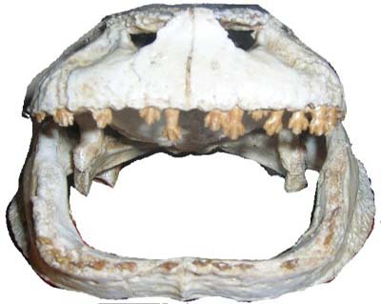
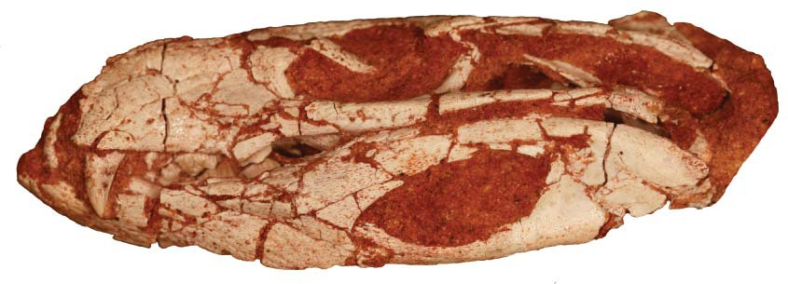
Baurusuchus
Terrestrial digitigrade carnivore
Sarcosuchus
Giant semi-aquatic species
(Nile crocodile skull for scale)
Cretaceous crocodylomorphs
Pakasuchus
Terrestrial carnivore with mammal-like dentition
(canines, premolars & molars)
Simosuchus
Terrestrial heavily armoured herbivore/omnivore

Slide 4
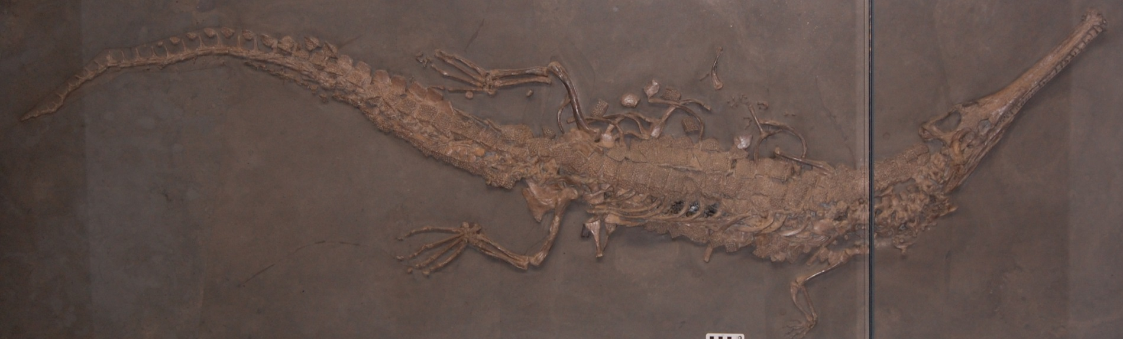
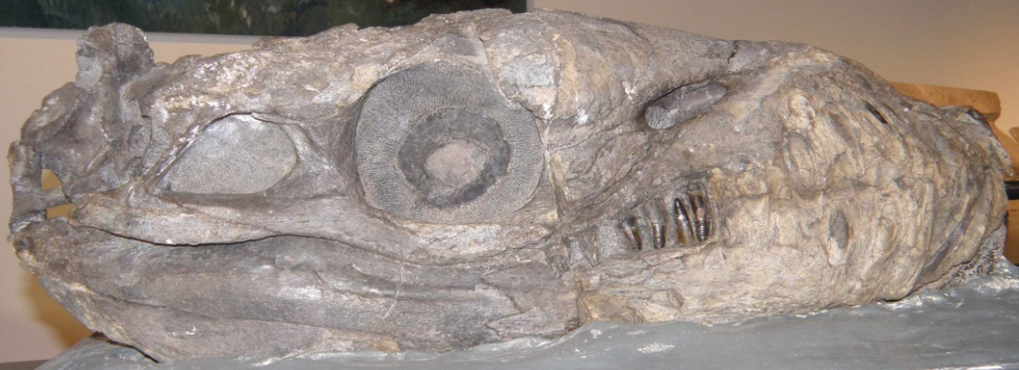
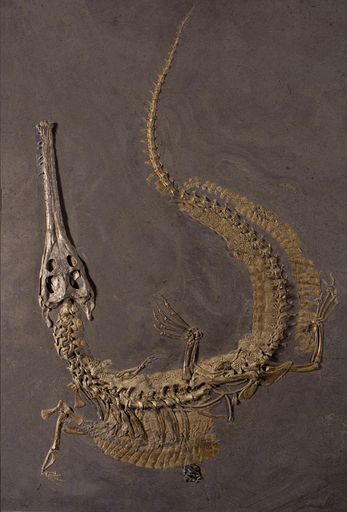
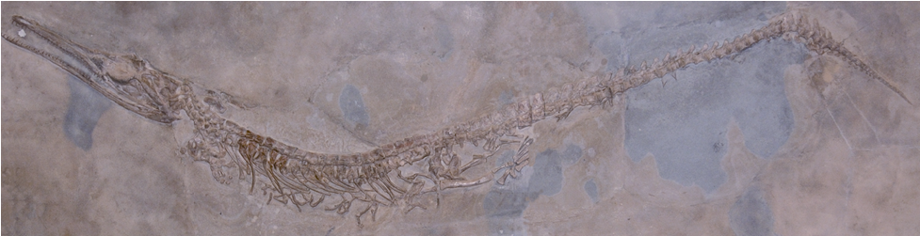

Thalattosuchia
First marine radiation of crocs
Early Jurassic – Early Cretaceous
> 10 genera
Includes gharial-like, dolphin-like, & killer whale-like species
Platysuchus
Steneosaurus
Dakosaurus
Cricosaurus

Slide 5
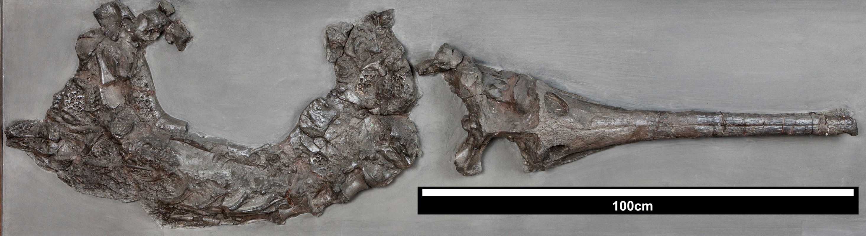
Teleosauroidea
‘Steneosaurus’ brevior
Small to large-bodied (2 – 7.2 m)
Largest crocs of the Jurassic
Early Jurassic – Early Cretaceous
At least 5 genera (more under description)
Most were gharial-like, but some (like Machimosaurus) fed on marine turtles
First known scientifically described croc fossil – 1758. From Yorkshire.
Steneosaurus bollensis

Slide 6

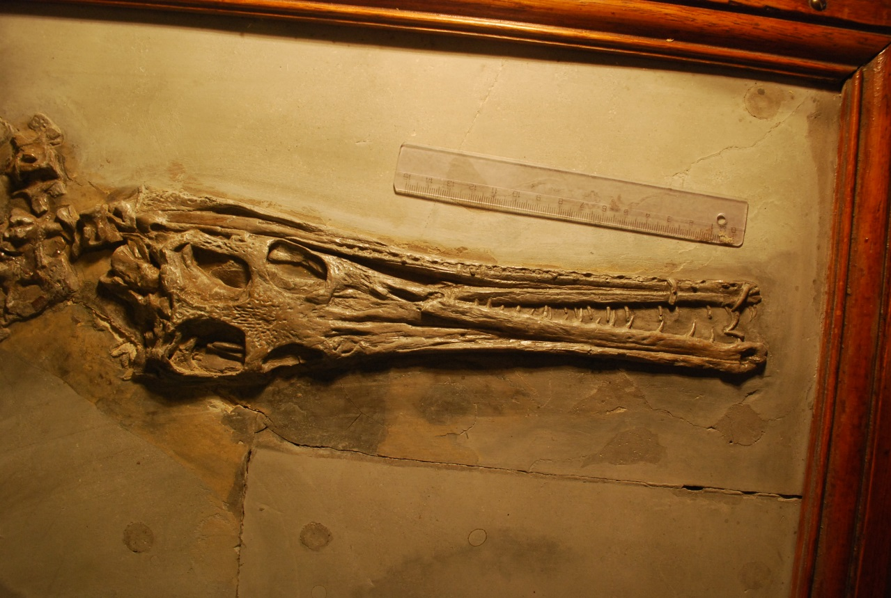
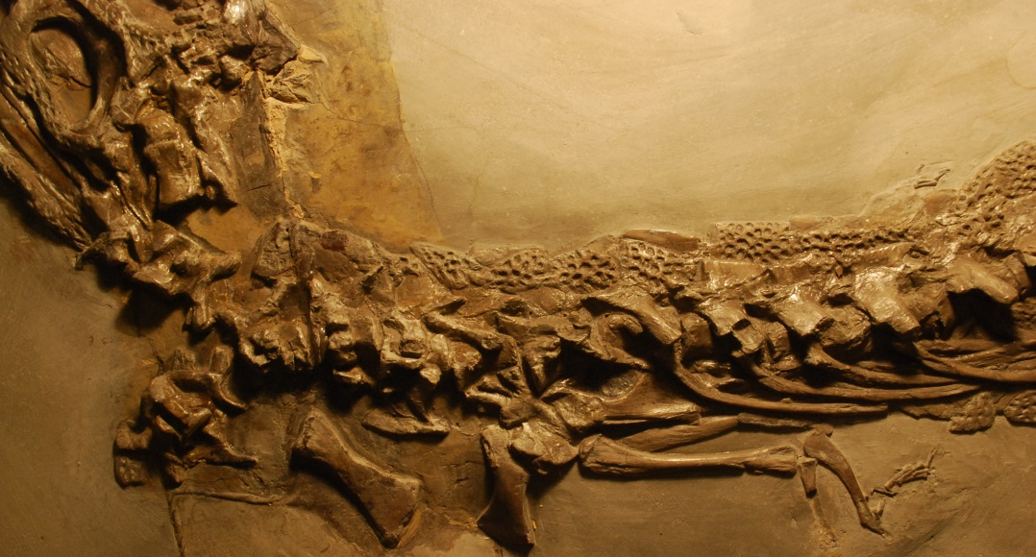
Metriorhynchoidea
Represents the transition from gharial-like to dolphin-like forms
Platysuchus
Teleosauroid
Basal metriorhynchoids start off very similar to teleosauroids
However, species like Pelagosaurus had: reduced armour, smaller forelimbs, wider pelvic canal, pes modifications
In the Middle Jurassic: the rise of Metriorhynchidae (the dolphin-like forms)
Pelagosaurus
Basal metriorhynchoid
Cricosaurus
Metriorhynchid

Slide 7
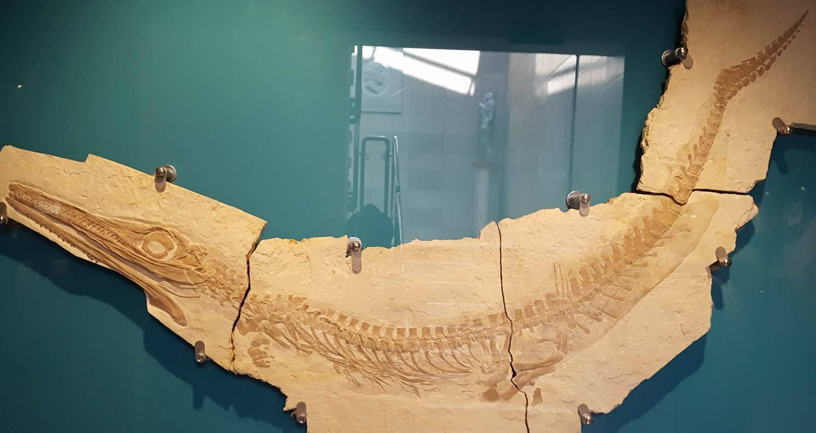
Metriorhynchidae
Regionalised tail, with hypocercal distal end
Enlarged orbits, with a well-defined sclerotic ring
Absence of osteoderms
Shortened neck
Widened & deepened pelvic canal
Hydrofoil-like
forelimbs
Paddle-like
hind-limbs

Slide 8
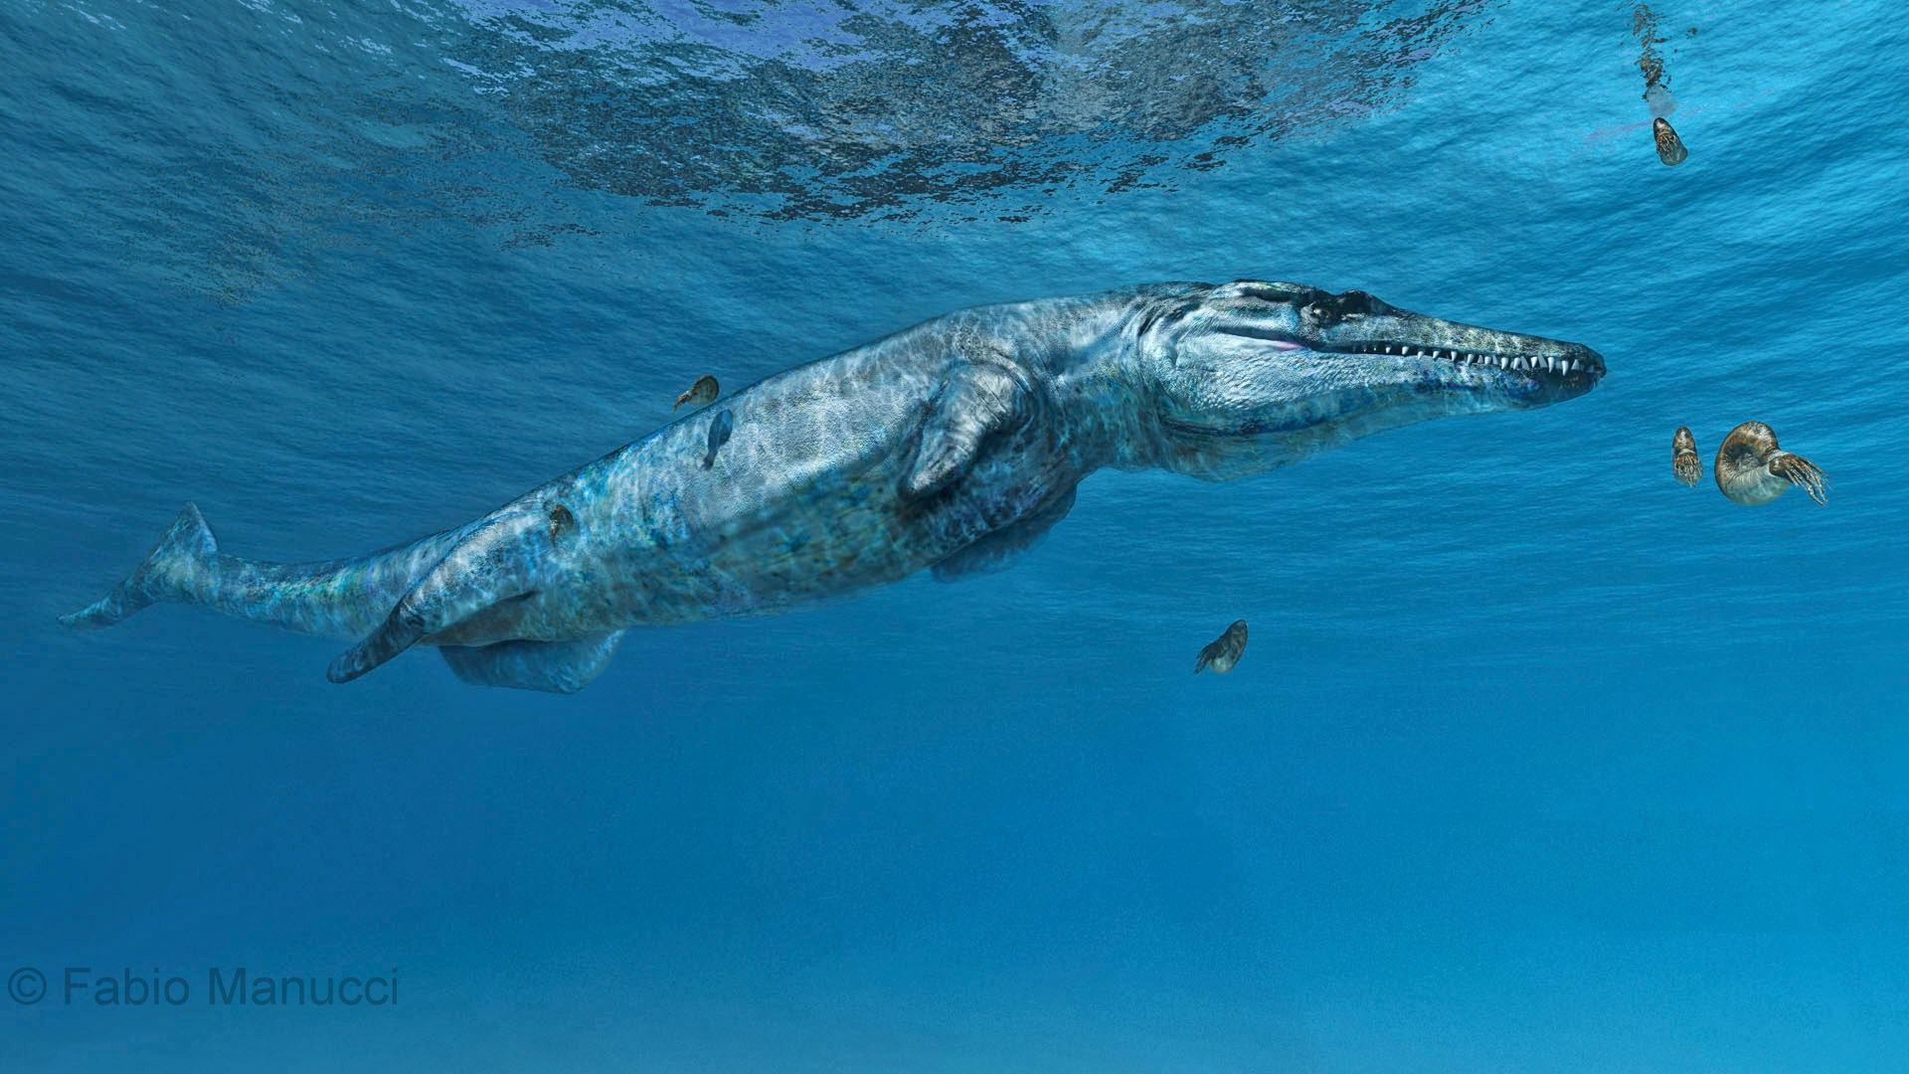
Research questions during SYNTHESYS visits
(1) Stablising the phylogeny of Thalattosuchia
  Incorporating more species into my phylogeny
  Building new characters, revising and modifying existing characters
  Essentially, where do thalattosuchians belong in the croc family tree?
(2) The origin, diversity and evolution of Thalattosuchia
  Exploring the anatomy, phylogeny and taxonomy of macrophagous thalattosuchian clades
  Elucidating morphological changes involved in the aquatic-to-pelagic shift in metriorhynchoids

Slide 9

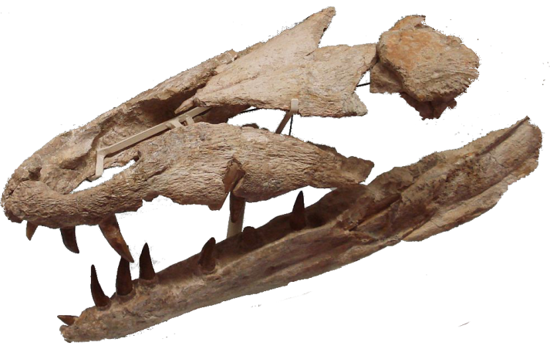

SYNYTHESYS Visits: Overview
Paris 2014
Muséum National d'Histoire Naturelle de Paris, France – One week visit
Anatomy, phylogeny and evolutionary biology of thalattosuchian crocodylomorphs
Stuttgart 2015
Staatliches Museum für Naturkunde Stuttgart, Germany – Two week visit
Land-to-sea transition: the early evolution and adaptations of thalattosuchian crocodylomorphs
Berlin 2016
Museum für Naturkunde Berlin, Germany – Two week visit
The land-to-sea transition: understanding the evolution of dolphin-like marine crocodylomorphs
Budapest 2017
Hungarian Natural History Museum, Budapest, Hungary – Two week visit
How Jurassic crocodylomorphs evolved into sea-going dolphin-like forms: elucidating the morphofunctional changes involved in the land-to-sea transition

Slide 10
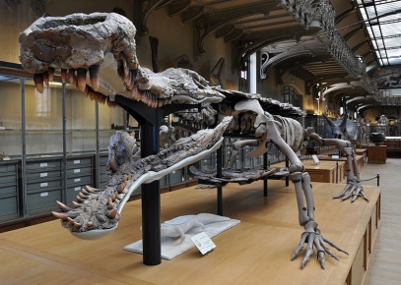
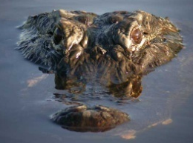
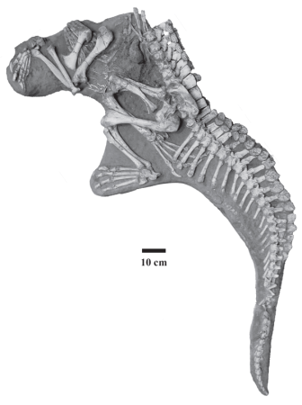
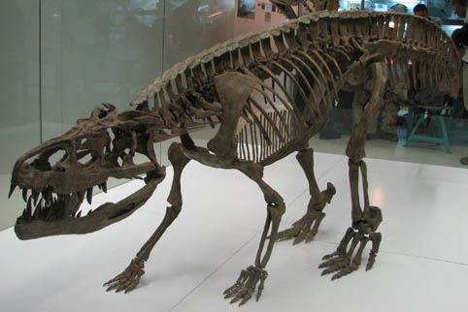
Thalattosuchia?
(1)
1
Semi-aquatic
neosuchians
Living Crocs
Notosuchia
Simplified cladogram
*some clades may be paraphyletic – e.g. Sphenosuchia*
Protosuchia
Sphenosuchia
Neosuchia
Mesoeucrocodylia
2
Rauisuchans
Crocodyliformes
3
Crocodylomorpha

Slide 11
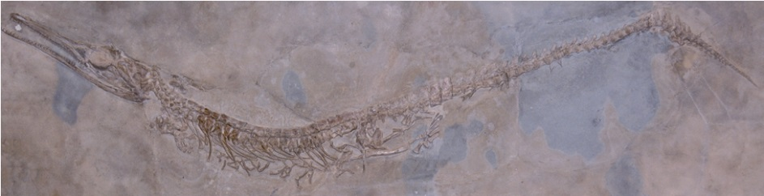
Thalattosuchia?
(1)
1
Semi-aquatic
neosuchians
Living Crocs
Notosuchia
This hypothesis means:
Thalattosuchia evolved from a
freshwater ancestor
Protosuchia
Sphenosuchia
Neosuchia
2
Hypothesis 1: derived neosuchian
Rauisuchans
Single origin for semi-aquatic crocodylomorphs (Neosuchia)
Means thalattosuchians are part of the same aquatic radiation that gave rise to living species
But, thalattosuchians lost most neosuchians apomorphies… & creates a long ghost lineage
3

Slide 12
Thalattosuchia?
(1)
1
Semi-aquatic
neosuchians
Living Crocs
Notosuchia
This hypothesis means:
Thalattosuchia evolved from a
terrestrial ancestor
Protosuchia
Sphenosuchia
Neosuchia
2
Hypothesis 2: basal crocodyliform
Rauisuchans
Two origins of semi-aquatic crocodylomorphs
The two radiations of aquatic Mesozoic crocs, with thalattosuchians being an independent aquatic radiation
My current preferred hypothesis – based on the odd morphologies of the group
3

Slide 13
Thalattosuchia?
(1)
1
Semi-aquatic
neosuchians
Living Crocs
Notosuchia
This hypothesis means:
Thalattosuchia evolved from a
terrestrial ancestor, but one
adapted for running…
Protosuchia
Sphenosuchia
Neosuchia
2
Hypothesis 3: non-crocodyliform
Rauisuchans
Also two independent origins for semi-aquatic crocodylomorphs
Two aquatic radiations of Mesozoic crocs
But, implies there must be Triassic thalattosuchians…
3

Slide 14
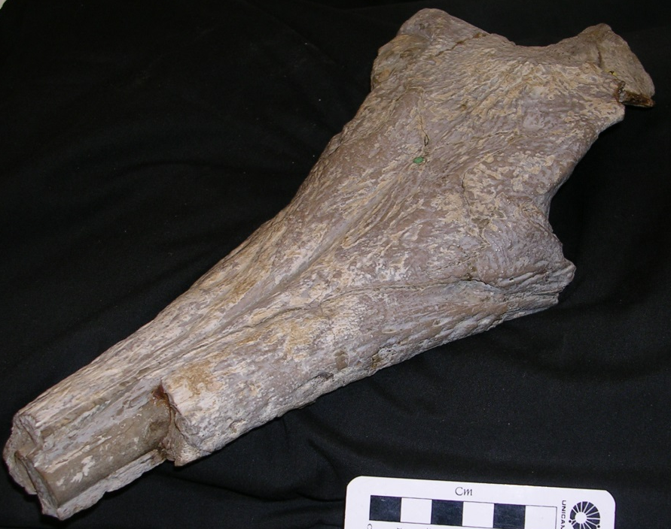
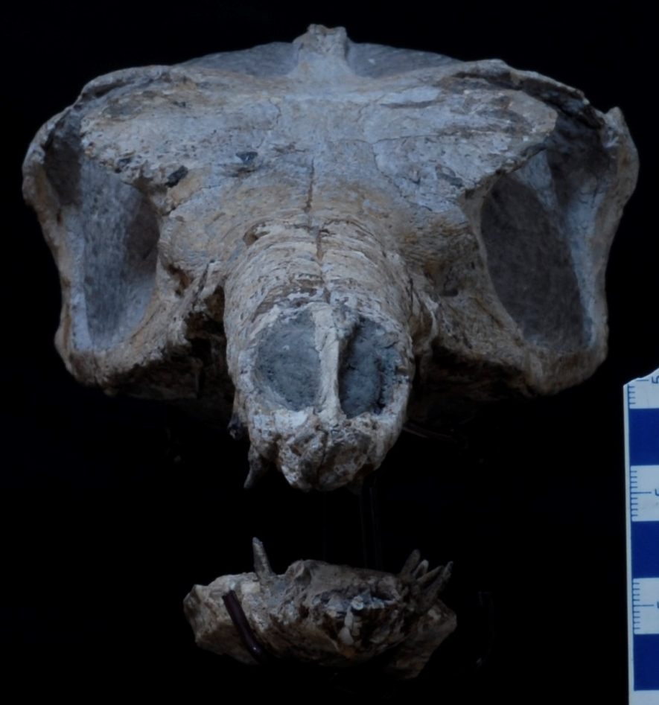
What does this mean?
Crocodylomorph systematics is currently a mess…
Different phylogenetic datasets support different evolutionary hypotheses…
(During these visits my analyses have jumped between all three hypotheses)
Thus we don’t know when major clades like Thalattosuchia evolved
What we’re the closest relatives of Thalattosuchia?
When did crocs become semi-aquatic? How many times?
Timing of the land-to-sea transition in thalattosuchians is still unclear

Slide 15
How do we fix this? CrocSuperMatrix Project
Young matrix
Hastings matrix
[Thalattosuchia]
[Dyrosauridae]
Jouve (2005) / Jouve et al. (2005)
Young (2006)
Wilkinson et al. (2008)
Barbosa et al. (2008)
Young & Andrade (2009)
Hastings et al. (2010)
Hastings et al. (2011)
Young et al. (2012)
Hastings et al. (2015)
Young et al. (2016) [dataset 2]
Has Paris + Stuttgart data
Young et al. (2016) [dataset 1]

Slide 16
CrocSuperMatrix Project
Young matrix
Hastings matrix
[298 characters]
Both matrices support hypothesis 3
[120 characters]
[103 OTUs]
[37 OTUs]
Character evaluations
Character merging
Creation of new character, & splitting old characters
Character re-writing & consistency
Taxon re-scoring
Partial cross-evaluation with the Andrade et al. (2011) matrix
New merged matrix: 397 characters for 140 OTUs Supports Hypothesis 2
Has data from all 4 visits

Slide 17
Semi-aquatic
neosuchians
Living Crocs
Notosuchia
Thalattosuchia
Neosuchia
Protosuchia
Sphenosuchia
Hypothesis 2: supported
2
Thalattosuchians are an aquatic radiation independent from the lineage that gave rise to living crocs
Evolved during the Early Jurassic (within the first 10 million years), evolving quickly after the Triassic- Jurassic mass extinction event
They are a “protosuchian”-grade lineage modified for a marine existence
3

Slide 18
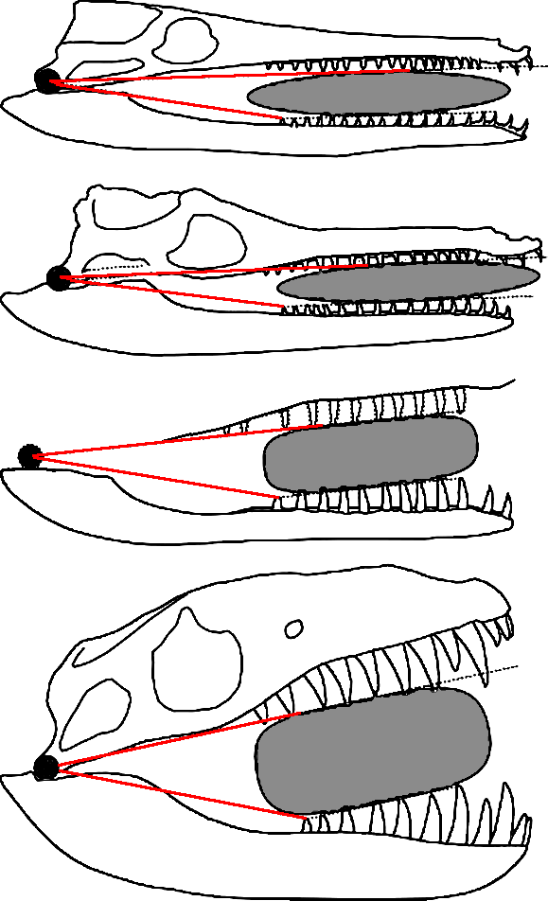
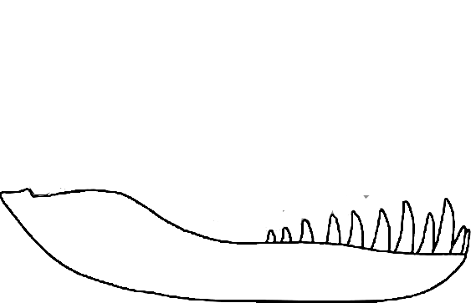
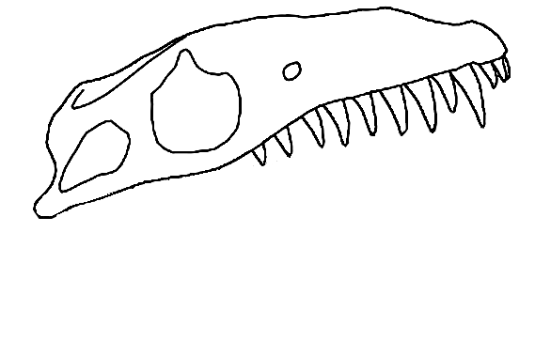
Macrophagy in Metriorhynchidae
Increase gape
Modified from Pol & Gasparini (2009) JSP; Young et al. (2013) JSP
Notes:
18

Slide 19

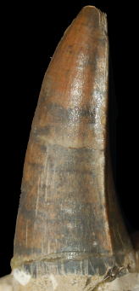
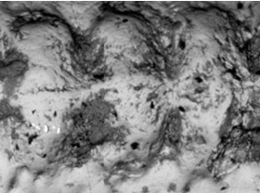
Macrophagy in Metriorhynchidae
Macrophagous metriorhynchids evolved a wider gape (first) in order to eat larger-bodied prey items
But, bite force decreases and gape increases
So, they evolved ways to increase bite force, or process prey more efficiently
Dakosaurus
Skull & mandibular characteristics
  Enlarged supratemporal fenestrae
  Shearing occlusion mechanics
  Shortened snout
Dental characteristics
  Enlarged apicobasal length
  Carinated & denticulated
  Fewer, but wider teeth

Slide 20
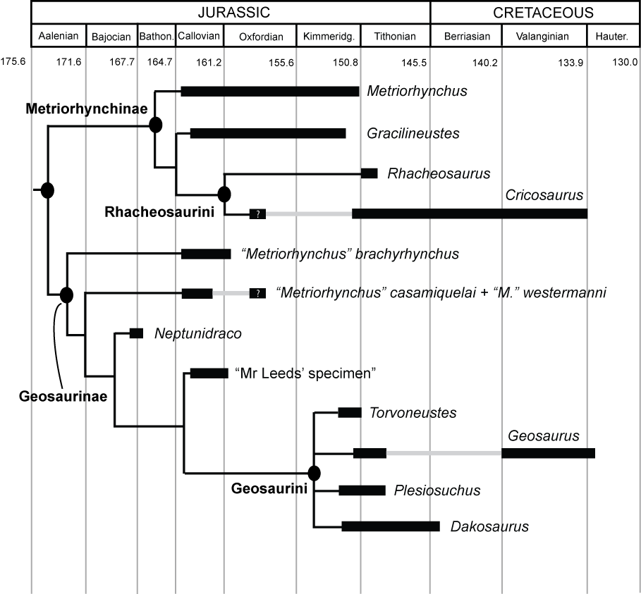
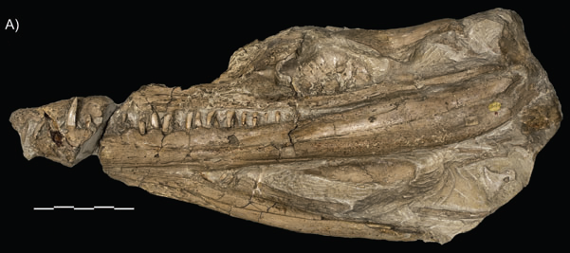

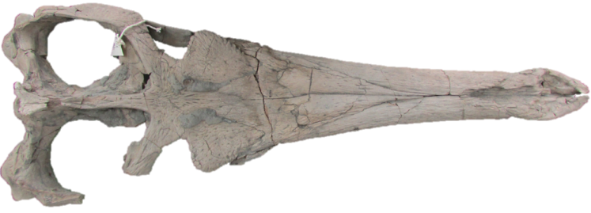
Young et al. (2012) PLoS ONE
Tyrannoneustes
Macrophagous subclade

Slide 21
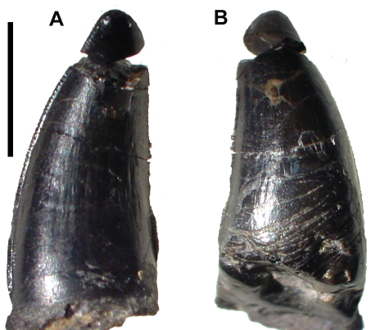
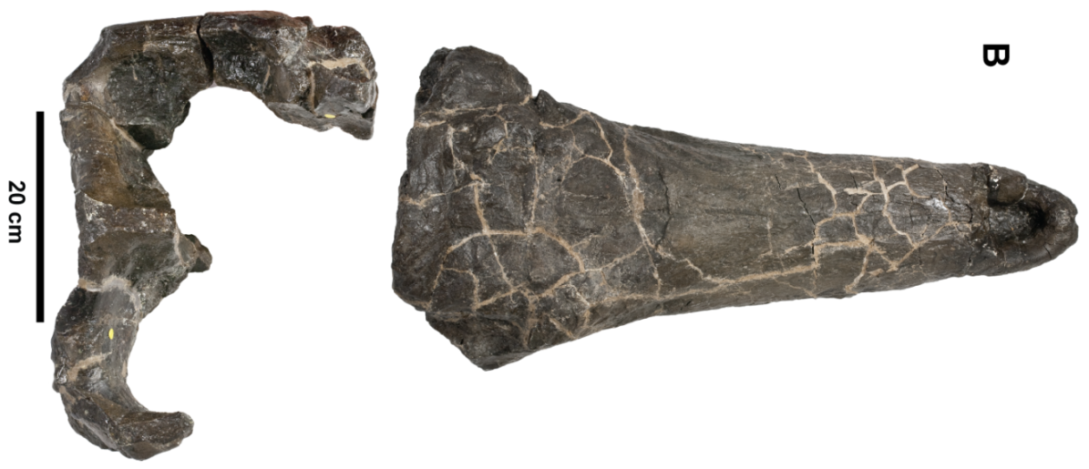

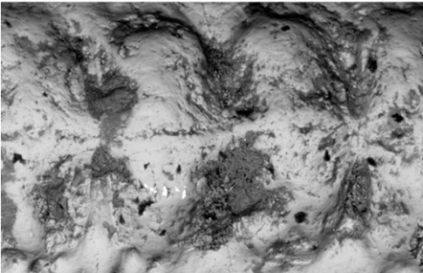
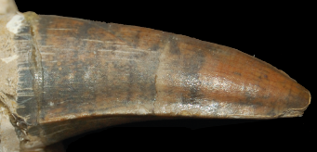
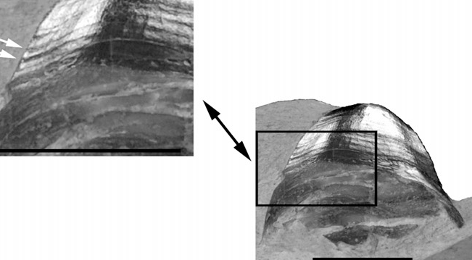
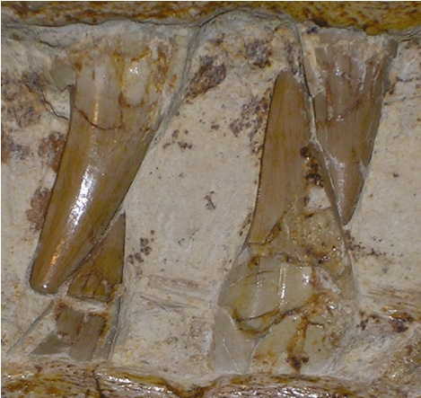
Geosaurini
Wide morphological diversity
Suite of adaptations for macrophagy
Plesiosuchus
Largest metriorhynchid
Dakosaurus
False killer-whale like forms
Geosaurus
Barracuda-like forms

Slide 22
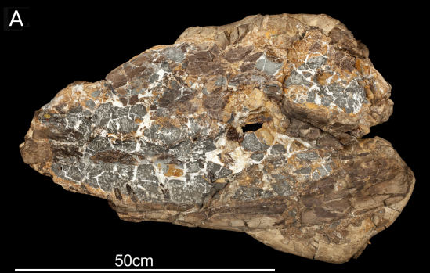
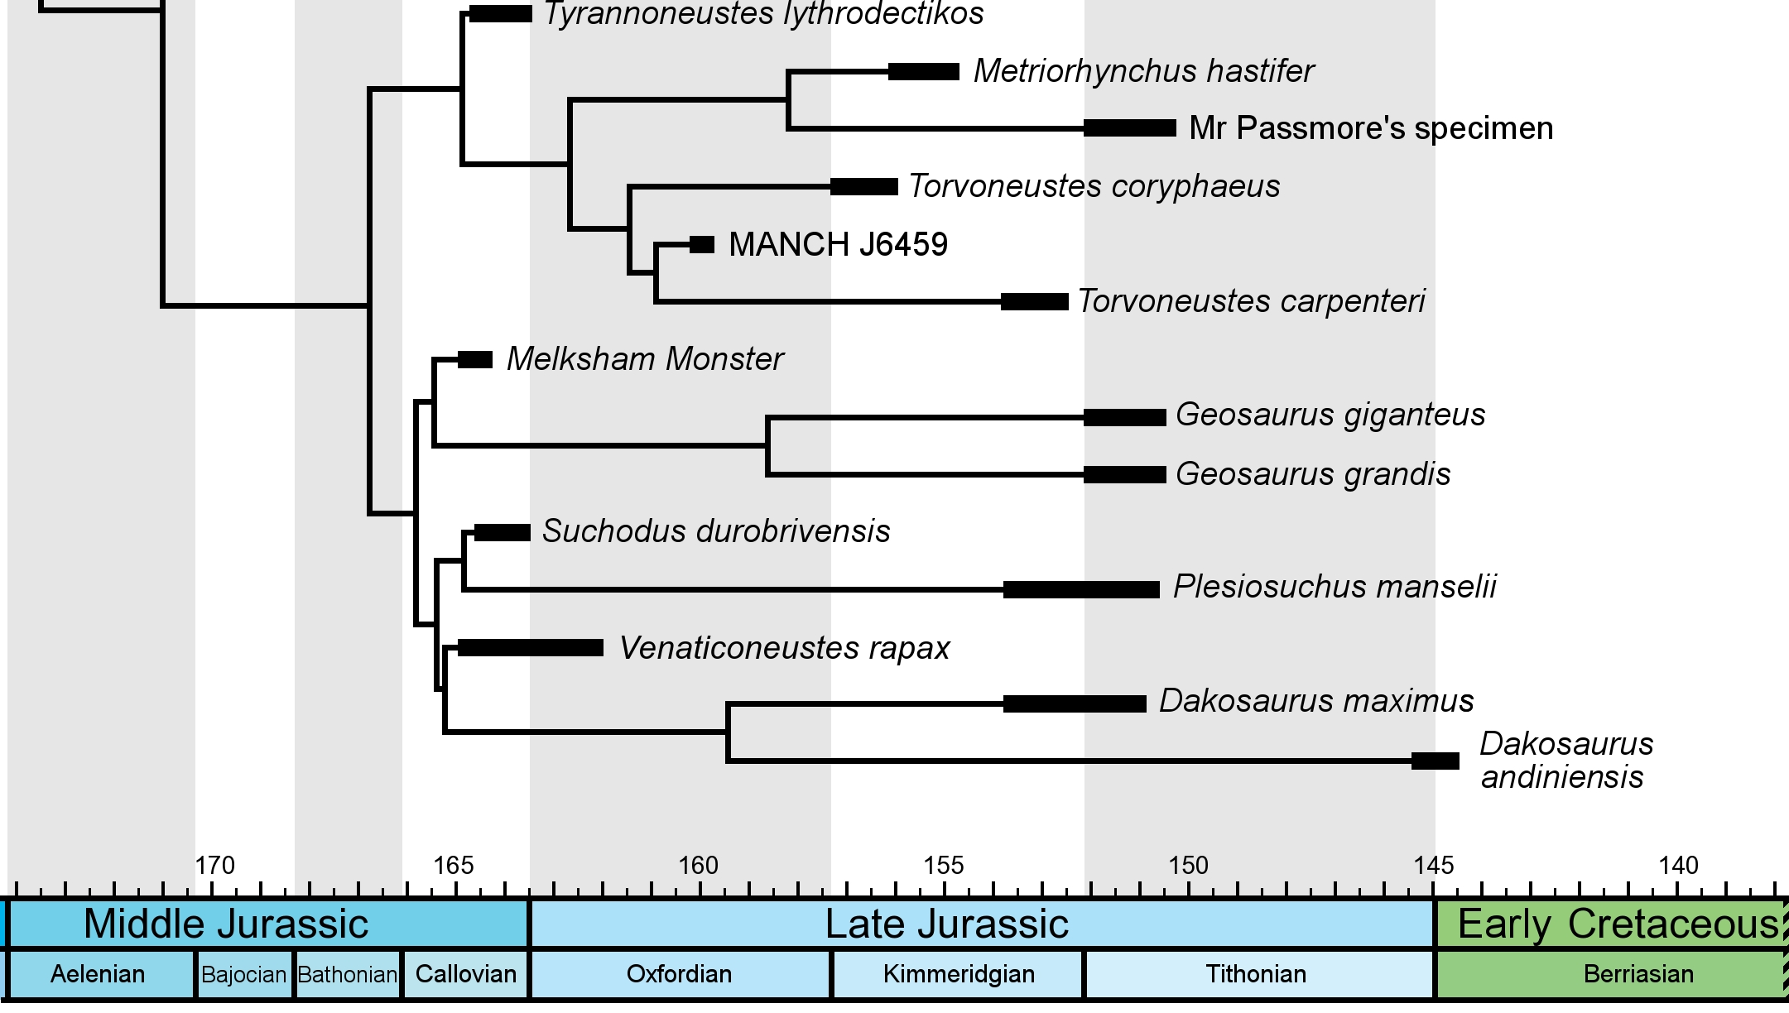
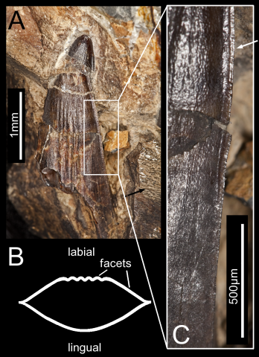
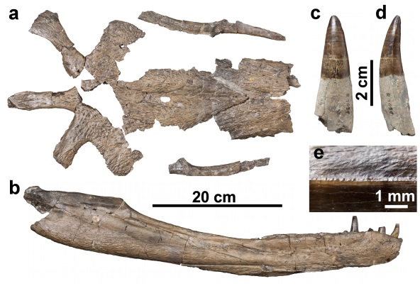
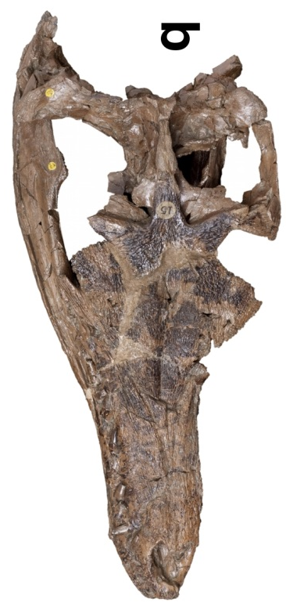

Slide 23

Paris 2014 (FR-TAF-4021): Outputs
Anatomy, phylogeny and evolutionary biology of thalattosuchian crocodylomorphs
Peer-reviewed papers citing Paris visit data:
  Young et al. (2014). Biological Journal of the Linnean Society 113: 854–871. [Marine tethysuchian from UK]
  Young et al. (2014). Royal Society Open Science 1: 140269. http://dx.doi.org/10.1098/rsos.140269 [Machimosaurus serrations]
  Johnson et al. (2015). Biological Journal of the Linnean Society 115: 911–918. [Steneosaurus edwardsi specimen re-description]
  Young et al. (2016). Zoological Journal of the Linnean Society doi: 10.1111/zoj.12452 [Re-description of Fortignathus felixi]
  Young et al. (2016). Palaeontologia Electronica 19.3.30A: 1–14. [Estimating body-size in teleosaurid crocodylomorphs]
  Brusatte et al. (2016). The Anatomical Record 299: 1511–1530. [Steneosaurus cf. gracilirostris endocast and neuroanatomy]
  Johnson et al. (In Press). Zoological Journal of the Linnean Society. [Steneosaurus obtusidens re-description]
Submitted papers citing Paris visit data:
  Ristevski et al. (In Review). Cretaceous Research. [New species of Anteophthalmosuchus]
Due to the sheer volume of material there, my PhD student Michela Johnson went to Paris with SYNTHESYS this year to continue the project (but focussing on the teleosauroids). This will lead to further papers.

Slide 24


Stuttgart 2015 (DE-TAF-5132): Outputs
Land-to-sea transition: the early evolution and adaptations of thalattosuchian crocodylomorphs
Peer-reviewed papers citing Stuttgart visit data:
  Young et al. (2016). Palaeontologia Electronica 19.3.30A: 1–14. [Estimating body-size in teleosaurids]
  Brusatte et al. (2016). The Anatomical Record 299:1511–1530. [endocast and neuroanatomy]
  Johnson et al. (In Press). Zoological Journal of the Linnean Society. [Steneosaurus obtusidens re-description]
Submitted papers citing Stuttgart visit data:
  Ristevski et al. (In Review). Cretaceous Research. [New species of Anteophthalmosuchus]
Due to the sheer volume of material there, my PhD student Michela Johnson has also gone to Stuttgart (but not with SYNTHESYS) to continue the project (with a focus on the teleosauroids).

Slide 25



Teleosauroid body size
Early Cretaceous
Maximum body-size increased through time
Skull lengths of > 1m evolving at least 3 times
But those teleosauroids were not much larger than extant species – evolving disproportionally large heads
Late Jurassic
Middle Jurassic
Early Jurassic

Slide 26


Berlin 2016 (DE-TAF-5698): Outputs
The land-to-sea transition: understanding the evolution of dolphin-like marine crocodylomorphs
Berlin ended up having fewer specimens that were useful than I had hoped, and many that where were either casts or not available to be taken out and studied.
However, the data gleaned has ended up being useful for three projects: 1) student project on a revision of Pholidosaurus; 2) gathering first-hand data for my phylogeny (character scoring, and character construction); and 3) meeting Dr Yanina Herrera, and the beginning of collaborative projects together.
In preparation papers citing Berlin visit data:
  Smith et al. (In Prep.). Journal of Systematic Palaeontology.
  [Revision of Pholidosaurus]

Slide 27



Budapest 2017 (HU-TAF-6505): Outputs
How Jurassic crocodylomorphs evolved into sea-going dolphin-like forms: elucidating the morphofunctional changes involved in the land-to-sea transition
Budapest project was intended to study two skeletons in the collection:
  The famous Gerescei krokodil – the only oldest known fossil crocodylomorph from Hungary.
  The almost complete sub-adult Pelagosaurus typus skeleton in their collection.
The current plan is for my project partners Dr Attila Ősi (MTM) & Dr Márton Rabi (UoTübingen), and I to describe both specimens. With Attila to lead on the Gerescei krokodil manuscript, and myself to lead on the Pelagosaurus manuscript.
Submitted papers citing Budapest visit data:
  Ristevski et al. (In Review). Cretaceous Research. [New species of Anteophthalmosuchus]
Pelagosaurus

Slide 28






Budapest
Tooth
Pelvis
The undescribed Gerecsei krokodil
Early Jurassic (late Toarcian)
Very incomplete, poorly preserved and fragmentary…
Osteoderms
Vertebrae
Femur & tibita
Lower jaw fragments

Slide 29




Budapest
Based on lower jaw and pelvic girdle characters it could be a new, very large basal metriorhynchoid
If correct, it reveals an undiscovered level morphological diversity in basal metriorhynchoids.
Before now they were consider small crocs on the way to Metriorhynchidae
But ~ 5m-long giant changes that picture
Twin nerve grooves that run parallel to one another under the tooth row
Anterior acetabular margin projects anterior to the ilium anterior margin

Slide 30



Budapest
Metriorhynchus on display
in Tuebingen
BUT!!!
On the final day of the trip, we found a tail bone that hints it could be something different…
Cricosaurus on display
in Tuebingen

Slide 31

Post-SYNTHESYS research
What morphological shifts occur, and in what sequence, during the land-to-sea transition?
Do neurosensory shifts occur before the large-scale osteological changes?
If so, which shifts underpin the marine diversification? Endocranial, sinus, auditory, salt-excretion?
Eoneustes
basal metriorhynchoid
Steneosaurus
teleosauroid

Slide 32

Acknowledgements
  SYNTHESYS
  Museum curators (Ronan Allain, Rainer Schoch, Erin Maxwell, Daniela Schwarz & Zoltán Szentesi)
  Project partners (Lorna Steel, Steve Brusatte, Márton Rabi & Attila Ősi)
  Virginie Bouetel (MNHN)
  Collaborators on the papers helped using SYNTHESYS funding
  And you all for listening!

