Slide 1
SYNTHESYS3 Final Meeting
Celebrating success and building SYNTHESYS+
June 2017
SYNTHESYS3 Final Meeting
NHM, London, 6-7 June 2017

Slide 2
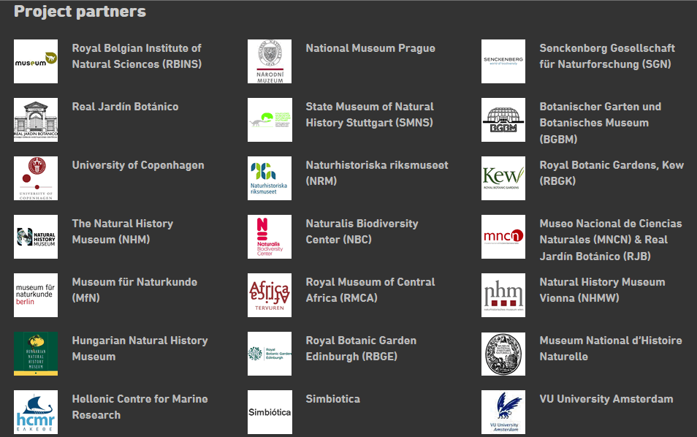
Thanks to all partners & EC

Slide 3
Conference Programme
Tuesday
09:30 – 10:00 Registration
10:00 – 10:10 Welcome ~ VS
10:10 – 10:30 SYNTH. overview ~ VP
10:30 – 11:00 Access (NA1) ~ KG
11:00 – 11:30 BREAK
11:30 - 12:30 Access highlights ~ LL
12:30 - 13:00 Keynote ~ Peter Raven
13:00 – 14:00 LUNCH
14:00 – 15:10 Impt & Sustain. (NA3) ~ JK
15:10 – 15:40 BREAK
15:40 – 17:30 Research (JRA) ~ EH
17:30 – 19:00 Wine Reception
Wednesday
09:00 – 09:30 TEA / COFFEE
09:30 – 11:00 Coll. man. (NA2) ~ TvR
11:00 – 11:30 BREAK
11:30 - 12:00 DiSSCo ~ DK
12:00 - 12:30 SYNT3 consultation ~ LL
12:30 – 13:30 LUNCH
13:30 – 15:00 Parallel Groups
Transnational Access
Networking (Collections)
Networking (Molecular)
Joint Research Activities
15:00 – 15:30 BREAK
15:30 – 16:10 Group feedback ~ VS
16:10 – 16:20 Final discussion / close

Slide 4
Planning SYNTHESYS+
Considerations
Results from prior discussions (JRA and NA3) & questionnaire
Recommendations from the EC & midterm review
Digital access
Increasing industry participation
Internationalisation
ESFRI
Alignment with DISSCo objectives
Possible wider institutional engagement (outside of our Science Depts.)
Tough competition & (probably) our last chance
Process
Breakout groups (possible tasks, partners)
Slide template for potential tasks
Homework
Flipchart boards & post-it notes
Parallel group signup

Slide 5
Logistics
Speakers
Slides (please upload during breaks)
3-5 minutes for questions (5- and 3-minute warnings)
Twitter (@SynthesysEU)
Practicalities
Exits & alarms
Toilets
Food and Drink within the Flett
Wi-Fi
Public NHM Network (NHM-Free-wifi)
Eduroam available
1 minute silence at 11am

Slide 7
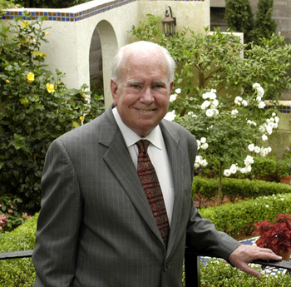
World leading botanist Peter Raven
Led Missouri Bot. Garden for 40 yrs.
Now President Emeritus
"Hero for the Planet” Time magazine
Leading advocate for conservation and a sustainable environment
Recipient of numerous prizes and awards, including U.S. National Medal of Science
Served for 12 years as home secretary of the National Academy of Sciences
Author of numerous books and reports, both popular and scientific
Co-author of "Butterflies and Plants: A Study in Coevolution" (1964)
Champion of conservation and global biodiversity
Peter Raven

Slide 8
SYNTHESYS3 Final Meeting
SYNTHESYS3 Final Meeting
NHM, London, 6-7 June 2017

Slide 9
Parallel Discussions
Key facts from draft call
INFRAIA-01-2018-2019: Integrating Activities for Advanced Communities
22 March 2018 Submission
Up to EUR 10 million (110.00 available across 22 themes)
Can influence draft call text up to 13th June
“Emphasis should be on improving accessibility to collections to a wide range of scientists, on developing innovative research services to answer the needs of a broader scientific community of users from climate change to human health and food security, and on ensuring long term sustainability of the integrated services”

Slide 10
Parallel Discussions
Considerations
Results from prior discussions (JRA and NA3) & questionnaire
Recommendations from the EC & midterm review
Digital access
Increasing industry participation
Internationalisation
ESFRI
Alignment with DISSCo objectives
Possible wider institutional engagement (outside of our Science Depts.)
Tough competition & (probably) our last chance
Process
Overview from discussion leads
Review past contributions
Identify possible topics and partners
Complete slides template (http://tiny.cc/SYNTH-Tasks)
Minutes / notes and preparation to report back
These are “possible” tasks only

Slide 11
SYNTHESYS+ Potential Tasks (Template)
Category:
Title | A short title for the proposed task
Vision | A brief description of what the task would achieve
The key challenge(s) | Elements of the main problem(s) being addressed
KPI’s | Possible measures of success e.g. #digital records, #workflows, #download events, #citations, #high-impact papers
Possible Partners | A list of possible partner institutions (with the technical capacity to engage in the task)
http://tiny.cc/SYNTH-Tasks

Slide 12
Task
Template
http://tiny.cc/SYNTH-Tasks
These are “possible” tasks only

Slide 14
Parallel Discussions
Logistics
Powerpoints & PDF’s (upload ASAP)
3-5 minutes for questions (5- and 3-minute warnings)
Event recording
Twitter (@SynthesysEU)
Reporting Back
PPT Templates
Entrance & exit
Toilets
Wifi
Public NHM Network (NHM-Free-wifi)
Eduroam available
1 Minute’s silence at 11am

