Slide 1
This talk certified
#grass-fed
#pasture-raised
&
100% #covfefe free

Slide 2
Opportunities for Collaboration: a community development view from iDigBio and the ADBC
Deborah L. Paul, 5-6 June 2017, @idbdeb
Synthesys3 Wrap-up, Synthesys+ Imagineering
Natural History Museum, London
https://www.idigbio.org

Slide 3

Consider iDigBio’s goals in the next 5 plus years.
Where is the overlap with Synthesys?

Slide 4
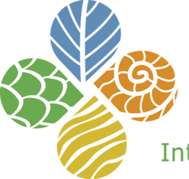
iDigBio – the home uniting biocollections (HUB)
Enable digitization of biodiversity collections data
  Develop efficient & effective standards & workflows
  Workforce education & training
Provide portal access to biodiversity data
in a cloud computing environment
  Respond to cyberinfrastructure needs
  Enable access & discoverability
Facilitate use of biodiversity data to
address key environmental and
economic challenges
  Researchers, educators, general public,
  policy-makers, education & training, …
Plan for long-term sustainability of the
national digitization network & effort
  Expand participation: partners, data sources, industry, agriculture, public,…
  Proliferate and broaden uses of biodiversity data
Cyber-
infrastructure
Digitization &
Capacity Building
Serving the Research Community
Administration
Education & Outreach

Slide 5
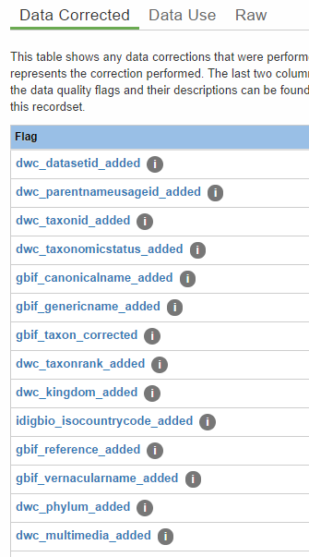
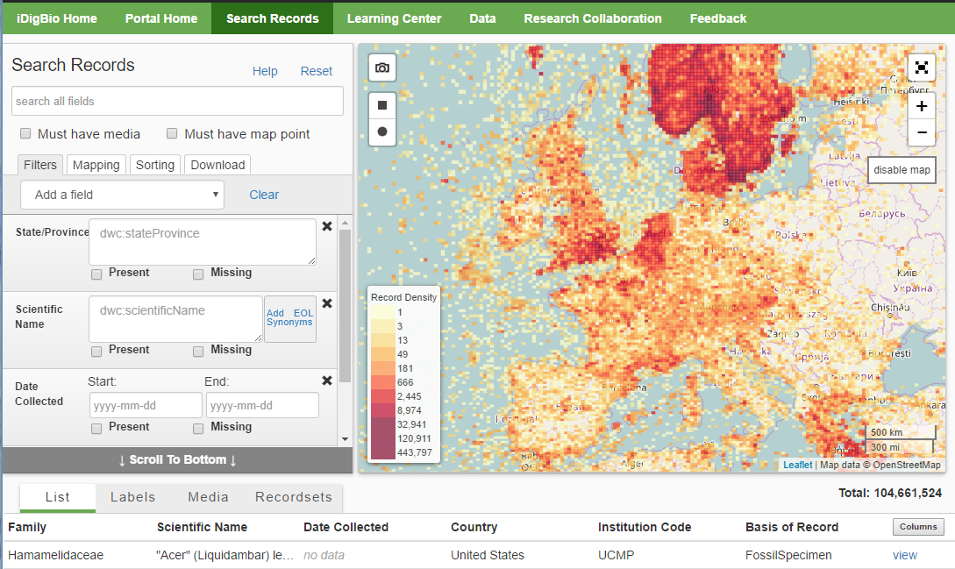
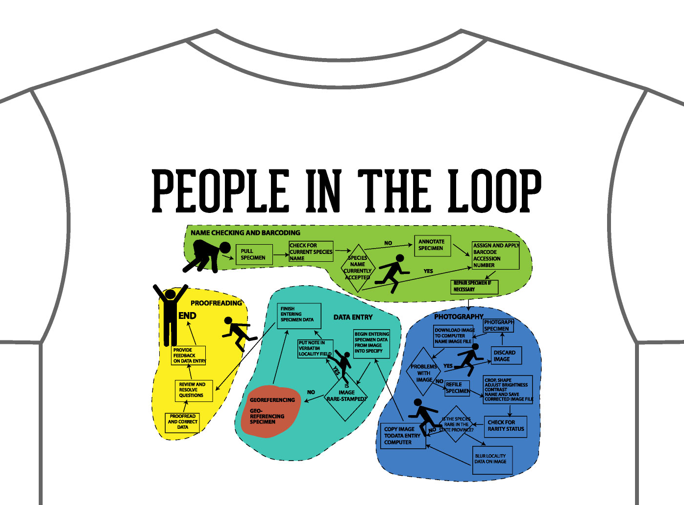
Digitization
Workflows
Protocols
Task Clusters
Dissemination
Research Use
Tool collaboration
Portal development
ENM workshop
Research Spotlight
Training
Biodiversity data skills Data literacy
Collections software
Imaging
Project Management
Education Outreach
Citizen Science
K-12 materials
Undergraduate
Fossil Clubs
Mentor teachers
104,661,524
Methods
Workshops
Webinars
Symposia
Conferences
Working Groups
Short Courses
Adobe Connect
Listservs
Publications
Social Media

Slide 6

Developing a Collections Digitization and Data Use Community

Slide 7
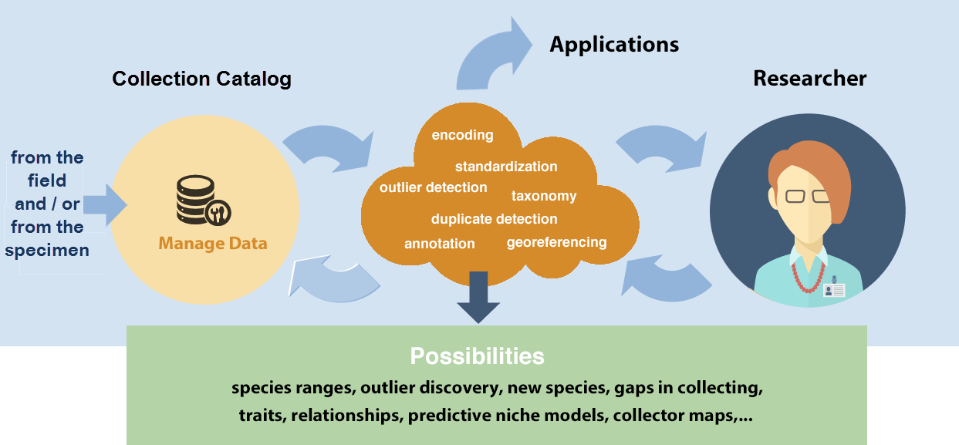
The Research Data Pipeline
Data > Knowledge > Application

Slide 8
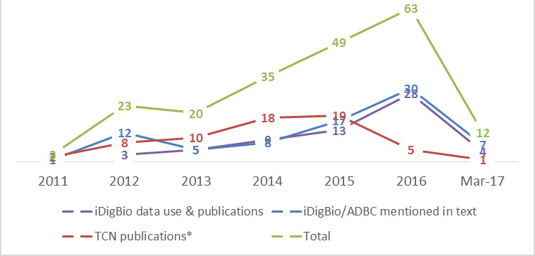
How might natural history collections and aggregators increase research use and novel data use?
ADBC Publications

Slide 9
Key Issues ~ from iDigBio’s point of view
Scale
Collections data now big data
New approaches to enabling use desired
Need more collections data used in
  research, education, policy, industry
Need new stakeholders and new uses
Data have gaps and need to be linked
  But maybe this is a selling point?
Must find a way to speed up publishing
Need worldwide participation
Required to remain relevant & funded
Scope
Speed

Slide 10
Looking for potential collaboration and joint-funding opportunities

Slide 11
The Importance of Sustaining Workforce Development
Key iDigBio accomplishment
  Professional development along the research-data-pipeline
  NSF Participant Funding enabled
How to continue this as participant funding drops?
How important is it? Consider this, …
When building National Biological eCollections - Should research workforce skills be considered a research infrastructure issue?
Arguably the highest resource requirement of research infrastructure development is human capacity and capability.
“2016 National Research Infrastructure Roadmap Capability Issues Paper.” CSIRO. Toni Moate, Director, National Collections and Marine Infrastructure. On building National Biological eCollections

Slide 12
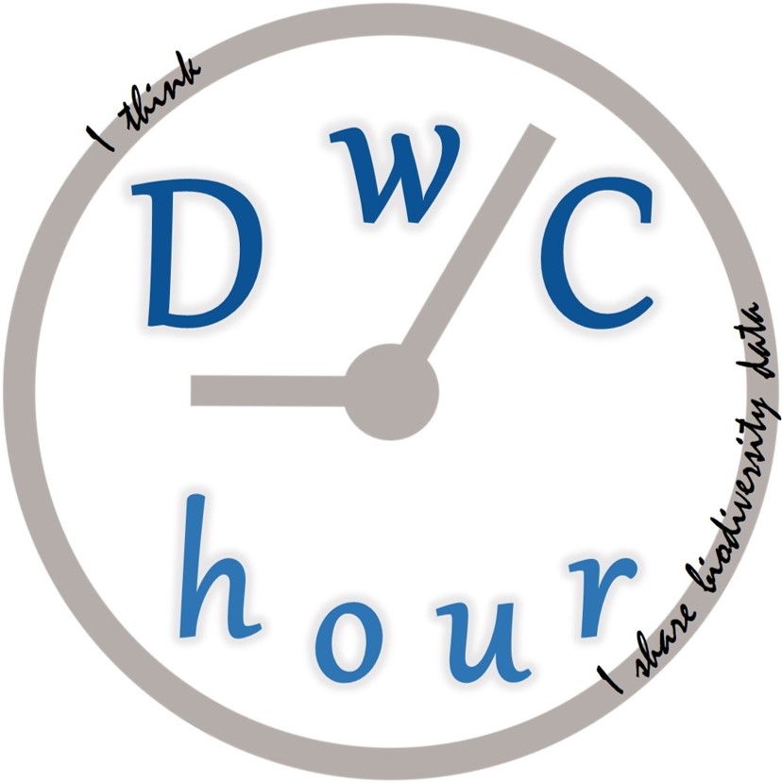



Aggregators & Developers
Researchers
Darwin Core Hour
Strategic capacity building
Community driven
Purpose-built
Supports
  research
  data mobilization
  data quality efforts
  standards development
  software development
Stakeholders’ Input

Slide 13
Why do we need something like DwC Hour?
DwC needs better examples, perhaps clearer definitions, in the documentation
Collection and Data Managers – need help to map to DwC terms and extensions. They need examples (and tools).
need standard data to improve discoverability, data quality, confidence, and (re)-usability
can improve data with data, with scripts and machine learning, but only to a point
drives standards evolution – how to facilitate and integrate this?
Researchers
Aggregators & Developers
Stakeholders’ Input

Slide 14
What are we trying to accomplish with this series?
Provide a periodic live open cross-community forum to discuss
topics of interest related the Darwin Core Standard
Identify and visualize problems
Find and share solutions
Improve documentation
Improve published data
Connect
data
providers & users
standards &
tools developers
Darwin Core Standard http://rs.tdwg.org/dwc
Webinar survey: https://tinyurl.com/jq8qzsq/
Questions? https://tinyurl.com/zja2muz

Slide 15
Some Project Opportunities

Slide 16
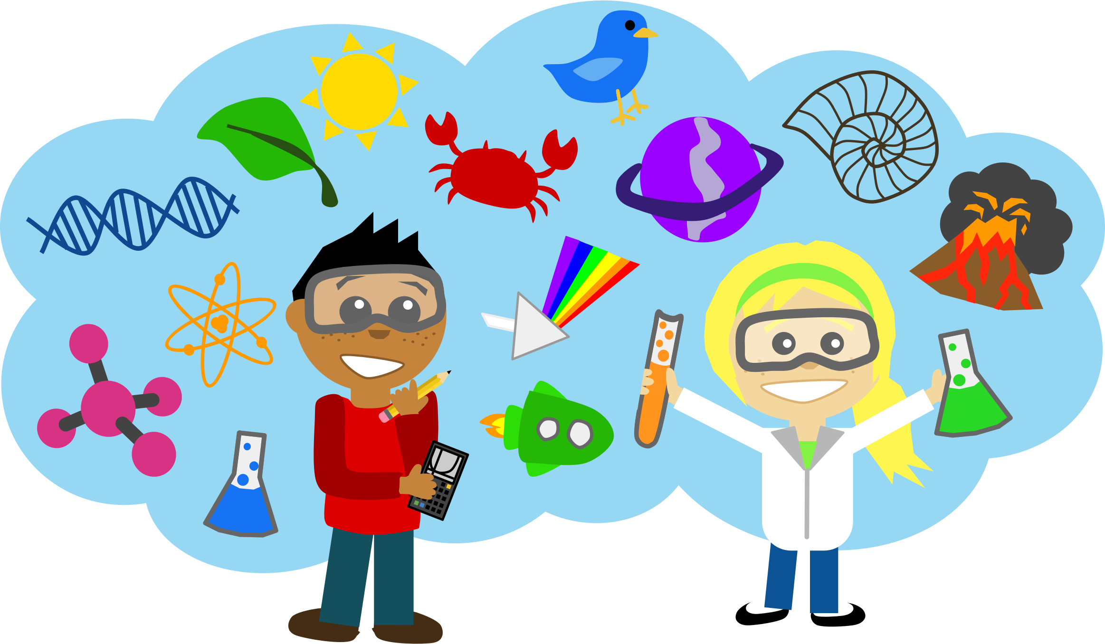
Integrating Collections and
Ecological Research (ICER)
Advertise our data to ecologists
Invite ecologists to our events
  Plenary, Brown bags, …
Document ecology research
  Using collections data
  That could use collections data
What data might collectors gather that would add value for the ecologist?
Will more ecologists voucher specimens in the future?
Agriculture?

Slide 17
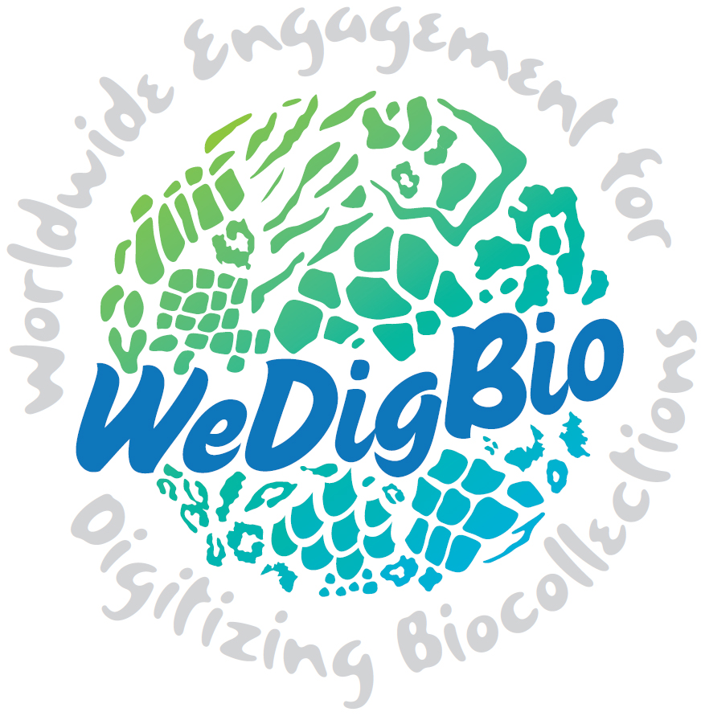

Worldwide Engagement for Digitizing Biocollections A 4-day event that engages participants online and onsite in digitizing natural history collections
Join us 19-22 October for WeDigBio 2017! Sign up at wedigbio.org !
GOALS
Increase the rate of digitization of biodiversity collections
Raise the profile of collections and their significance in science, society, and education
Build our global biodiversity community
WeDigBio.org
Contact:
Libby Ellwood: ellwoodlibby@gmail.com
Austin Mast: amast@bio.fsu.edu
Deb Paul: dpaul@fsu.edu
Remember

Slide 18
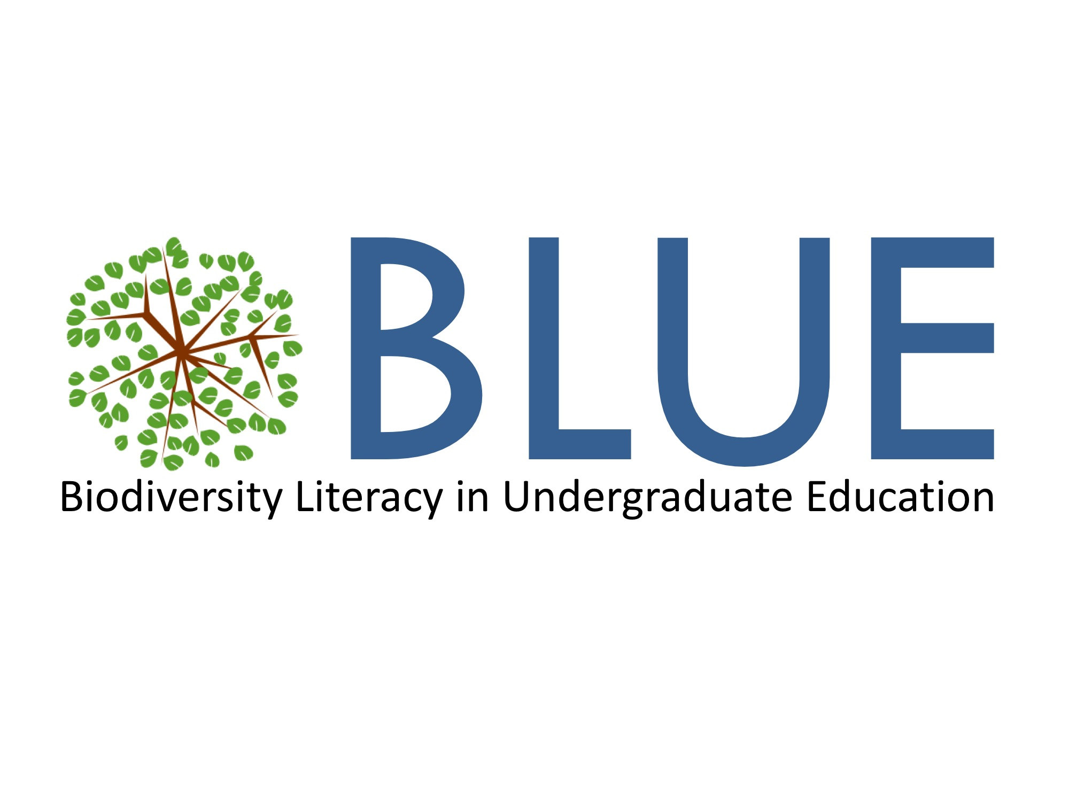
Biodiversity Literacy in Undergraduate Education
An inclusive network focused on developing resources that integrate biodiversity data with educational materials.
GOALS
Cultivate a diverse and global network of biodiversity researchers and biology educators focused on undergraduate data-centric biodiversity education.
Develop strategies and exemplar materials to guide the integration of biodiversity data into introductory undergraduate biology curricula.
Extend the network to engage a broader community of undergraduate educators in biodiversity literacy efforts.
BiodiversityLiteracy.com
Contact:
Anna Monfils: monfi1ak@cmich.edu
Molly Phillips: mphillips@flmnh.ufl.edu
Libby Ellwood: ellwoodlibby@gmail.com
Deb Linton: linto1dl@cmich.edu

Slide 19

Enhancing Paleontological and Neontological Data Discovery
an API to link
  The Paleobiology Database
    (PBDB, paleontological, literature based)
  iDigPaleo
    (paleontological, specimen-based)
  iDigBio
    (neontological, specimen-based)
collaborators: The American Museum of Natural History, Florida State University, George Mason University, STEPPE – Geological Society of America, University of Wisconsin – Madison, and the Yale Peabody Museum
ePANDDA
linking specimen data with the underlying scientific literature

Slide 20
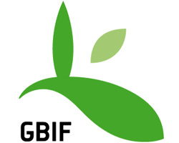


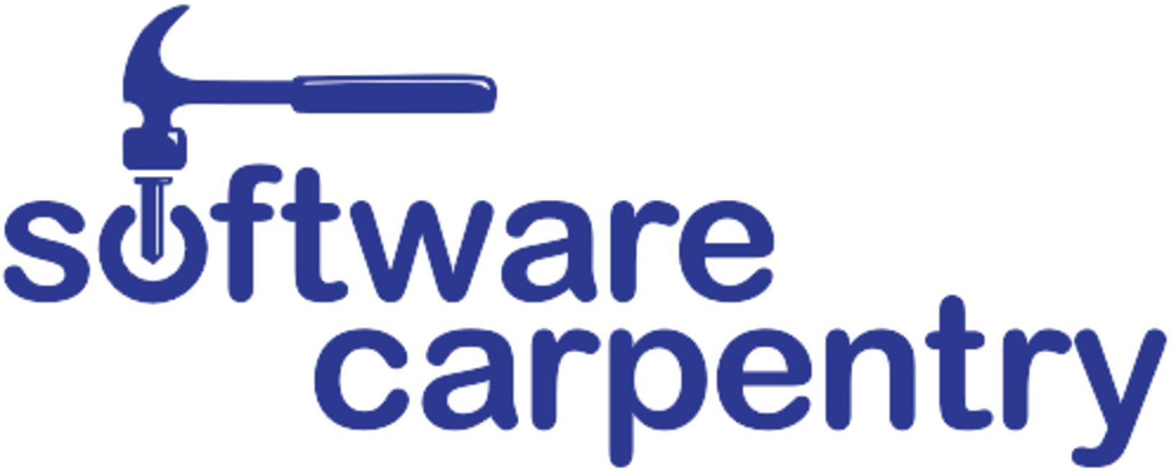
More possible collaboration opportunities
GBIF
DiSSCo
The Carpentries
  Reproducible Research Curriculum?
  Lesson development – natural history collections data lessons
  Joint training, co-funded?
SPNHC-TDWG 2018
  Joint efforts
    Symposium, Workshop, Ecology, Agriculture, Industry, Technology
  What’s unique in our SYNTHESYS-iDigBio partnership?
  How can we enable expertise-sharing?
Data Quality (TDWG-DQIG)
Research
  GenBank
  Soils and Geochemistry Data Layers and Linking (unique to countries, often not yet public)
  Extracting Trait-Data from images
  Training – facilitating research-use of the data

Slide 21
NSF DEB and UK NERC opportunities
NSF looking for more effective ways to support GBIF
UK researchers co-funding option with Natural Environment Research Council (NERC) U.K. with the Division of Environmental Biology (DEB).
  Ecosystem Studies
  Evolutionary Genetics
  Population and Community Ecology
  Biodiversity: Discovery and Analysis
  Phylogenetic Systematics

Slide 22
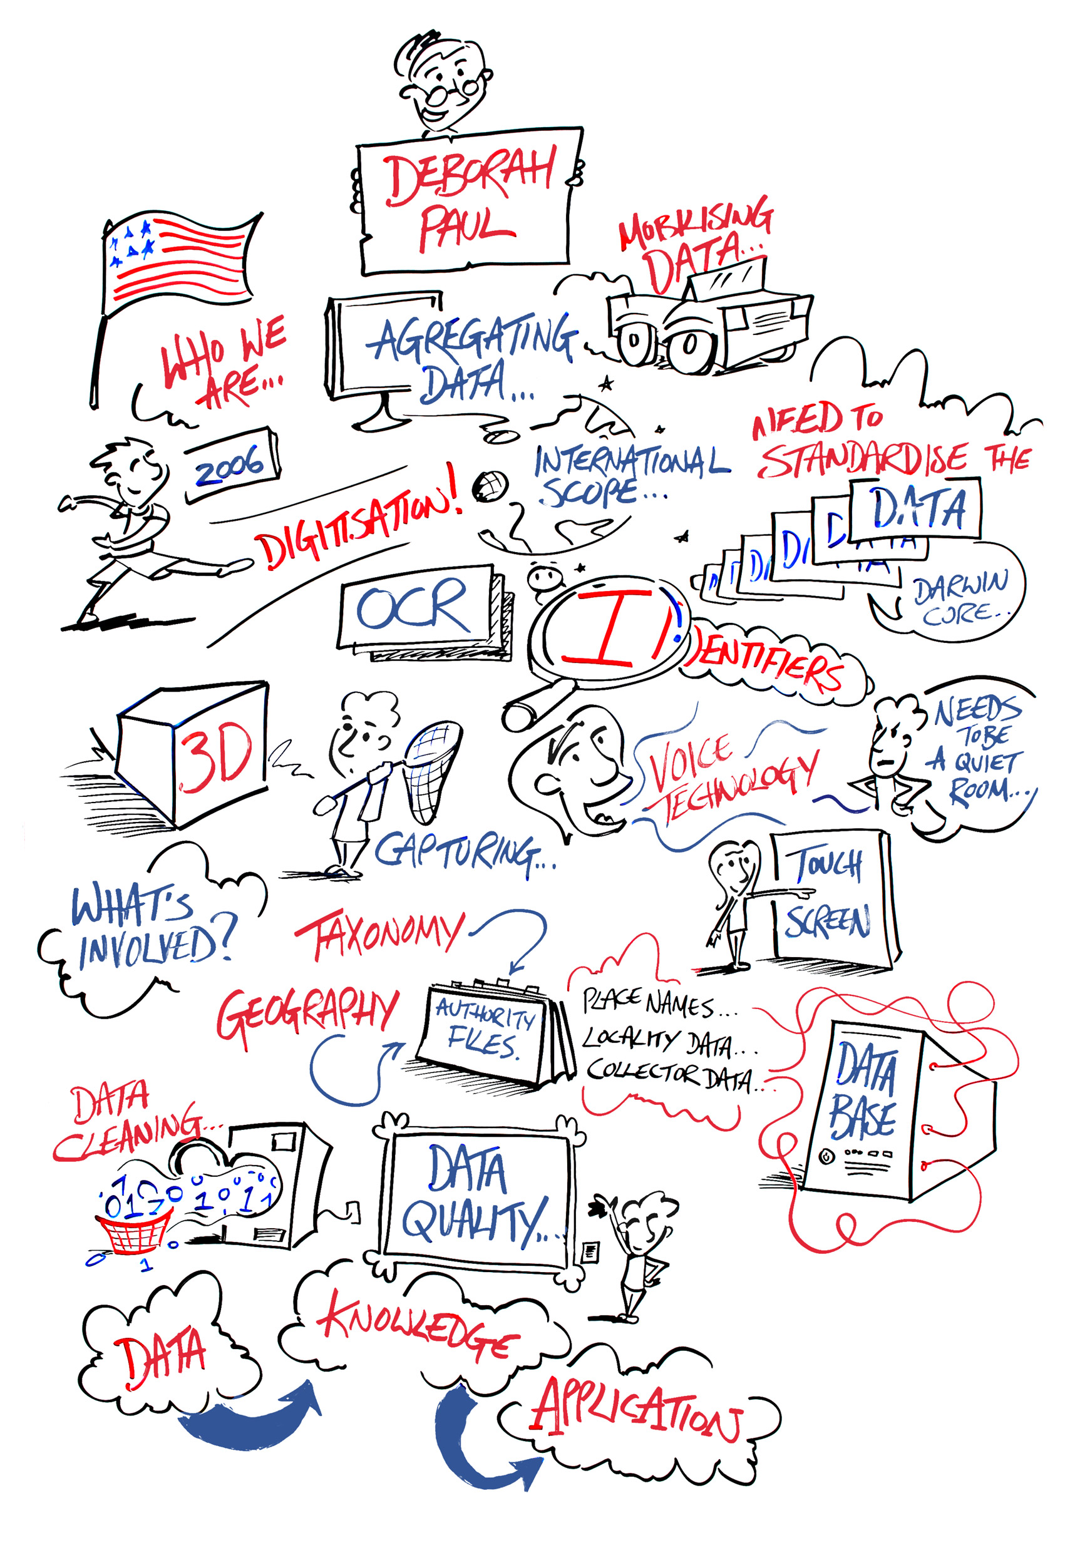
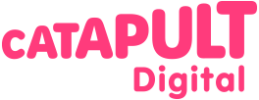


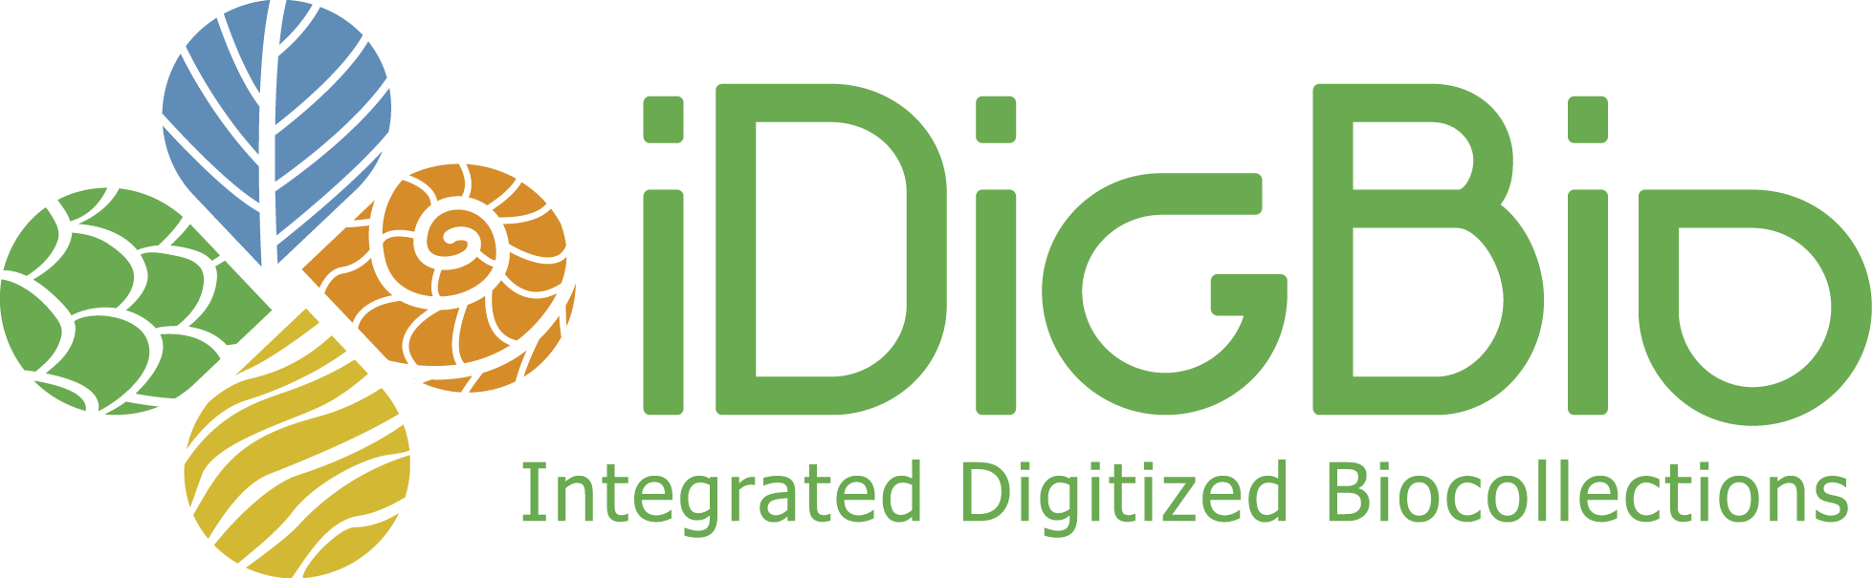
Wider Collaboration
Need to look outwards
  industry and start-ups
  Cisco Pit Stop
Some thoughts on SMEs
  the green bottom line – environmental and social impacts
  “selling” our data – compelling use-cases
  industry roles
A Pitstop-like event in the US?
  Focus on research and novel uses of the data
  Increase stakeholders
DiSSCo
https://www.entrepreneur.com/article/274618

Slide 23
Summary
Innovate – a better mouse-trap
Let’ figure out more ways to share our challenges with industry and new stakeholders
  (growing EC funding requirement!)
Experiment in non-traditional-academic collaboration (e.g. workshops, hackathons)
Innovation by necessity
  Evaluate entire infrastructure for opportunities
Ensure we remain relevant & funded

Slide 24

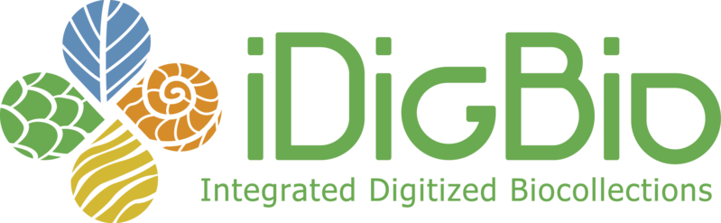
Acknowledgements and many thanks!
SYNTHESYS SAB
  Some of this work carried out with funding from SYNTHESYS3 under EU 7th Framework Programme for Research (FP7). Project reference: 312253
iDigBio funding statement
  iDigBio is funded by a grant from the National Science Foundation's Advancing Digitization of Biodiversity Collections Program (Cooperative Agreement EF-1115210). Any opinions, findings, and conclusions or recommendations expressed in this material are those of the author(s) and do not necessarily reflect the views of the National Science Foundation.
Here’s to SYNTHESYS+

